Slide 1
CIB QUANT RESEARCH · EXAMPLE DECK
Forex Drift
JPY
Carry, intervention and the trade balance: what Japan and India teach us about trading currencies
INR
USD
Capital Investments at Berkeley · September 2026
Draft template for the team's pitch: swap in your own words, keep the flow
Notes:
Open with the question from GM #2: the yen and rupee both hit record lows in 2026 despite central banks fighting back. This deck is an EXAMPLE of how to present the forex-drift research; replace text as needed.

Slide 2
THE QUESTION
Rates should tell us where currencies drift. Do they?
1
Japan
Yen at a 40-year low despite BoJ hikes and a rare joint US-Japan intervention (Jul 2026).
The theory (uncovered interest parity)
A currency with higher interest rates should lose value by about the rate gap, so no one earns a free lunch.
Governments often fight that drift. Our idea: find where the fight creates a tradable pattern.
2
India
Rupee at record lows despite RBI dollar sales and a $52bn FCNR(B) deposit scheme.
3
17 currencies
Test whether the pattern generalises, then turn it into a strategy with rules.
Builds on GM #2 (22 Sep 2026)
Japan case study (slide 10) · India FCNR case study (slide 11)
EXAMPLE DECK · numbers from forex-drift-idea/research.ipynb (data through 25 Sep 2026)
2
Notes:
Frame the pitch: theory says rates predict FX drift; policymakers push back; we look for a repeatable trade. Japan and India are the case studies from GM #2; the 17-currency panel is the real test.

Slide 3
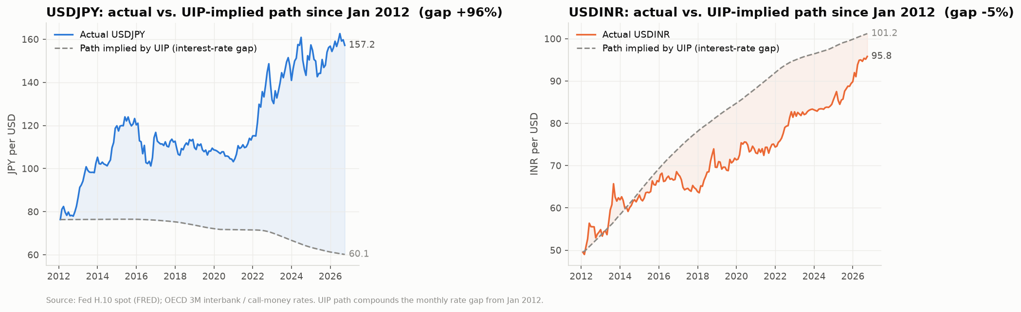
THE HOOK
Rates said one thing. Currencies did another.
+96%
−5%
β = 0.25
Yen weaker than its rate-implied path since 2012
Rupee vs its rate-implied path: roughly on track
How much FX follows rate gaps across 17 currencies (theory says 1.0)
Source: FRED (Fed H.10 spot), OECD short rates; research.ipynb §2, §5.2
EXAMPLE DECK · numbers from forex-drift-idea/research.ipynb (data through 25 Sep 2026)
3
Notes:
Dashed line = where the currency 'should' be if it drifted by the rate gap. The yen went the opposite way, which is the profit of the yen carry trade. The rupee fell about as much as rates implied. Pooled across 17 currencies the slope is 0.25, not 1: rate gaps are a poor guide to FX drift.

Slide 4
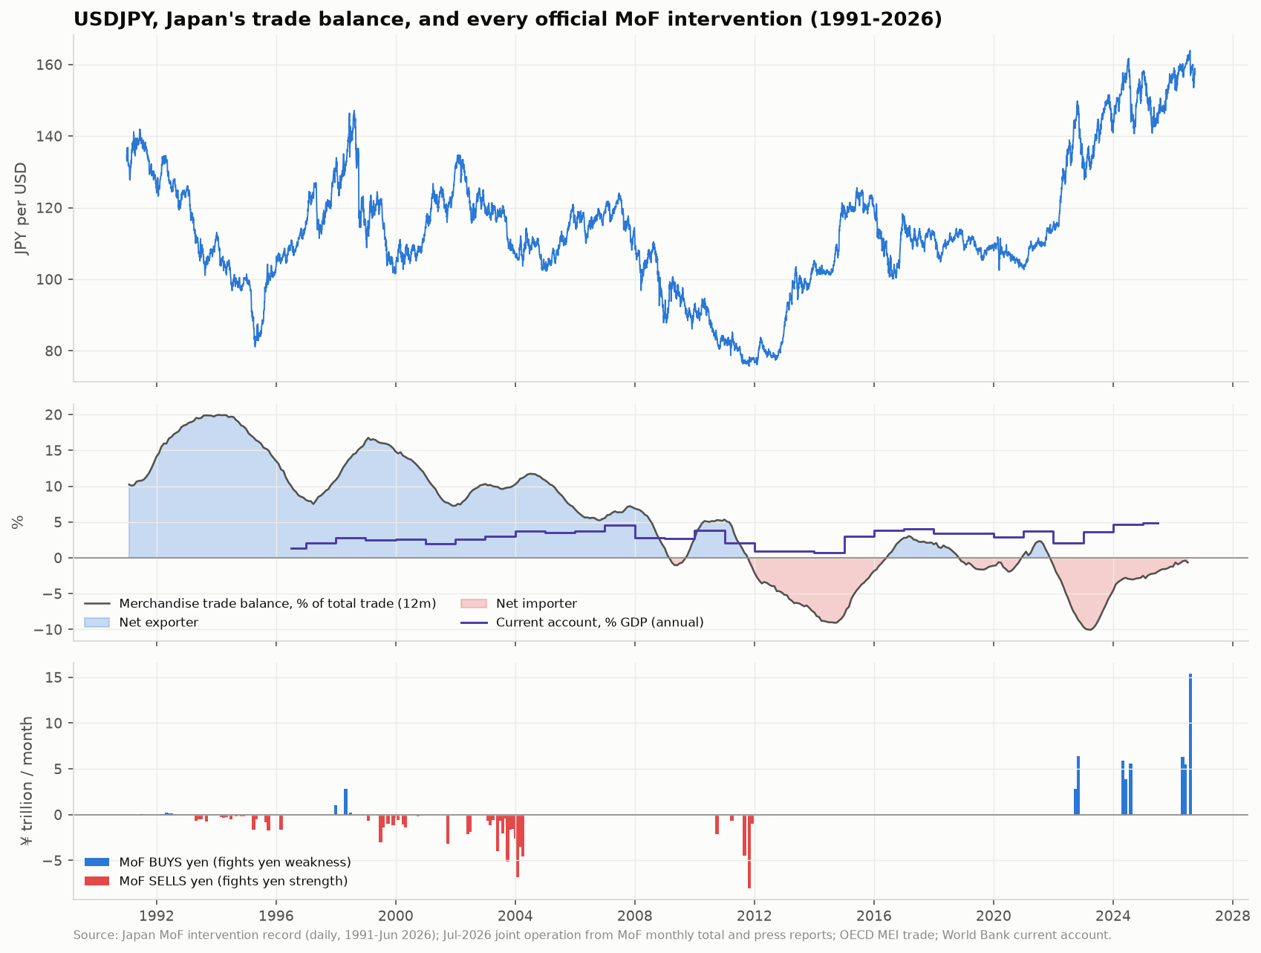
JAPAN
The trade balance decides which way Tokyo fights
1
Net exporter · 1993–2011
MoF SOLD yen in every intervention to protect exporters (¥35tn in 2003–04 alone).
2
Net importer · 2022–26
MoF BOUGHT yen every time: ¥9tn (2022), ¥15tn (2024), ~¥27tn (2026, incl. the joint US operation).
3
The nuance
The current account stayed positive throughout. It's goods trade, where a weak yen raises energy and food bills, that lines up.
Source: Japan Ministry of Finance intervention records 1991–2026; OECD trade; World Bank; research.ipynb §3.2
EXAMPLE DECK · numbers from forex-drift-idea/research.ipynb (data through 25 Sep 2026)
4
Notes:
This is the strongest support for the original intuition: the trade position tells you WHICH direction policymakers lean. Caveat: one country, and the yen's level (weak vs strong) also matters.

Slide 5
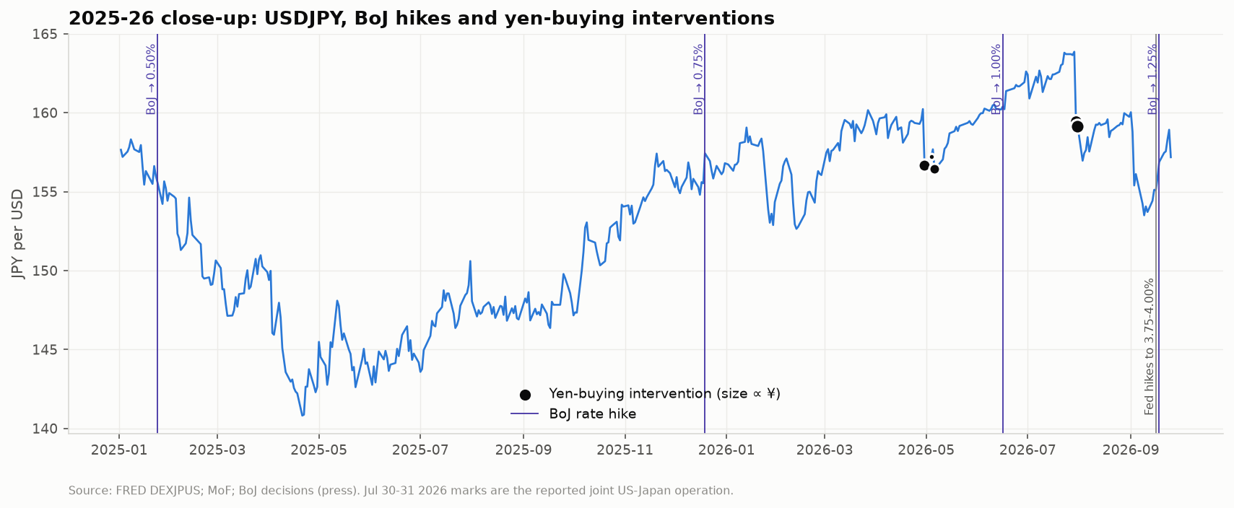
JAPAN
Intervention buys weeks, not trends
68%
of 28 intervention episodes still 'working' 60 trading days later
4 of 6
BoJ rate hikes since 2024 WEAKENED the yen on the day
~164
What to say
Each operation knocks USDJPY down 2–3% within days. But the April 2026 round (¥11.7tn at ~160) was fully reversed, and the yen went on to ~164 before the July joint operation.
Where the 2026 line in the sand ended up (145 in 2022, ~160 in 2024)
Source: Japan MoF; BoJ decisions; FRED DEXJPUS; research.ipynb §3.3–3.4
EXAMPLE DECK · numbers from forex-drift-idea/research.ipynb (data through 25 Sep 2026)
5
Notes:
Interventions work short-term but don't fix the trend while the US-Japan rate gap stays wide. BoJ hikes are telegraphed and small relative to the gap, so the yen often weakens on the day ('sell the fact').

Slide 6
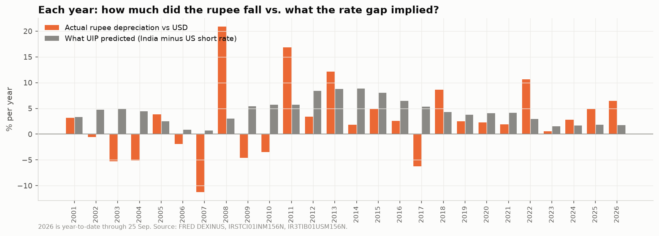
INDIA
Rupee carry: up the stairs, down the elevator
2.6%/yr
17 of 25
5 crashes
Average rupee fall 2001–25, vs 4.5%/yr implied by rates
Years the rupee fell LESS than rates implied: the 'stairs'
2008, 2011, 2013, 2018, 2022: +9–21% jumps (the 'elevator')
Source: FRED DEXINUS, IRSTCI01INM156N; research.ipynb §4.1
EXAMPLE DECK · numbers from forex-drift-idea/research.ipynb (data through 25 Sep 2026)
6
Notes:
RBI smoothing makes rupee carry look safe (6.7% vol, 2nd lowest of 17), then the jumps arrive. Since 2013 long-rupee carry has earned ~0.6%/yr.

Slide 7
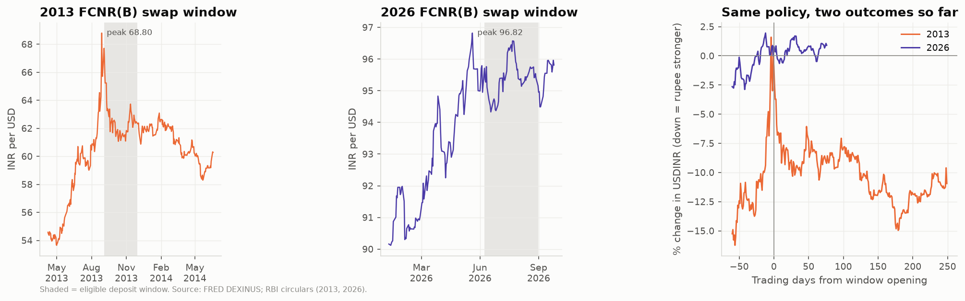
INDIA
Same rescue tool, two different outcomes
2013
$34bn raised
Rupee +8% stronger during the window, +12% a year later
Tailwind: the Fed surprised by NOT tapering (18 Sep 2013)
2026
$52bn raised, window closed early (31 Aug)
Rupee flat: 95.0 → 95.8
Headwind: the Fed HIKED (16 Sep 2026), oil ~$100
Source: FRED DEXINUS; RBI circulars; Business Standard; research.ipynb §4.4
EXAMPLE DECK · numbers from forex-drift-idea/research.ipynb (data through 25 Sep 2026)
7
Notes:
Domestic defence buys time; global rates decide the trend. That's the same lesson as Japan.

Slide 8
THE TWIST
Net-importer carry is the WORST carry
Our starting thesis
High-rate net importers get defended by their central banks, so buy them.
What the data says
They earn 0.6%/yr vs 3.0% for high-rate exporters, and crash harder (skew −1.4 vs −0.4). Holds in 13 of 14 robustness checks.
Defence delays the fall, then concentrates it into a crash.
Source: 17-currency panel, monthly 2000–2026; research.ipynb §5.4
EXAMPLE DECK · numbers from forex-drift-idea/research.ipynb (data through 25 Sep 2026)
8
Notes:
Present this honestly: the original idea was reversed by the data. That's a strength of the pitch; it shows we tested it. Deficit currencies track the theory more closely (β 0.41 vs −0.20), so their high rates are real compensation for risk.

Slide 9
THE NEW SIGNAL
The trade balance is a signal of its own, and it hedges carry
−0.32
Correlation between the carry and trade-balance portfolios: they diversify
8 of 10
Of carry's worst months (2008, 2020...), the trade-balance portfolio made money
Both halves
Works in 2000–12 AND 2013–26; momentum, value and positioning don't
Source: research.ipynb §5.6–5.7
EXAMPLE DECK · numbers from forex-drift-idea/research.ipynb (data through 25 Sep 2026)
9
Notes:
Goods trade matters, not the total current account (which is negative here). The 'vs own 5-year average' version rules out a static country bet: an IMPROVING trade balance predicts outperformance.

Slide 10
THE PROPOSAL
Three trades, one idea: carry where trade supports it
01
CORE
02
SATELLITE
03
WATCH
Carry + trade-balance basket
Short yen, paused after intervention
Long rupee only while the RBI accumulates
Each month rank 17 currencies. Half: long high-rate / short low-rate. Half: long net exporters / short net importers.
Short JPY while the US–Japan rate gap is above 2pp. Stand aside for 3 months after the MoF buys yen.
Long INR only if RBI reserves rose over the last 3 months. A stress gauge more than a trade.
Sharpe 0.73 (carry alone 0.44)
Sharpe 0.49 (always short 0.35)
Sharpe 0.30 (always long 0.16)
Primary recommendation
Secondary · risk-managed
Monitor, not a trade
Source: research.ipynb ⭐ Final proposal
EXAMPLE DECK · numbers from forex-drift-idea/research.ipynb (data through 25 Sep 2026)
10
Notes:
The reframed thesis: harvest the interest-rate gap only where the trade balance supports the currency; fund it with currencies whose trade balance is deteriorating. A central bank spending reserves is a warning, not a floor.

Slide 11
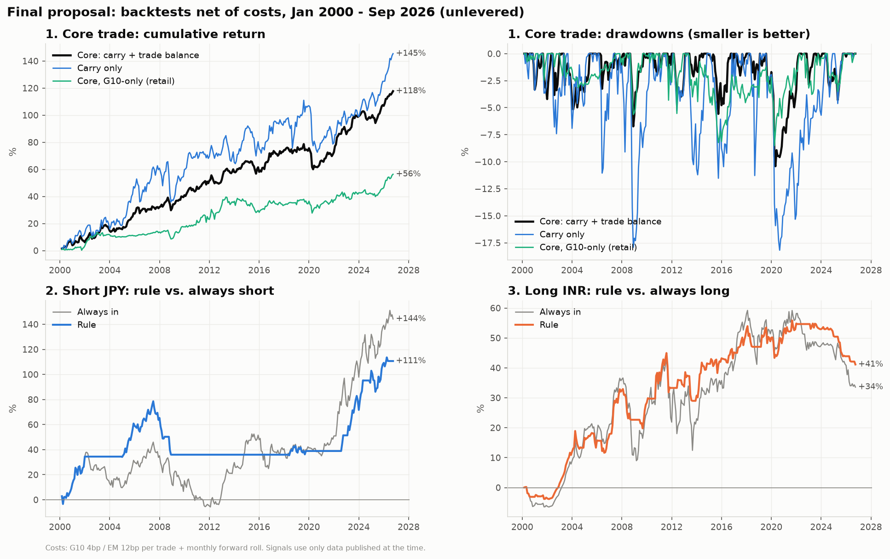
BACKTEST
27 years, net of costs, no hindsight in the signals
0.73
Core Sharpe ratio vs 0.44 for plain carry
−10%
Core worst drawdown vs −18% for plain carry
0.79 → 0.68
Sharpe in 2000–12 vs 2013–26: stable across both halves
Source: Monthly Jan 2000–Sep 2026; costs 4bp G10 / 12bp EM + forward roll; research.ipynb ⭐ Final proposal
EXAMPLE DECK · numbers from forex-drift-idea/research.ipynb (data through 25 Sep 2026)
11
Notes:
How it was tested: monthly, only data published at the time (trade lagged 2 months, reserves 1), return = interest + FX move, realistic costs. Sharpe stays 0.61–0.79 across 12 recipe variations.

Slide 12
RESULTS
The rules win on risk, not on raw return
Trade | Return %/yr | Volatility % | Sharpe | Worst drawdown | Sharpe 2000–12 | Sharpe 2013–26
1. Core: carry + trade basket | 2.9 | 4.0 | 0.73 | −10% | 0.79 | 0.68
benchmark: carry only | 3.4 | 7.7 | 0.44 | −18% | 0.53 | 0.34
1b. Core, G10-only (retail) | 1.7 | 3.6 | 0.47 | −9% | 0.63 | 0.31
2. Short yen, intervention pause | 2.8 | 5.8 | 0.49 | −24% | 0.37 | 0.64
benchmark: always short yen | 3.4 | 9.5 | 0.35 | −35% | 0.05 | 0.66
3. Long rupee while reserves rise | 1.3 | 4.4 | 0.30 | −11% | 0.46 | 0.10
benchmark: always long rupee | 1.1 | 6.6 | 0.16 | −21% | 0.26 | 0.06
Say this out loud: unlevered, plain carry earns more (3.4% vs 2.9%/yr). At the SAME risk the core would earn ~5.6%/yr vs 3.4%, with a similar worst drawdown (−19% vs −18%).
Source: Net of costs, monthly Jan 2000–Sep 2026; research.ipynb ⭐ Final proposal
EXAMPLE DECK · numbers from forex-drift-idea/research.ipynb (data through 25 Sep 2026)
12
Notes:
Be precise here; this is where judges will probe. The two-halves split shows stability, not a true out-of-sample test, because the strategy was chosen after seeing the full sample.

Slide 13
WHERE WE STAND
What the model says today (end of September 2026)
02
Short yen: PAUSED
Rate gap 2.8pp (above 2 ✓), but the MoF bought yen in July. Re-enter in November if the gap holds.
03
Rupee watch: weak ON
Reserves +2.2% over 3 months, but mostly borrowed FCNR dollars. Fundamentals still weak.
!
Long book is commodity-heavy
BRL, ZAR, NOK, IDR: a commodity crash is the scenario to stress-test.
Source: research.ipynb §7 and ⭐ Final proposal (signals as of Sep 2026)
EXAMPLE DECK · numbers from forex-drift-idea/research.ipynb (data through 25 Sep 2026)
13
Notes:
Update this slide right before presenting: re-run the notebook to refresh positions.

Slide 14
RISKS
What would make us change our mind
1
Core drawdown beyond −15%
1.5× the historical worst, or a negative 3-year Sharpe: pause and re-examine.
2
Global commodity crash
The long book leans on commodity exporters (BRL, ZAR, NOK, IDR).
3
US–Japan gap below 2pp
Fed cuts or faster BoJ hikes switch the yen trade off automatically.
4
Not truly out-of-sample
Chosen after seeing the data. Real test: paper-trade from Oct 2026 and add ~13 more currencies.
Source: research.ipynb §8.4 and ⭐ kill criteria
EXAMPLE DECK · numbers from forex-drift-idea/research.ipynb (data through 25 Sep 2026)
14
Notes:
Other caveats worth one sentence: carry is measured with interest rates rather than forward prices; the intervention evidence rests on a few dozen episodes; July 2026 intervention sizes are still estimates.

Slide 15
TAKEAWAYS
1
Rates don't predict where currencies drift, and governments' fights rarely change the trend.
2
Defended net-importer currencies are the worst place to earn carry.
3
Carry + trade balance: Sharpe 0.73 vs 0.44, half the drawdown, stable across 27 years.
Questions?
Full research, data and code: github.com/ethanl814/CIB → forex-drift-idea/
EXAMPLE DECK · numbers from forex-drift-idea/research.ipynb (data through 25 Sep 2026)
Notes:
Close on the reframed thesis and invite questions. Point people to the repo for the notebook.

