Slide 1
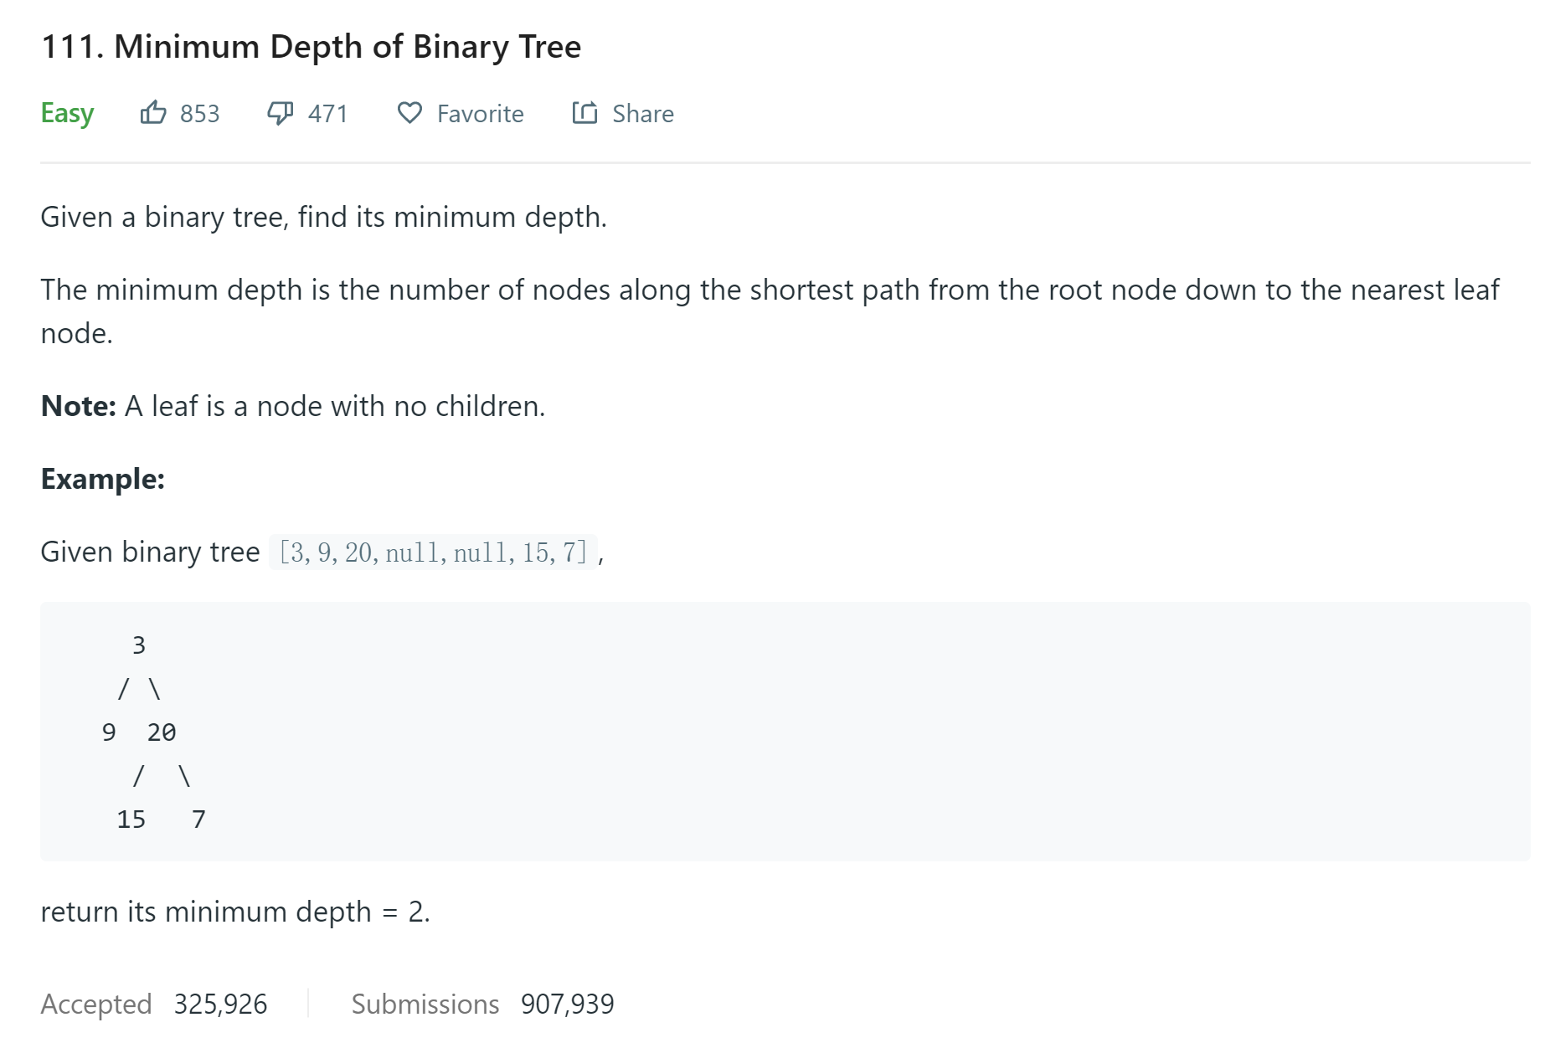
1. Minimum Depth of Binary Tree
https://leetcode.com/problems/minimum-depth-of-binary-tree/

Slide 2
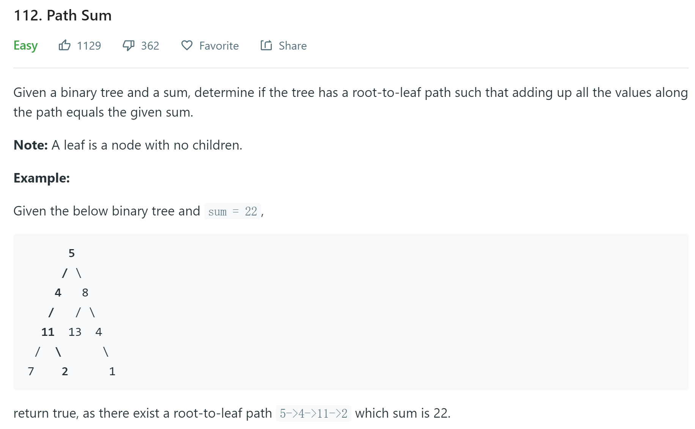
2. Path Sum https://leetcode.com/problems/path-sum/

Slide 3
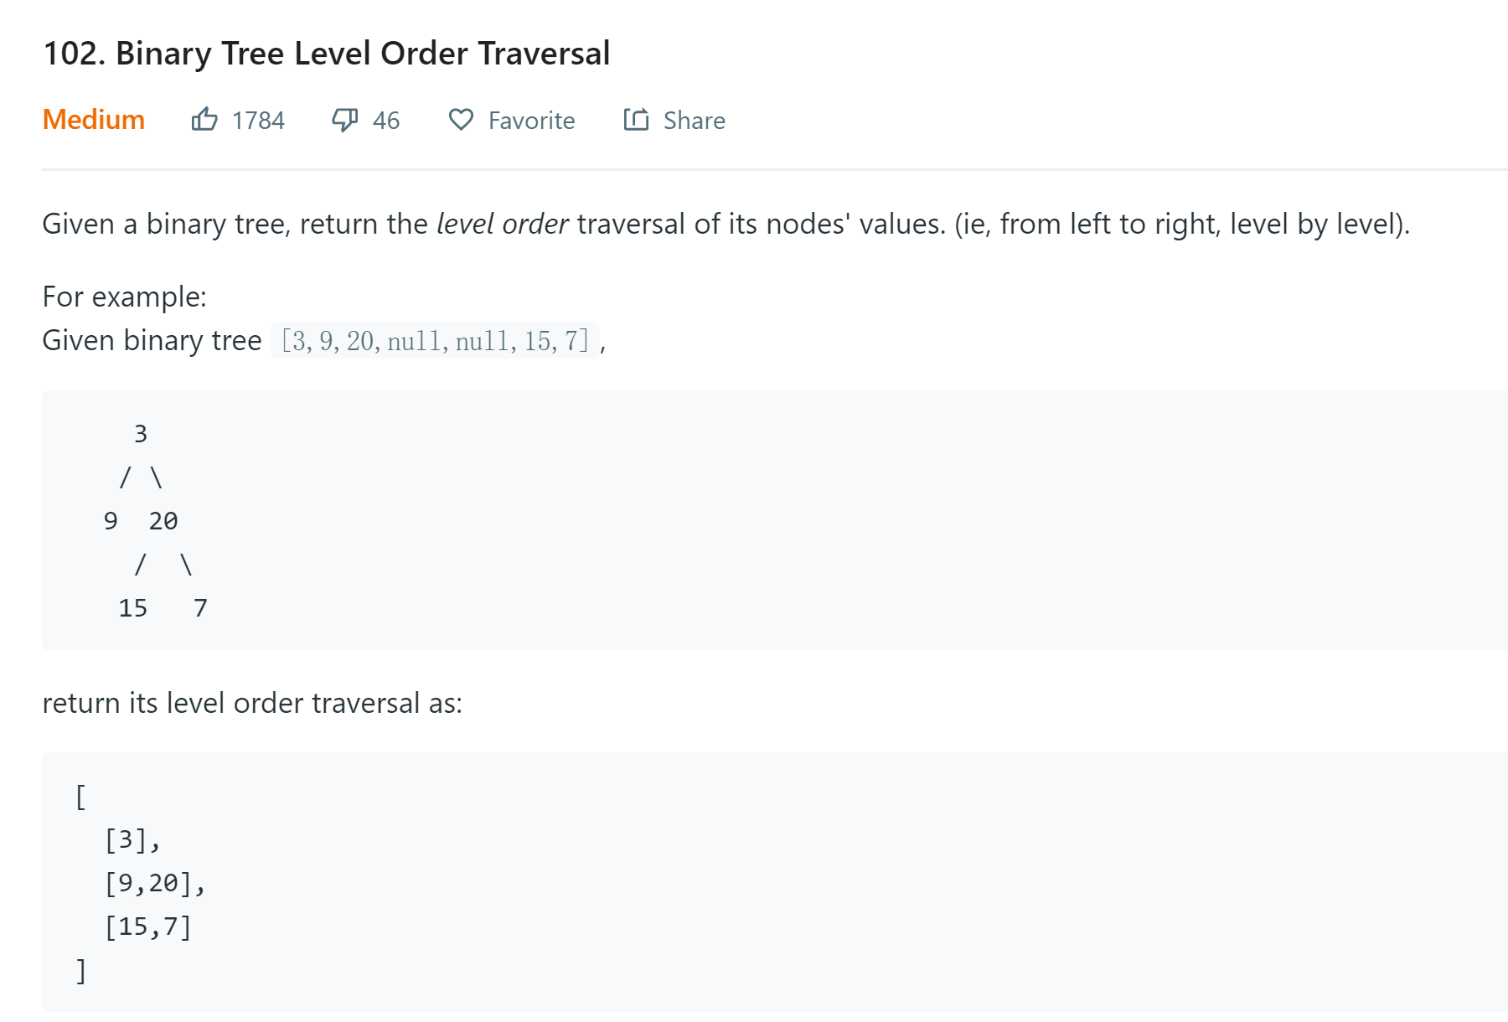
3. Binary Tree Level Order Traversal https://leetcode.com/problems/binary-tree-level-order-traversal/

Slide 4
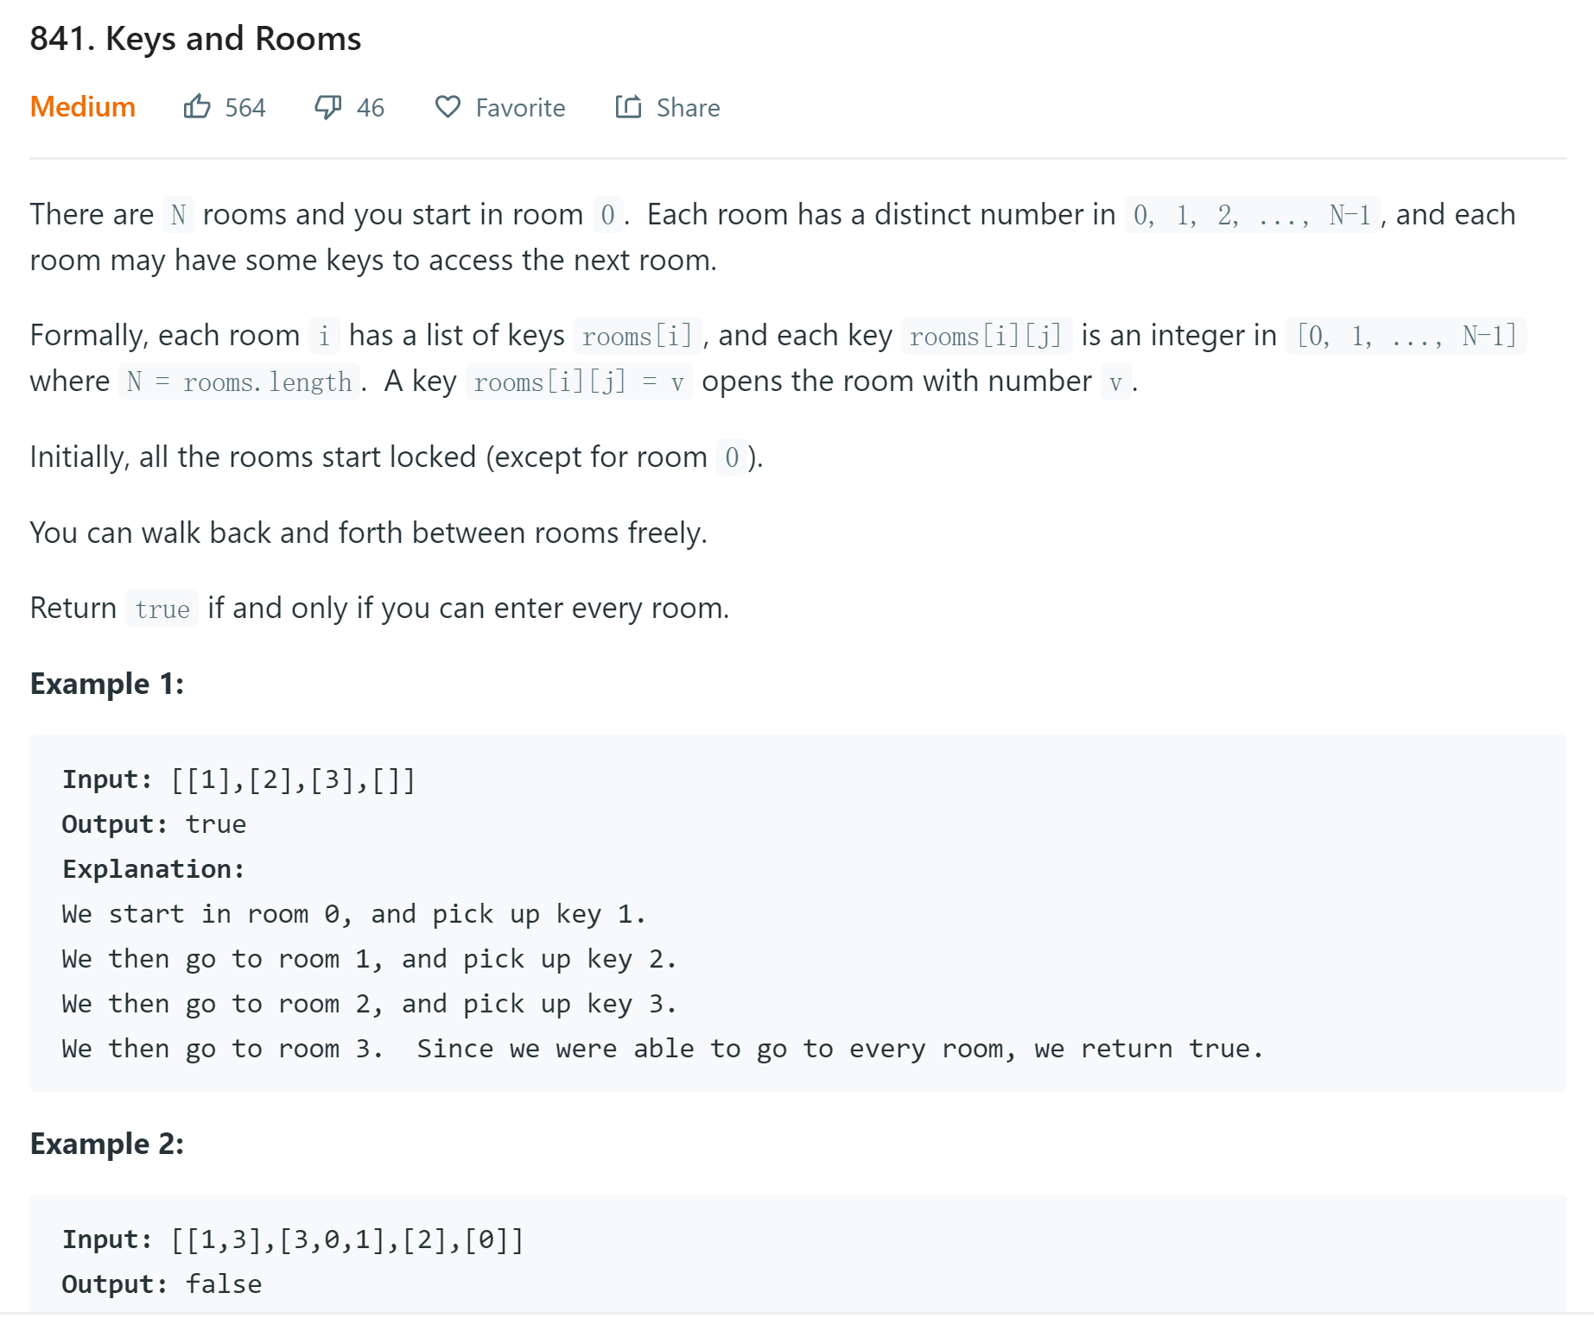
4. Keys and Rooms
https://leetcode.com/problems/keys-and-rooms/

Slide 5
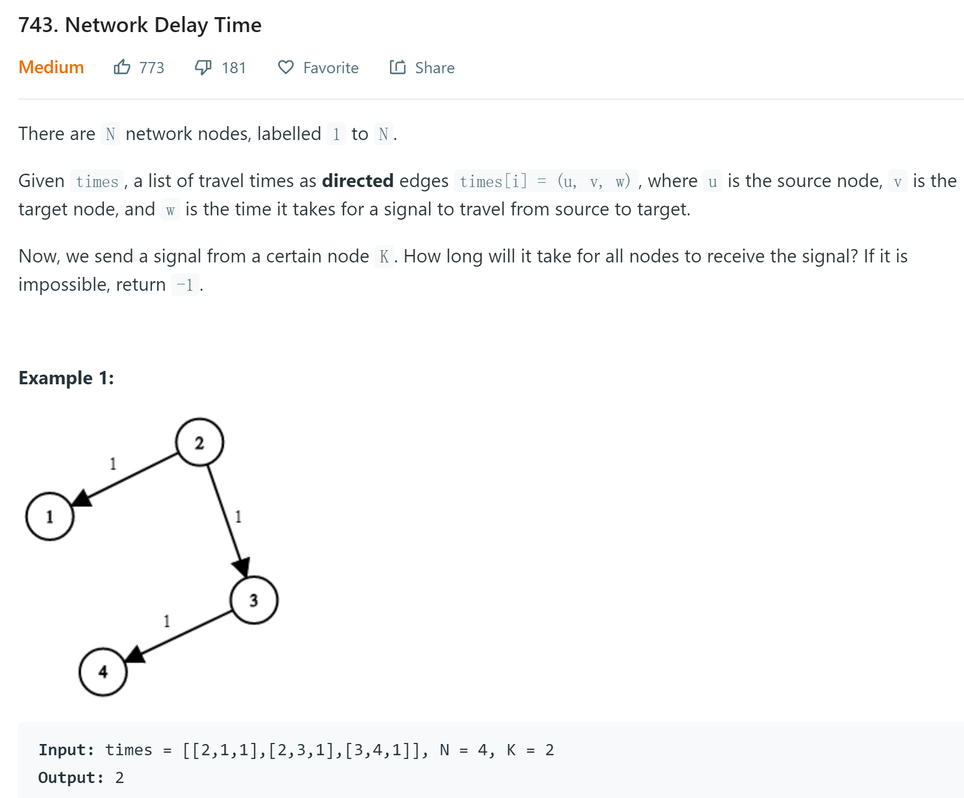
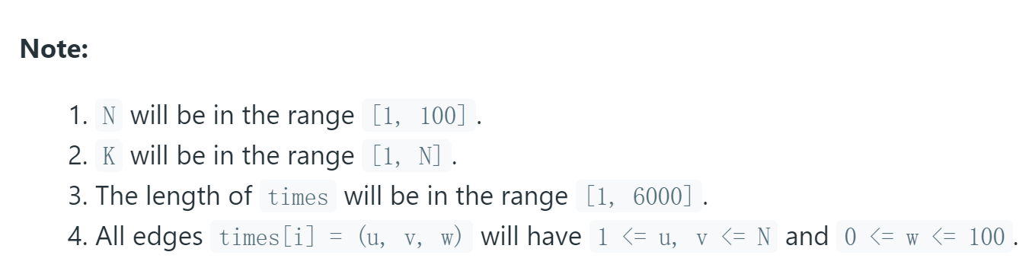
5. Network Delay Time
https://leetcode.com/problems/network-delay-time/

Slide 6
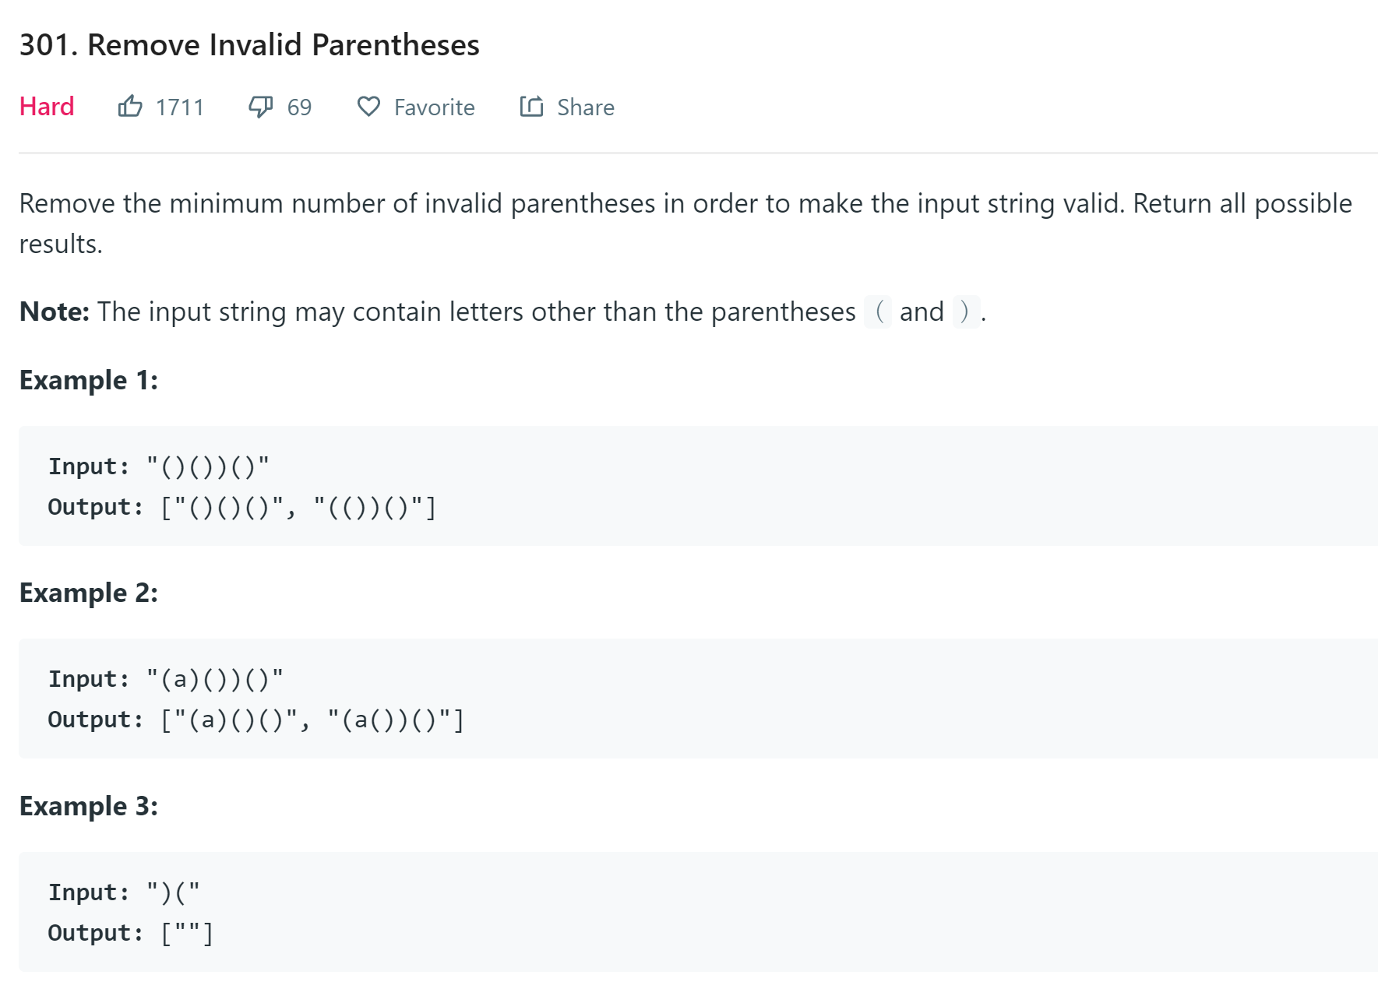
6. Remove Invalid Parentheses
https://leetcode.com/problems/remove-invalid-parentheses/

