Slide 1
Divide and Conquer
Xiaoyu Li

Slide 2
Divide and Conquer
A typical Divide and Conquer algorithm solves a problem using following three steps.
1. Divide: Break the given problem into subproblems of same type. 2. Conquer: Recursively solve these subproblems 3. Combine: Appropriately combine the answers

Slide 3
Divide and Conquer
Divide and Conquer vs Dynamic Programming (DP)
Both paradigms divide the given problem into subproblems and
solve subproblems.
DP approach may be applied to the problem only if the problem has
certain restrictions or prerequisites.
Optimal substructure
Overlapping sub-problems
DP extends Divide and Conquer approach with memorization or
tabulation techniques
Divide and Conquer vs Recursive
Some recursive algorithms may just have one recursive call
Fibonacci numbers: two recursive calls but it doesn’t divide the problem
Notes:
Divide and Conquer should be used when same subproblems are not evaluated many times. Otherwise Dynamic Programming or Memoization should be used. For example, Binary Search is a Divide and Conquer algorithm, we never evaluate the same subproblems again. On the other hand, for calculating nth Fibonacci number, Dynamic Programming should be preferred.

Slide 4
Applications
Binary Search
Sorting (Merge Sort; Quick Sort)
Maximum Sub-Array Problem
Closest Point Problem
Skyline Problem
Tiling Problem
Strassen’s Algorithm (Matrix Multiplication)

Slide 5
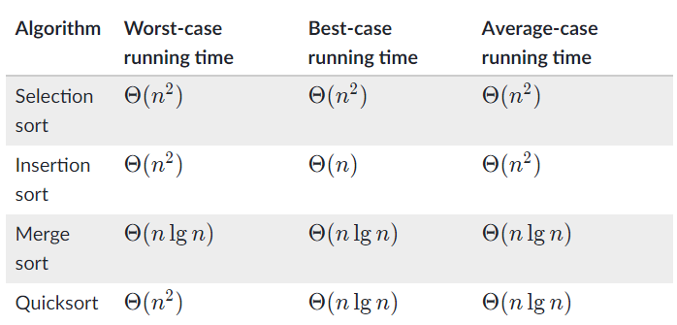
Sorting
fff
Bubble Sort, Heap Sort…

Slide 6
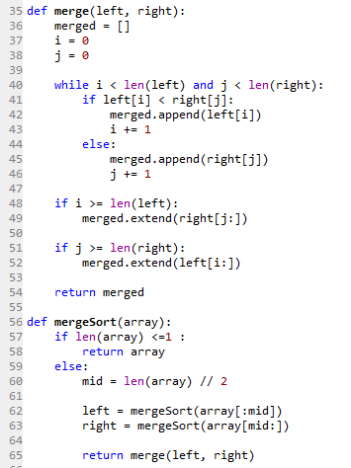
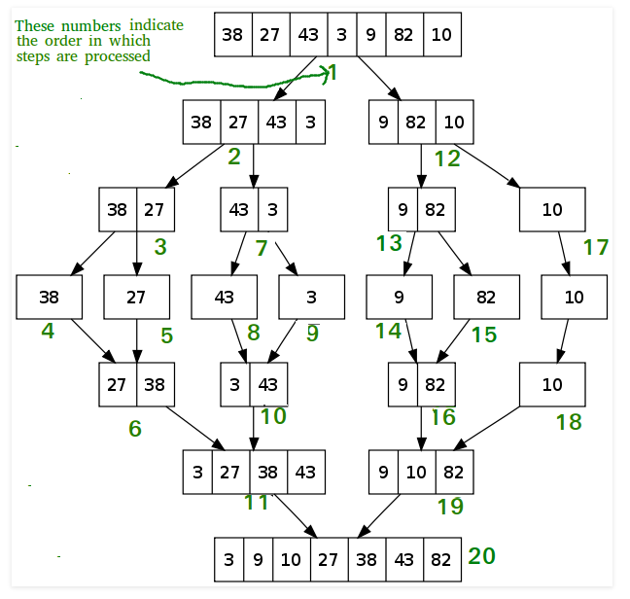
Merge Sort

Slide 7
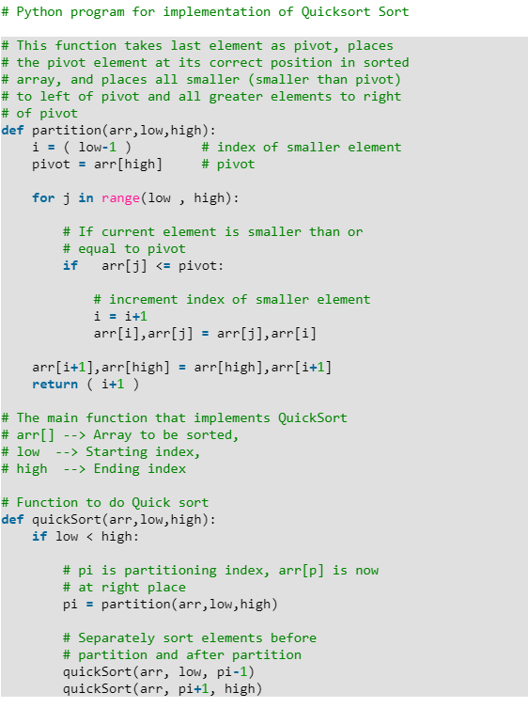
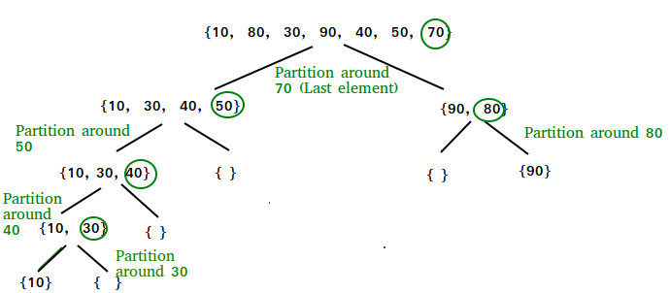

Quick Sort

Slide 8
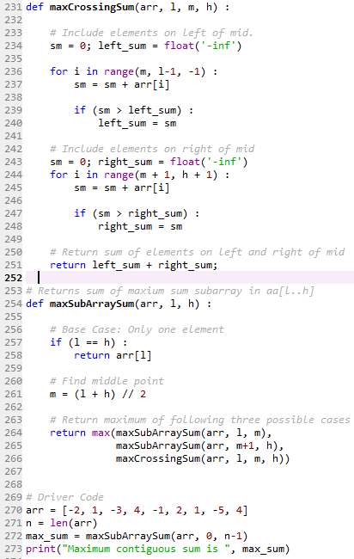
Maximum Sub-Array Problem
You are given a one dimensional array that may contain both positive and negative integers, find the sum of contiguous subarray of numbers which has the largest sum.
For example, if the given array is {-2, -5, 6, -2, -3, 1, 5, -6}, then the maximum subarray sum is 7
[-2, -5, 6, -2, -3, 1, 5, -6]
[-3, -1, 4, -2 || -3, -2, 3, -3]

Slide 9
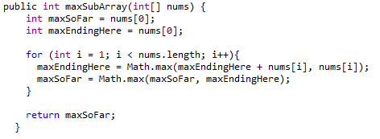
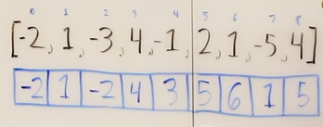
Alternative way to solve Max Sub-Array Problem?
index 0 1 2 3 4 5 6 7 8
Input: [ -2, 1, -3, 4, -1, 2, 1, -5, 4 ]
-2, 1, -2, 4, 3, 5, 6, 1, 5 'maxEndingHere' at each point
The best subarrays we would take if we took them:
ending at index 0: [ -2 ] (snippet from index 0 to index 0)
ending at index 1: [ 1 ] (snippet from index 1 to index 1) [we just took the item at index 1]
ending at index 2: [ 1, -3 ] (snippet from index 1 to index 2)
ending at index 3: [ 4 ] (snippet from index 3 to index 3) [we just took the item at index 3]
ending at index 4: [ 4, -1 ] (snippet from index 3 to index 4)
ending at index 5: [ 4, -1, 2 ] (snippet from index 3 to index 5)
ending at index 6: [ 4, -1, 2, 1 ] (snippet from index 3 to index 6)
ending at index 7: [ 4, -1, 2, 1, -5 ] (snippet from index 3 to index 7)
ending at index 8: [ 4, -1, 2, 1, -5, 4 ] (snippet from index 3 to index 8)

Slide 10
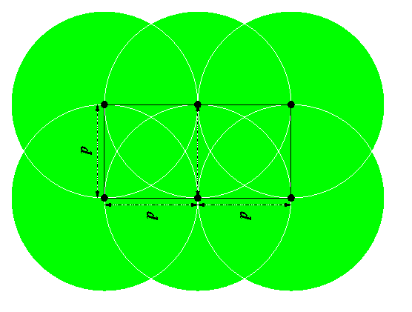
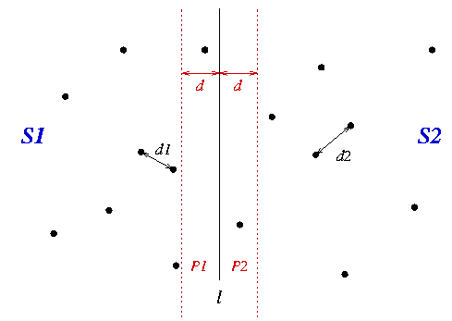
Closest-Points Problem
Given n ordered pairs (x₁ , y₁), (x₂ , y₂), ... , (x_{n} , y_{n}), find the distance between the two points in the set that are closest together.
Closest Pair of a set of points:
1. Divide the set into two equal sized parts by the line l, and recursively compute the minimal distance in each part.
2. Let d be the minimal of the two minimal distances.
3. Eliminate points that lie farther than d apart from l
4. Sort the remaining points according to their y-coordinates
5. Scan the remaining points in the y order and compute the distances of each point to its five neighbors.
6. If any of these distances is less than d then update d.
Theorem
A rectangle of width d and height 2d can contain at most six points such that any two points are at distance at least d.
https://www.cs.mcgill.ca/~cs251/ClosestPair/proofbox.html

Slide 11

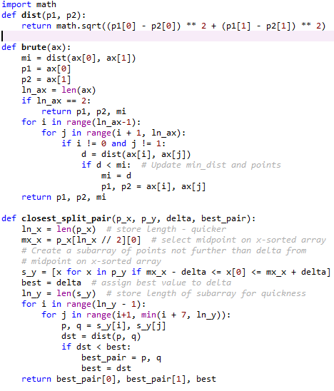
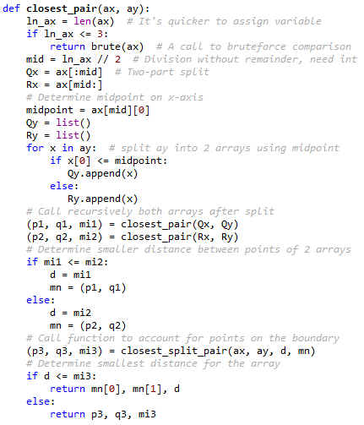
5

Slide 12
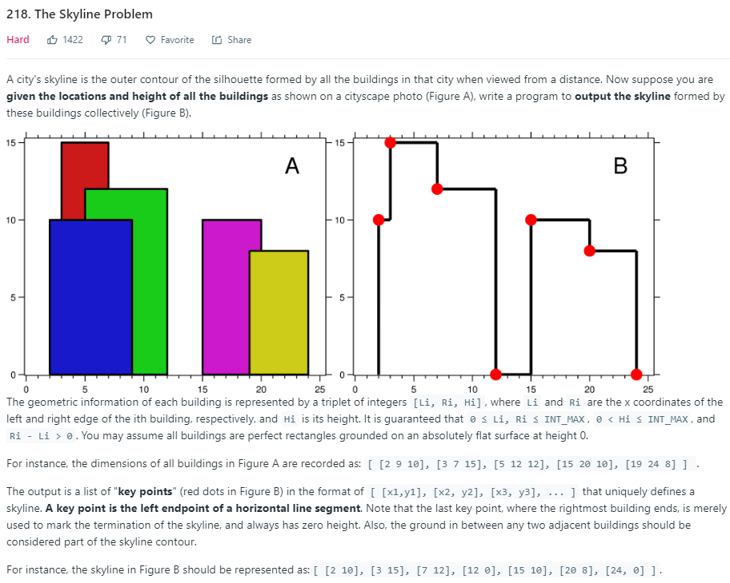
Skyline Problem

Slide 13
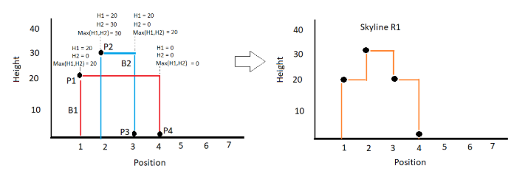
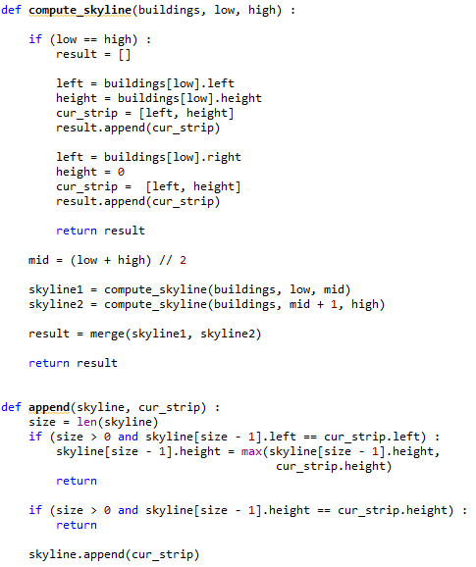
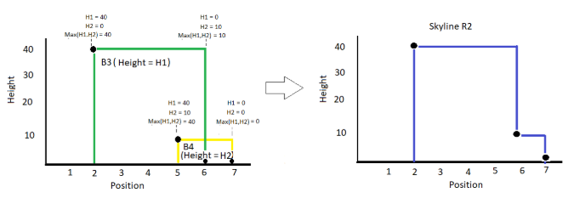
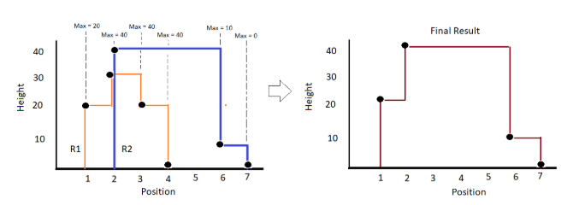

Slide 14
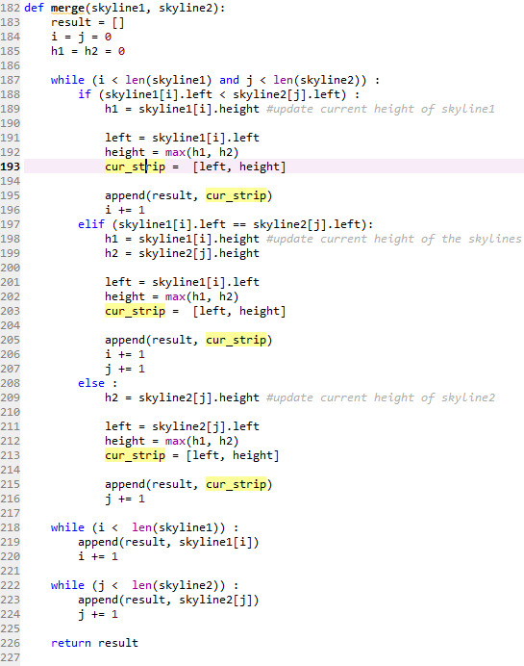

Slide 15
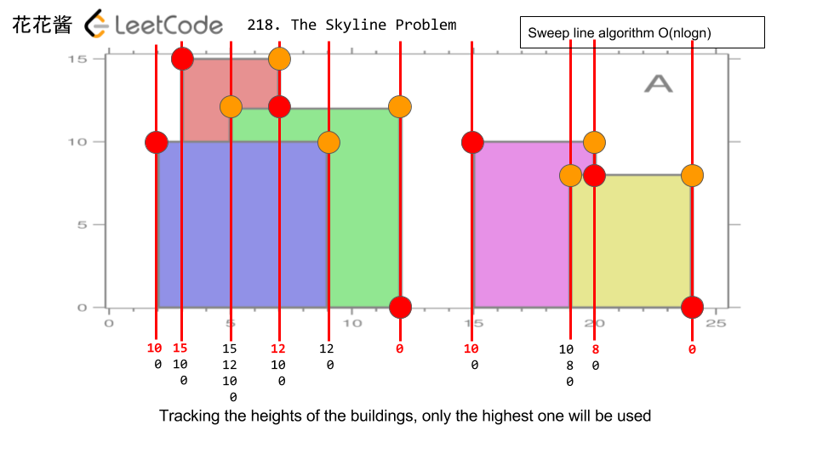
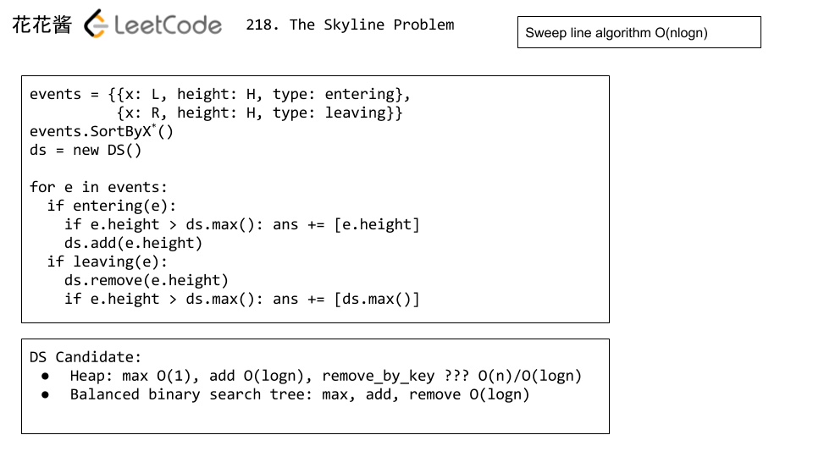
Alternative way to solve Skyline Problem?
https://zxi.mytechroad.com/blog/tree/leetcode-218-the-skyline-problem/

Slide 16
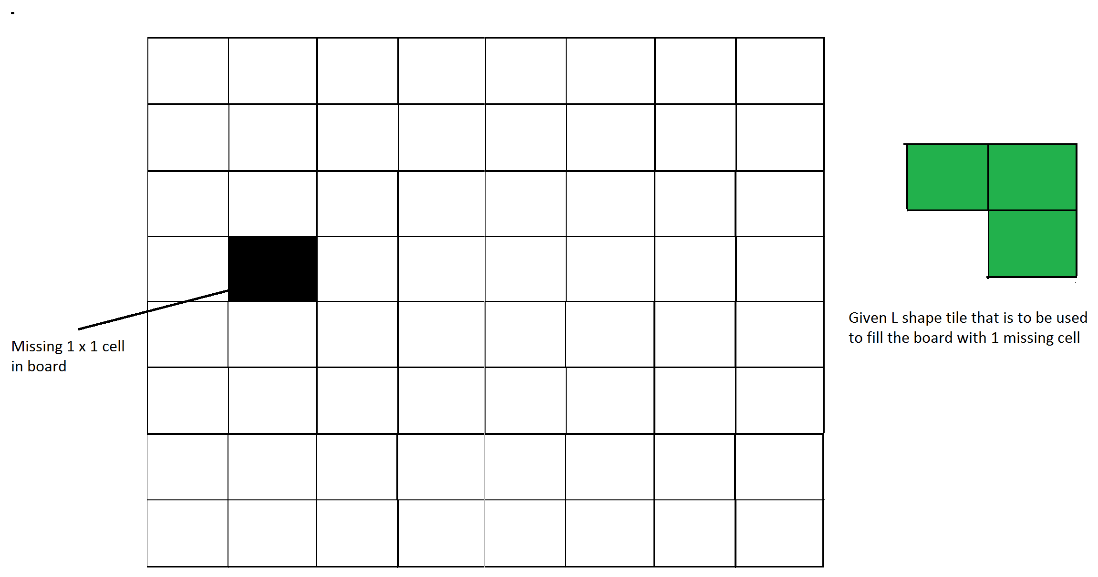
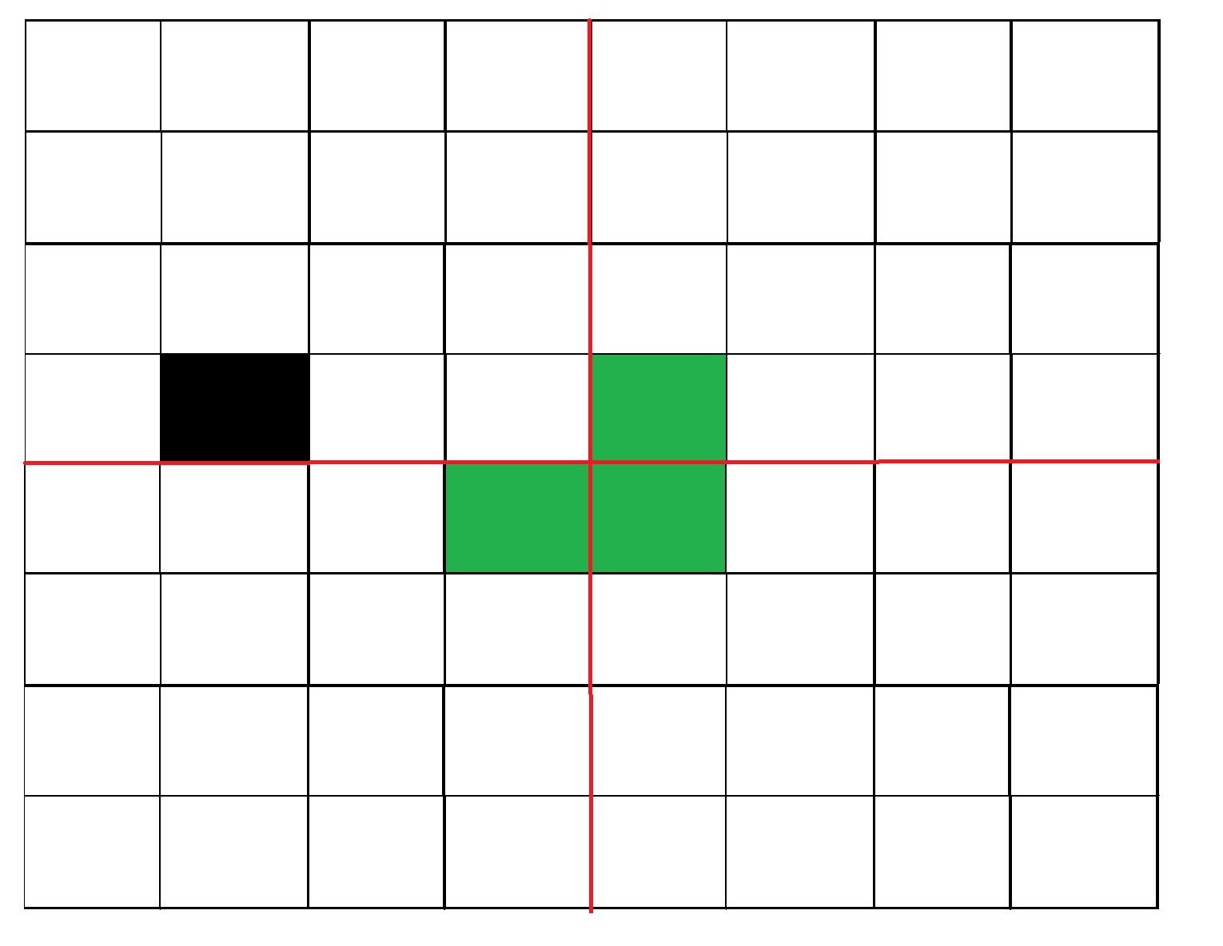
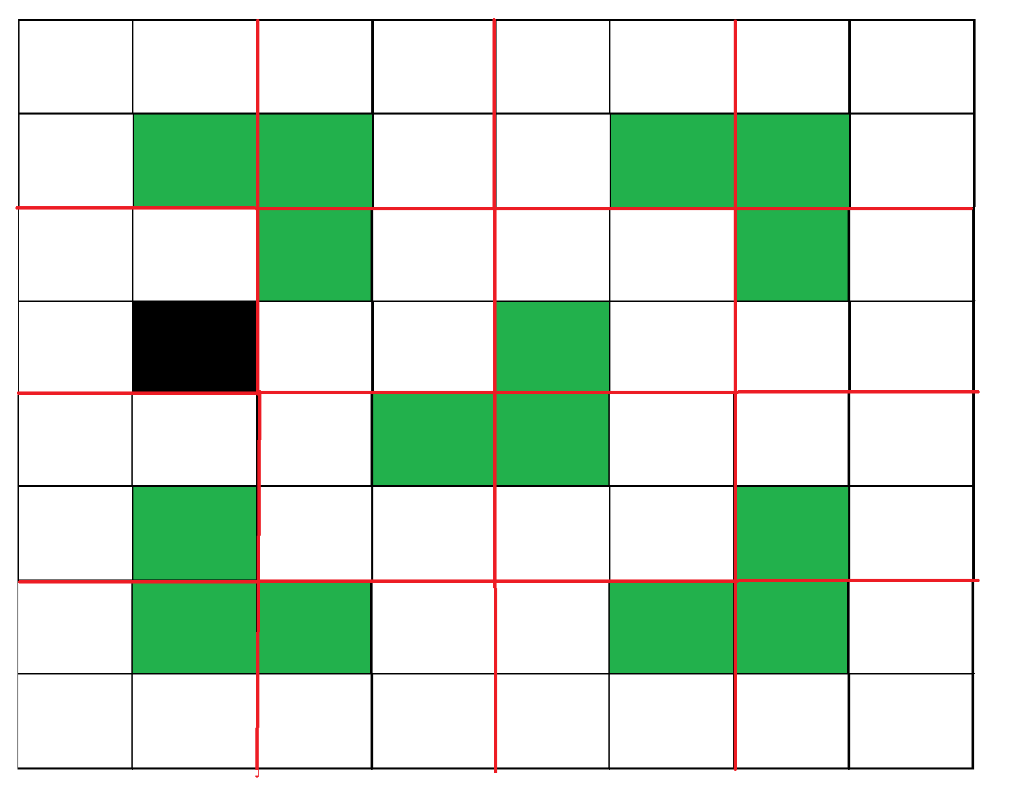
Tiling Problem
Given a n by n board where n is of form 2^{k} where k >= 1 (Basically n is a power of 2 with minimum value as 2). The board has one missing cell (of size 1 x 1). Fill the board using L shaped tiles. A L shaped tile is a 2 x 2 square with one cell of size 1×1 missing.

Slide 17
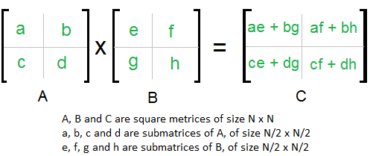
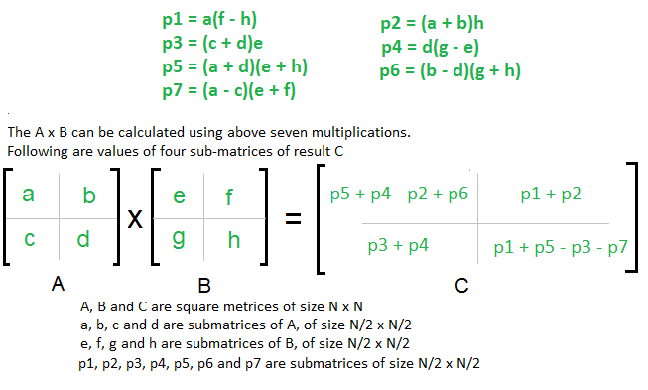
Strassen Algorithm
Given two square matrices A and B of size n x n each, find their multiplication matrix.
T(N) = 8T(N/2) + O(n^2)
Time complexity O(n^3)
T(N) = 7T(N/2) + O(n^2)
Time complexity O(n^log7)
https://github.com/stanislavkozlovski/Algorithms/blob/master/Coursera/algorithms_stanford/Strassen%20Matrix%20Multiplication/python/strassen.py

Slide 18
Thank you!

Slide 19
Appendix
DC, DP, Recursive: https://itnext.io/dynamic-programming-vs-divide-and-conquer-2fea680becbe
Skyline: http://www.interviewdruid.com/find-the-skyline-of-a-group-of-buildings/
https://www.comp.nus.edu.sg/~sanjay/cs3230/dandc.pdf
http://www.cs.columbia.edu/~mihalis/cs4231/Handouts/Divide%20and%20Conquer.pdf

Slide 20
LC 973. K Closest Points to Origin
LC 411. Arranging Coins

