Slide 1
Dynamic Programming
Hui Duan

Slide 2
Dynamic Programming
The idea is to simply store the results of subproblems, so that we do not have to re-compute them when needed later. This simple optimization reduces time complexities from exponential to polynomial.
Dynamic Programming is mainly an optimization over plain recursion.
How to classify a problem as a Dynamic Programming Problem?
Typically, all the problems that require to maximize or minimize certain quantity or counting problems that say to count the arrangements under certain condition or certain probability problems can be solved by using Dynamic Programming.
All dynamic programming problems satisfy the overlapping subproblems property and most of the classic dynamic problems also satisfy the optimal substructure property. Once, we observe these properties in a given problem, be sure that it can be solved using DP.

Slide 3
Approaches
Top Down - Memoization (direct result of the recursive formulation of any problem)
When the recursion does a lot of unnecessary calculation, an easy way to solve this is to cache the results and to check before executing the call if the result is already in the cache.
Bottom-Up (Start by computing the result for the smallest subproblem (base case))
Try solving the sub-problems first and use their solutions to build on and arrive at solutions to bigger sub-problems. We have to identify and initialize the boundary conditions such as when we start the iteration, those are available. We can most of the time optimize the space and avoid storing all the partial results along the way by storing only the strictly necessary partials.
Bottom-up is a way to avoid recursion, saving the memory cost that recursion incurs when it builds up the call stack.

Slide 4
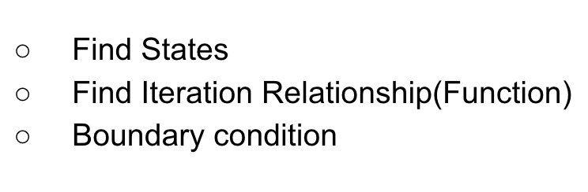
Steps:
How to recognize a DP problem
Identify problem variables
Clearly express the recurrence relation
Identify the base cases
Decide if you want to implement it iteratively or recursively
Add memoization
Determine time complexity

Slide 5
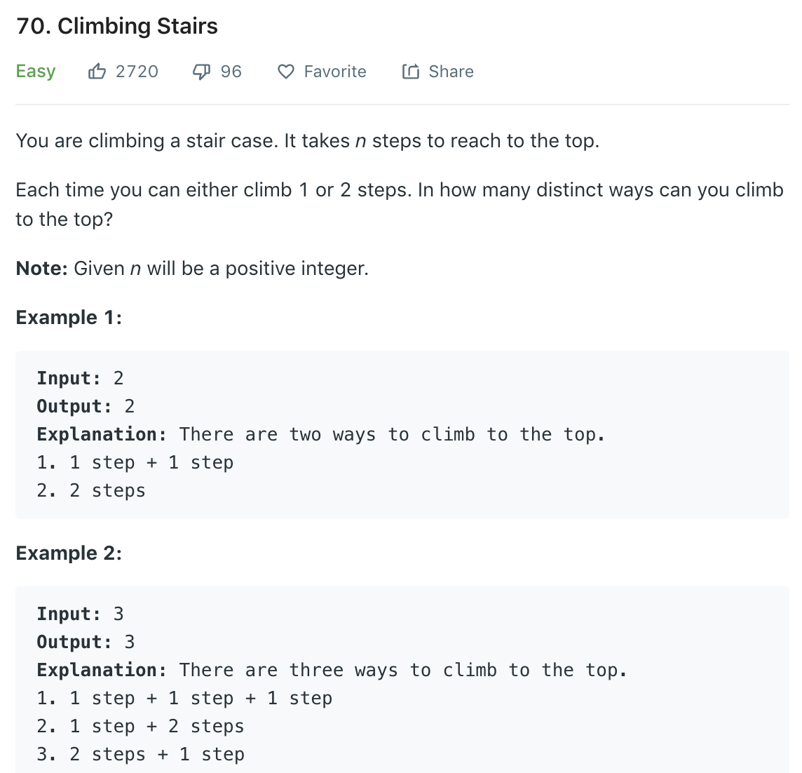
Q1
States: climbStairs (dp)
Iteration relationship: dp[i]=dp[i−1]+dp[i−2]
Boundary Conditions: dp[0] = 1, dp[1] = 2

Slide 6
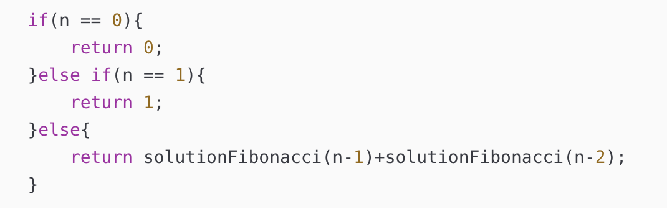
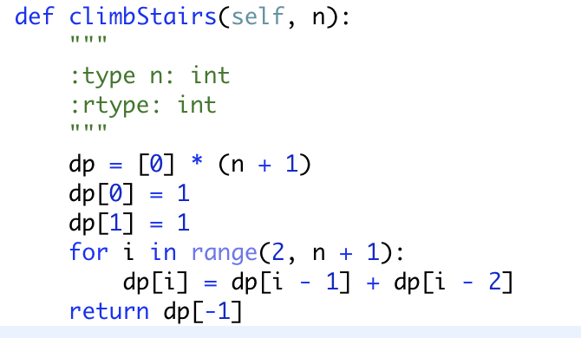
Solution:
Recursion: stairs(n) = stairs(n-1) + stairs(n-2)
DP: Bottom to Top
Complexity Analysis
Time complexity : O(n)
Space complexity : O(n)
Create array “dp” here to store results (Add memoization)

Slide 7
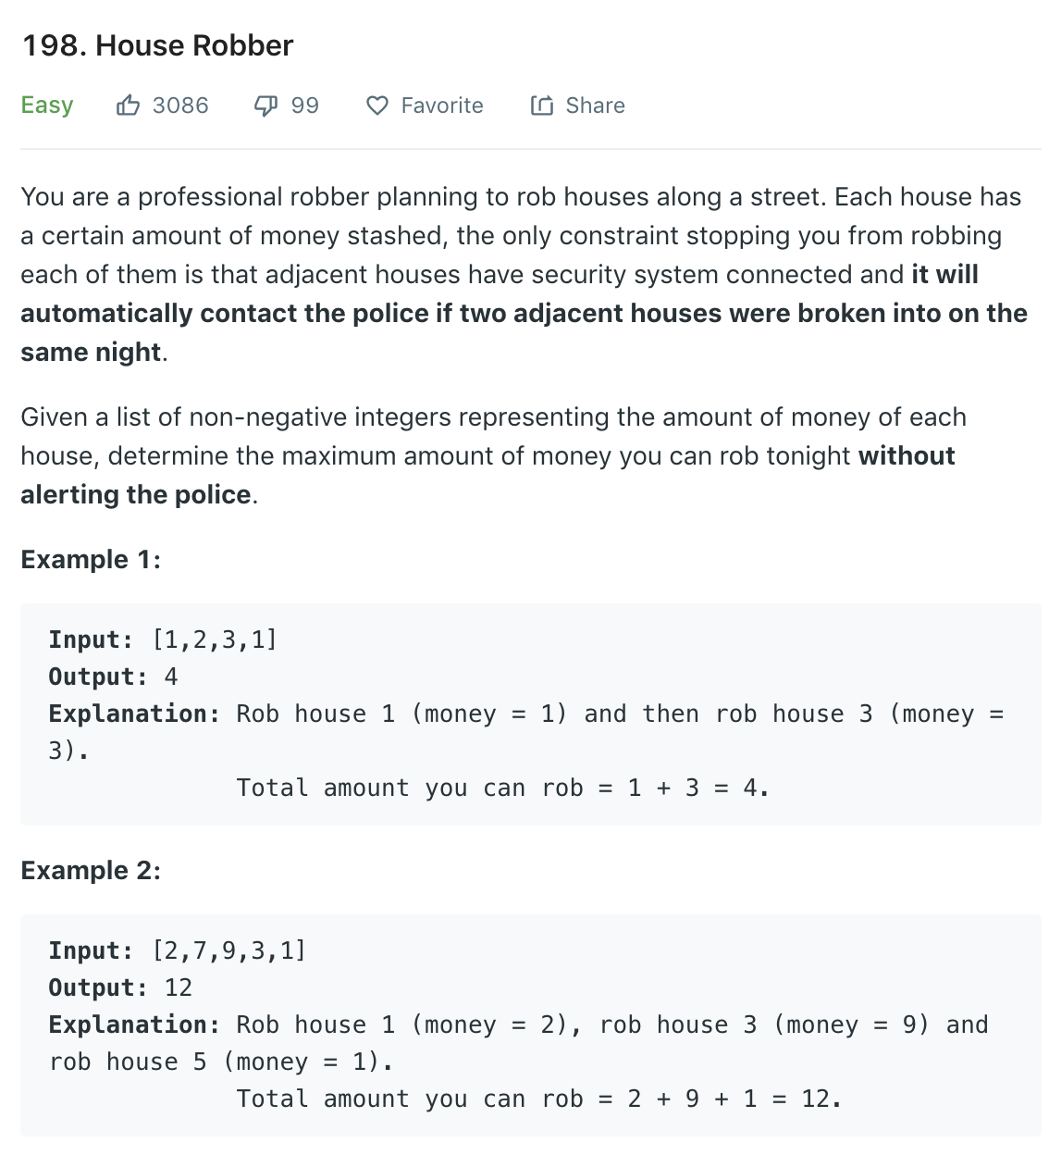
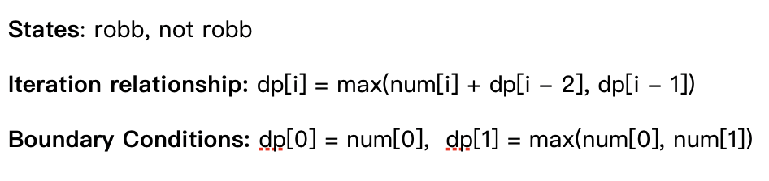
Q2：Find Max Amount!
Robb: current[i] + robb[i-2]
Not robb: robb[i-1] (Previous one)
dp: the maximum amount the robber can obtain.

Slide 8
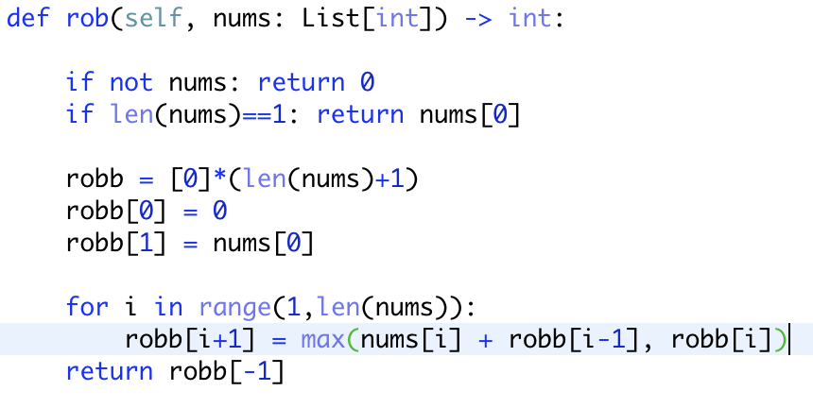
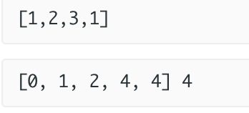
Solution
Complexity Analysis
Time complexity : O(n)
Space complexity : O(n)
Given array:
Robb array, length

Slide 9
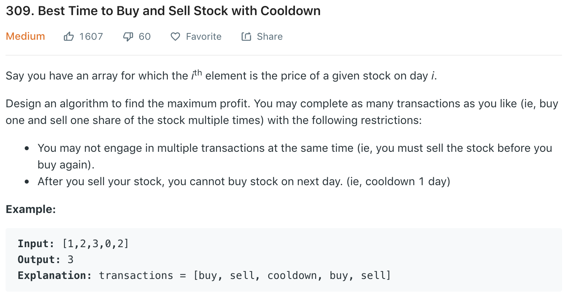
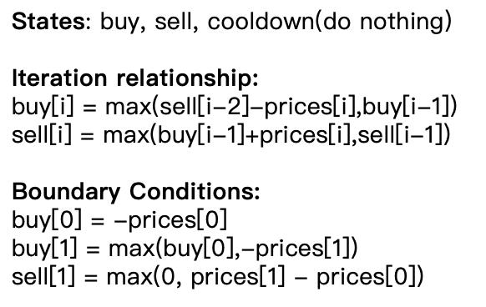
Q3: Find Max Amount
Attention: No buy action at the first day!
buy[i]: the maximum revenue for buy operation at the i-th day
sell[i]: the maximum revenue for sell operation at the i-th day

Slide 10
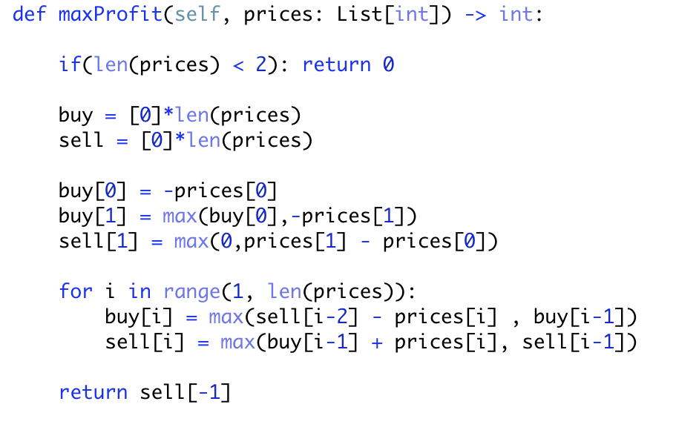
Solution
Complexity Analysis
Time complexity : O(n)
Space complexity : O(n)
At the end, we have: buy[-1]<sell[-1]
=> return sell[-1]

Slide 11
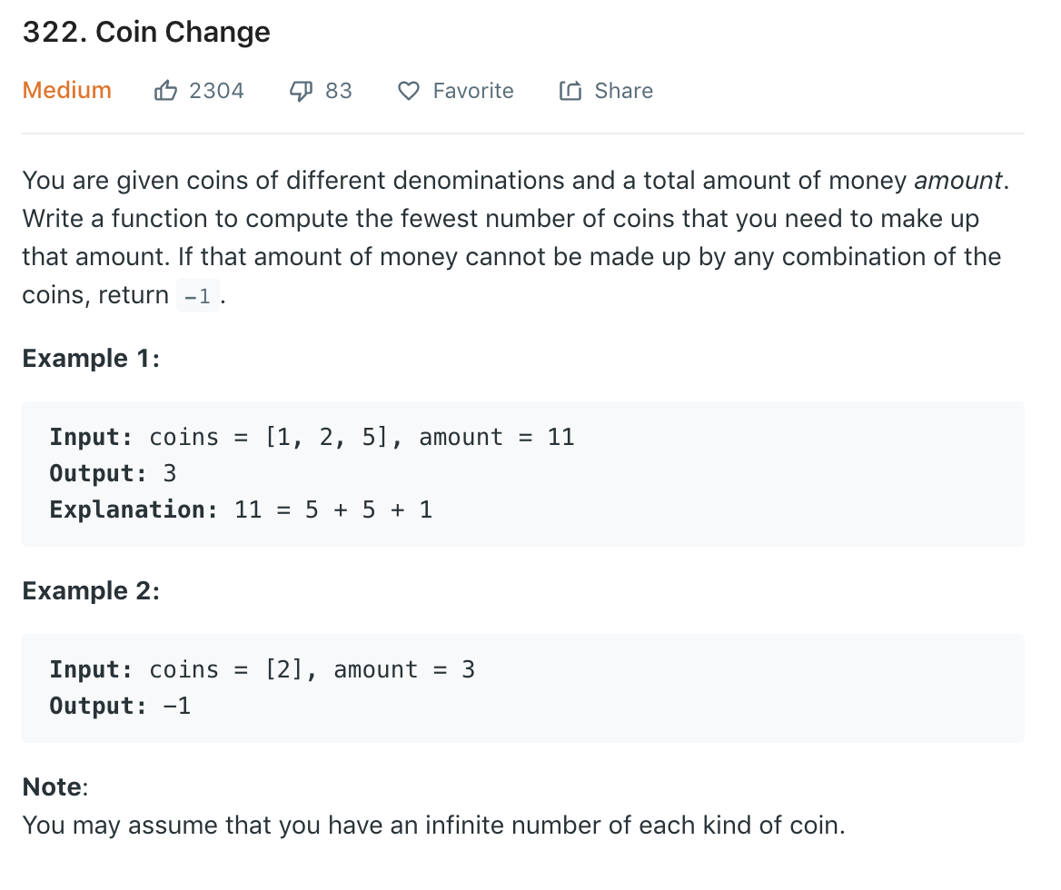
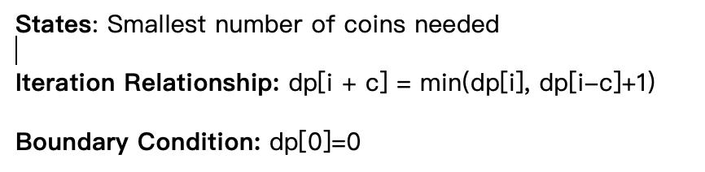
Q4：Bottom to Up (min)
Questions: what is the smallest number of coins to build the amount?
SubProblem: what is the smallest number of coins to build 1 cent,2 cents…? => until we get the amount.
dp: store the smallest number of coins
dp[0]: smallest number of coins to make 0 cent
dp[1]: smallest number of coins to make 1 cent
…….
dp[amount]: smallest number of coins to make required amount

Slide 12
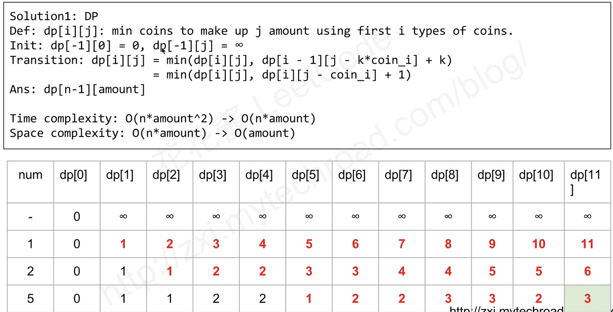
min(11,5+1)
min(2, 0+1) = 1
min(3,1+1)=2
min(4,1+1)
min(5,2+1)
min(5,2+1)
min(3,0+1)
Iteration Relationship: dp[i + c] = min(dp[i], dp[i-c]+1)

Slide 13
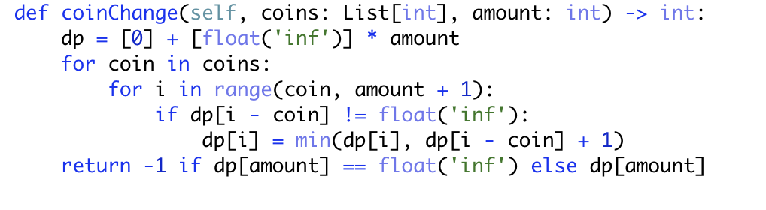
Solution
Initial dp[1:len(amount)] : the amount we cannot build (set to infinity here)
i: how many cents we tried to make up
Complexity Analysis
Time complexity : O(n*m)(coins,amount)
Space complexity : O(m)(amount)

Slide 14
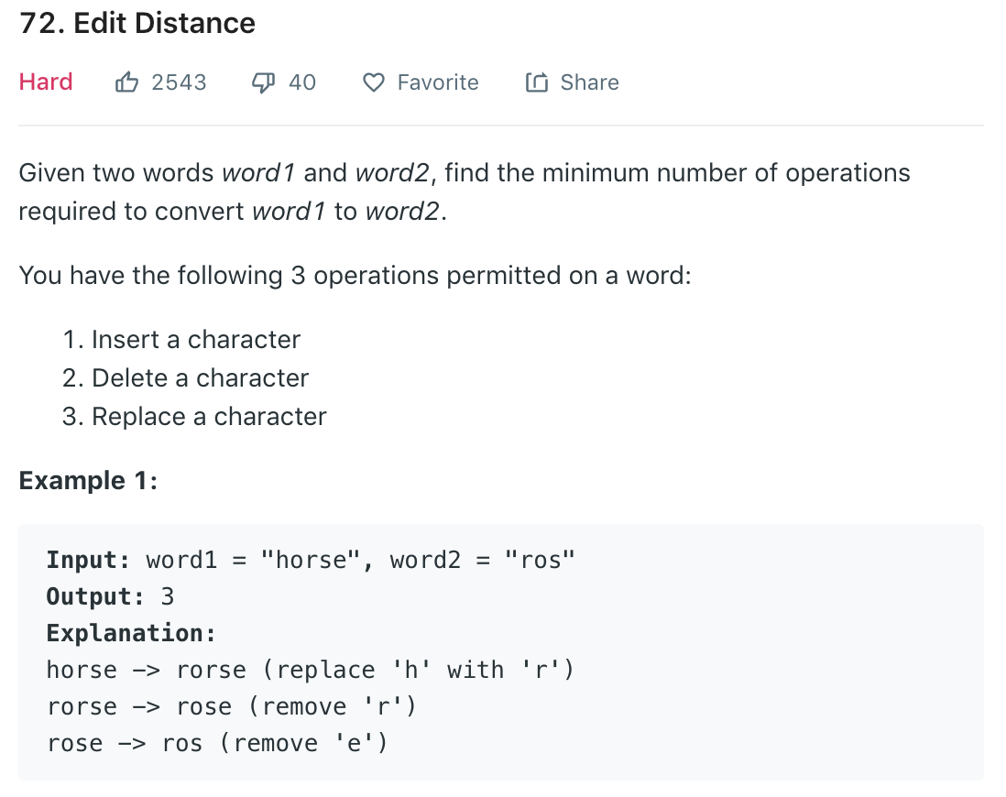
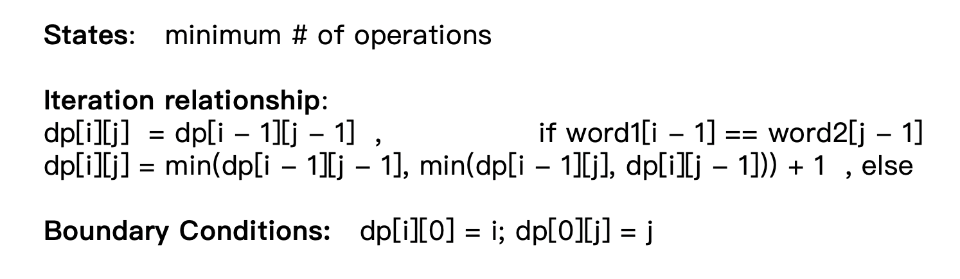
Q5: Minimum # operations
dp[i][j] : represents the smallest operations(steps) required to convert from first first i characters of word1 to the first j characters of word2.

Slide 15
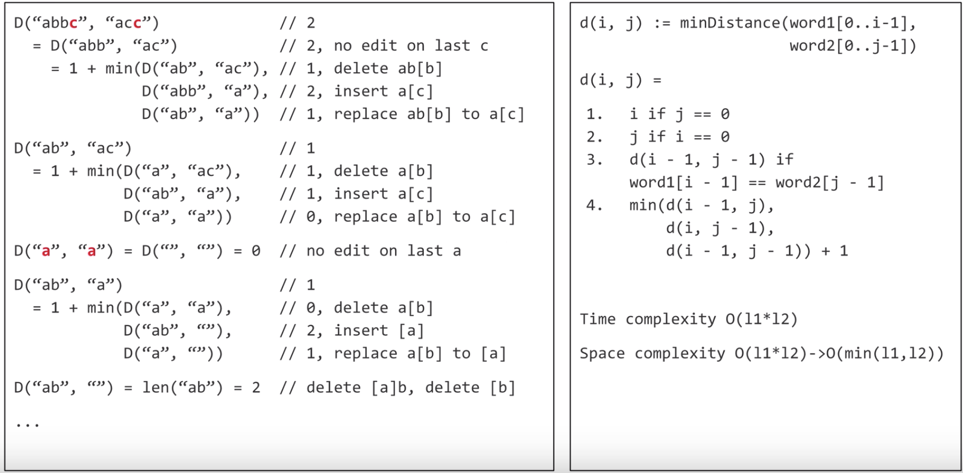
Recursion Def: use the first i elements of word1 and word2 to change from w1 tp w2

Slide 16
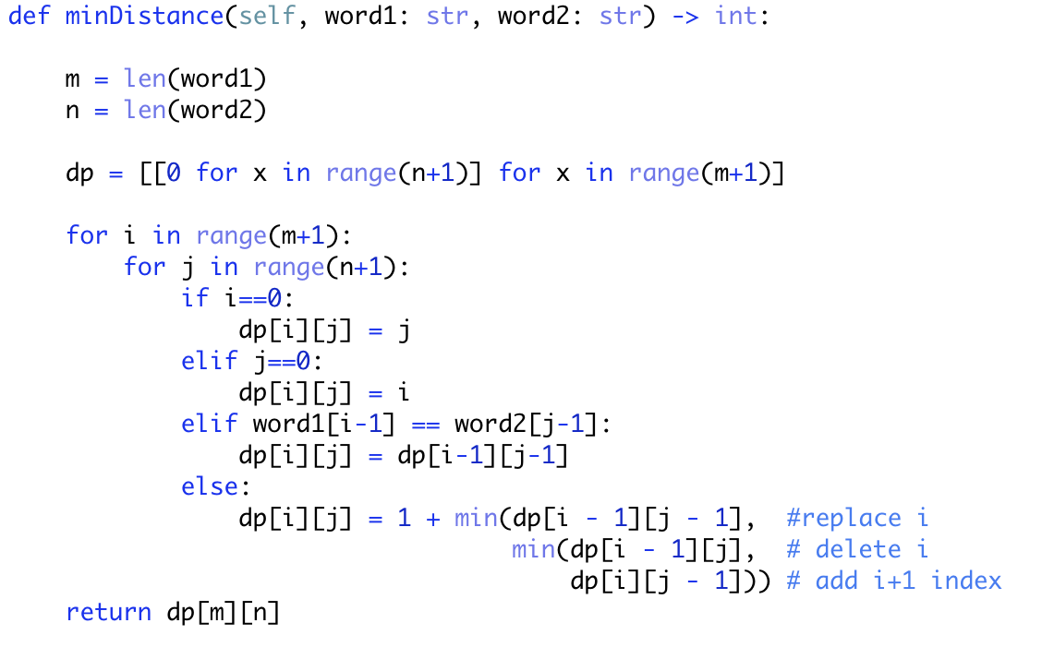
Solution
Complexity Analysis
Time complexity : O(m*n)
Space complexity：O(m*n)

Slide 17
PS: DP Practice Questions: https://people.cs.clemson.edu/~bcdean/dp_practice/

