Slide 1

PROOF OF CONCEPT · AUGUST 2026
CRE AI Agent System
Proposition | Solution | Demo
London Office Market Monitor
Reliable intelligence, empowering every decision to stay ahead of the market. By Lee Sheung Chit Ethan
Do Good and Do Well, with Love

Slide 2

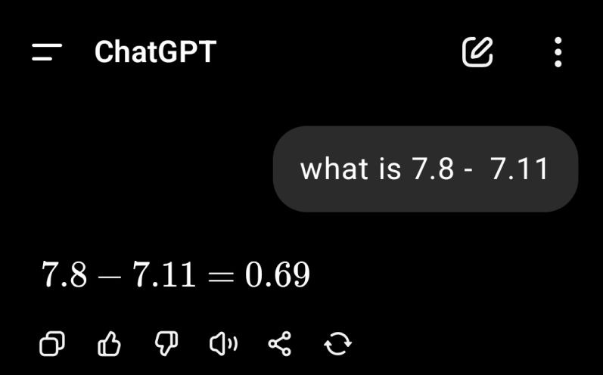
PROPOSITION
Monitoring is tedious, yet AI cannot be trusted.
66% of CRE professionals use AI weekly or daily; only 5% trust it enough to inform a deal.
First American Data & Analytics / DealGround, survey of 255 CRE professionals, May 2026
Multiple interrelated areas to be tracked, while the world keeps moving rapidly. → Analysis by hand puts you behind the market.
General-purpose AI might hallucinate: inventing a figure, getting the arithmetic wrong. → The power of AI goes unused: the analyst redoes the work by hand.
The solution: bridging the trust gap by an AI agent grounded with credible information and robust agentic tools. → This CRE AI Agent System

Slide 3
SOLUTION
A Rapid, Reliable, and Relevant AI Agent
 | This system Deterministic spine, agentic edges | Published research Savills · CBRE · CoStar | General-purpose AI ChatGPT · Gemini · Claude
Efficiency | High Insight from credible sources in seconds | Low You consolidate and analyse it yourself | Low You verify everything before you use it
Know your portfolio | Yes Analysis matched to your holdings | No Market-wide data only | No Only what you paste in
Credibility | High Named sources: Savills, VOA, EPC register | High Enterprise research | Low Fragmented internet data
Strategic insight | High Specific to the buildings you hold | No You do your own research | Low Generic advice
vs
vs

Slide 4
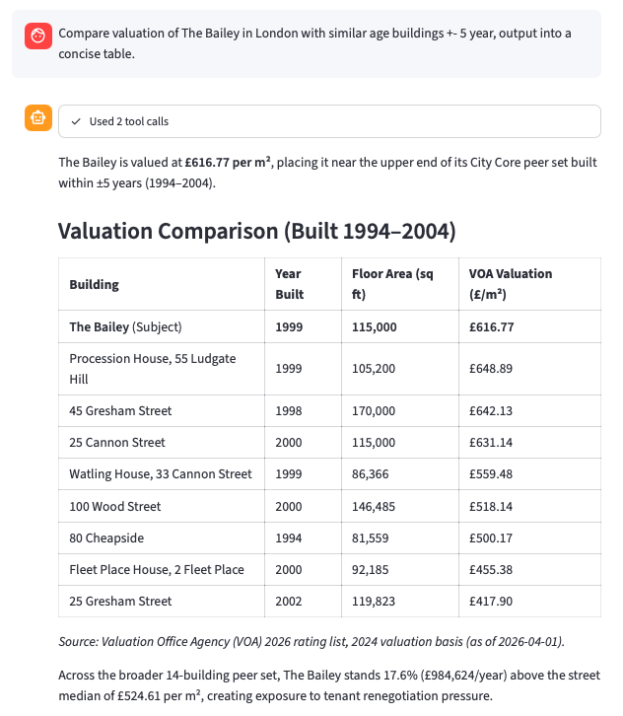
DEMO · SUBMARKET DYNAMICS
Is The Bailey priced right against its peers?
“Compare valuation of The Bailey in London with similar age buildings +- 5 year, output into a concise table.”
RELIABLE PRICING ANALYSIS IN SECONDS
1
Recalled what you own.
The agent opened the portfolio first, found The Bailey among your five London holdings, and took its 1999 completion and City Core address from there.
EFFICIENCY
KNOW YOUR PORTFOLIO
2
Picked comparable buildings, then measured the gap.
It pulled every City Core building in the VOA rating list, kept the ones completed within five years of The Bailey as you asked, and computed the median and the gap.
CREDIBILITY
3
Turned findings into strategy.
The Bailey sits above its peer group, which is exposure at the next rent review.
STRATEGIC INSIGHT

Slide 5
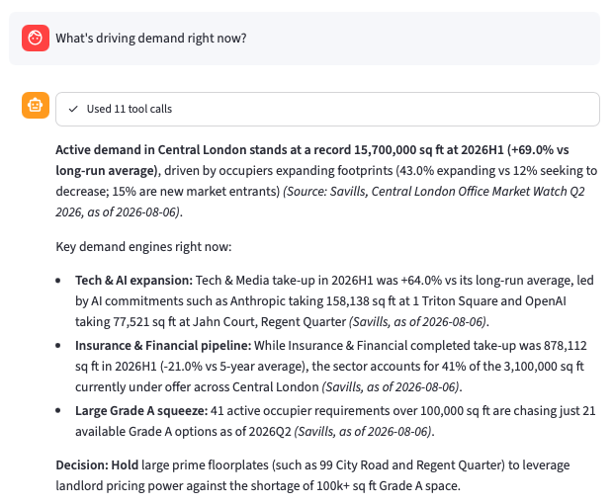
DEMO · OCCUPIER DEMAND DRIVERS
What’s driving demand right now?
RELIABLE DEMAND ANALYSIS IN SECONDS
1
Resolved what you mean.
It checked what figures exist on database, then scoped every lookup to Central London at the latest published half.
EFFICIENCY
2
Pulled six figures, and the deals behind them.
Active demand, take-up, the share of occupiers expanding, large requirements, space under offer, one sector's take-up, and the named lettings. Each with its source and its date.
CREDIBILITY
3
Found a gap, and stayed with the source.
Tech & Media take-up is not published for this half. Instead of estimating one, it reported the change the source does give: 64% above the long-run average.
CREDIBILITY
4
Turned findings into strategy.
The response closes on 99 City Road and Regent Quarter, and on a decision, rather than on Central London in general.
KNOW YOUR PORTFOLIO
STRATEGIC INSIGHT
~THE END~

