Slide 1
DualPath
Breaking the Storage Bandwidth Bottleneck in Agentic LLM Inference
Paper overview | arXiv:2602.21548 | Generated with slides skill

Slide 2
Executive Summary
DualPath targets a systems bottleneck in agentic LLM serving: KV-cache I/O from storage.
Core idea: dual-path loading + dynamic scheduling to aggregate prefill/decode bandwidth.
Reported gains: up to 1.73x throughput and up to 1.61x lower median latency.
Main implication: storage-aware architecture is a first-order optimization in agentic inference.

Slide 3
Problem Statement
Agentic workloads are multi-turn and tool-driven, producing many short appends over long contexts.
High KV-cache reuse shifts the bottleneck from pure compute to KV-cache movement.
In PD-disaggregated systems, prefill-side storage bandwidth saturates first.
Decode-side storage/network capacity is often left underutilized.

Slide 4
Key Contributions
Diagnoses prefill-side storage network bandwidth as the dominant throughput limiter.
Introduces DualPath loading to route KV-cache via both prefill and decode paths.
Applies NIC-centric traffic isolation to protect latency-sensitive model communication.
Designs dynamic scheduling that balances NIC load and GPU utilization together.

Slide 5
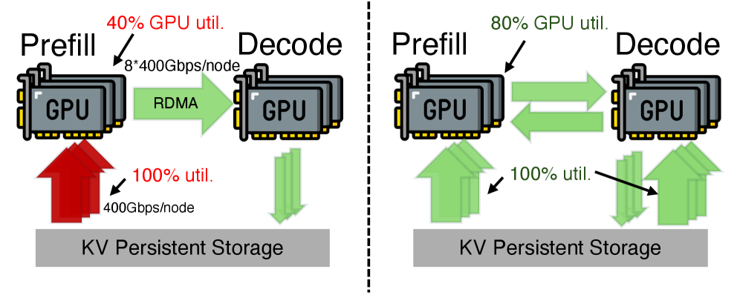
Method Overview (Figure 1)
DualPath adds a second data path for KV-cache loading.
It avoids concentrating all storage reads on prefill engines.
It exploits spare decode-side I/O to break the prefill bottleneck.
Figure 1: Existing bottleneck (left) and DualPath (right).

Slide 6
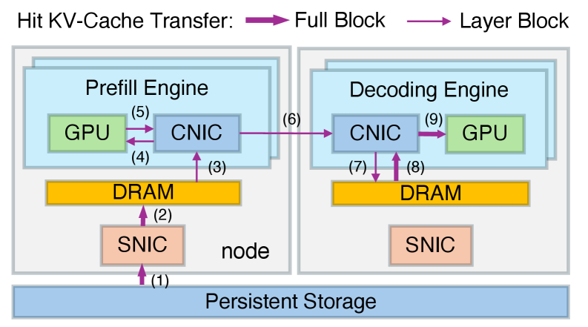
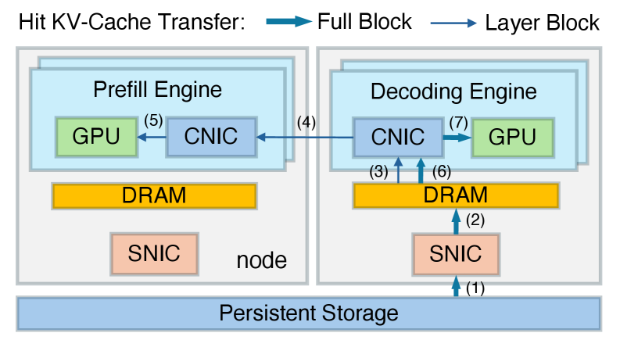
Dual-Path Data Movement (Figure 4a/4b)
Figure 4(a): PE Read Path
Figure 4(b): DE Read Path
PE path serves direct reads; DE path can assist under pressure.
Together they aggregate available storage bandwidth.

Slide 7
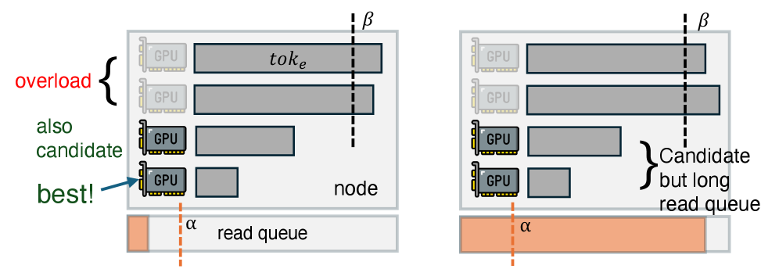
Scheduling and Load Balancing (Figure 5)
Inter-engine scheduling decides where prefill work should run.
Two balancing targets: storage NIC traffic and GPU utilization.
Goal: use spare I/O without harming latency-sensitive collectives.
Figure 5: Inter-engine PE scheduling illustration.

Slide 8
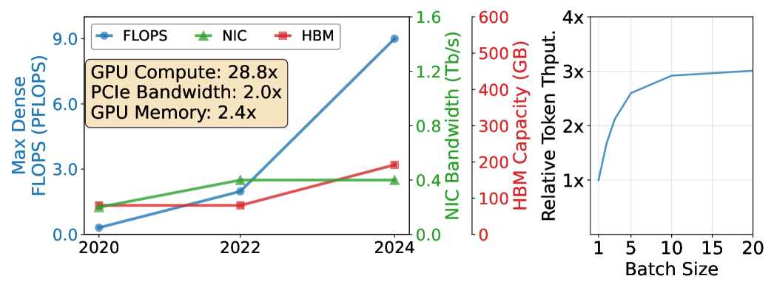
Key Results
Up to
Up to
Up to
Around
1.73x
1.61x
90.9%
77.3%
Throughput gain
Lower median latency
Less storage bandwidth
Speculative token acceptance
Figure 3: Hardware trends and relative token throughput vs request batch size.

Slide 9
Limitations and Considerations
Performance depends on workload shape (turn structure, context length, append size).
Benefits assume compatible cluster/network architecture and KV-cache storage design.
Scheduling complexity increases; careful operational tuning is required.
Reported numbers are from paper-evaluated systems and may vary in different deployments.

Slide 10
Actionable Lessons for Production Teams
Profile storage-network bottlenecks before scaling compute only.
Coordinate prefill and decode as a single bandwidth orchestration problem.
Isolate KV-cache traffic from latency-critical inference communication.
Evaluate serving designs using realistic agent traces, not single-turn prompts only.
Track NIC utilization, queueing, and cache transfer metrics as first-class SLO indicators.

Slide 11
Closing Summary
DualPath reframes agentic LLM serving as a storage-centric systems challenge.
Its dual-path loading + scheduling strategy unlocks major efficiency gains by using available bandwidth more intelligently.
Source: https://arxiv.org/abs/2602.21548

