Slide 1
A Neural Network Approach for Determining Compliance with the GAO AI Accountability Framework
Month XX, 2023

Slide 2
GAO AI Accountability Frameworks Overview
Governance
Data
Monitoring
Performance
Notes:
Governance: Promote accountability by establishing processes to manage, operate, and oversee implementation
Data: Ensure quality, reliability, and representativeness of data sources and processing
Monitoring: Ensure reliability and relevance over time
Performance: Produce results that are consistent with program objectives

Slide 3
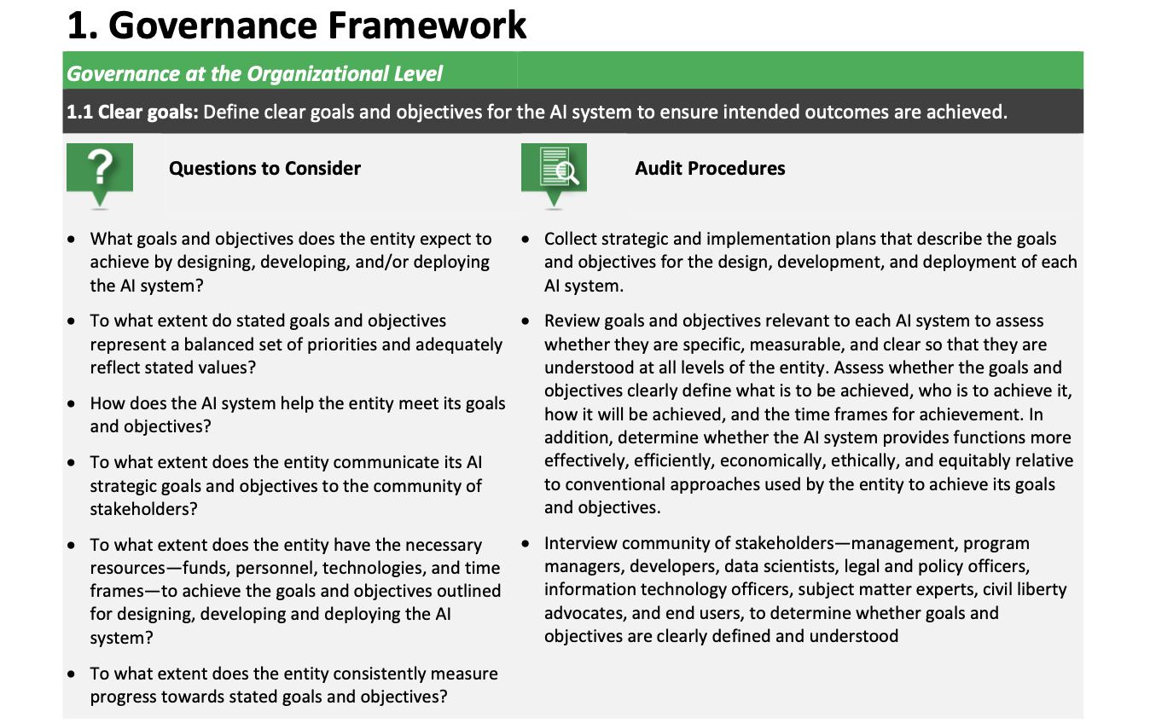
Framework Specifics
Notes:
Describe the problem. Why is it a problem? Who does it affect? What is the proposed solution? How will the solution help?

Slide 4
Neural Network Approach
Compliance Scores for Audit Procedures
Governance
Section 1.1 = Score 20
Section 1.2 = Score 40
Section 1.3 = Score 99
…
Section 1.9 = Score 75
Data
Section 2.1 = Score 27
Compliant? 0-69 = No, 70-100 = Yes
…
Section 2.8 = Score 89
Performance
Section 3.1 = Score 72
…
.
.
.
Section 3.9 = Score 55
Monitoring
Section 4.1 = Score 49
…
Section 4.5 = Score 92
Notes:
Why neural networks? Why can’t we just use a function?

Slide 5
Proposed Solution
High-level overview of solution
Provide simple diagram of solution of user submitting a CSV file to the hypothetical solution
Note that the system could be used/developed by GSA, AI system owners

Slide 6
Determining Compliance with Results

Slide 7
Example

Slide 8
Next Steps

