Slide 1
Project Overview
What is the problem?
GAO currently audits DHS AI/ML use-cases –– but how is this done?
AI Accountability Framework (93 criteria for developers to comply with)
Proposed Solution A tool that:
Allows AI/ML use-case owners to submit self-defined GAO principles scores
Computes an overall compliance score for an AI/ML use-case
Notes:
No mechanisms exist for documenting, scoring, or determining compliance of AI/ML use-cases against the GAO AI Accountability Framework
Governance: The Governance Principle Framework promotes accountability by establishing processes to manage, operate, and oversee implementation
Data: The Data Principle Framework ensures quality, reliability, and representativeness of data sources and processing
Performance: The Performance Principle Framework produces results that are consistent with program objectives
Monitoring: The Monitoring Principle Framework ensures reliability and relevance over time
Quick and objective determination of GAO Framework compliance
Streamline the scoring and compliance process for use-case owners
Surfaces issues with the GAO AI Accountability Framework
Foster scoring/compliance standardization across federal government
Owner self-scores use-case(s) for each framework
Ingest submission and predict compliance for each submitted use-case
Compliance predicted using neural networks
(one for each framework)
Render interactive HTML display

Slide 2
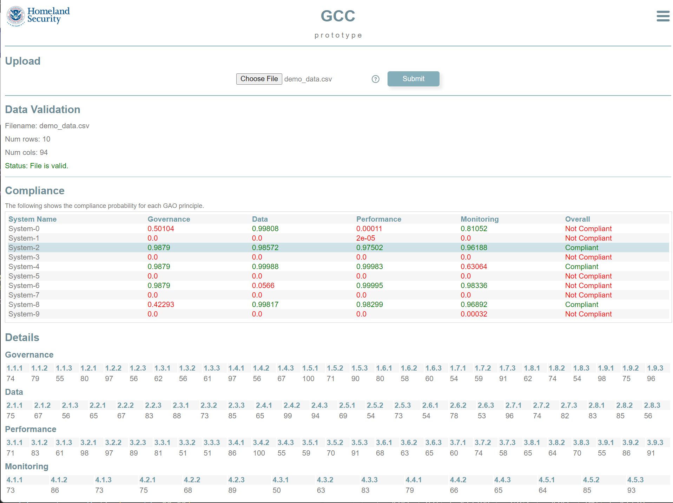
Results
1. Submit CSV
2. Check data format
(0.9879 + 0.98572 + 0.97502 + 0.96188) / 4
0.97763 > 0.70 = Compliant
3. Assess compliance
Notes:
Why neural networks? Why can’t we just use a function?
No guidelines on scoring; there’s variability in how this is currently done (which will throw off numbers)
100k rows of synthetic data

