Slide 1
A Neural Network Approach for Determining Compliance with the GAO AI Accountability Framework
July 28, 2023

Slide 2
Project Overview
What is the problem? No mechanisms exists for documenting, scoring, or determining compliance of AI/ML use-cases against the GAO AI Accountability Framework
Why is this problem important? GAO conducts audits of DHS AI/ML use-cases based on the GAO AI Accountability Framework
What is the proposed solution? Develop a tool that (1) allows AI/ML use-case owners to submit their self-defined GAO principles scores and (2) computes an overall compliance score for an AI/ML use-case.
What is the potential impact of the solution?
Quick determination of GAO Framework compliance
Streamline the scoring and compliance process for use-case owners
Surfaces issues with the GAO AI Accountability Framework
Foster scoring/compliance standardization across federal government
Notes:
Governance: Promote accountability by establishing processes to manage, operate, and oversee implementation
Data: Ensure quality, reliability, and representativeness of data sources and processing
Performance: Produce results that are consistent with program objectives
Monitoring: Ensure reliability and relevance over time

Slide 3
GAO AI Accountability Framework Overview
Comprises Four Principles Frameworks
Governance
2. Data
3. Performance
4. Monitoring
Notes:
Governance: The Governance Principle Framework promotes accountability by establishing processes to manage, operate, and oversee implementation
Data: The Data Principle Framework ensures quality, reliability, and representativeness of data sources and processing
Performance: The Performance Principle Framework produces results that are consistent with program objectives
Monitoring: The Monitoring Principle Framework ensures reliability and relevance over time

Slide 4
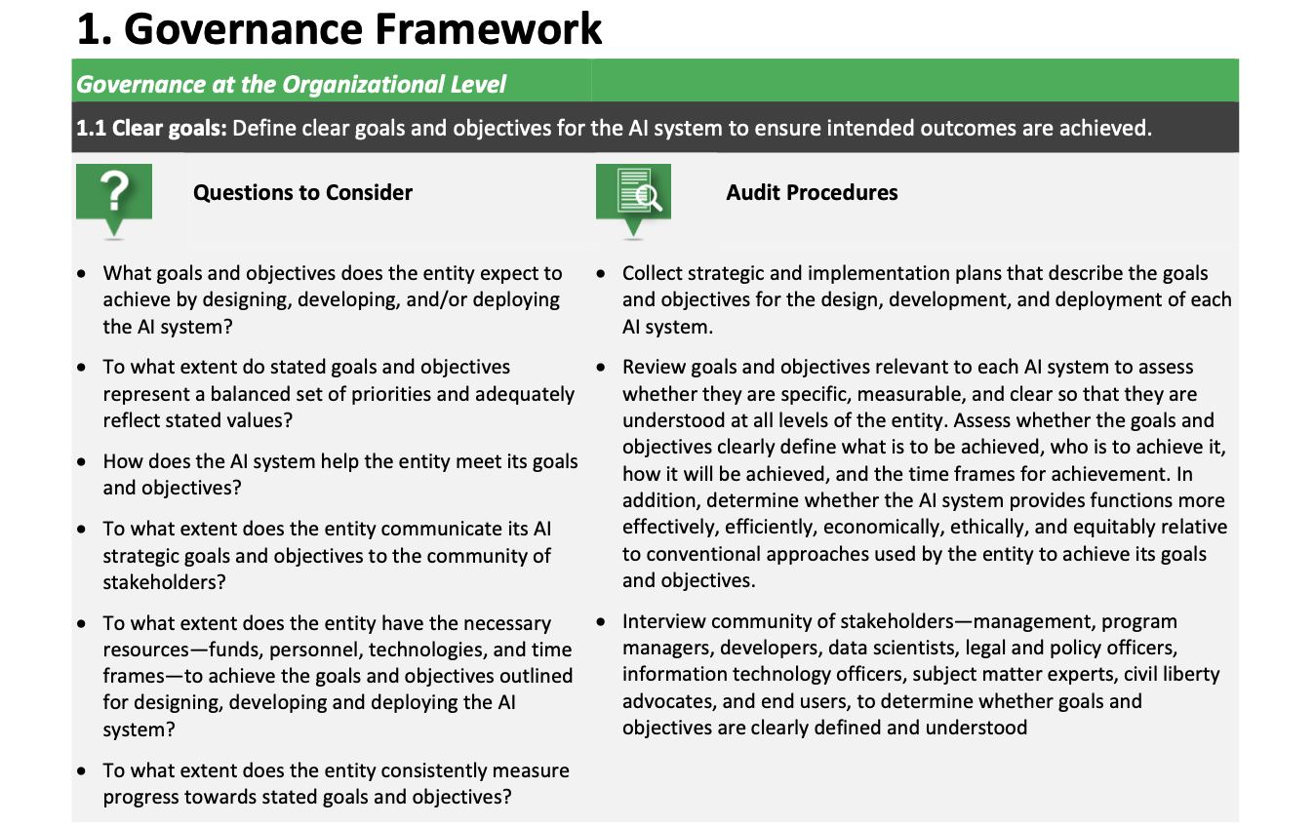
Example: Governance Principle Framework
These will need to be further broken down
into deeper subsections
1.1.1
1.1.2
1.1.3
Notes:
Describe the problem. Why is it a problem? Who does it affect?

Slide 5
Concept of Operations (cont.)
1
Owner self-scores use-case(s) for
each principle.
Owner will self-score each of the 93+ audit requirements
Owner will add scores for one or more use-cases to a CSV file.
Notes:
Describe the problem. Why is it a problem? Who does it affect? What is the proposed solution? How will the solution help?

Slide 6
Concept of Operations (cont.)
Example Scores CSV Submission
Notes:
Describe the problem. Why is it a problem? Who does it affect? What is the proposed solution? How will the solution help?

Slide 7
Concept of Operations (cont.)
1
Owner self-scores use-case(s) for
each principle.
2
Ingest submission and predict compliance for each submitted use-case
Compliance predicted using neural networks (one for each Principle Framework)
Submit CSV
Notes:
Describe the problem. Why is it a problem? Who does it affect? What is the proposed solution? How will the solution help?

Slide 8
Neural Network Architecture
Model Card
Arch: 3-layer, Sequential (FF)
Package: Keras/TensorFlow
Activation Function: Sigmoid
Output: binary
Training: 100k synthetic
Accuracy: TBD
Compliance Scores for Audit Procedures
Governance
Section 1.1 = Score 20
Section 1.2 = Score 40
Section 1.3 = Score 99
…
Section 1.9 = Score 75
Data
Section 2.1 = Score 27
Compliant? 0-69% = No, 70-100% = Yes
…
Section 2.8 = Score 89
Performance
Section 3.1 = Score 72
…
.
.
.
Section 3.9 = Score 55
Monitoring
Section 4.1 = Score 49
…
Section 4.5 = Score 92
Notes:
What is the proposed solution? How will the solution help?
NN: performs calculations using some (or all) of the neurons in the last layer of the neural network, which uses these values in the next layer of the neural network
Why neural networks? Why can’t we just use a function?
No guidelines on scoring; there’s variability in how this is currently done (which will throw off numbers)

Slide 9
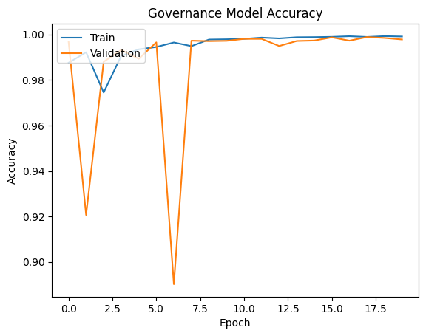
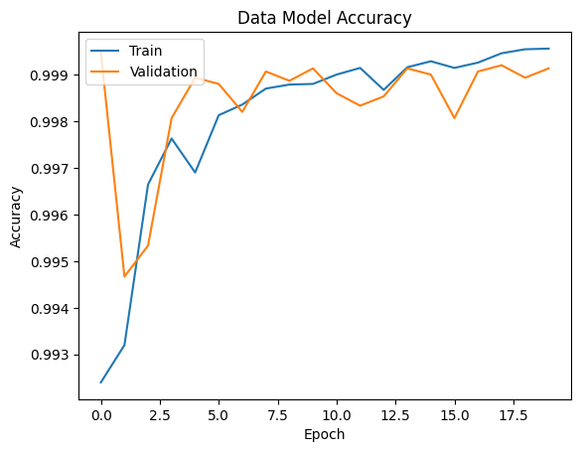
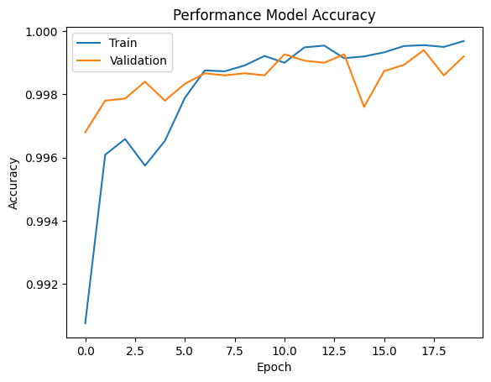
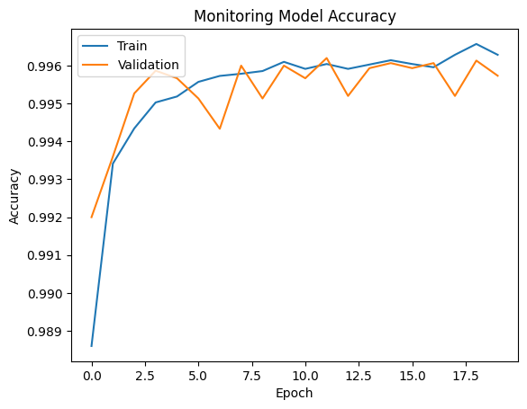
Model Performance (Accuracy)
Notes:
Validation: allows for unbiased evaluation of a model fit on the training data set while tuning the hyperparameters (the number of hidden units in a neural network)

Slide 10
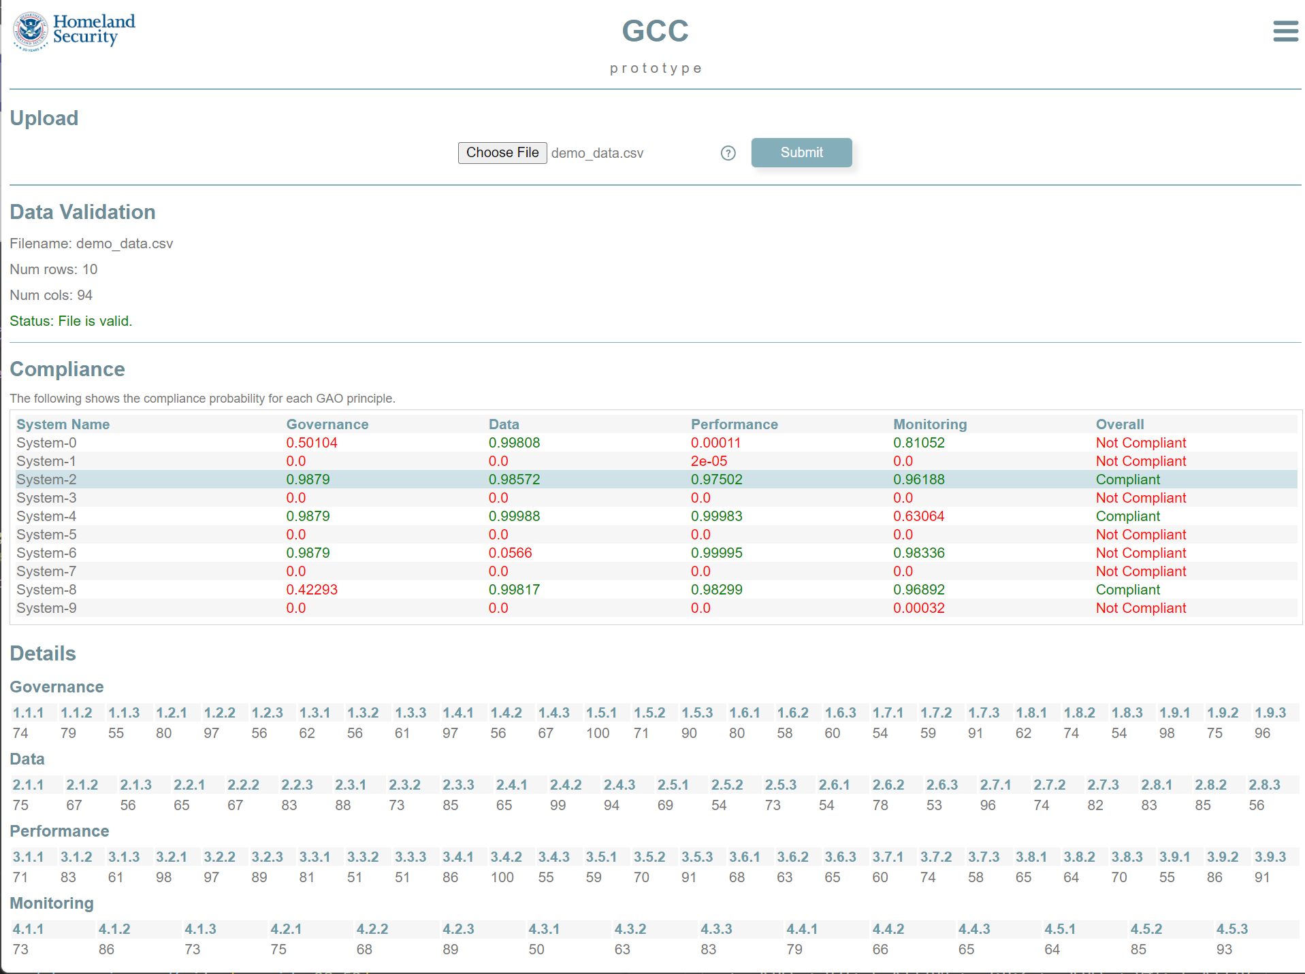
Concept of Operations (cont.)
1
Owner self-scores use-case(s) for
each principle.
2
Ingest submission and compute compliance for each submitted use-case
3
Render interactive HTML display
Submit CSV
Display results
Notes:
Describe the problem. Why is it a problem? Who does it affect? What is the proposed solution? How will the solution help?

Slide 11
Results

Slide 12
Next Steps
Fine-tune training data & parameters
Further guidance on scoring from GAO
Possibility of rules instituted to handle edge cases?
Collaboration on stand-up service with GAO
Enhance guidance for GAO framework (AI principles)
Adapt to NIST AI Risk Framework

