Slide 1
A Neural Network Approach for Determining Compliance with the GAO AI Accountability Framework
Month XX, 2023

Slide 2
GAO AI Accountability Frameworks Overview
Governance
Data
Monitoring
Performance
Notes:
Governance: Promote accountability by establishing processes to manage, operate, and oversee implementation
Data: Ensure quality, reliability, and representativeness of data sources and processing
Monitoring: Ensure reliability and relevance over time
Performance: Produce results that are consistent with program objectives

Slide 3
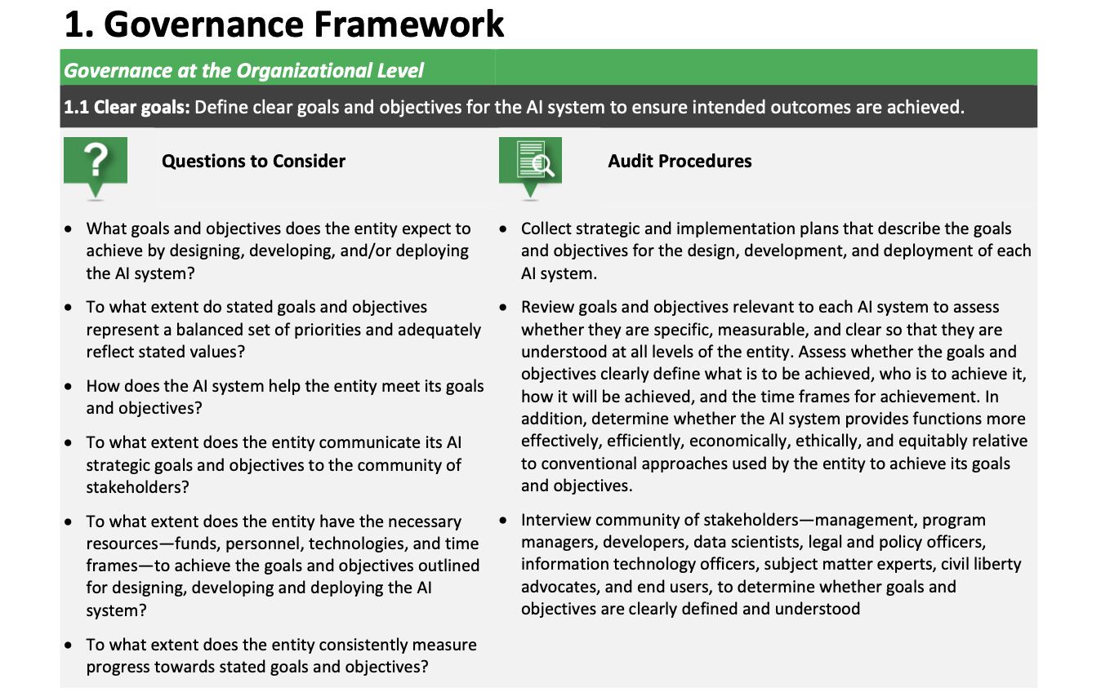
Framework Specifics
Notes:
Describe the problem. Why is it a problem? Who does it affect? What is the proposed solution? How will the solution help?

Slide 4
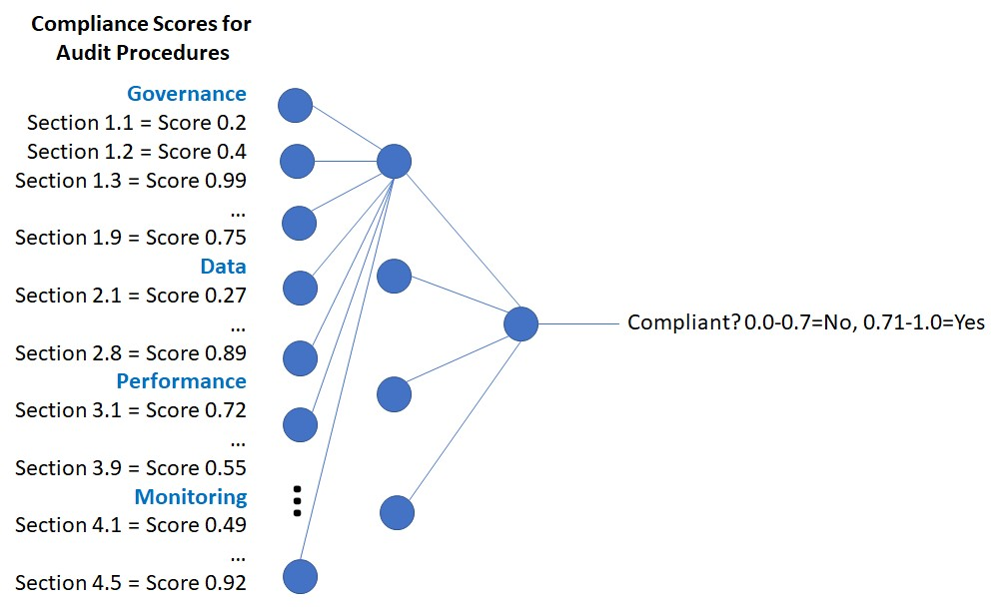
Neural Network Approach
Notes:
Why neural networks? Why can’t we just use a function?

Slide 5
Proposed Solution
High-level overview of solution
Provide simple diagram of solution of user submitting a CSV file to the hypothetical solution
Note that the system could be used/developed by GSA, AI system owners

Slide 6
Determining Compliance with Results

Slide 7
Example

Slide 8
Next Steps

