Slide 1
A Neural Network Approach for Determining Compliance with the GAO AI Accountability Framework
August 16, 2023

Slide 2
Project Overview
What is the problem?
GAO audits DHS AI/ML use-cases based on the GAO AI Accountability Framework –– but how is this done?
Why is this problem important?
No mechanisms exist for documenting, scoring, or determining compliance of AI/ML use-cases against the GAO AI Accountability Framework

Slide 3
Project Overview
What is the proposed solution? A tool that:
Allows AI/ML use-case owners to submit self-defined GAO principles scores
Computes an overall compliance score for an AI/ML use-case
What is the potential impact of the solution?
Quick and objective determination of GAO Framework compliance
Streamline the scoring and compliance process for use-case owners
Surfaces issues with the GAO AI Accountability Framework
Foster scoring/compliance standardization across federal government

Slide 4
What I Learned

Slide 5
What I Liked/Didn’t Like

Slide 6
Impact on Future Work

Slide 7
GAO AI Accountability Framework Overview
Governance
2. Data
3. Performance
4. Monitoring
Notes:
Governance: The Governance Principle Framework promotes accountability by establishing processes to manage, operate, and oversee implementation
Data: The Data Principle Framework ensures quality, reliability, and representativeness of data sources and processing
Performance: The Performance Principle Framework produces results that are consistent with program objectives
Monitoring: The Monitoring Principle Framework ensures reliability and relevance over time

Slide 8
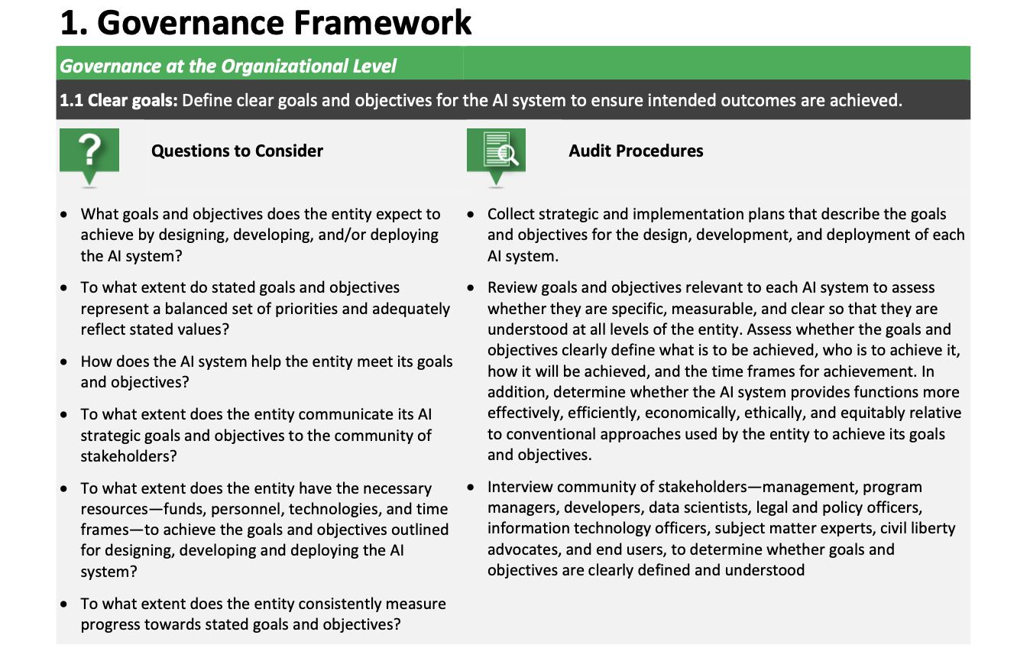
Example: Governance Framework
Who is responsible for answering?
How would the necessary perspectives be gathered?
These need to be broken down
into deeper subsections!
1.1.1
1.1.2
1.1.3

Slide 9
Concept of Operations
1
Owner self-scores use-case(s) for
each framework
Owner will self-score each of the 93 audit requirements
Owner will add scores for one or more use-cases to a CSV file

Slide 10
Concept of Operations (cont.)
Example Scores CSV Submission

Slide 11
Concept of Operations (cont.)
1
Owner self-scores use-case(s) for
each framework
2
Ingest submission and predict compliance for each submitted use-case
Compliance predicted using neural networks
(one for each framework)
Submit CSV

Slide 12
Neural Network Architecture (Governance)
Model Card
Arch: 3-layer, Sequential (FF)
Package: Keras/TensorFlow
Activation Function: Sigmoid
Output: binary
Training: 100k synthetic
Compliance Scores for Audit Procedures
[64]
[27]
[32]
Section 1.1.1 = Score 85
Section 1.1.2 = Score 96
[1]
Section 1.1.3 = Score 64
Framework Compliant? 0-69% = No, 70-100% = Yes
Section 1.2.1 = Score 83
Section 1.2.2 = Score 60
.
.
.
.
.
.
.
.
.
.
.
.
Section 1.9.3 = Score 75
Notes:
93 TOTAL INPUTS
What is the proposed solution? How will the solution help?
NN: performs calculations using some (or all) of the neurons in the last layer of the neural network, which uses these values in the next layer of the neural network
Why neural networks? Why can’t we just use a function?
No guidelines on scoring; there’s variability in how this is currently done (which will throw off numbers)

Slide 13
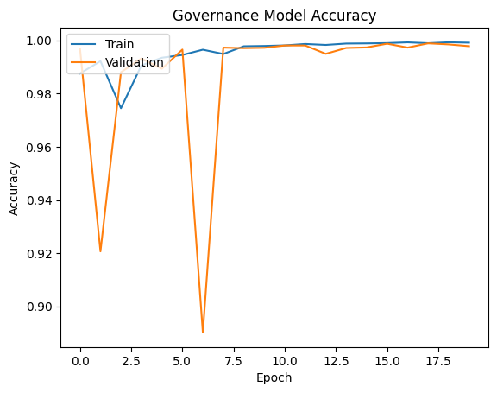
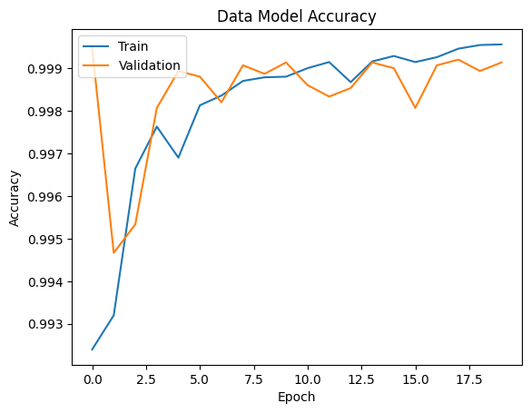
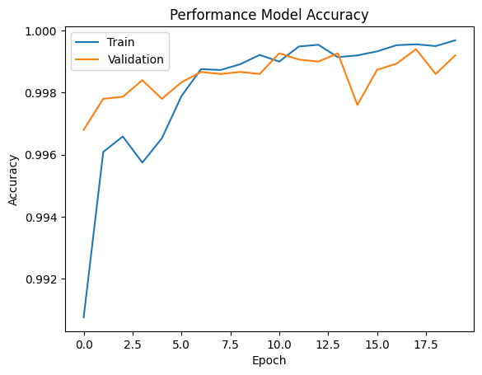
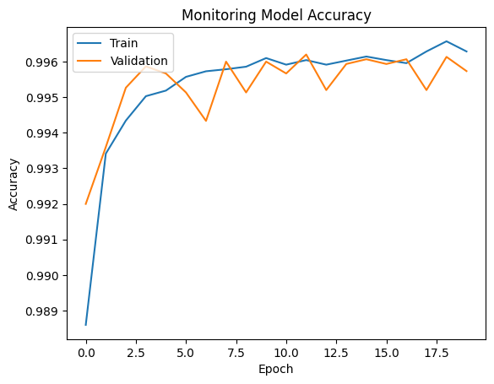
Model Performance (Accuracy)
Notes:
Validation: allows for unbiased evaluation of a model fit on the training data set while tuning the hyperparameters (the number of hidden units in a neural network)

Slide 14
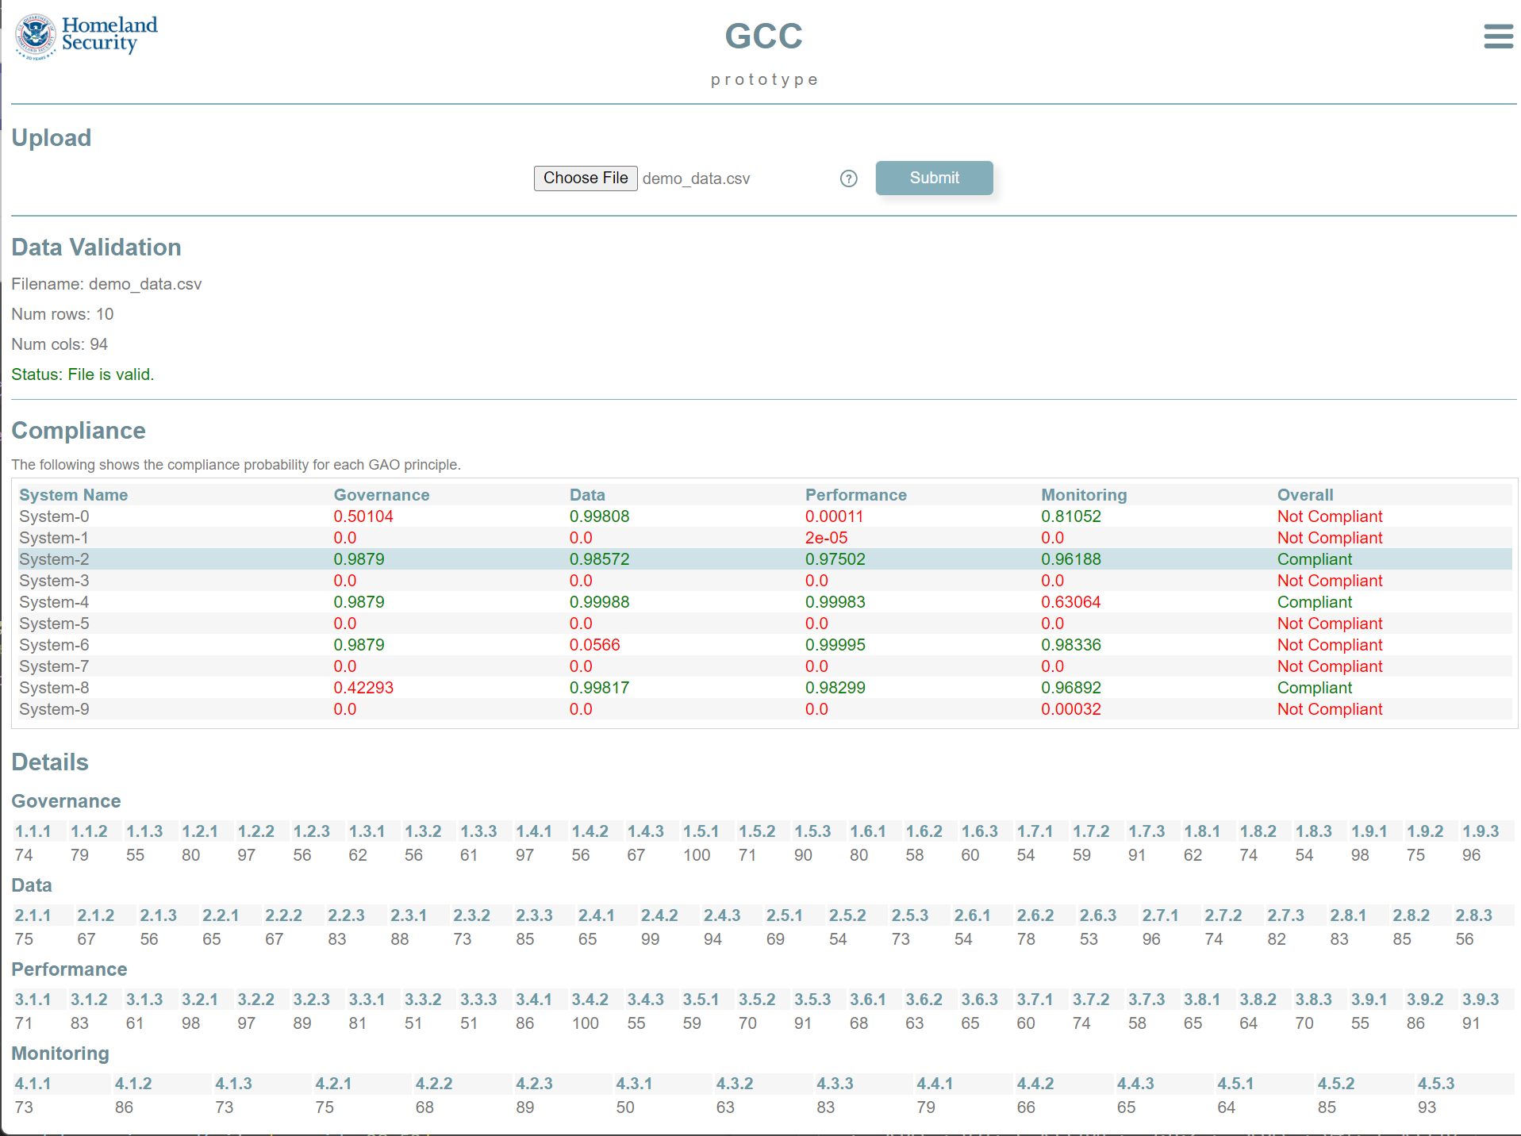
Concept of Operations (cont.)
1
Owner self-scores use-case(s) for
each framework
2
Ingest submission and compute compliance for each submitted use-case
3
Render interactive HTML display
Submit CSV
Display results

Slide 15
Results
1. Submit CSV
2. Check data format
(0.9879 + 0.98572 + 0.97502 + 0.96188) / 4
0.97763 > 0.70 = Compliant
3. Assess compliance

Slide 16
Next Steps
Fine-tune training data, neural network architecture & parameters
Further guidance on scoring from GAO
Possibility of rules instituted to handle edge cases?
Collaboration on stand-up service with GAO
Enhance guidance for GAO framework (AI principles)
Adapt to NIST AI Risk Framework

