Slide 1
A Neural Network Approach for Determining Compliance with the GAO AI Accountability Framework
July 28, 2023

Slide 2
GAO AI Accountability Frameworks Overview
Governance
Data
Performance
Monitoring
Notes:
Governance: Promote accountability by establishing processes to manage, operate, and oversee implementation
Data: Ensure quality, reliability, and representativeness of data sources and processing
Performance: Produce results that are consistent with program objectives
Monitoring: Ensure reliability and relevance over time

Slide 3
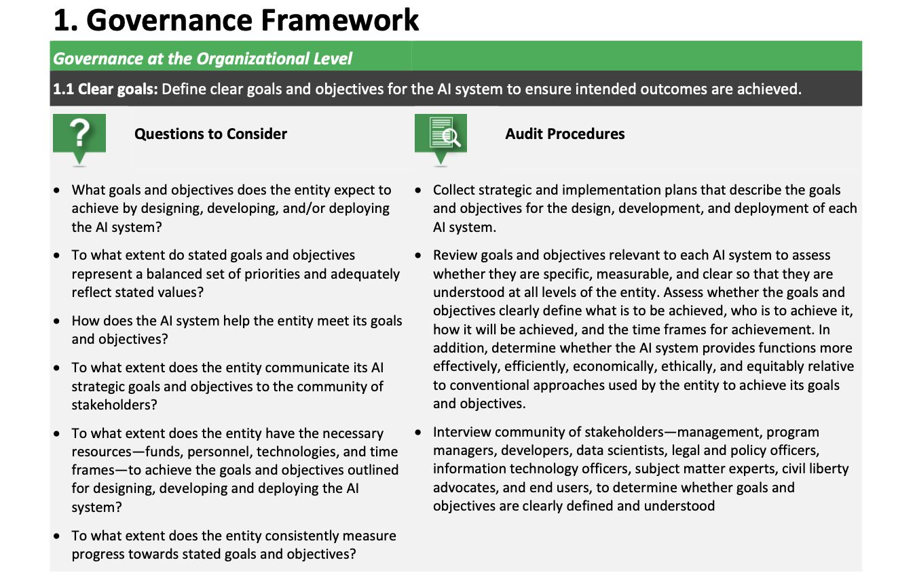
Framework Specifics
Notes:
Describe the problem. Why is it a problem? Who does it affect? What is the proposed solution? How will the solution help?

Slide 4
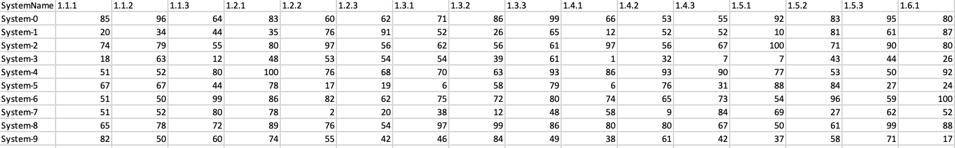
Framework Standardization
Notes:
Describe the problem. Why is it a problem? Who does it affect? What is the proposed solution? How will the solution help?

Slide 5
Neural Network Approach
Compliance Scores for Audit Procedures
Governance
Section 1.1 = Score 20
Section 1.2 = Score 40
Section 1.3 = Score 99
…
Section 1.9 = Score 75
Data
Section 2.1 = Score 27
Compliant? 0-69% = No, 70-100% = Yes
…
Section 2.8 = Score 89
Performance
Section 3.1 = Score 72
…
.
.
.
Section 3.9 = Score 55
Monitoring
Section 4.1 = Score 49
…
Section 4.5 = Score 92
Notes:
Why neural networks? Why can’t we just use a function?
No guidelines on scoring; there’s variability in how this is currently done (which will throw off numbers)

Slide 6
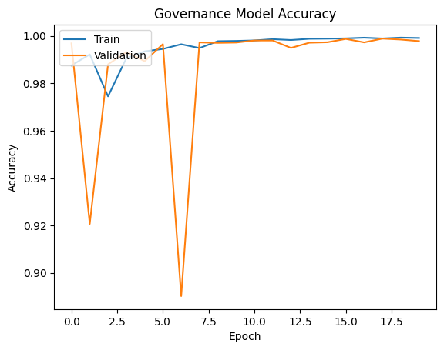
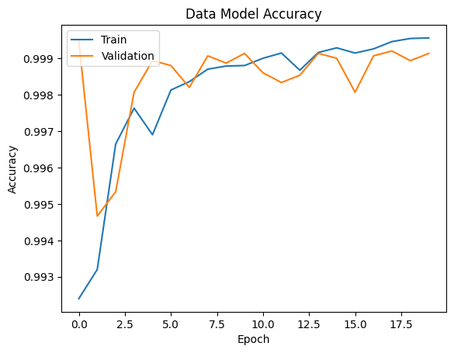
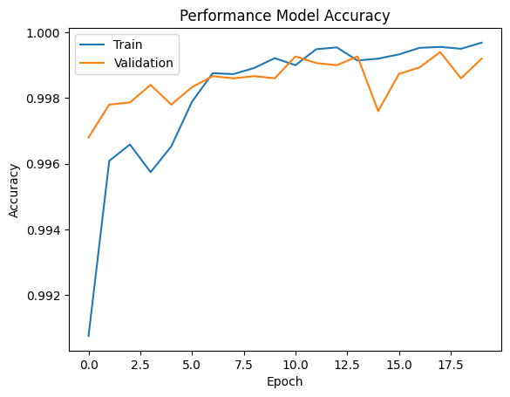
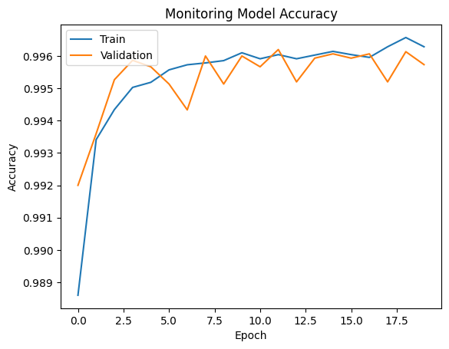
Model Performance (Accuracy)

Slide 7
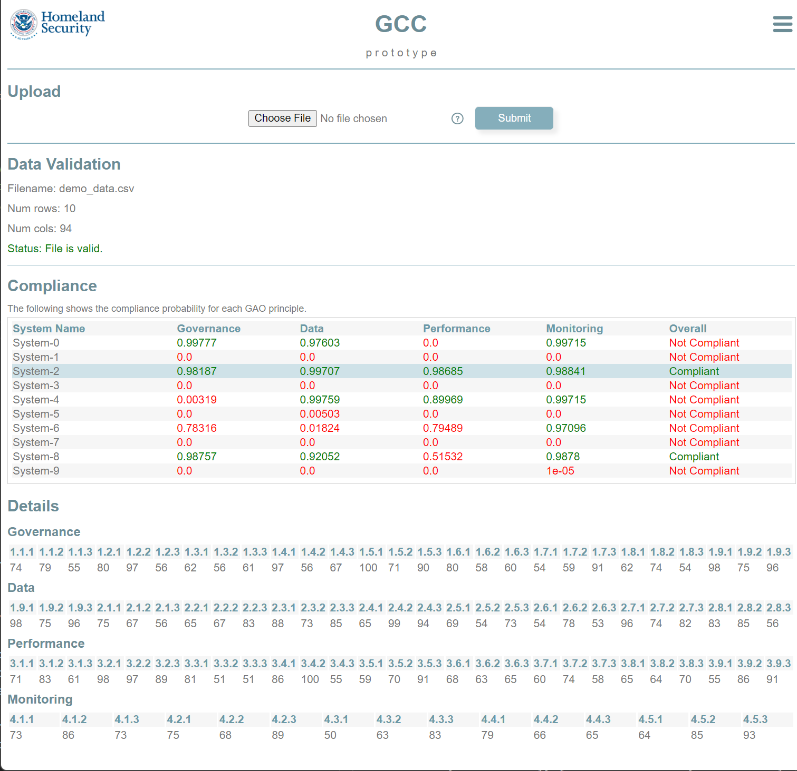
User Submission

Slide 8
Going Forward
Fine-tune training data & parameters
Further guidance on scoring from GAO
Possibility of rules instituted to handle edge cases?
Collaboration on stand-up service with GAO
Enhance/expand upon guidance for GAO framework (AI principles)

