Slide 1
A Neural Network Approach for Determining Compliance with the GAO AI Accountability Framework
August 21, 2023

Slide 2
Project Overview
What is the proposed solution?
Submission of self-defined GAO framework scores
Computation of overall compliance score for AI/ML use-cases
What is the potential impact of the solution?
Quick and objective determination of GAO Framework compliance
Streamline the scoring and compliance process for use-case owners
Foster scoring/compliance standardization across federal government

Slide 3
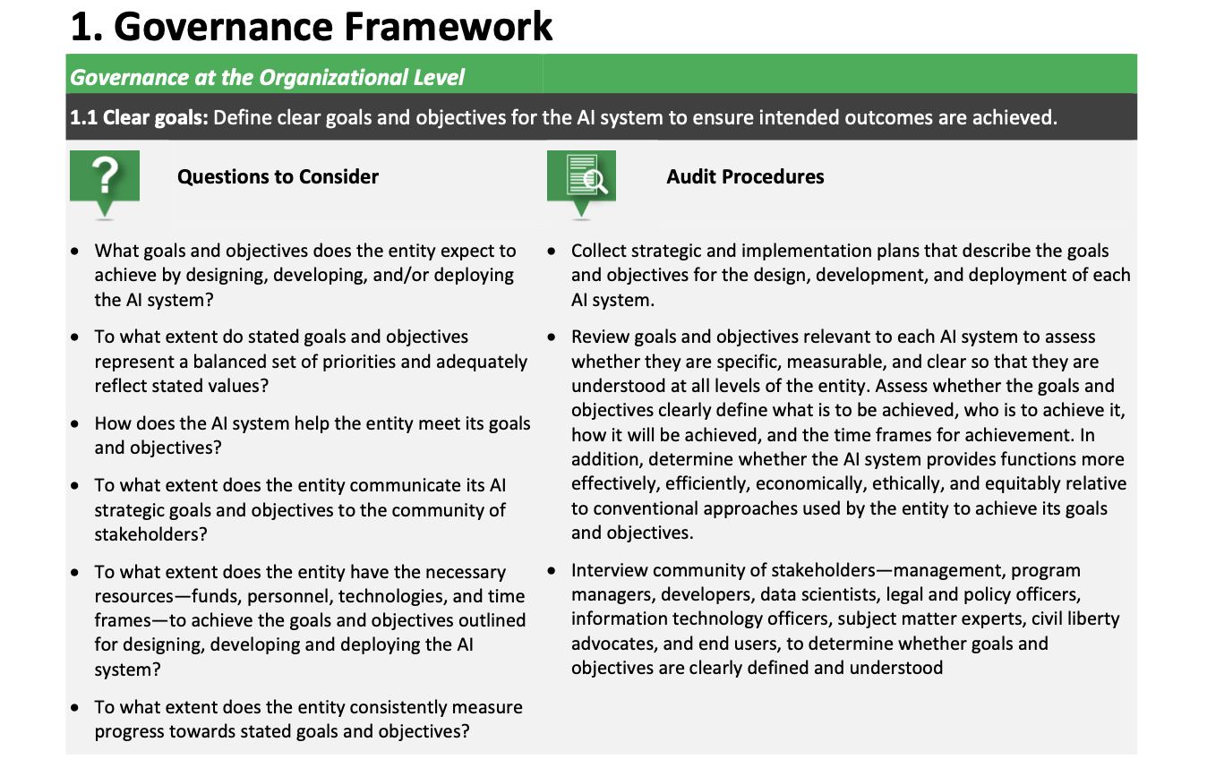
Example: Governance Framework
1.1.1
1.1.2
1.1.3

Slide 4
Hierarchical Overview
GCC UI (Flask)
Instantiate models &
calculate overall compliance
GAO Principles
Governance
Performance
Monitoring
Data
Create NNs & train/test, fit, evaluate
Training Data
Create synthetic data (evenly distributed)

Slide 5
Neural Network Architecture (Governance)
Model Card
Arch: 3-layer, Sequential (FF)
Package: Keras/TensorFlow
Activation Function: Sigmoid
Output: binary
Training: 100k synthetic
Compliance Scores for Audit Procedures
[64]
[27]
[32]
Section 1.1.1 = Score 85
Section 1.1.2 = Score 96
[1]
Section 1.1.3 = Score 64
Framework Compliant? 0-69% = No, 70-100% = Yes
Section 1.2.1 = Score 83
Section 1.2.2 = Score 60
.
.
.
.
.
.
.
.
.
.
.
.
Section 1.9.3 = Score 75
Notes:
93 TOTAL INPUTS
What is the proposed solution? How will the solution help?
NN: performs calculations using some (or all) of the neurons in the last layer of the neural network, which uses these values in the next layer of the neural network
Why neural networks? Why can’t we just use a function?
No guidelines on scoring; there’s variability in how this is currently done (which will throw off numbers)

Slide 6
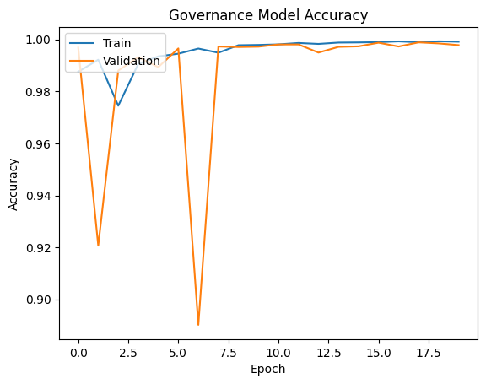
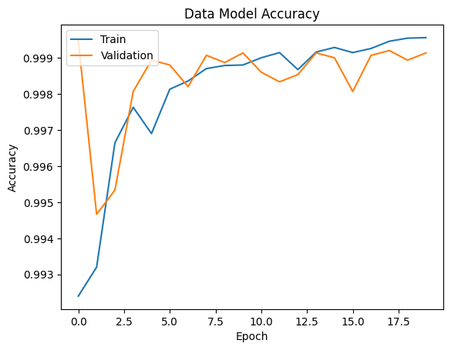
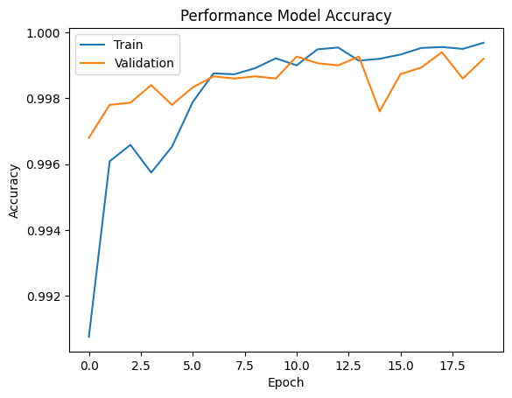
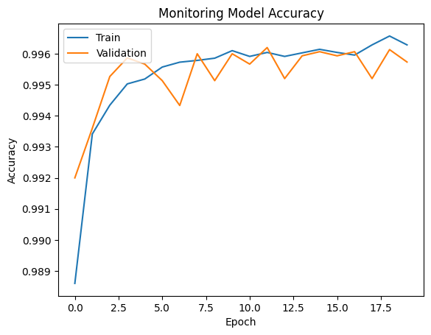
Model Performance (Accuracy)
Notes:
Validation: allows for unbiased evaluation of a model fit on the training data set while tuning the hyperparameters (the number of hidden units in a neural network)

Slide 7
Concept of Operations
1
Owner self-scores use-case(s) for
each framework
Owner will self-score each of the 93 audit requirements
Owner will add scores for one or more use-cases to a CSV file

Slide 8
Concept of Operations (cont.)
Example Scores CSV Submission

Slide 9
Concept of Operations (cont.)
1
Owner self-scores use-case(s) for
each framework
2
Ingest submission and predict compliance for each submitted use-case
Compliance predicted using neural networks
(one for each framework)
Submit CSV

Slide 10
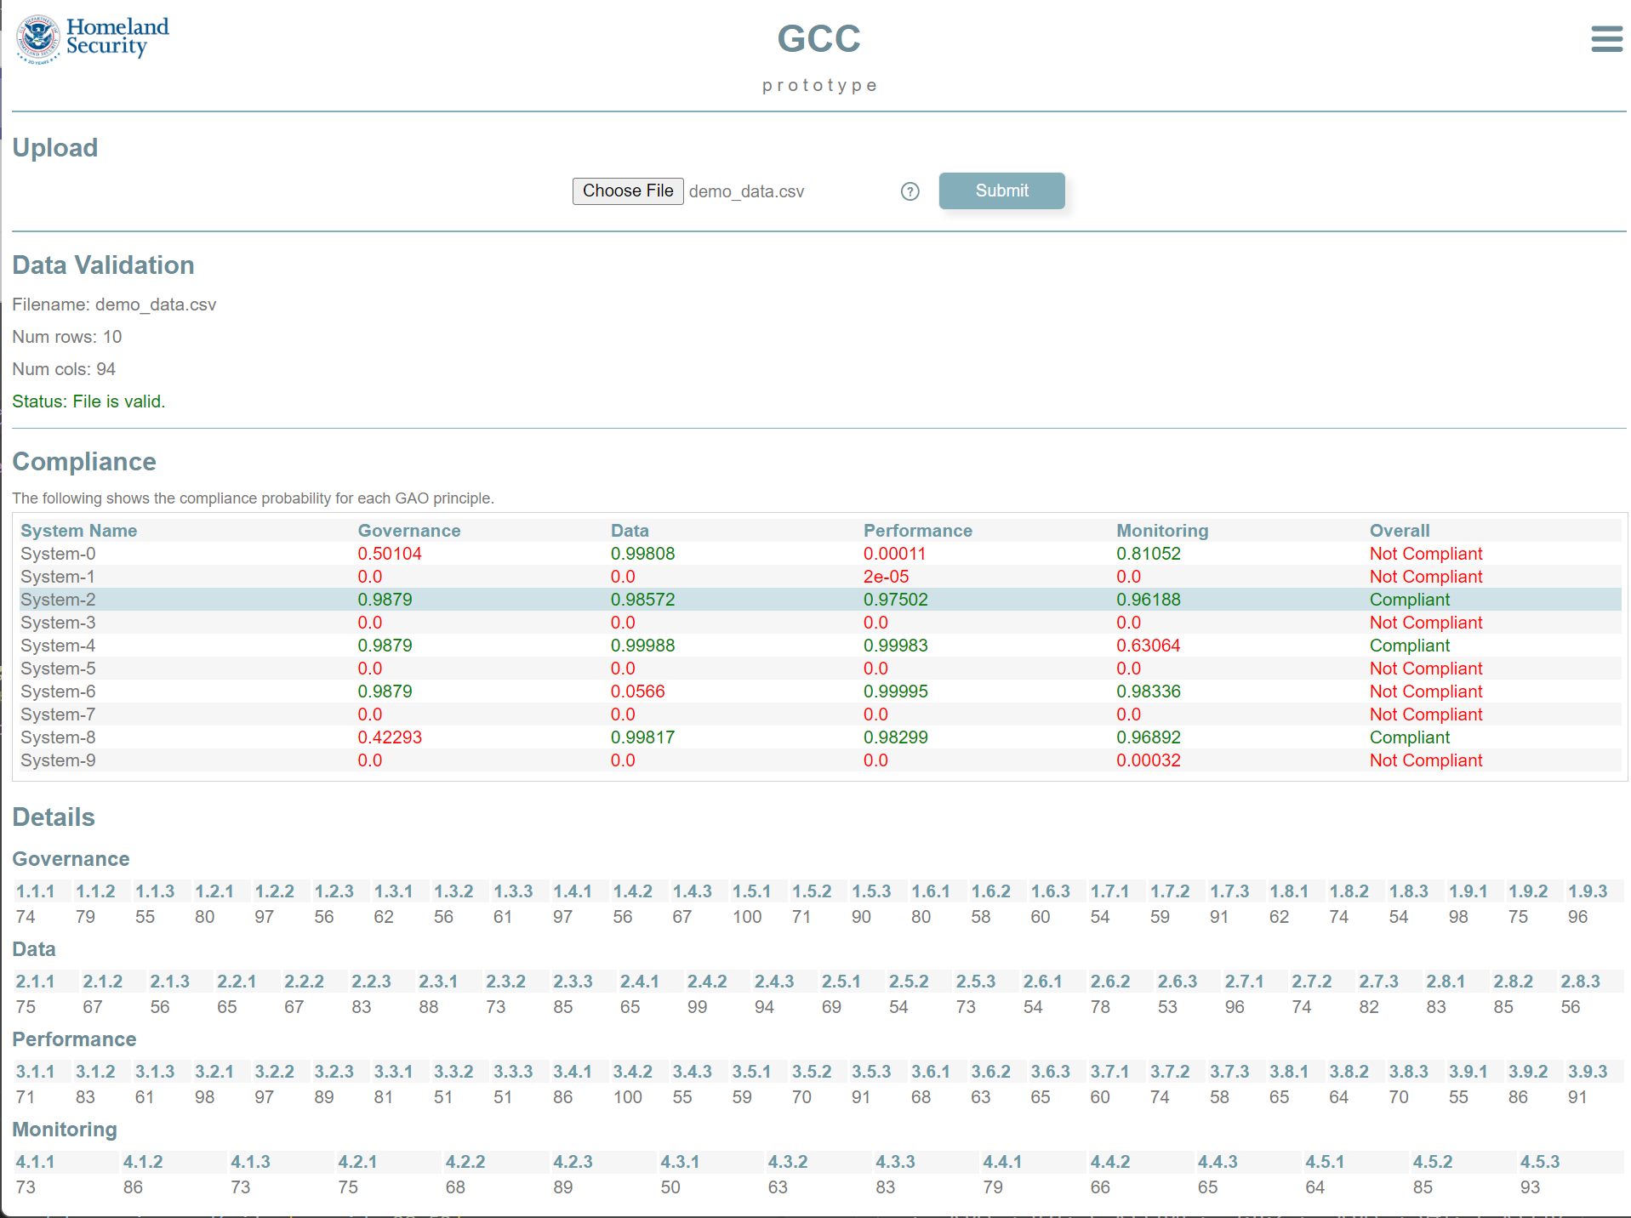
Concept of Operations (cont.)
1
Owner self-scores use-case(s) for
each framework
2
Ingest submission and compute compliance for each submitted use-case
3
Render interactive HTML display
Submit CSV
Display results

Slide 11
Results
1. Submit CSV
2. Check data format
(0.9879 + 0.98572 + 0.97502 + 0.96188) / 4
0.97763 > 0.70 = Compliant
3. Assess compliance

