Slide 1
A Neural Network Approach for Determining Compliance with the GAO AI Accountability Framework
July 28, 2023

Slide 2
GAO AI Accountability Frameworks Overview
Governance
Data
Performance
Monitoring
Notes:
Governance: Promote accountability by establishing processes to manage, operate, and oversee implementation
Data: Ensure quality, reliability, and representativeness of data sources and processing
Performance: Produce results that are consistent with program objectives
Monitoring: Ensure reliability and relevance over time

Slide 3
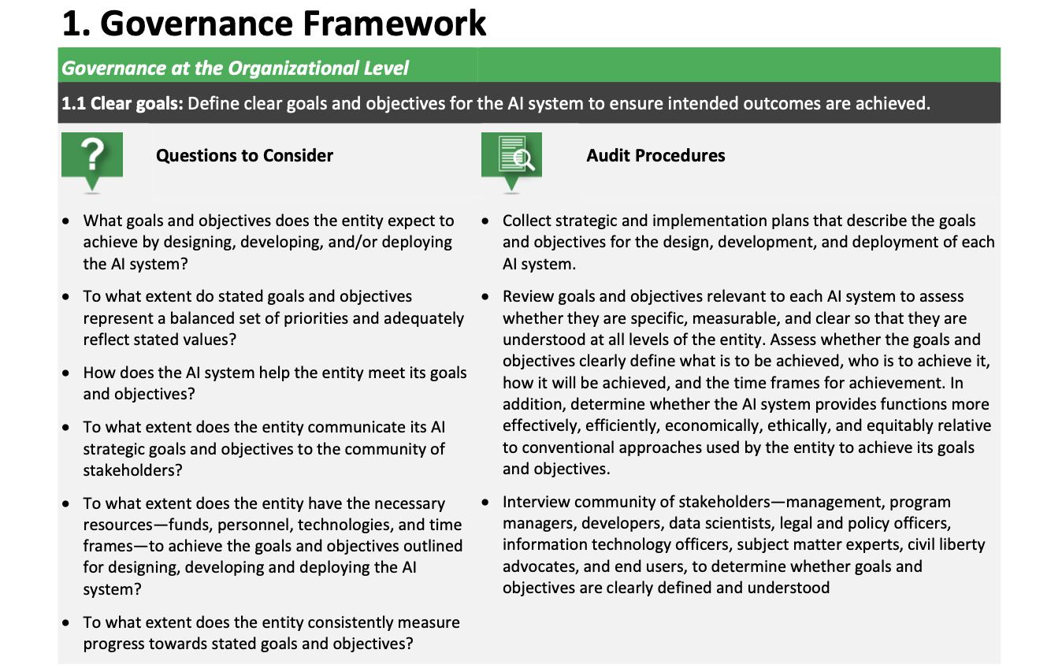
Framework Specifics
Notes:
Describe the problem. Why is it a problem? Who does it affect?

Slide 4
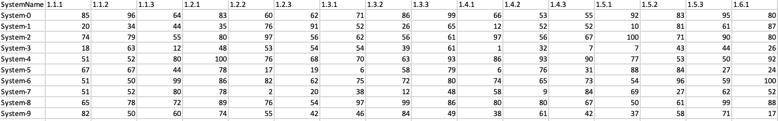
Framework Standardization
Notes:
Describe the problem. Why is it a problem? Who does it affect? What is the proposed solution? How will the solution help?

Slide 5
Neural Network Approach
Compliance Scores for Audit Procedures
Governance
Section 1.1 = Score 20
Section 1.2 = Score 40
Section 1.3 = Score 99
…
Section 1.9 = Score 75
Data
Section 2.1 = Score 27
Compliant? 0-69% = No, 70-100% = Yes
…
Section 2.8 = Score 89
Performance
Section 3.1 = Score 72
…
.
.
.
Section 3.9 = Score 55
Monitoring
Section 4.1 = Score 49
…
Section 4.5 = Score 92
Notes:
What is the proposed solution? How will the solution help?
NN: performs calculations using some (or all) of the neurons in the last layer of the neural network, which uses these values in the next layer of the neural network
Why neural networks? Why can’t we just use a function?
No guidelines on scoring; there’s variability in how this is currently done (which will throw off numbers)

Slide 6
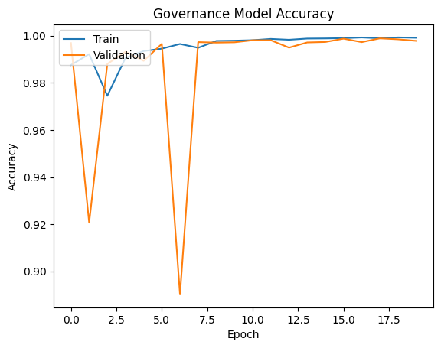
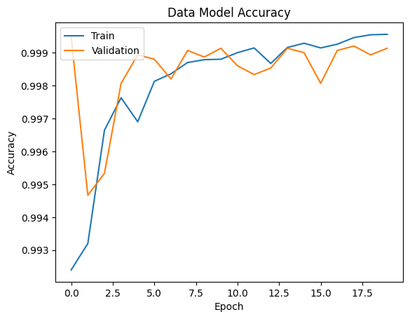
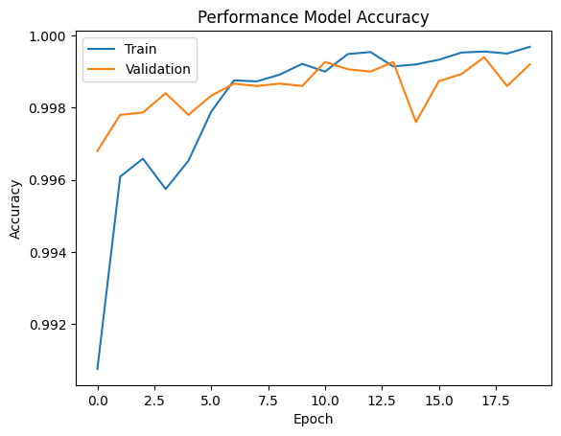
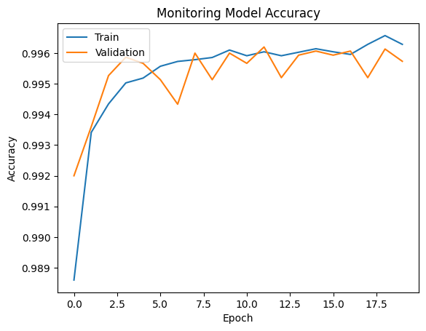
Model Performance (Accuracy)
Notes:
Validation: allows for unbiased evaluation of a model fit on the training data set while tuning the hyperparameters (the number of hidden units in a neural network)

Slide 7
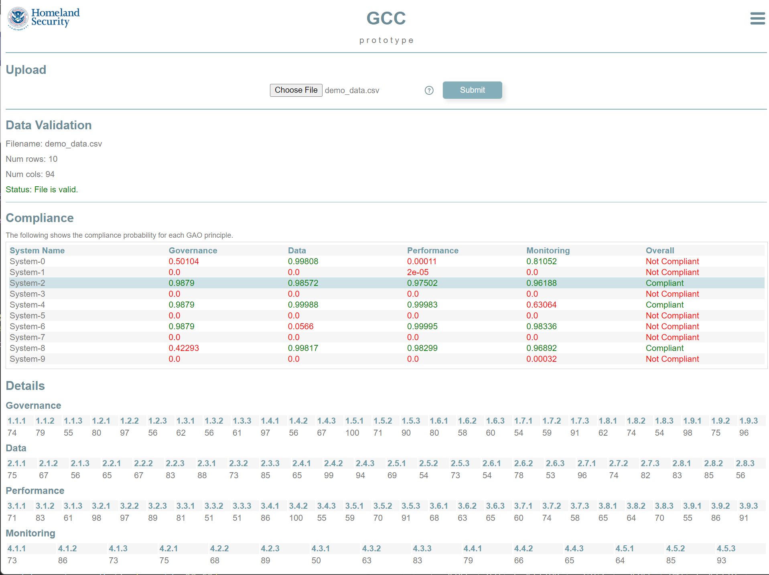
User Submission

Slide 8
Going Forward
Fine-tune training data & parameters
Further guidance on scoring from GAO
Possibility of rules instituted to handle edge cases?
Collaboration on stand-up service with GAO
Enhance guidance for GAO framework (AI principles)

