Slide 1
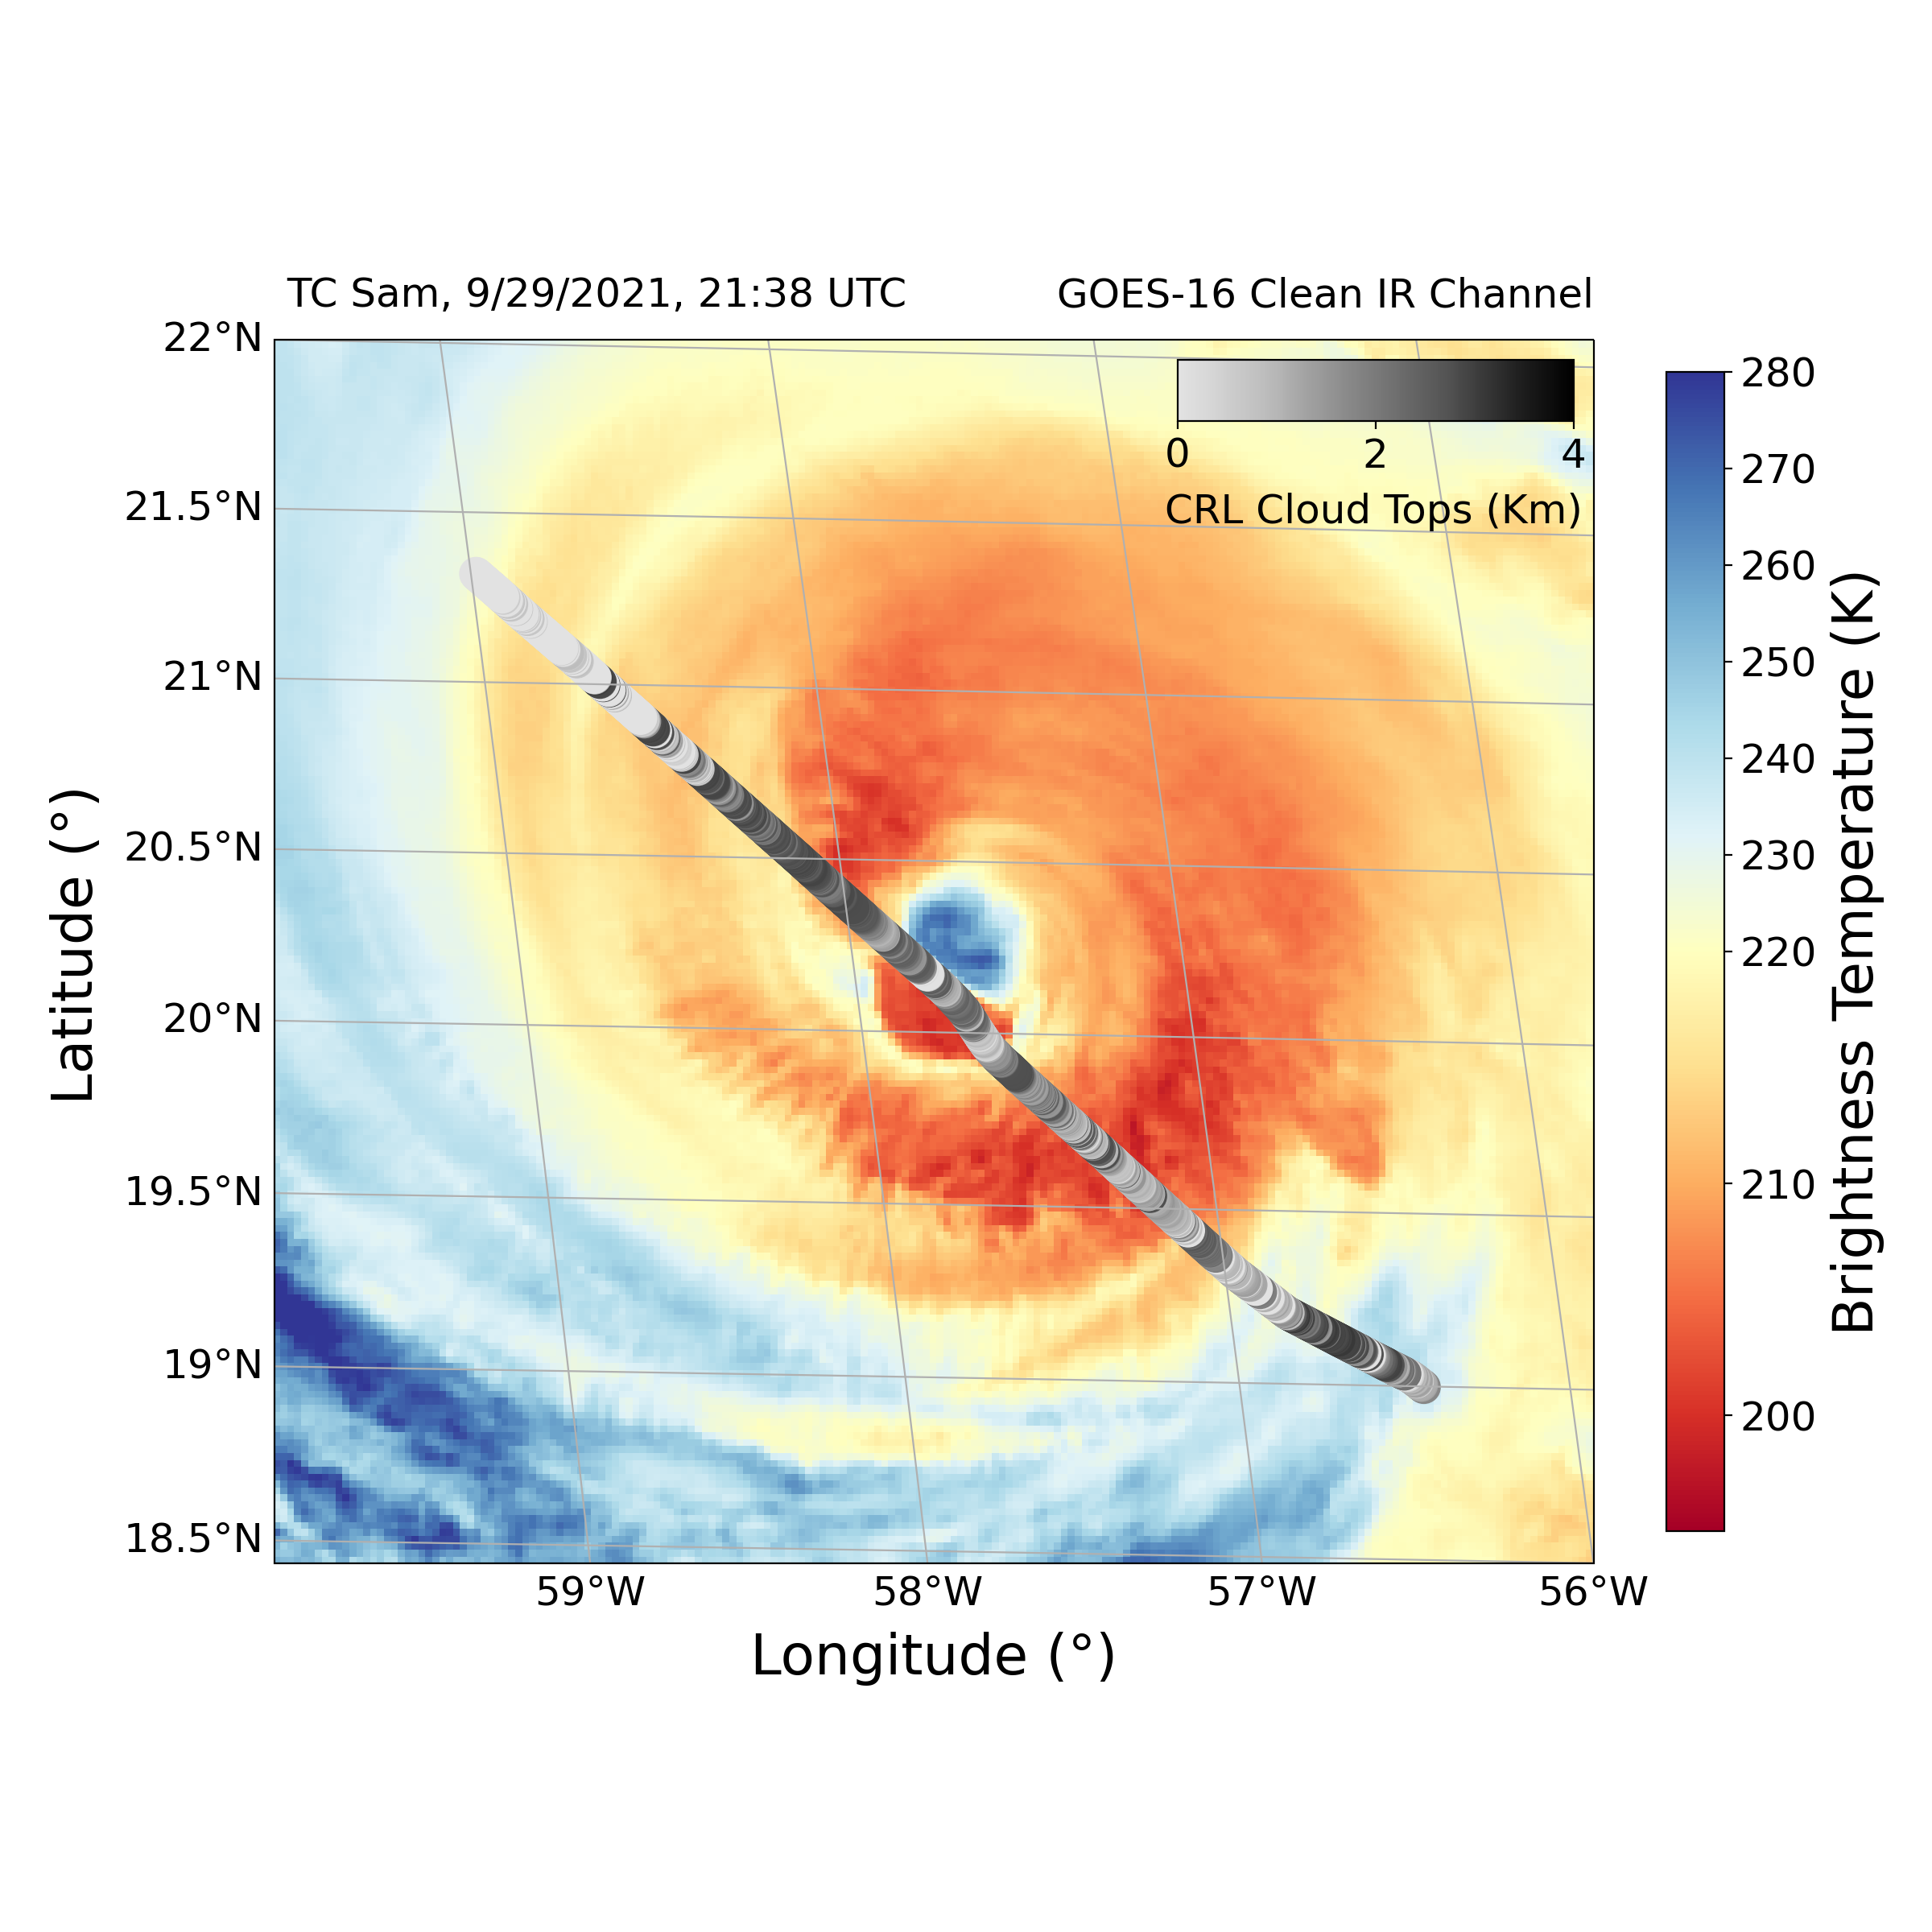
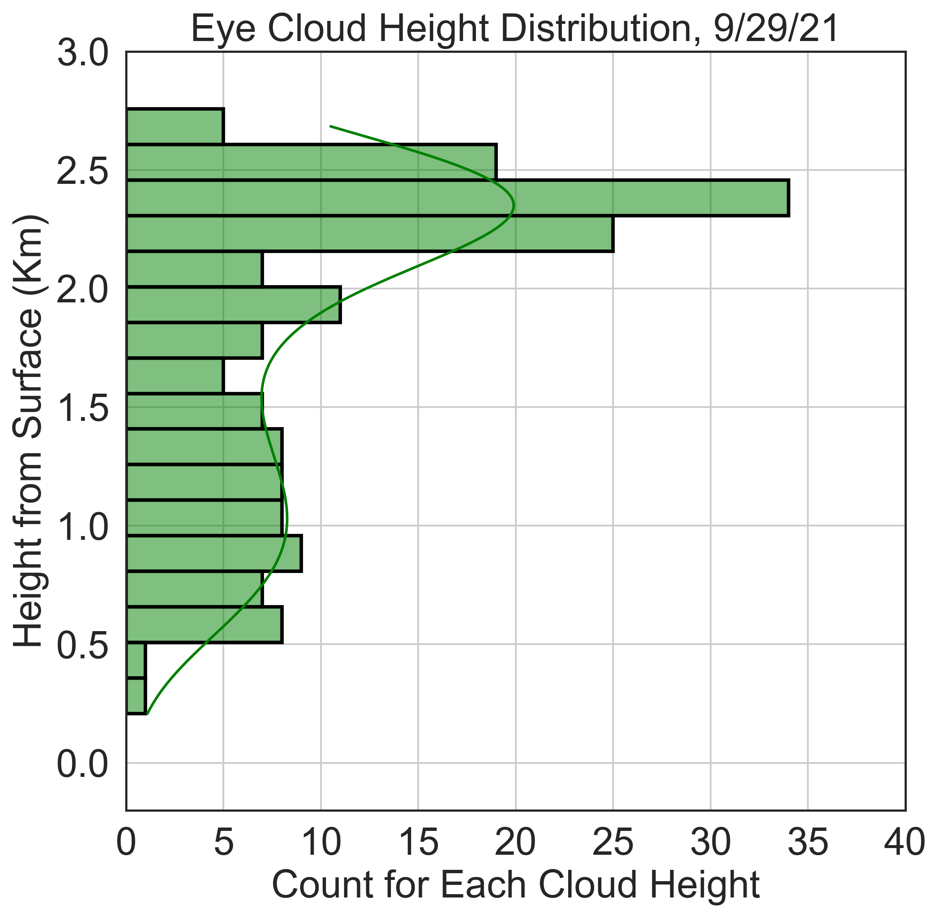
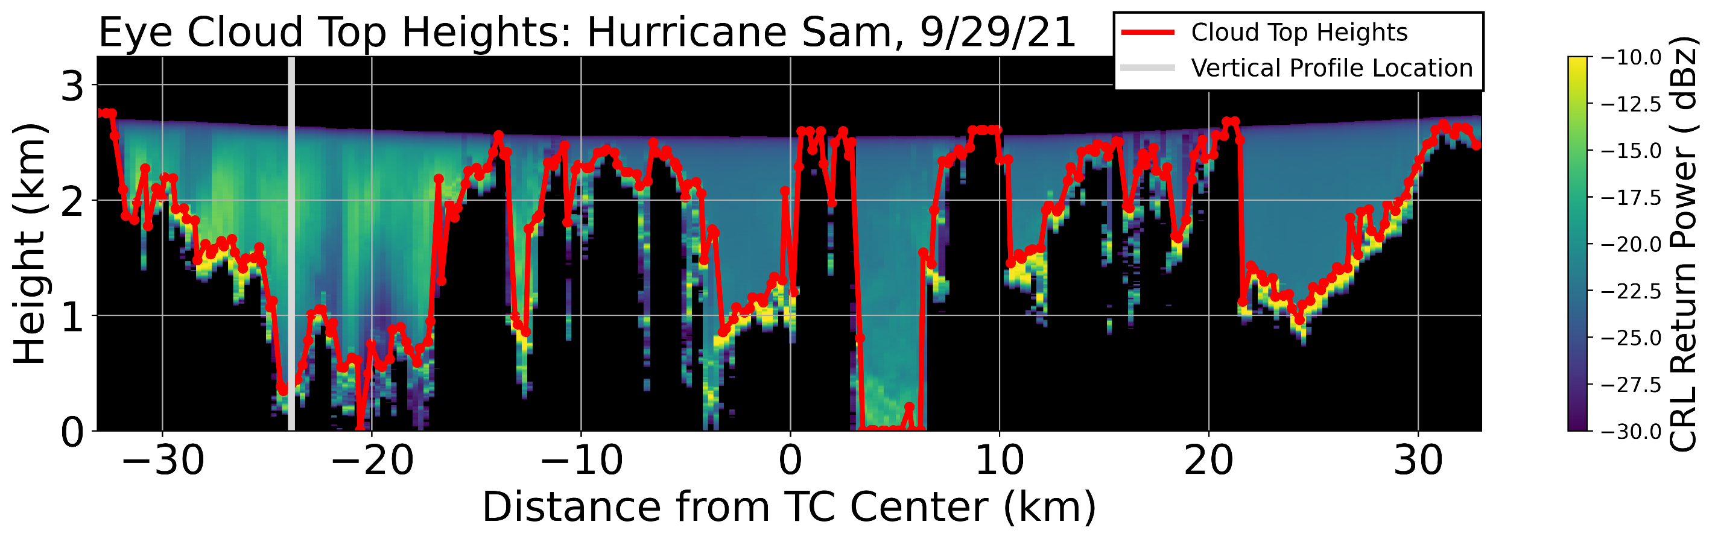
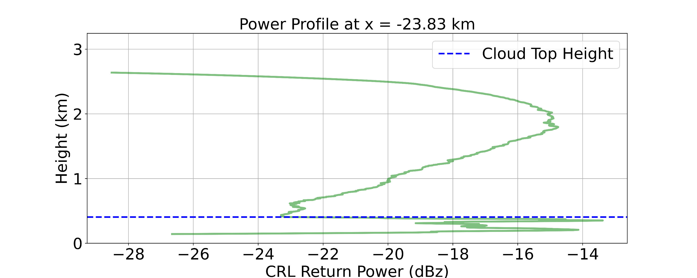
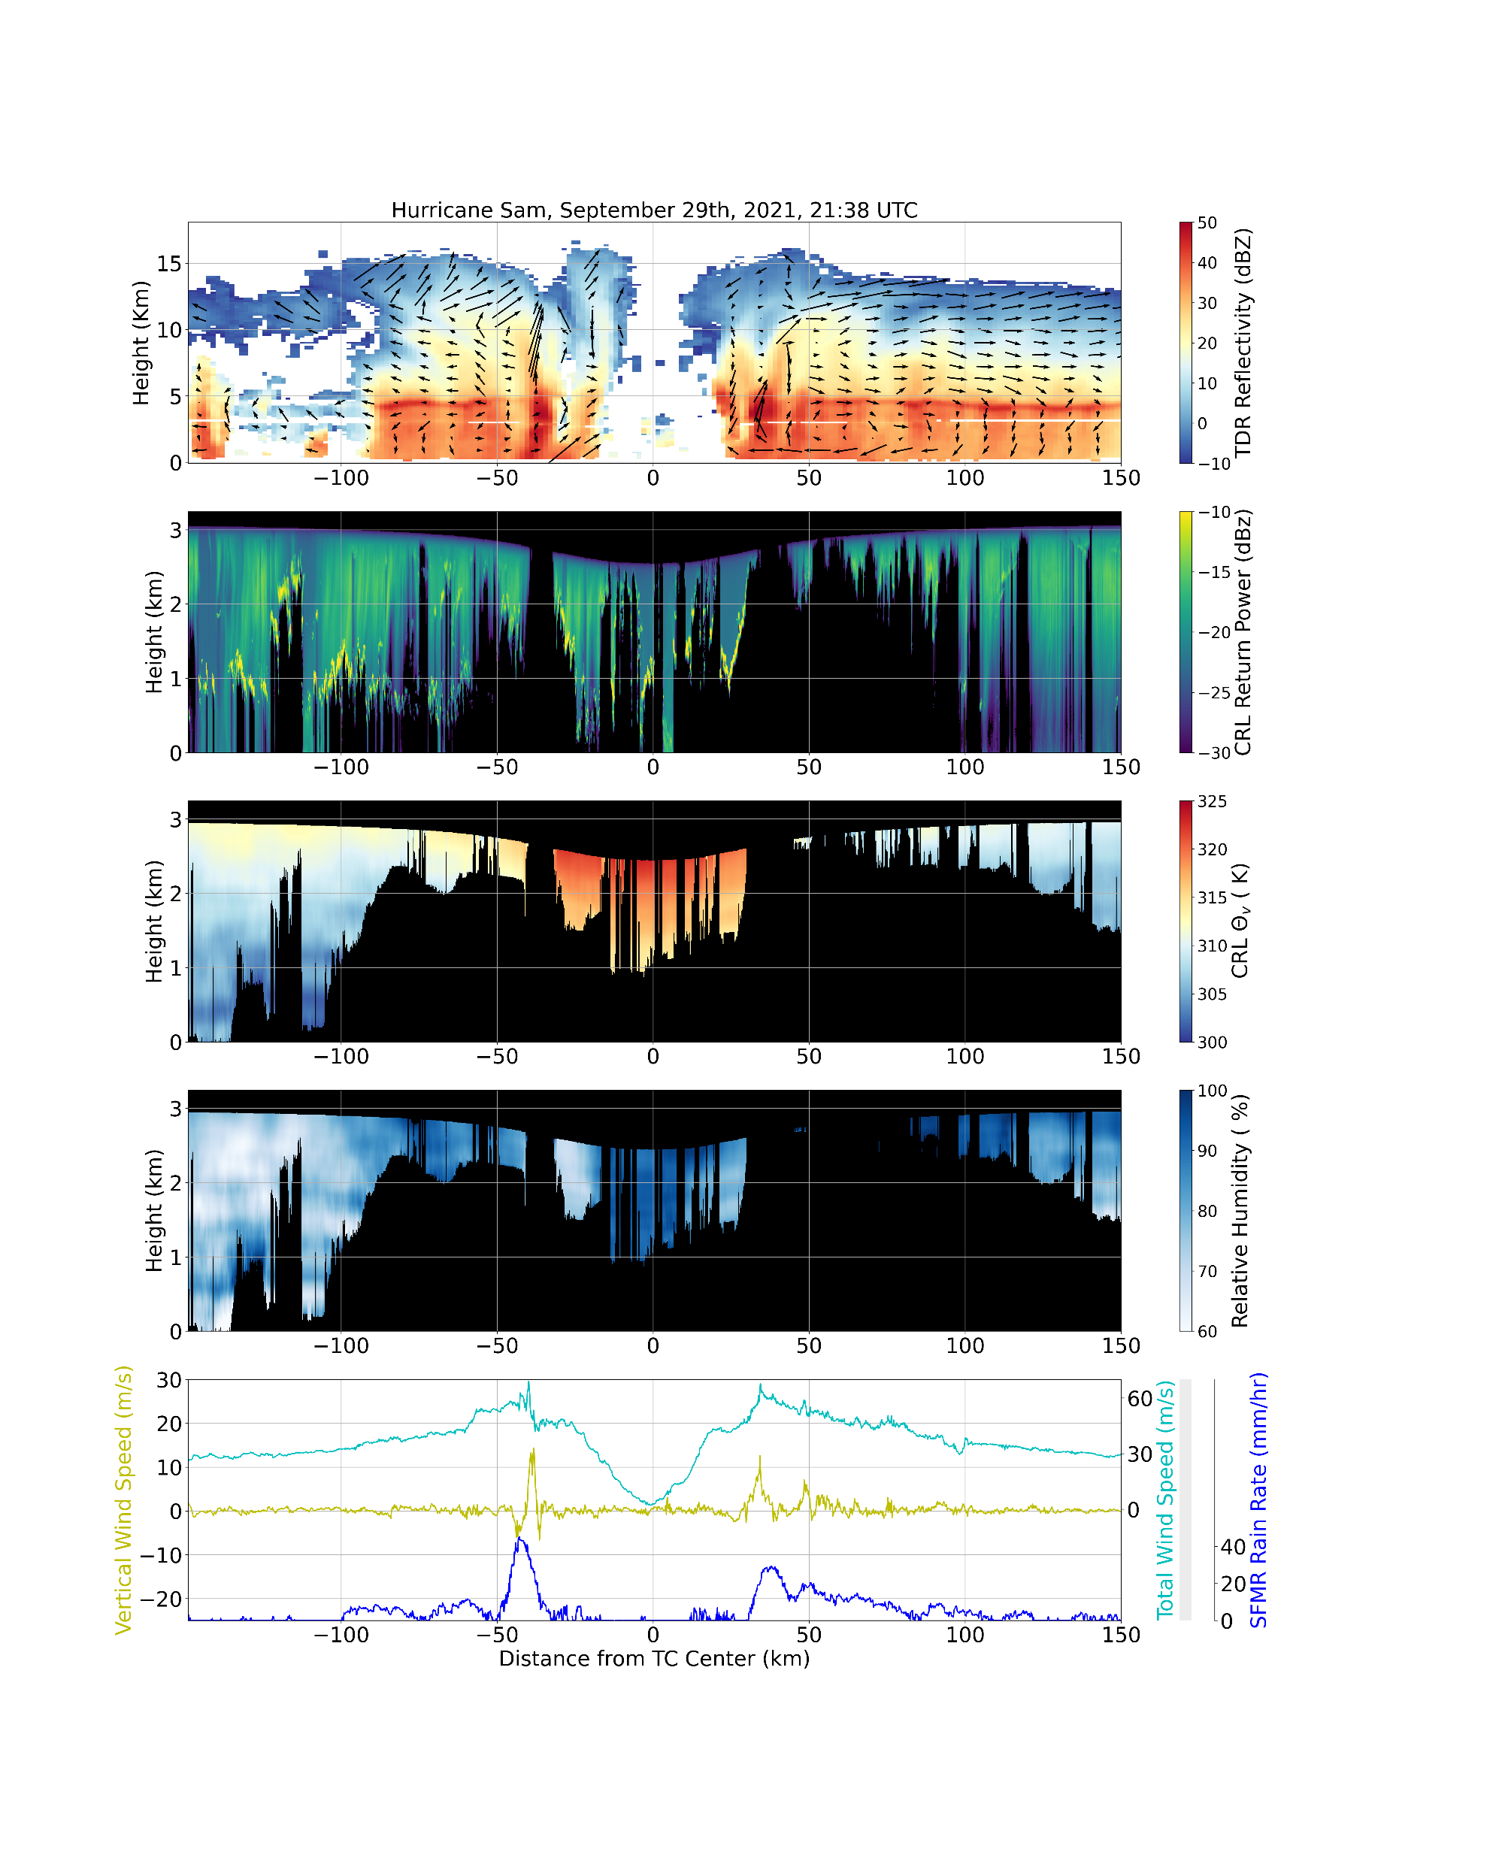




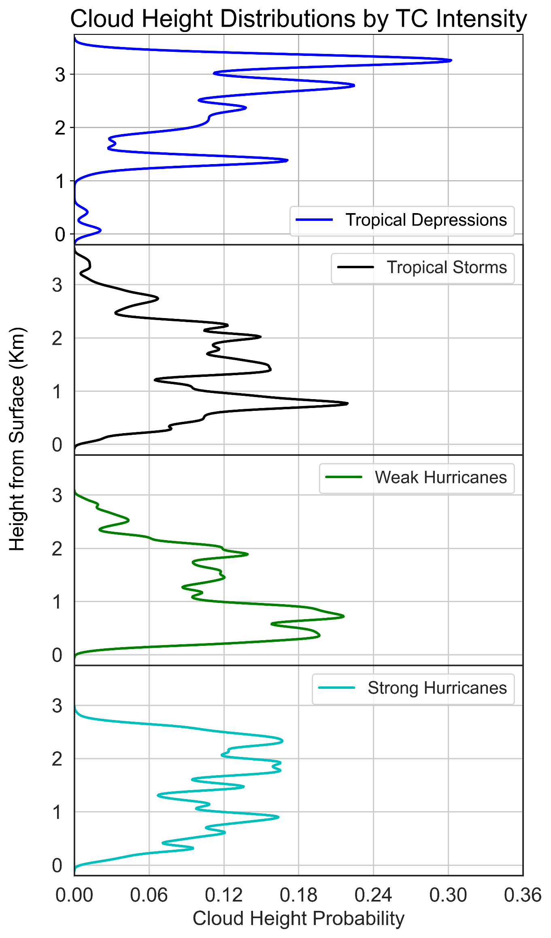
Convective Properties of Inner Core Tropical Cyclone Clouds Observed by Airborne Compact Raman Lidar
a
b
a
10.3 Knots
b
Ethan Murray^{1, 2}, Lisa Bucci³ , Jason Dunion^{3, 4} , Zhien Wang^{1, 2}, Jonathan Zawislak³ , and Jun A. Zhang^{3,4}
¹ Laboratory for Atmospheric and Space Physics, University of Colorado Boulder, Boulder, Colorado
² Department of Atmospheric and Oceanic Sciences, University of Colorado Boulder, Boulder, Colorado
³ NOAA Atlantic Oceanographic and Meteorological Laboratory and Hurricane Research Division, Miami, Florida
⁴ Cooperative Institute for Marine & Atmospheric Studies, University of Miami, Miami, Florida
c
Correspondence: Ethan.Murray@Colorado.edu
Figure 2 (above): Schematic view of a cloud top height calculation. a) A zoomed in view of TC Sam’s eye, where the red line atop the data is the estimated cloud top heights. b) A vertical profile of return power at the position of the gray line in a). The smoother curve above .5 km represents precipitation, while the steeper peaks below .5 km represents attenuation from clouds. The dashed blue line is the estimated cloud top height for this location.
Highlights
Tail Doppler radar (TDR), compact Raman lidar (CRL), and flight level measurements from NOAA’s P-3 aircraft are collocated to view tropical cyclone (TC) inner core structure (Figure 1).
Cloud top heights are derived from CRL backscattered power (Figure 2).
Cloud top height distributions are plotted for individual TCs (Figure 1b) and by intensity (Figure 3).
d
Cyclone Type | No. of Passes | Mean Cloud Height (km) | Clear Air Presence (%)
TD | 2 | 1.94 | 22.47
TS | 8 | 1.19 | 17.83
Weak Hurricane (Categories 1-2) | 10 | 1.03 | 10.12
Strong Hurricane (Categories 3-5) | 8 | 1.39 | 6.97
Background
e
TC eye clouds are related to eyewall and boundary layer dynamics, two regions essential for understanding TC intensity change.
Yet, cloud top heights throughout TC eyes are poorly resolved by current observational satellite¹ and radar² measurements.
While studies of TC eye clouds using observations³ and theory ⁴ have been made, no detailed research on cloud top heights throughout an entire TC eye exists.
Currently, only stratiform clouds trapped beneath a strong inversion layer are thought to develop in TC eyes,⁴ suggesting that low level mixing and downward subsidence are the main contributors to eye dynamics.
This theory can be tested by finding cloud top heights using the CRL’s backscattered power channel (Figure 2), which was deployed on NOAA’s P-3 aircraft during the 2021 Hurricane Season (Table 1).
Figure 3 (left): Cloud top height distributions for tropical storms (a), weak hurricanes (b), and strong hurricanes (c). Table 2 (above) contains a summary of these statistics. Note that clear air includes any CRL return height below 50 m.
f
Discussion
TC Sam is very intense and axisymmetric. Its main eyewalls at ±37.5 km have strong updrafts and high wind speeds (Figure 1g).
Figure 1 depicts an active eyewall replacement cycle (ERC). Four main updrafts on can be seen in the TDR data, with the outer eyewalls replacing the inner ones. The total wind speed profile in 1g is typical for an ERC.
Precipitation entrainment from the disintegrating inner eyewall is present in the left side of the eye (green streaks in 1d).
Temperature inversions are strong where convection doesn’t dominate, and air is much drier along the eyewalls versus in the TC center (Figure 1e-f). This, along with the vertical velocities in 1g, suggests that subsidence dominates along the eyewalls while mixing occurs in the TC center.
TS and weak hurricane distributions are dominated by low clouds, strong hurricanes have an even cloud distribution, and TD cases are dominated by tall convective clouds (Figure 3).
Weaker TCs also have more clear air filling the eye, likely from asymmetric convection and a less stratified inversion layer (Table 2).
Methods
The TC center (0 km) is defined for every continuous eye pass as the lowest recorded surface pressure.
Dips in aircraft height are accounted for when plotting CRL data and calculating cloud heights.
Available TDR, CRL, and flight level data are collocated and plotted using a common x axis (Figure 1).
An algorithm is used to find cloud top heights based on CRL backscattered power. Sharp return peaks from clouds differ from the smoother precipitation peaks (Figure 2).
Table 1: All TC cases included in cloud height calculations, highlighting the number of eye passes by intensity.
g
Storm Name | Date (2021) | No. of Passes | Mean SLP (hPa) | Surface Winds (kt) | Category (Saffir-Simpson)
Grace | 16 Aug | 2 | 1007 | 32.5 | TD
Grace | 17 Aug | 3 | 1005 | 45 | TS
Grace | 18 Aug | 3 | 988 | 70 | 1
Grace | 19 Aug | 3 | 994 | 55 | TS
Henri | 20 Aug | 2 | 993 | 60 | TS
Henri | 21 Aug | 3 | 988 | 65 | 1
Ida | 27 Aug | 4 | 989 | 70 | 1
Ida | 29 Aug | 1 | 931 | 130 | 4
Sam | 26 Sept | 3 | 928 | 135 | 4
Sam | 27 Sept | 2 | 958 | 105 | 3
Sam | 29 Sept | 2 | 945 | 115 | 4
Figure 1: Observational data from the inner core of TC Sam.
a) A GOES 16 clean IR satellite view of Sam’s eye and eyewall . CRL cloud top heights and environmental shear are also provided.
b) The cloud top height distribution for this eye pass calculated using the methods described in Figure 2.
c) A tail Doppler Radar (TDR) view of Sam’s eye, eyewall, and inner rainbands. High reflectivity values correspond to high precipitation rates. Arrows show Sam’s secondary circulation derived from TDR velocities. Both eyewalls are located around 37.5 Km from the TC center.
d-f) Compact Raman lidar (CRL) plots of return power, virtual potential temperature, and relative humidity. Black regions denote areas of total signal attenuation. Note the dry air in the eye next to the eyewalls in f).
g) Flight level measurements of total wind speed (cyan), vertical wind speed (yellow), and SFMR rain rates (blue).
Citations
¹ Harnos, Daniel S., and Stephen W. Nesbitt. “Passive Microwave Quantification of Tropical Cyclone Inner-Core Cloud Populations Relative to Subsequent Intensity Change.” Monthly Weather Review 144, no. 11 (November 1, 2016): 4461–82.
² Rogers, Robert F. “Recent Advances in Our Understanding of Tropical Cyclone Intensity Change Processes from Airborne Observations.” Atmosphere 12, no. 5 (May 2021): 650.
³ Willoughby, H. E. “Tropical Cyclone Eye Thermodynamics.” Monthly Weather Review 126, no. 12 (December 1, 1998): 3053–67.
⁴ Houze, Robert A. “Clouds in Tropical Cyclones.” Monthly Weather Review 138, no. 2 (February 1, 2010): 293–344.

