Slide 1


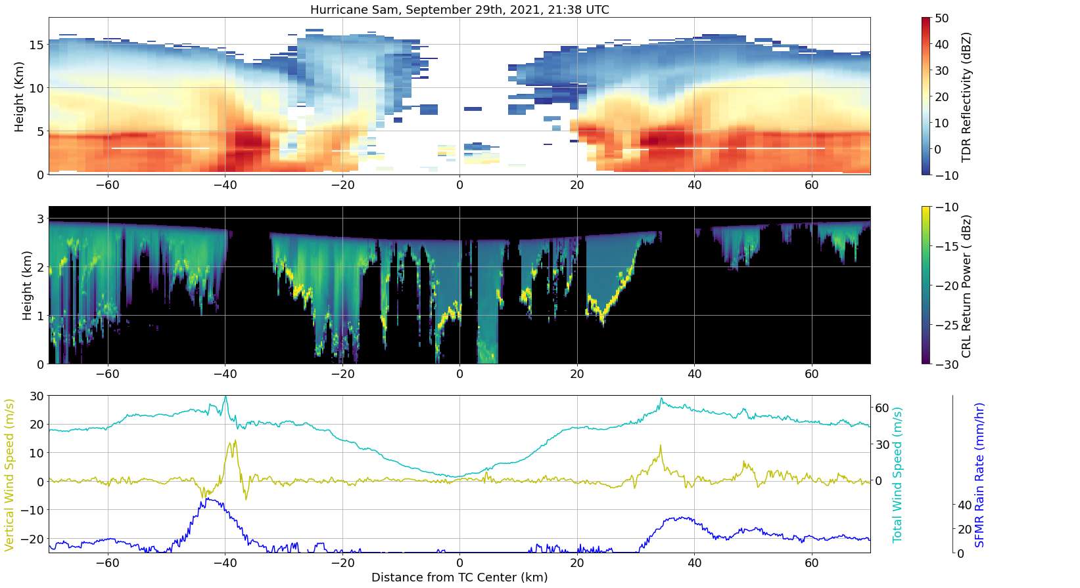
Observing Atmospheric Boundary Layer Property and Processes Associated Rapid Intensification in TCs
FY21-FY24
Dr. Zhien Wang, Ethan Murray
University of Colorado, Boulder and
Laboratory for Atmospheric and Space Physics
Objectives
  TC eye clouds and dynamics are challenging to diagnose with current observational methods (anvil clouds often block views from satellites, and radars rely on scattering from heavy precipitation not found in the eye).
  Using novel lidar instrumentation, cloud top heights and thermodynamics in the TC eye can be viewed with very high resolution, which will lead to a much more detailed depiction of eye dynamics.
a
b
c
  Figure 1: A cross sectional view of TC Sam’s eye and eyewall, with the TC center at 0 km. The TDR plot (a) shows upper level structure and intense rainfall. The CRL plot (b) highlights regions of rainfall (green streaks, -20 km), clear air ( 25 km), and convective eye clouds (black regions, 10 km). Flight level data confirms eyewall updraft locations.
Technical Approach
  Novel compact Raman lidar (CRL) measurements are combined with tail Doppler radar (TDR) and flight level data to view TC inner core structures.
  CRL power measurements have a vertical resolution of 6m, allowing for accurate cloud height determinations. Novel 2D curtains of temperature and water vapor are also found (Figure 1).
  This updated view of the TC eye highlights the role of convection pushing through the eye’s boundary layer.
FY22 Annual Accomplishments
  Summer 2022: methods to correct CRL data (account for flight height dips, etc) and collocate it with TDR and flight level data were developed.
  Fall 2022: Initial cloud top height statistics for all CRL datasets of TC eyes were calculated.
  Goals for this research project: use statistics of cloud top heights, clear air fraction, and rainfall, along with case studies of collocated data to update our conceptual understanding of TC eye dynamics.
  Then, present this research at conferences and publish it in an academic journal.
Distribution Statement D: Distribution authorized to DoD and U.S. DoD contractors only.
October 2022

