Slide 1
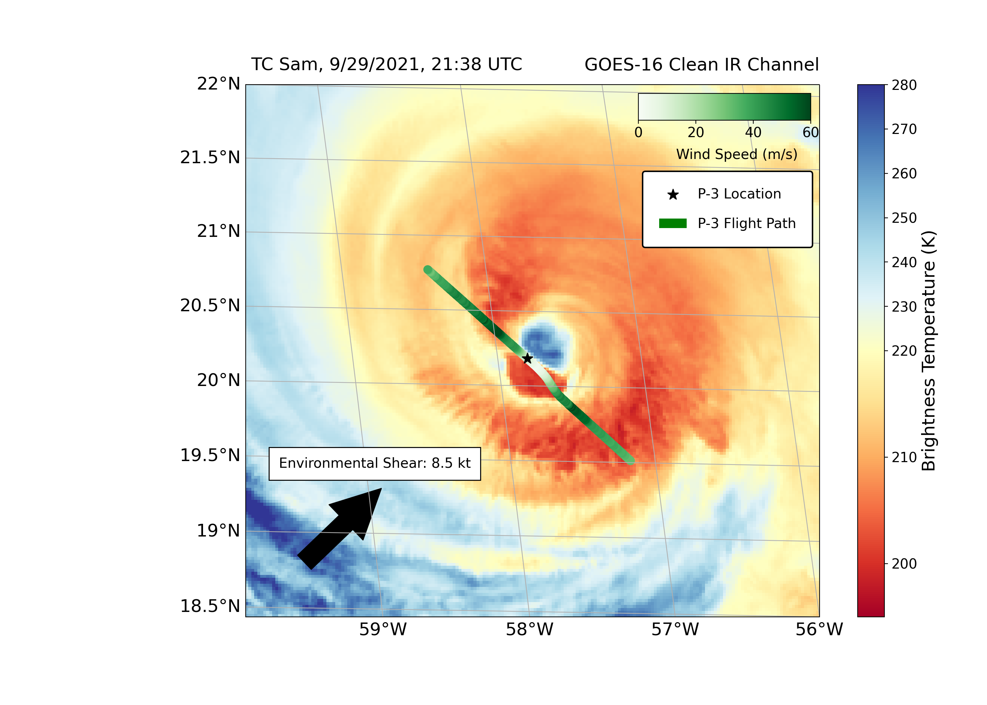
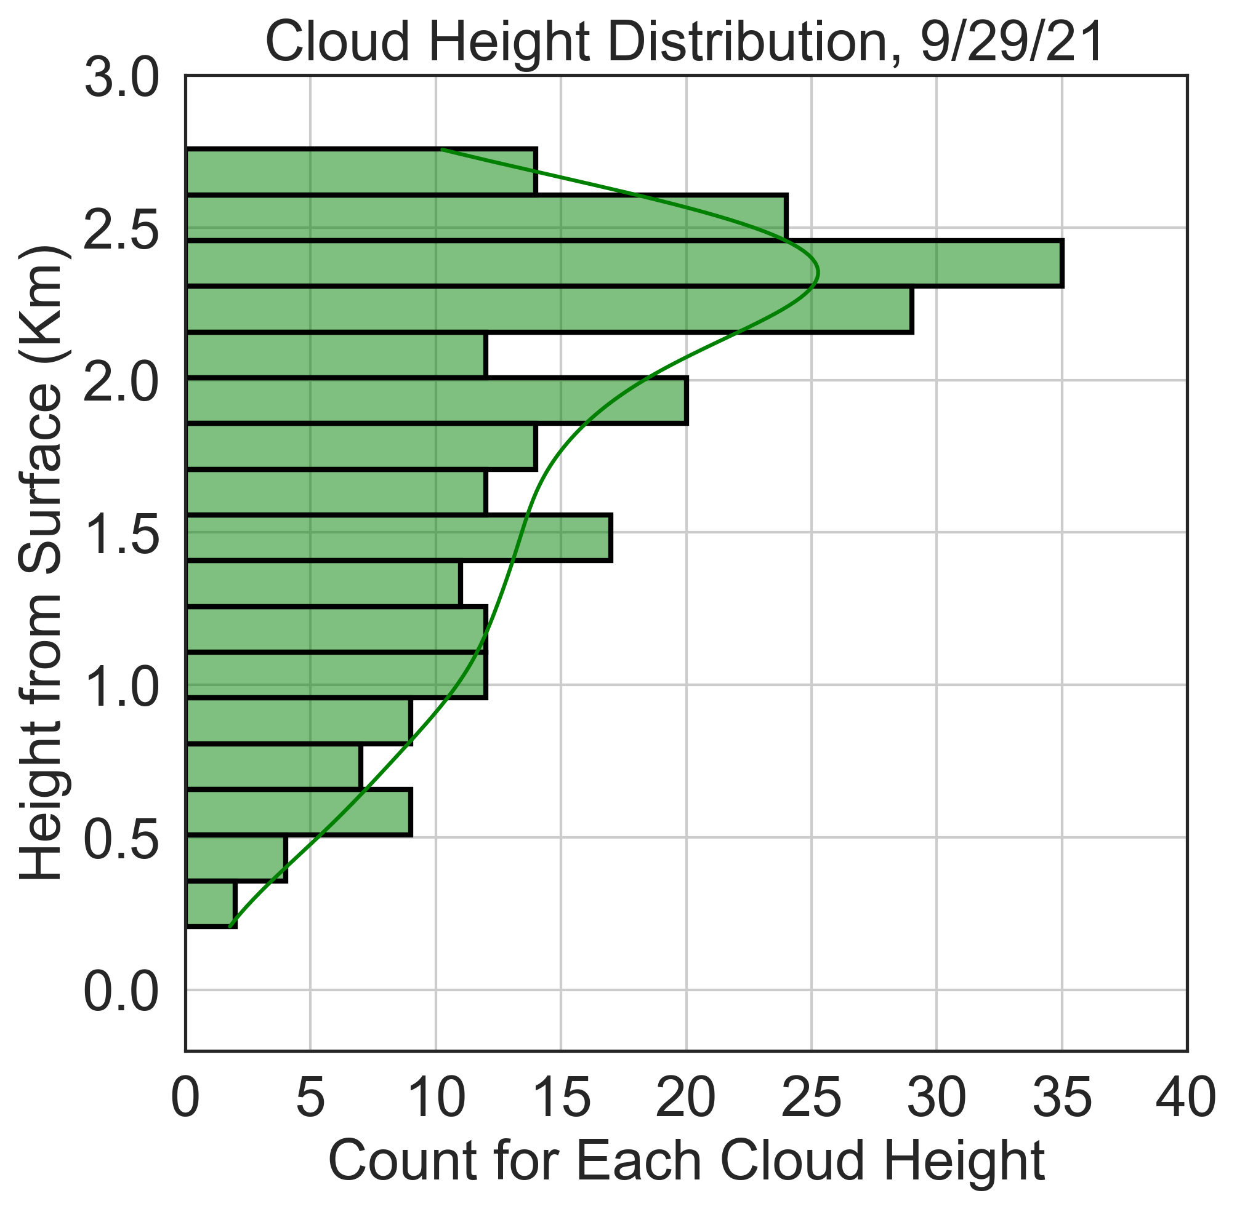
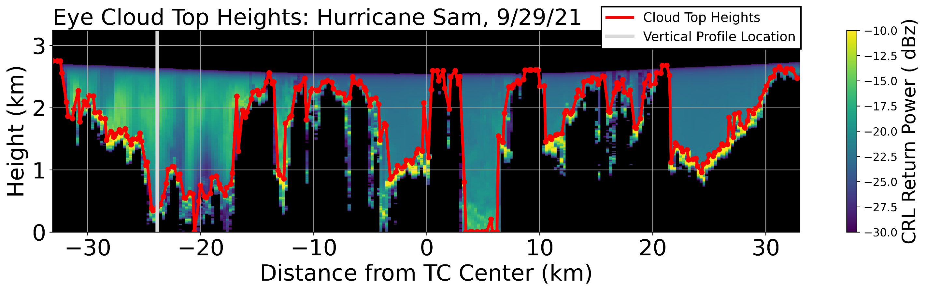
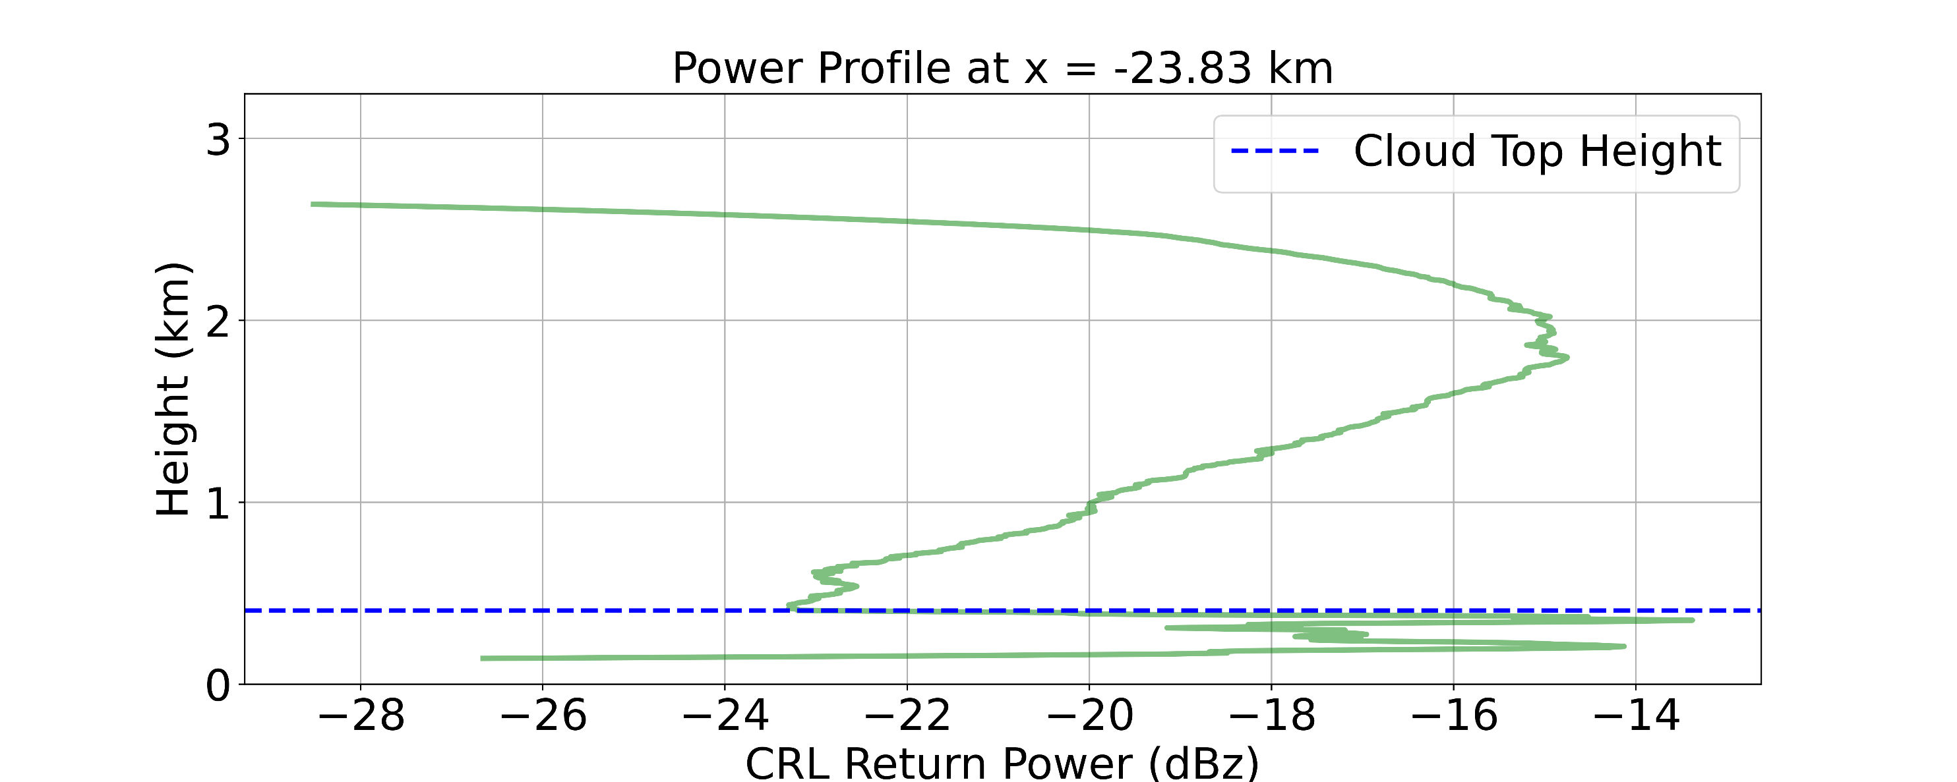
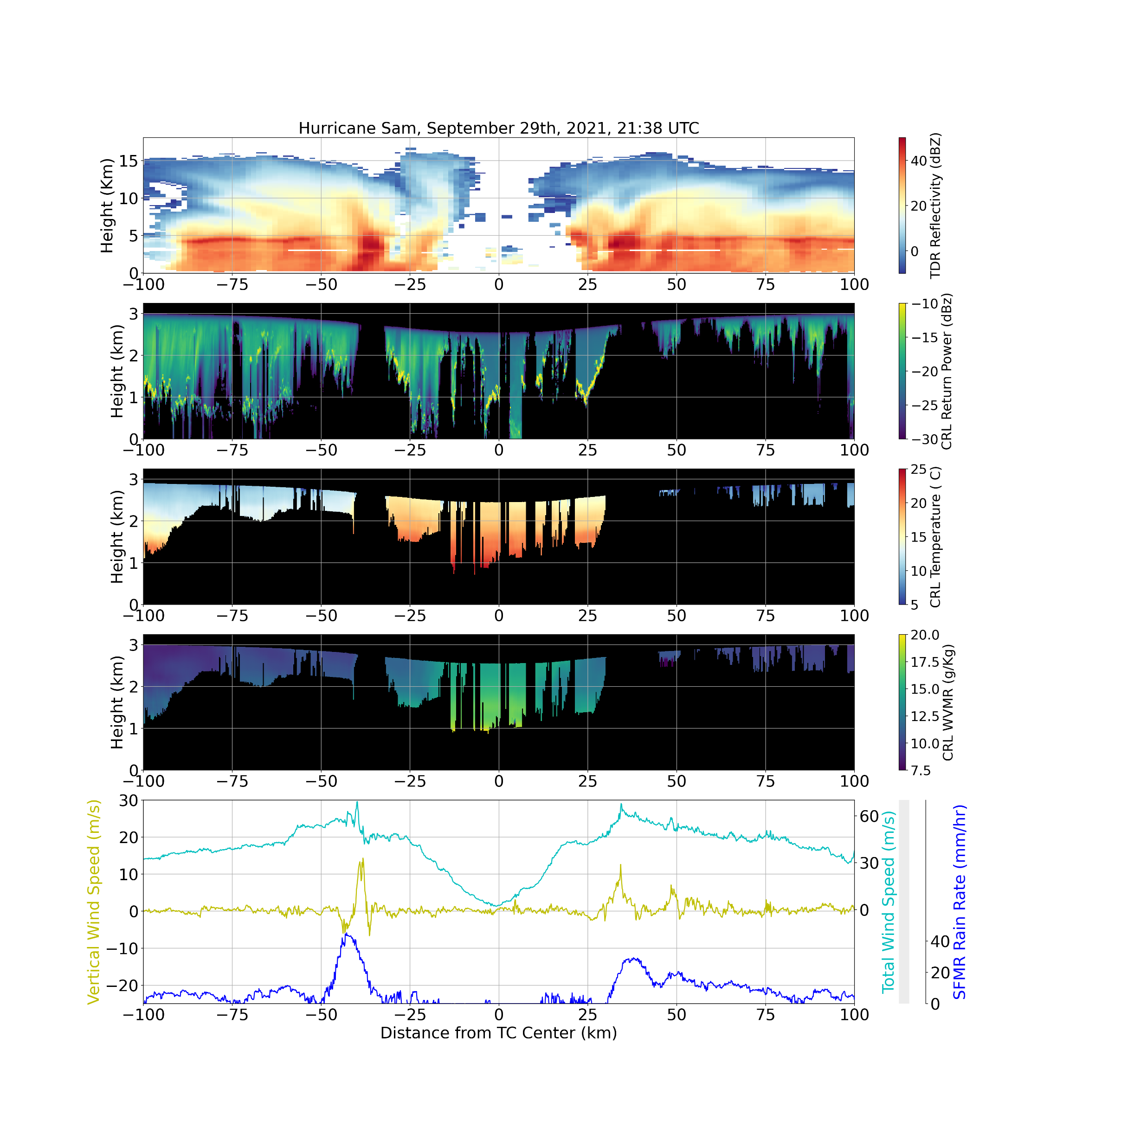




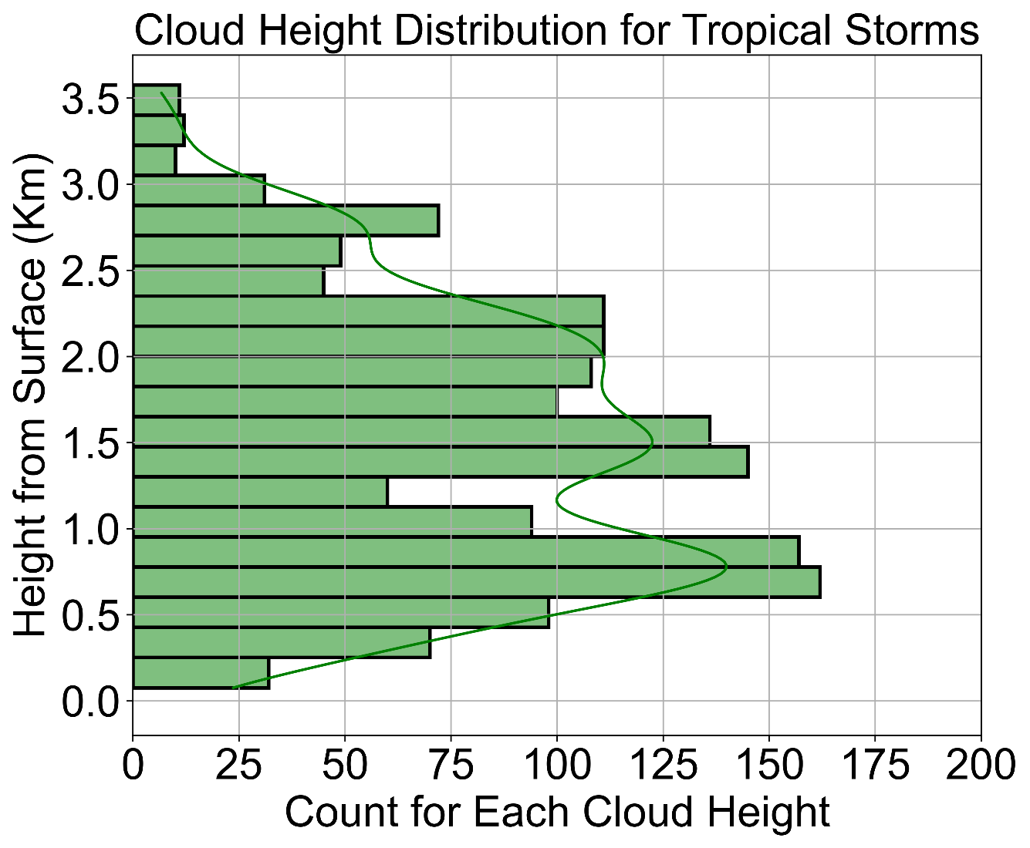
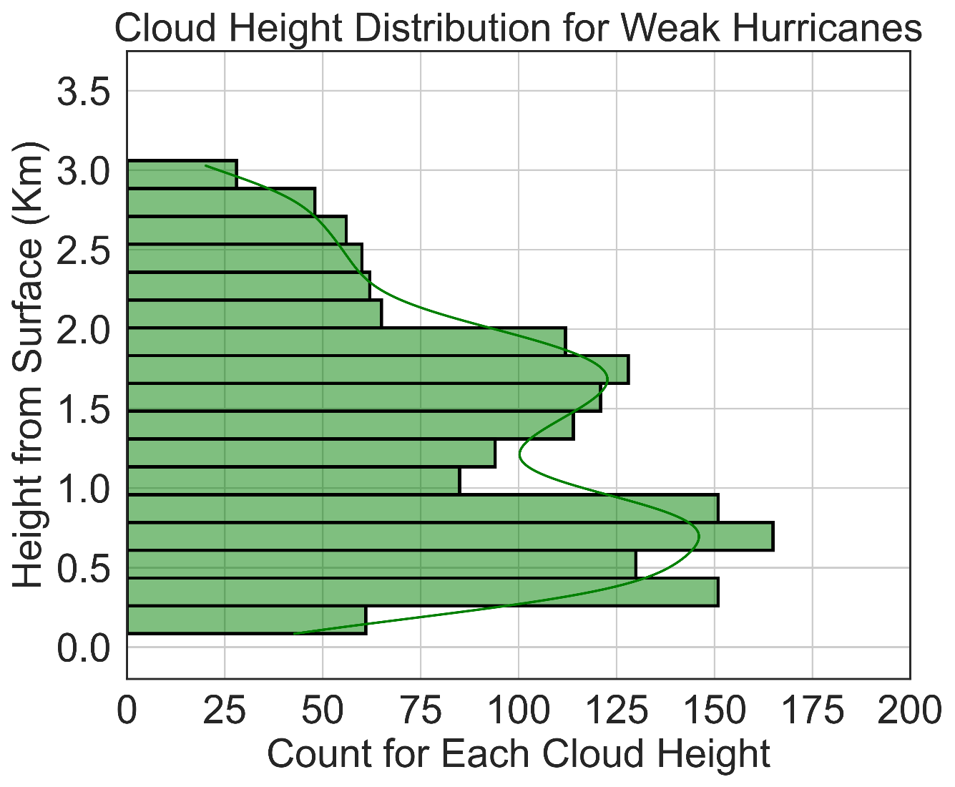
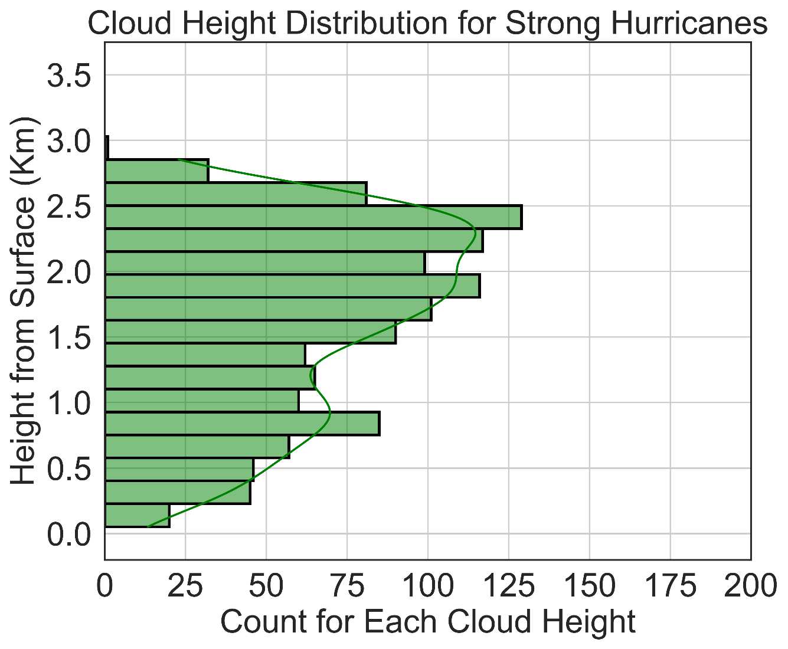
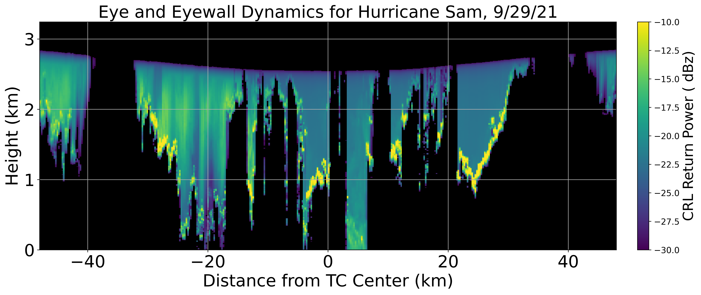
Convective Properties of Tropical Cyclone Eye and Eyewall Clouds Observed by Airborne Compact Raman Lidar
a
b
a
b
Ethan Murray^{1, 2}, Lisa Bucci³ , Jason Dunion^{3, 4} , Zhien Wang^{1, 2}, Jonathan Zawislak³ , and Jun A. Zhang³
¹ Laboratory for Atmospheric and Space Physics, University of Colorado Boulder, Boulder, Colorado
² Department of Atmospheric and Oceanic Sciences, University of Colorado Boulder, Boulder, Colorado
³ NOAA Atlantic Oceanographic and Meteorological Laboratory and Hurricane Research Division, Miami, Florida
⁴ Cooperative Institute for Marine & Atmospheric Studies, University of Miami, Miami, Florida
c
Correspondence: Ethan.Murray@Colorado.edu
Figure 2: A schematic view of a cloud top height calculation. a) A zoomed in view of TC Sam’s eye, where the red line atop the data is the estimated cloud top heights. b) A vertical profile of return power at the position of the gray line in a). The smoother curve above .5 km represents precipitation, while the steeper peaks below .5 km represents attenuation from clouds. The dashed blue line is the estimated cloud top height for this location.
d
Highlights
GOES satellite images, along with tail Doppler radar (TDR), compact Raman lidar (CRL), and flight level measurements from NOAA’s P-3 aircraft are collocated to view tropical cyclone (TC) inner cores (Figure 1).
Cloud top heights are derived using the CRL’s backscattered power channel (Figure 2).
Cloud top height distributions are plotted for individual TCs (Figure 1b) and for TCs grouped by intensity (Figure 3).
A conceptual model of TC eye cloud dynamics is presented (Figure 4), highlighting how both convective and stratiform clouds influence the cyclone’s dynamics.
e
a
b
f
Background
TC eye clouds are directly related to eyewall and boundary layer dynamics, two regions essential for understanding TC intensity change.
Yet, cloud heights and extents in TC eyes are poorly resolved by current observational measurements, as satellite studies can be obscured by tall anvil clouds¹ and radar measurements can only view regions with large amounts of precipitation. ²
While studies of TC eye clouds based on observations³ and theory ⁴ have been made in the past, no detailed study of cloud top heights throughout an entire TC eye exists.
Currently, the only clouds thought to develop throughout the TC eye are stratiform clouds trapped beneath a strong inversion layer.⁴ This would suggest that low level mixing and downward subsidence are the only main contributors to eye dynamics.
This theory can be tested by finding cloud top heights for a variety of TCs using the CRL’s backscattered power channel (Figure 2), which was deployed on NOAA’s P-3 aircraft during the 2021 Hurricane Season (Table 1).
Cyclone Type | No. of Passes | Mean Cloud Height (km) | Clear Air Presence (%)
TS | 8 | 1.24 | 17.06
Weak Hurricane (Categories 1-2) | 9 | 1.21 | 8.32
Strong Hurricane (Categories 3-5) | 8 | 1.56 | 5.11
g
c
Figure 3: Cloud top height distributions for tropical storms (a), weak hurricanes (b), and strong hurricanes (c). Table 2 (above) contains a summary of these statistics. Note that clear air includes any CRL return height below 50 m.
Figure 1: Observational data used to find cloud top heights and diagnose dynamic processes present in the eye of Hurricane Sam.
a) A satellite view of Sam’s inner core using the GOES 16 clean IR channel. Wind speed data and the P-3’s position are also indicated.
b) The cloud top height distribution for this pass calculated using the method described in Figure 2.
c) Tail Doppler Radar (TDR) view of Sam’s eye, eyewall, and inner rainbands. High reflectivity corresponds to high precipitation rates, with eyewalls located at approximately-37.5 km and 25 km from the TC center, respectively.
d-f) Compact Raman lidar (CRL) plots of return power, temperature, and water vapor. Black regions denote areas of total signal attenuation. Note the dry air in the eye next to the eyewalls in f).
g) Flight level measurements of total wind speed (cyan), vertical wind speed (yellow), and SFMR derived rain rates (blue).
Eyewall
TC Eye
Eyewall
Methods
Only flights that made a continuous pass through a TC eye are included in this analysis.
The TC center at 0 km was defined for every eye pass as the lowest central pressure recorded at flight level.
Dips in aircraft height are common during eye penetrations, and they were accounted for when plotting CRL data and calculating cloud heights.
The available TDR, CRL, and flight level data were collocated and plotted using the same x axis for comparison (Figure 1).
An algorithm was used to find cloud top heights based on CRL backscattered power. Sharp return peaks from clouds look much different than the smoother return peaks from precipitation (Figure 2).
Storm Name | Date (in 2021) | No. of Passes | Mean Sea Level Pressure (hPa) | Surface Wind Speed (kt) | Category (Saffir-Simpson)
Grace | 17 Aug | 3 | 1005 | 45 | TS
Grace | 18 Aug | 3 | 988 | 70 | 1
Grace | 19 Aug | 3 | 994 | 55 | TS
Henri | 20 Aug | 2 | 993 | 60 | TS
Henri | 21 Aug | 3 | 988 | 65 | 1
Ida | 27 Aug | 3 | 989 | 70 | 1
Ida | 29 Aug | 1 | 931 | 130 | 4
Sam | 26 Sept | 3 | 928 | 135 | 4
Sam | 27 Sept | 2 | 958 | 105 | 3
Sam | 29 Sept | 2 | 945 | 115 | 4
Discussion
Temperature is high but relatively uniform in the eye, while air is much drier along the eyewalls versus the center (Figure 1e-f). This, along with the vertical velocities in 1g, suggest that subsidence dominates along the eyewalls while significant mixing above the inversion layer occurs in the TC center.
Looking at Figure 3, TS and weak hurricane distributions are very similar, while strong hurricanes have higher clouds, likely due to steep eyewalls and convective eye clouds.
TS cases also have much more clear air, likely from weaker convection and a less stratified inversion layer.
Inflow Layer
The TC present in Figure 1 is quite intense and axisymmetric; its main eyewalls at -37.5 km and 37.5 km have strong updrafts and high wind speeds (Figure 1g).
Figure 1 also shows an active eyewall replacement cycle; two main updrafts on each side of the eye can be seen in 1a, and the total wind speed in 1g flattens out before it peaks at the outer eyewall.
Large amounts of asymmetric precipitation entrainment from the disintegrating inner eyewall can be seen on the left side of the eye (green streaks in 1d).
Figure 4: A conceptual model of parcel movements within the eye of Hurricane Sam; light blue arrows denote updrafts, red arrows show downdrafts, and yellow arrows highlight inflow. This schematic was derived using the collocation of data in Figure 1, and it stresses the importance of inflowing air rising convectively in the eye (thin blue arrows) and penetrating the boundary layer.
Citations
¹ Harnos, Daniel S., and Stephen W. Nesbitt. “Passive Microwave Quantification of Tropical Cyclone Inner-Core Cloud Populations Relative to Subsequent Intensity Change.” Monthly Weather Review 144, no. 11 (November 1, 2016): 4461–82.
² Rogers, Robert F. “Recent Advances in Our Understanding of Tropical Cyclone Intensity Change Processes from Airborne Observations.” Atmosphere 12, no. 5 (May 2021): 650.
³ Willoughby, H. E. “Tropical Cyclone Eye Thermodynamics.” Monthly Weather Review 126, no. 12 (December 1, 1998): 3053–67.
⁴ Houze, Robert A. “Clouds in Tropical Cyclones.” Monthly Weather Review 138, no. 2 (February 1, 2010): 293–344.
Table 1: A summary of TC cases included in cloud height calculations, showing the number of eye passes by intensity.

Slide 2
Eyewall
TC Eye
Eyewall
Inflow Layer

