Slide 1
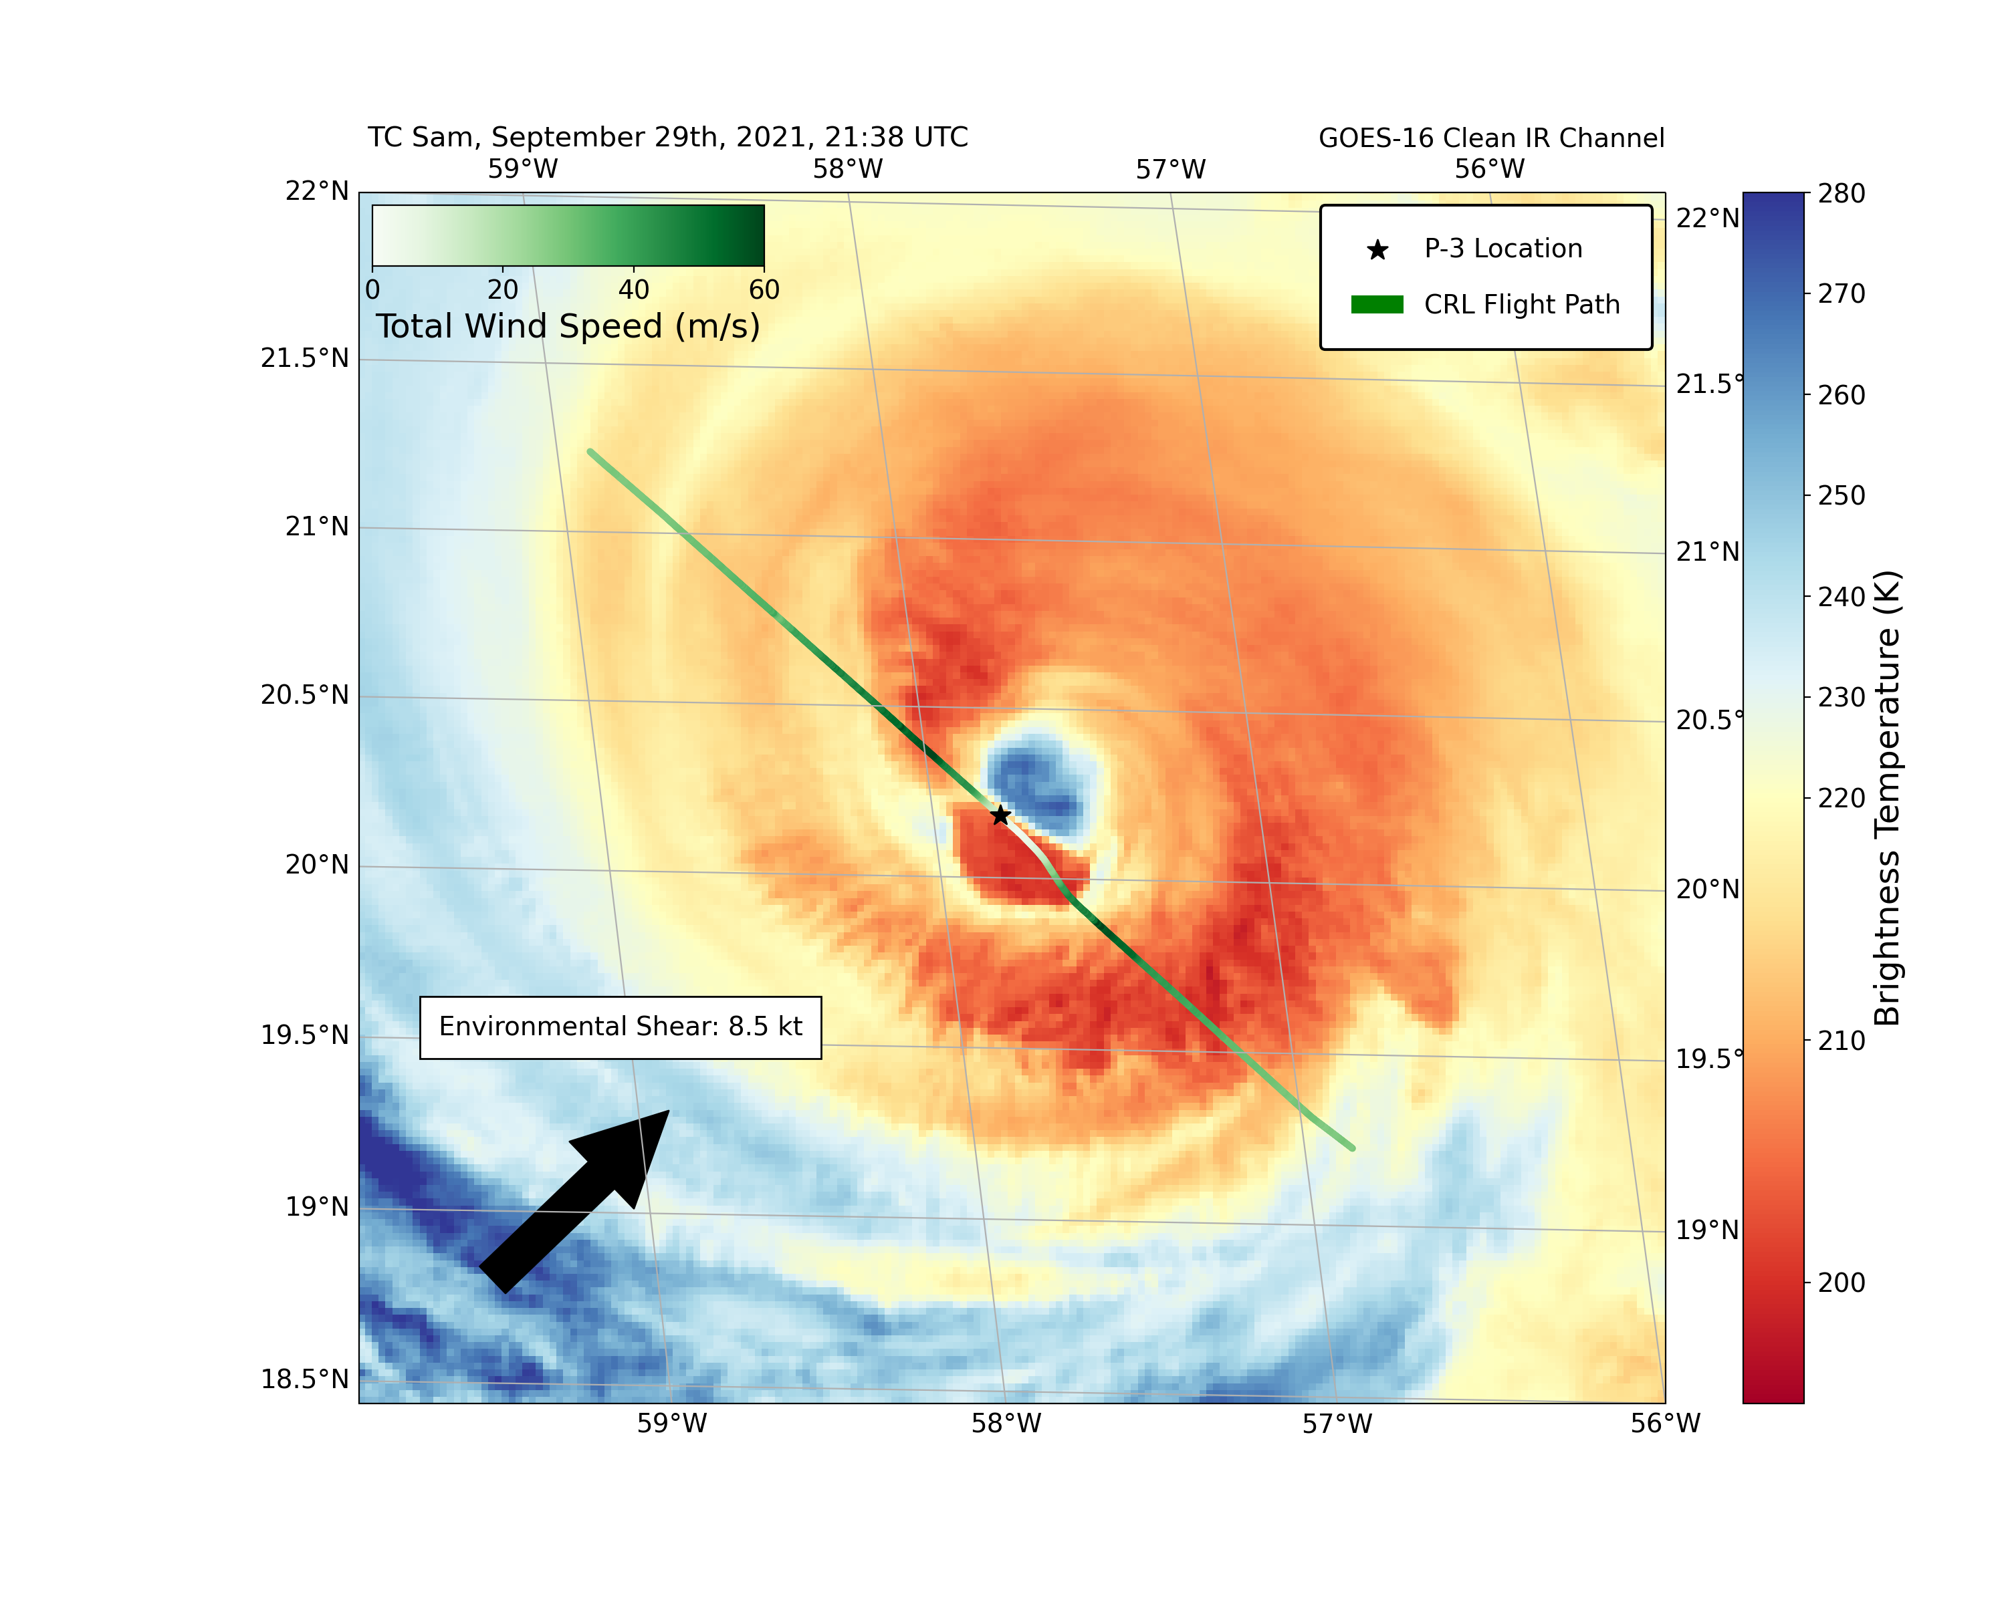
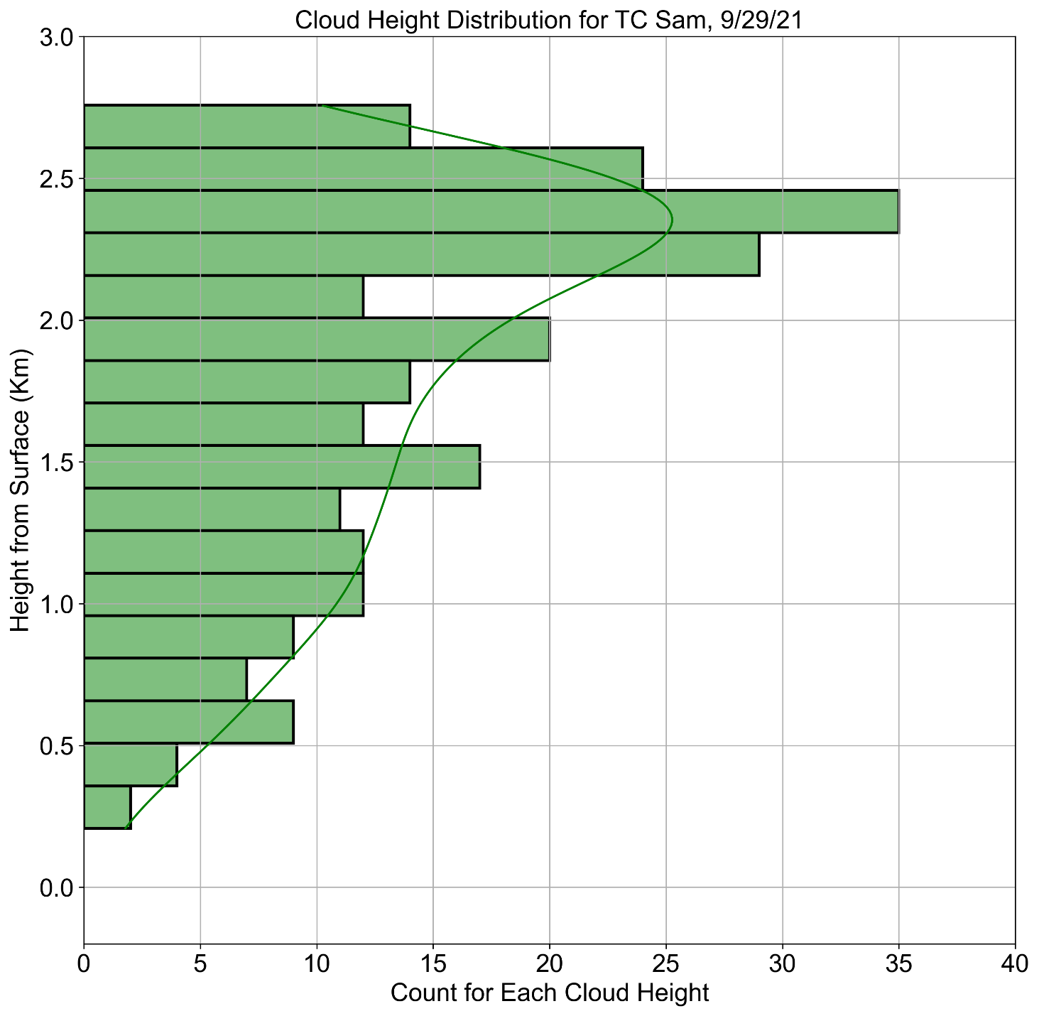
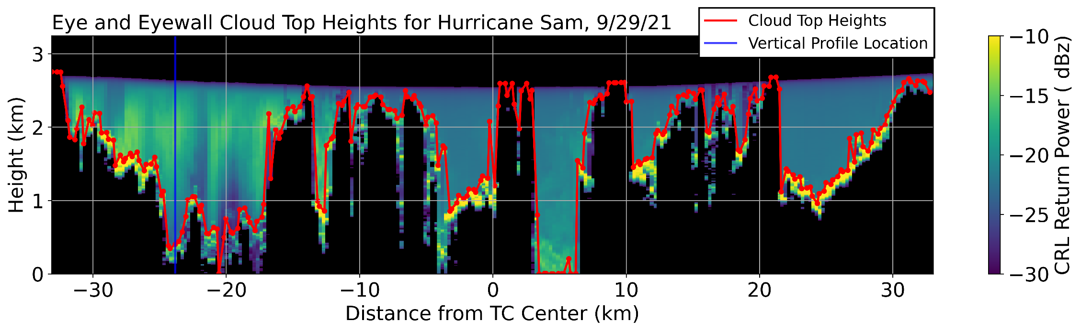
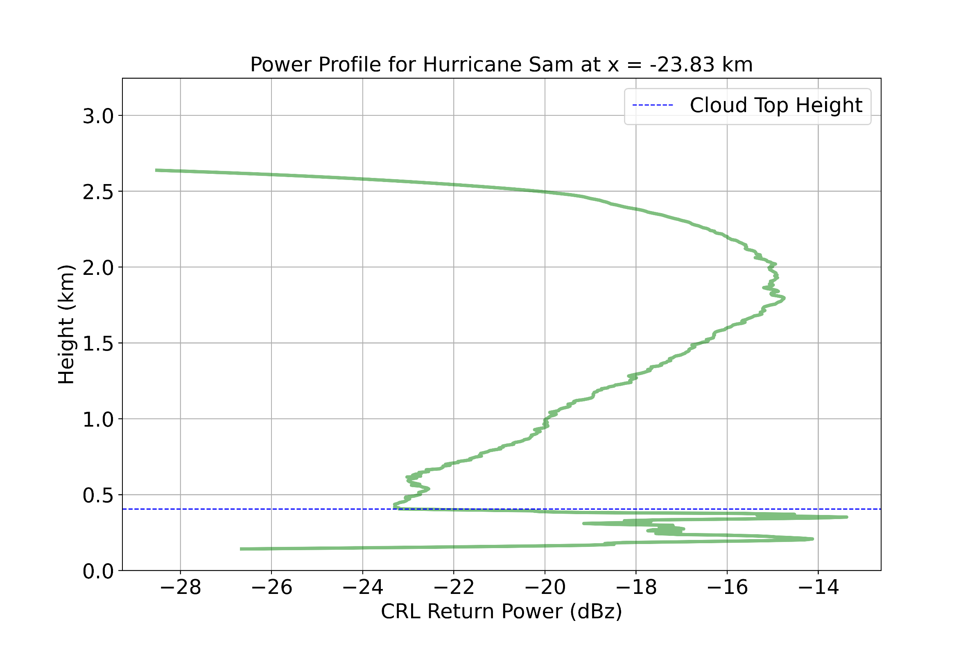
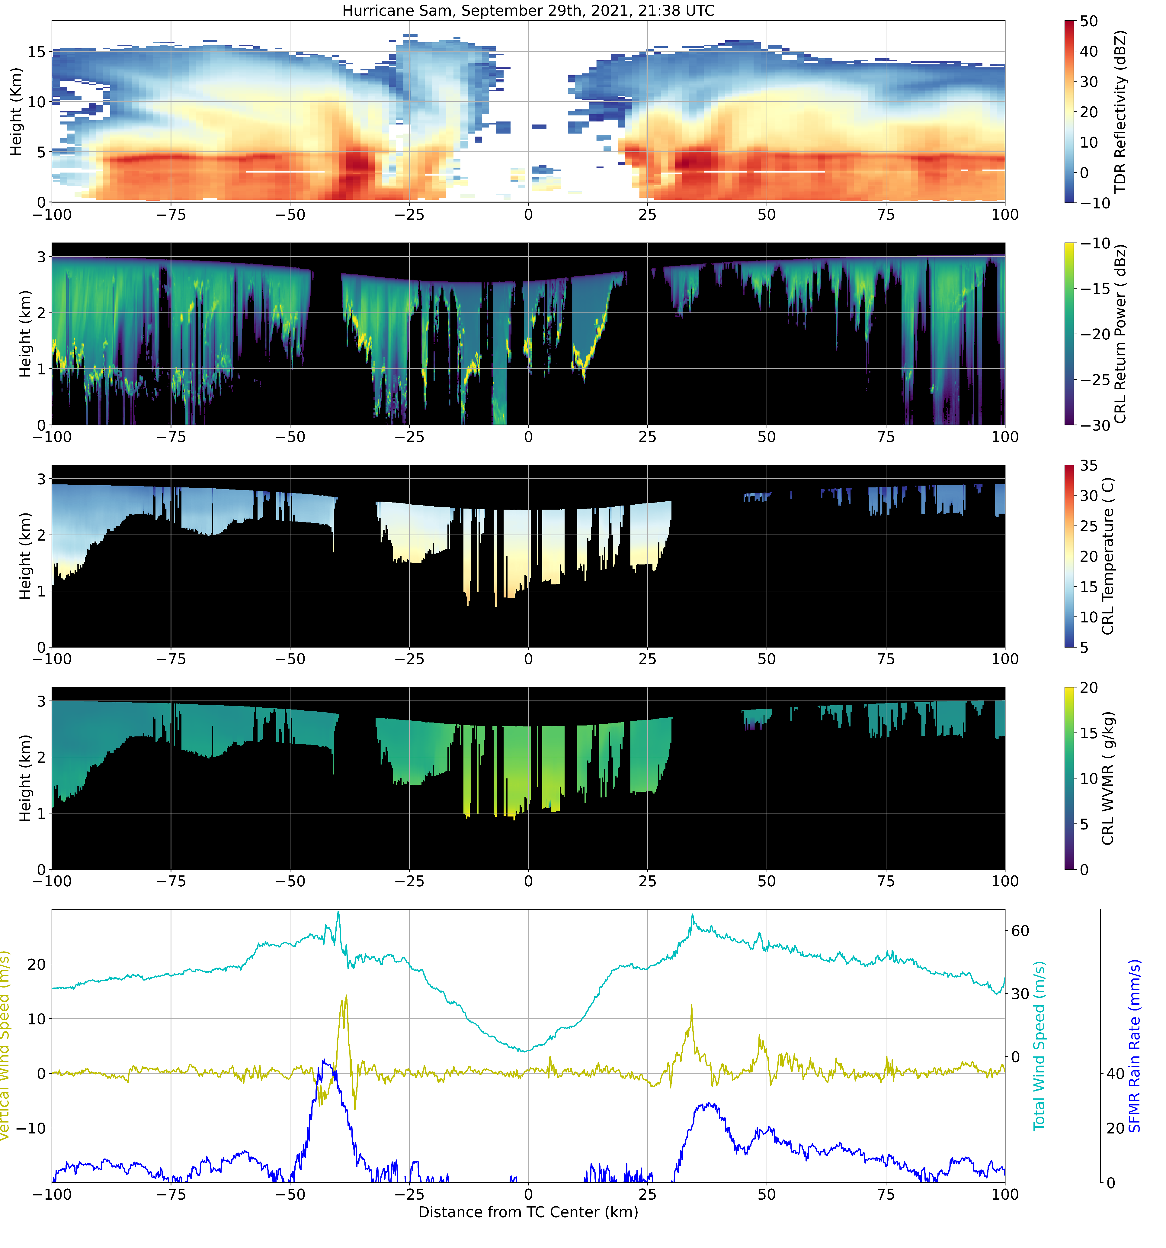



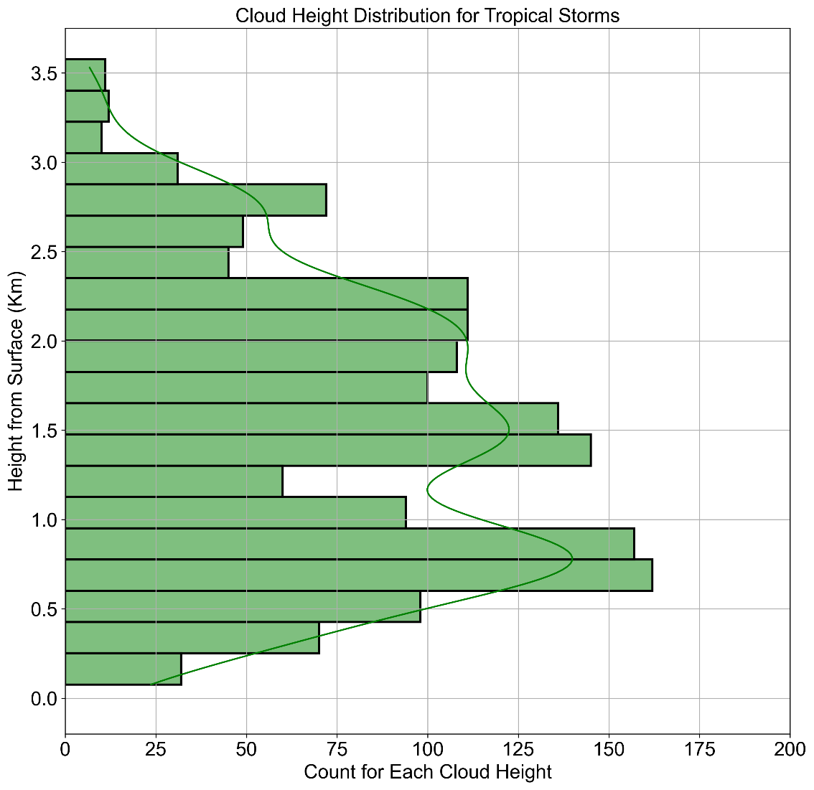
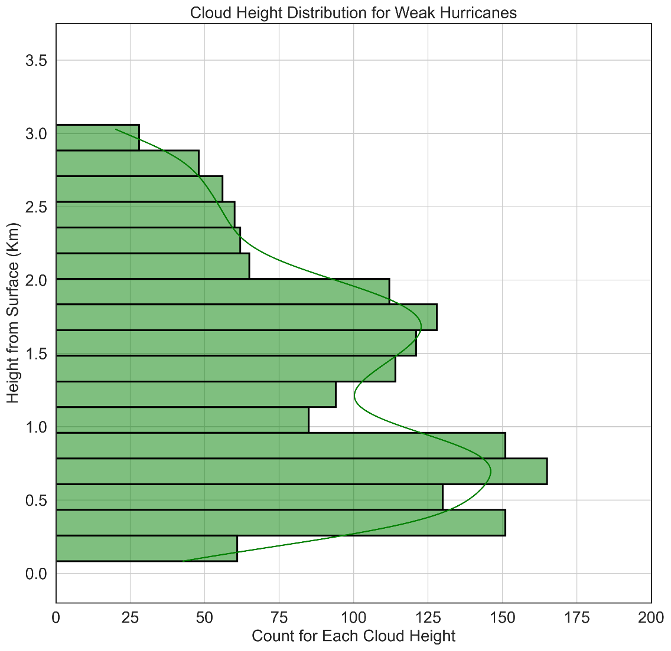
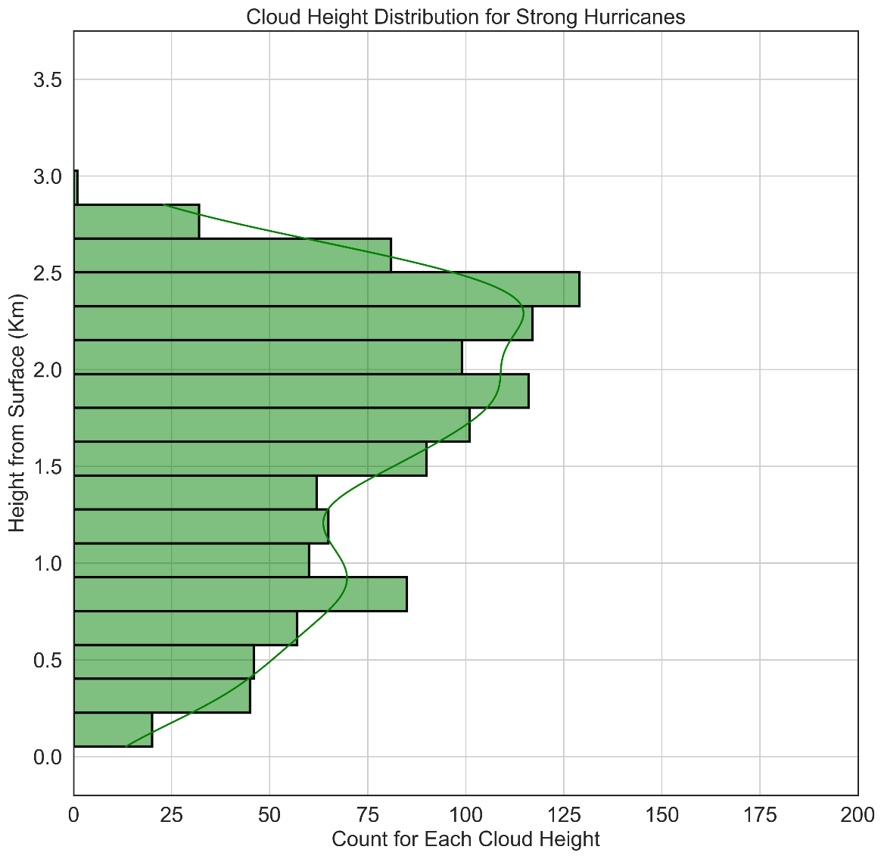
Convective Properties of Tropical Cyclone Eye and Eyewall Clouds Observed by Airborne Compact Raman Lidar
Ethan Murray^{1, 2}, Lisa Bucci³ , Jason Dunion^{3, 4} , Zhien Wang^{1, 2}, Jonathan Zawislak³ , and Jun A. Zhang³
¹ Laboratory for Atmospheric and Space Physics, University of Colorado Boulder, Boulder, Colorado
² Department of Atmospheric and Oceanic Sciences, University of Colorado Boulder, Boulder, Colorado
³ NOAA Atlantic Oceanographic and Meteorological Laboratory and Hurricane Research Division, Miami, Florida
⁴ Cooperative Institute for Marine & Atmospheric Studies, University of Miami, Miami, Florida
Correspondence: Ethan.Murray@Colorado.edu
Figure 2:
Highlights
Cloud top height distributions are plotted for individual TCs (Figure 1b) and for TCs grouped into their respective intensities (Figure 3).
A conceptual model of TC eye cloud dynamics is presented (Figure 4), highlighting how both convective and stratiform clouds influence the cyclone’s dynamics.
GOES satellite, tail Doppler radar (TDR), compact Raman lidar (CRL), and flight level measurements are collocated to view tropical cyclone (TC) inner cores (Figure 1).
Cloud top heights are derived using the CRL’s backscattered power channel (Figure 2).
Cloud Height PDFs by TC Intensity
Abstract
With a 6 meter vertical resolution and the ability to distinguish between precipitation and clouds, CRL data are used to find eye and eyewall cloud heights for each TC. The CRL also collects two dimensional profiles of temperature and water vapor which link eye dynamics to thermodynamics. Tail Doppler radar and flight level measurements complement the CRL data and highlight the full, three-dimensional TC structure in regions of dense clouds and precipitation. These results help to fill a knowledge gap on TC inner-core cloud structure and stress the importance of convective clouds in eye processes, contradicting the more accepted belief that stratocumulus clouds uniformly fill the TC eye.
Cloud heights and extents in tropical cyclone eyes are poorly resolved by current observational measurements, yet they are directly related to eyewall and boundary layer dynamics, two regions essential for understanding TC intensity change. In this study, we present new findings gained from using airborne compact Raman lidar measurements to observe TC inner-core cloud structures. CRL data were collected from five TCs during the 2021 Hurricane Season (Table 1), with cyclones ranging from weak tropical depressions to intense Category 4 storms.
Cyclone Type | No. of Passes | Mean Cloud Height (km) | Clear Air Presence (%)
TS
Weak Hurricane (Categories 1-2)
Strong Hurricane (Categories 3-5)
Figure 1: A collection of observational data used to find cloud top heights and diagnose the dynamic processes present in the eye of Hurricane Sam.
a) A satellite view of Sam’s inner core using the GOES 16 clean IR channel. Wind speed data and the P-3’s position are also indicated.
b) The cloud top height distribution for this pass calculated using the method described in Figure 2.
c) Tail Doppler Radar (TDR) view of Sam’s eye, eyewall, and inner rainbands. High reflectivity corresponds to high precipitation rates, with eyewalls located at approximately-37.5 km and 25 km from the TC center, respectively.
d-f) Compact Raman lidar (CRL) plots of return power, temperature, and water vapor. Black regions denote areas of total signal attenuation. Note the dry air in the eye next to the eyewalls in f).
g) Flight level measurements of total wind speed (cyan), vertical wind speed (yellow), and SFMR derived rain rates (blue).
Figure 3:
Background
Storm Name | Date (in 2021) | No. of Passes | Mean Sea Level Pressure (hPa) | Surface Wind Speed (kt) | Category (Saffir-Simpson)
Grace | 17 Aug | 3 | 1005 | 45 | TS
Grace | 18 Aug | 3 | 988 | 70 | 1
Grace | 19 Aug | 3 | 994 | 55 | TS
Henri | 20 Aug | 2 | 993 | 60 | TS
Henri | 21 Aug | 3 | 988 | 65 | 1
Ida | 27 Aug | 3 | 989 | 70 | 1
Ida | 29 Aug | 1 | 931 | 130 | 4
Sam | 26 Sept | 3 | 928 | 135 | 4
Sam | 27 Sept | 2 | 958 | 105 | 3
Sam | 29 Sept | 2 | 945 | 115 | 4
Conceptual figure
While studies of TC eye clouds based on observations^{1, 2} and theory^{3, 4} have been made in the past, a detailed view of cloud top heights throughout an entire TC has yet to be published. Currently, only stratiform clouds trapped beneath a strong inversion layer are thought to develop throughout the TC eye. This would suggest that low level mixing and downwards subsidence are the main contributors to eye dynamics.
This theory can be tested by finding cloud top heights using the CRL’s backscattered power channel.
Results
Citations
Table 1: A summary of TC cases included in cloud height calculations, showing the distribution of eye passes by intensity.

