Slide 1
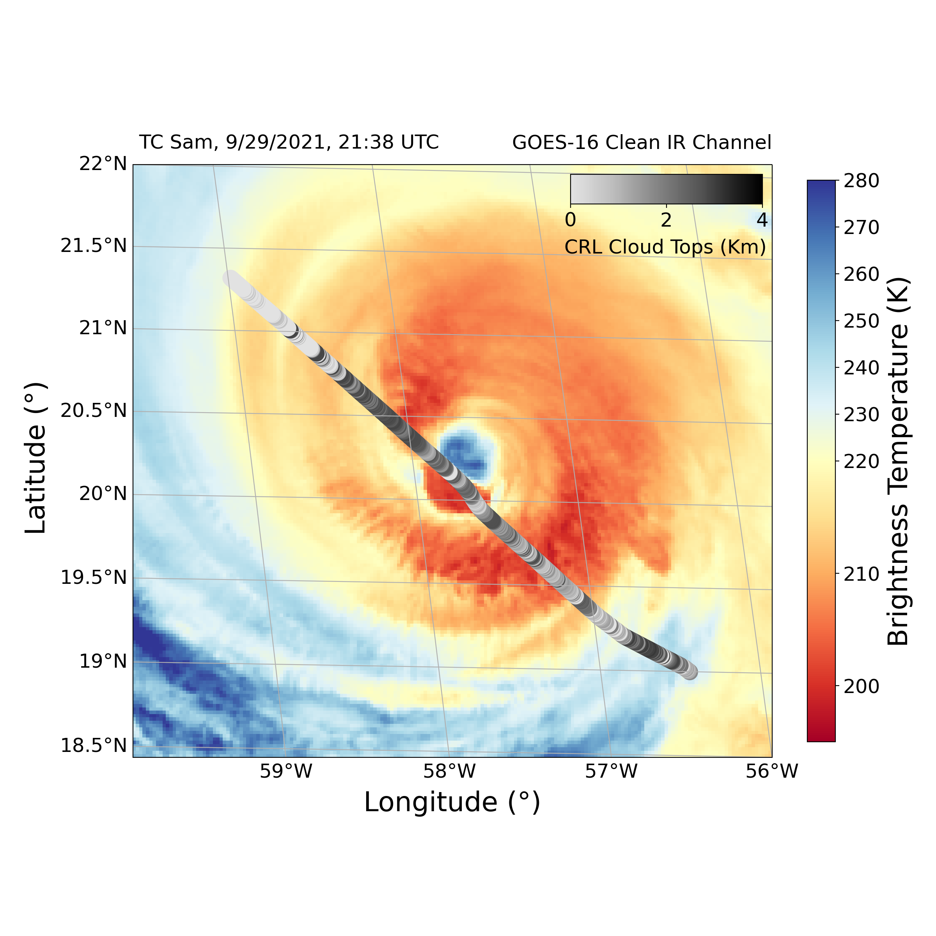
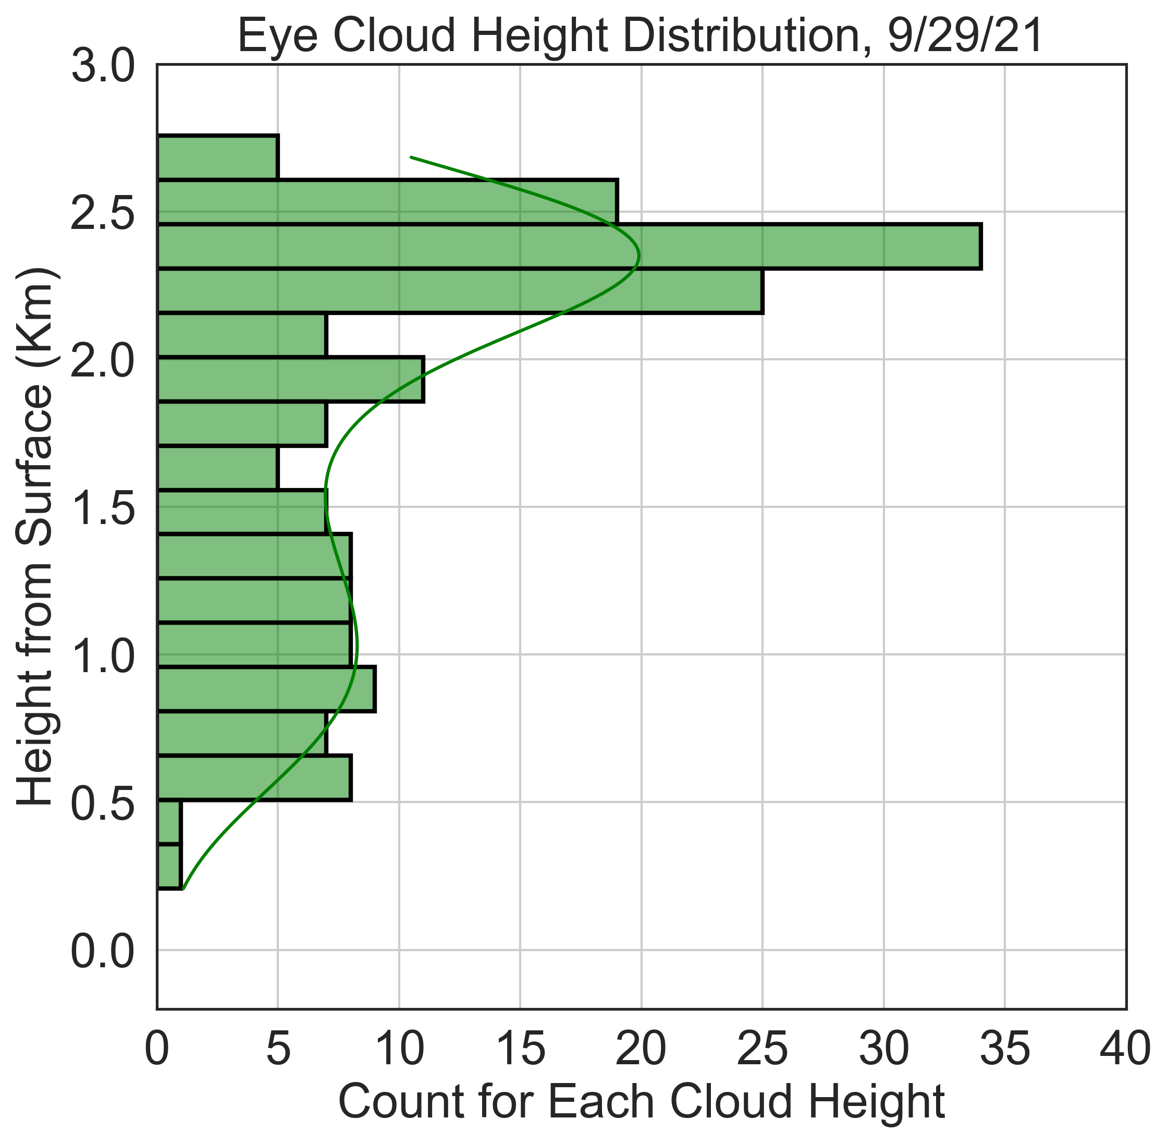
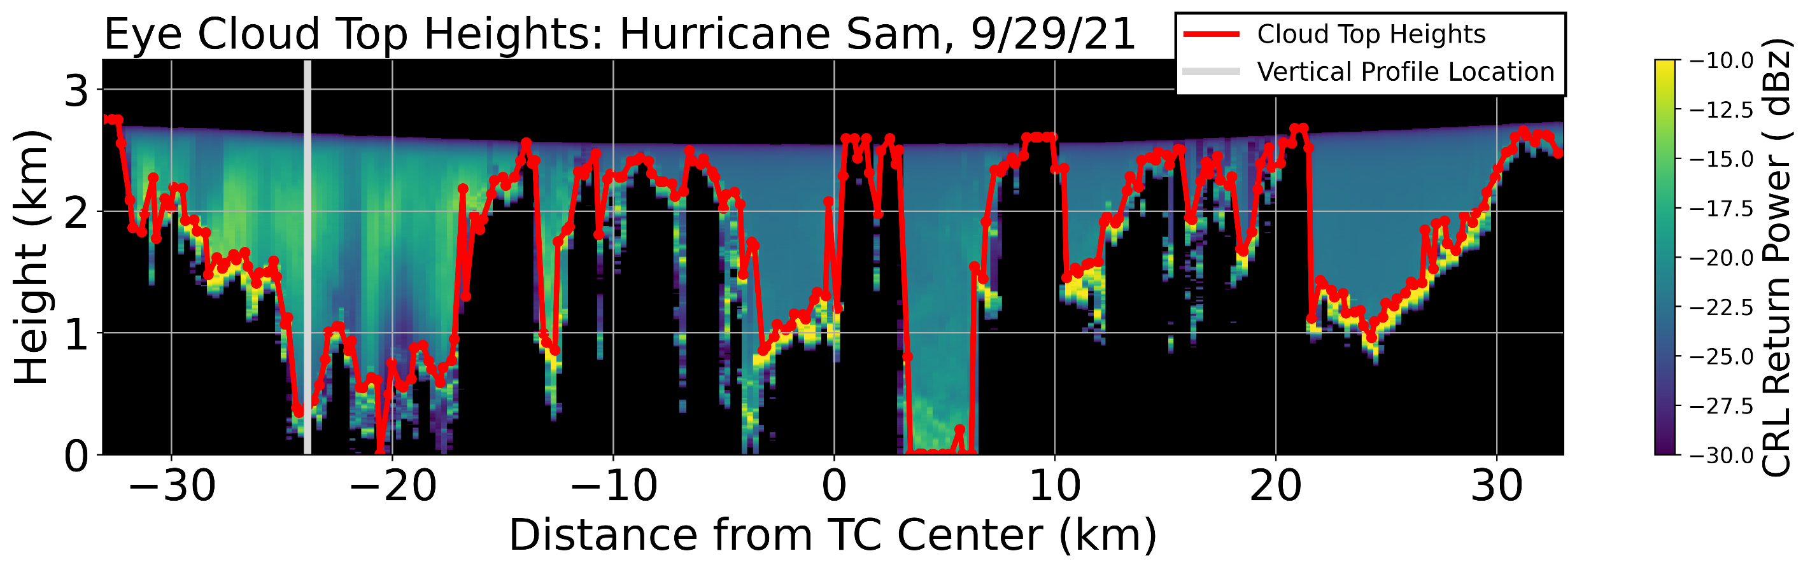
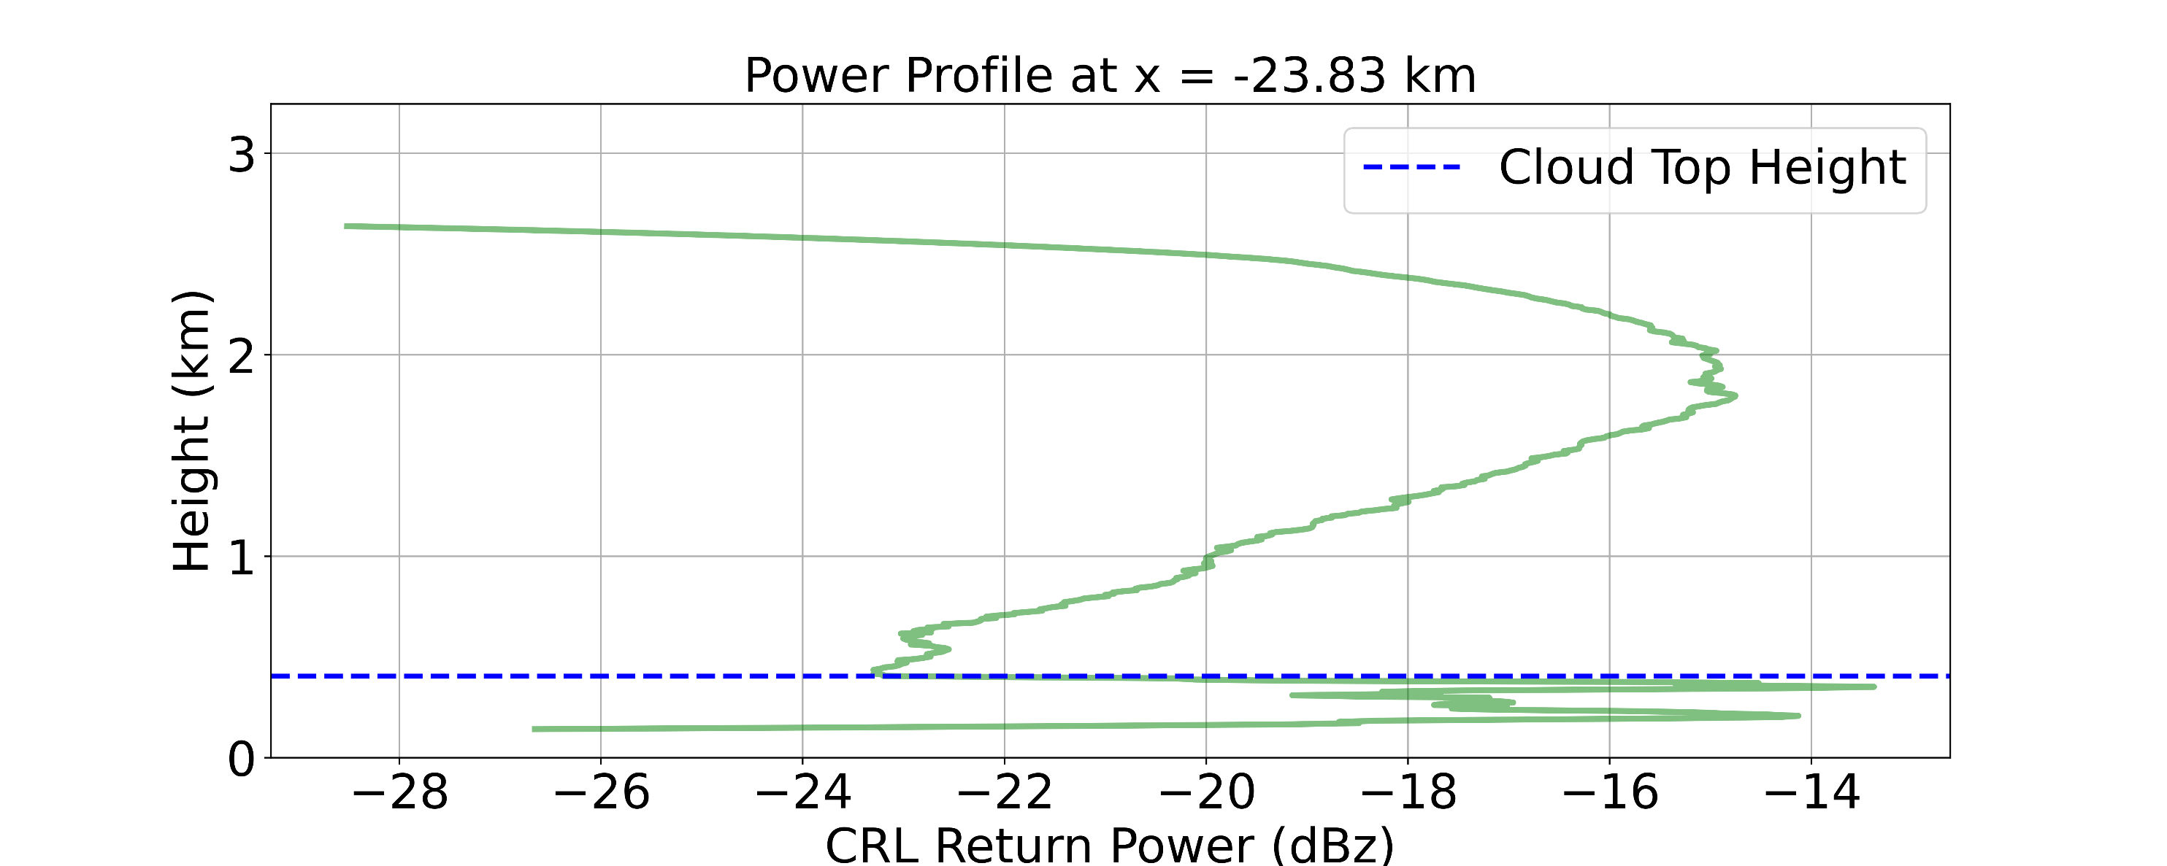
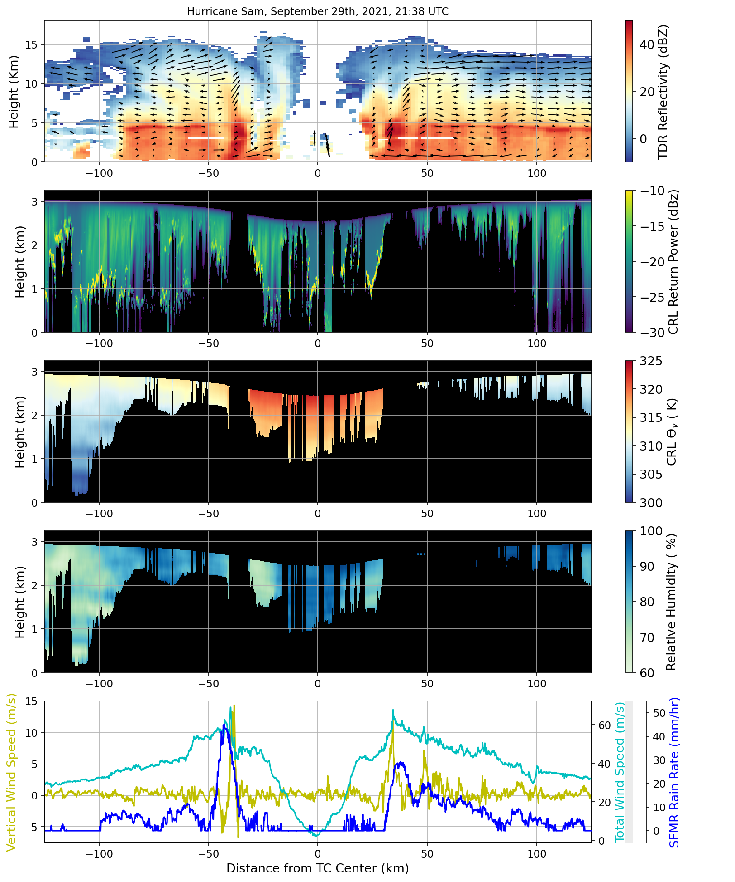




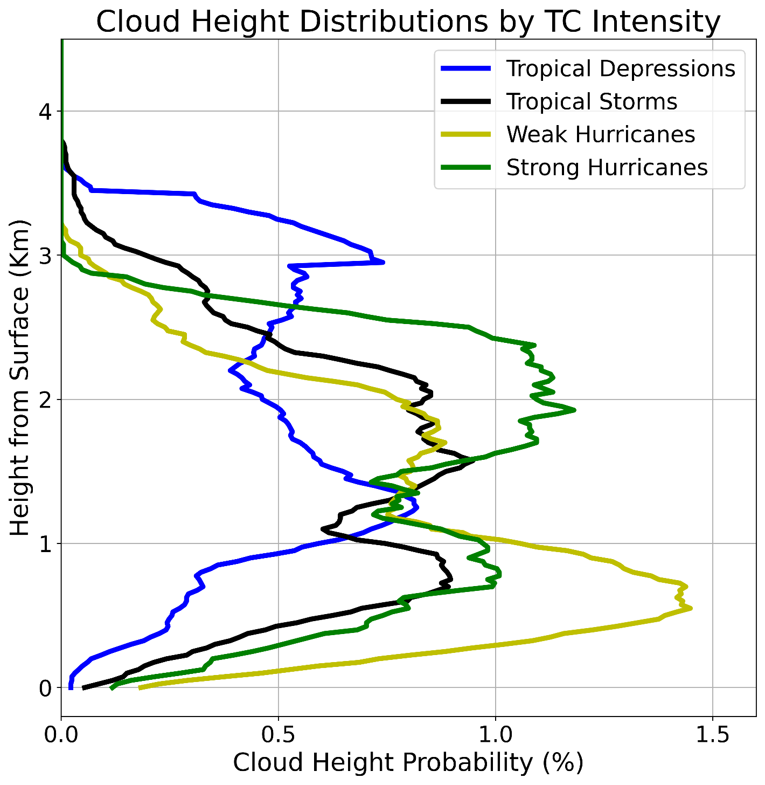
Convective Properties of Inner Core Tropical Cyclone Clouds Observed by Airborne Compact Raman Lidar
a
b
a
10.3 Knots
b
Ethan Murray^{1, 2}, Lisa Bucci³ , Jason Dunion^{3, 4} , Zhien Wang^{1, 2}, Jonathan Zawislak³ , and Jun A. Zhang^{3,4}
¹ Laboratory for Atmospheric and Space Physics, University of Colorado Boulder, Boulder, Colorado
² Department of Atmospheric and Oceanic Sciences, University of Colorado Boulder, Boulder, Colorado
³ NOAA Atlantic Oceanographic and Meteorological Laboratory and Hurricane Research Division, Miami, Florida
⁴ Cooperative Institute for Marine & Atmospheric Studies, University of Miami, Miami, Florida
c
Correspondence: Ethan.Murray@Colorado.edu
Figure 2: Schematic view of a cloud top height calculation. a) A zoomed in view of TC Sam’s eye, where the red line atop the data is the estimated cloud top heights. b) A vertical profile of return power taken at the position of the gray line in a). The smoother curve above .5 km represents precipitation, while the steeper peaks below .5 km represents attenuation from clouds.
Highlights
d
High resolution measurements of tropical cyclone (TC) eye cloud heights are made for the first time using compact Raman lidar (CRL) retrievals.
Paired with other observations, TC eye and eyewall dynamics are viewed with unprecedented detail, highlighting inner eye convection and mixing.
Cyclone Type | No. of Passes | Mean Cloud Height (km) | Clear Air Presence (%)
TD | 9 | 1.91 | 35.30
TS | 8 | 1.50 | 24.04
Weak Hurricane (Cat 1-2) | 10 | 1.15 | 10.19
Strong Hurricane (Cat 3-5) | 8 | 1.49 | 6.97
e
Background
TC eye clouds are the result of eyewall and boundary layer dynamics, two regions essential for understanding TC intensity change.
Yet, previous satellite and radar¹ based cloud studies have not measured cloud top heights throughout an entire TC eye.
Current theories propose that only stratiform clouds trapped beneath a strong inversion layer develop in TC eyes,^{2, 3} suggesting that low level mixing and downward subsidence are the only drivers of eye dynamics.
For the first time, this research project uses the CRL’s backscattered power channel (Figure 2) to find TC eye cloud top heights and update our understanding of eye dynamics.
Figure 3 (left): Cloud top height distributions for tropical depressions (TDs), tropical storms (TSs), weak hurricanes, and strong hurricanes. Table 2 (right): a summary of important cloud top height statistics. Note that clear air includes any CRL return height below 50 m.
f
Results
Important asymmetries exist even in strong TCs; precipitation entrainment on the left side of TC Sam’s eye (green streaks in Figure 1d) contrasts with clear air on the right side of the eye.
Air is much drier along the eyewalls versus in the TC center (Figure 1f); subsidence dominates along the eyewalls while mixing occurs in the TC center.
These asymmetries provide a
suitable environment for weak convective clouds to reach flight level in TC Sam’s center (Fig. 1d).
Weaker TCs also have more clear air filling their eyes due to more asymmetric convection and a less stratified inversion layer (Table 2).
TS and weak hurricane distributions show many low cloud peaks, strong hurricanes have an even cloud height distribution, and the TD signal is dominated by sporadic, tall convective clouds (Figure 3).
Available TDR, CRL, and flight level data are plotted on a common x axis (Figure 1).
Cloud top heights are found using a CRL backscattered power algorithm. Sharp return peaks from clouds differ from the smoother peaks due to precipitation (Figure 2), a feature unique to CRL observations.
TC eye and eyewall dynamics are diagnosed from case studies and cloud top height distributions grouped by intensity (Figure 3).
g
Methods
Storm Name | Dates (2021) | No. of Passes | Lowest Mean SLP (hPa) | Highest Surface Winds (kt) | Category (Saffir-Simpson)
Fred | 12-13 Aug | 7 | 1010 | 32.5 | TD
Grace | 16-19 Aug | 11 | 988 | 70 | TD-1
Henri | 20-21 Aug | 5 | 988 | 65 | TS-1
Ida | 27-29 Aug | 5 | 931 | 130 | 1-4
Sam | 26-29 Sept | 7 | 928 | 135 | 3-4
Figure 1: Observational data from the inner core of TC Sam.
a) A GOES 16 clean IR satellite view of Sam’s eye and eyewall . CRL cloud top heights and environmental shear are also provided.
b) The cloud top height distribution for this eye pass calculated using the methods described in Figure 2.
c) A tail Doppler Radar (TDR) view of Sam’s eye, eyewall, and inner rainbands. High reflectivity values correspond to high precipitation rates. Arrows show Sam’s secondary circulation derived from TDR velocities. Both eyewalls are located around 37.5 Km from the TC center.
d-f) Compact Raman lidar (CRL) plots of return power, virtual potential temperature, and relative humidity. Black regions denote areas of total signal attenuation.
g) Flight level measurements of total wind speed (cyan), vertical wind speed (yellow), and SFMR rain rates (blue).
Citations
¹ Rogers, Robert F. “Recent Advances in Our Understanding of Tropical Cyclone Intensity Change Processes from Airborne Observations.” Atmosphere 12, no. 5 (May 2021): 650.
² Willoughby, H. E. “Tropical Cyclone Eye Thermodynamics.” Monthly Weather Review 126, no. 12 (December 1, 1998): 3053–67.
³ Houze, Robert A. “Clouds in Tropical Cyclones.” Monthly Weather Review 138, no. 2 (February 1, 2010): 293–344.
Table 1: All TC cases included in cloud height calculations, highlighting the number of eye passes versus intensity.

