Slide 1
SPACE MONITOR
EXECUTIVE BRIEFING · APR 2026
Space Monitor.
An always-on intelligence layer for international space partnerships — built for the people in the room when those partnerships are made.
SUBJECT
TIME
Capability overview
10 minutes

Slide 2
SPACE MONITOR
02 / 10
THE TRIP YOU'RE ABOUT TO TAKE
Eight capitals. Forty meetings. One question, every time.
"What is this country actually doing in space — and where can we work together?"
Today the answer lives across an analyst's spreadsheet, last week's news, three PDFs, and someone's memory.
Space Monitor consolidates it into a single briefing, refreshed daily, with sources you can cite in the room.

Slide 3
SPACE MONITOR
03 / 10
WHAT THIS GIVES YOU
Four products, one database.
01
A country briefing on demand
Walk into any meeting with a Claude-written, citation-backed dossier on that country's space activity in the last 90 days.
02
A live map of every partnership
Bilateral and multilateral cooperation, sized by count and shaded by strength — clickable down to the source article.
03
A watchlist that finds you
Star a country, an organization, or a partnership type. A weekly digest tells you what changed, with one-click approve / reject links.
04
A search across seven thousand vetted partnerships
The legacy intelligence binder, now queryable — joined to every news article and contract the system has ingested since.

Slide 4
SPACE MONITOR
04 / 10
A BRIEFING FOR EVERY MEETING
One command. Ninety days of context.
Type the country. Get a written briefing synthesized from every article, partnership, contract and leadership change tagged to that country.
$ space-monitor brief India --since-days 90
India — Space activity, last 90 days
62 ARTICLES · 11 PARTNERSHIPS · ISRO + IN-SPACE
TOP DEVELOPMENTS
NSIL signs commercial launch agreement with European smallsat operator.
IN-SPACe authorizes two new private launch vehicle programs.
ISRO confirms Gaganyaan crew rotation and Q3 demonstrator schedule.
Cost-optimized: the same query within the same week is reused for free; older briefings refresh automatically with new sources.
ACTIVE PARTNERSHIPS IN WINDOW
India — United States · G2G · civil exploration
India — France · B2B · Earth observation joint venture
Articles ·
62
Partnerships ·
11
Leadership ·
3
India — Australia · G2G · ground station access

Slide 5
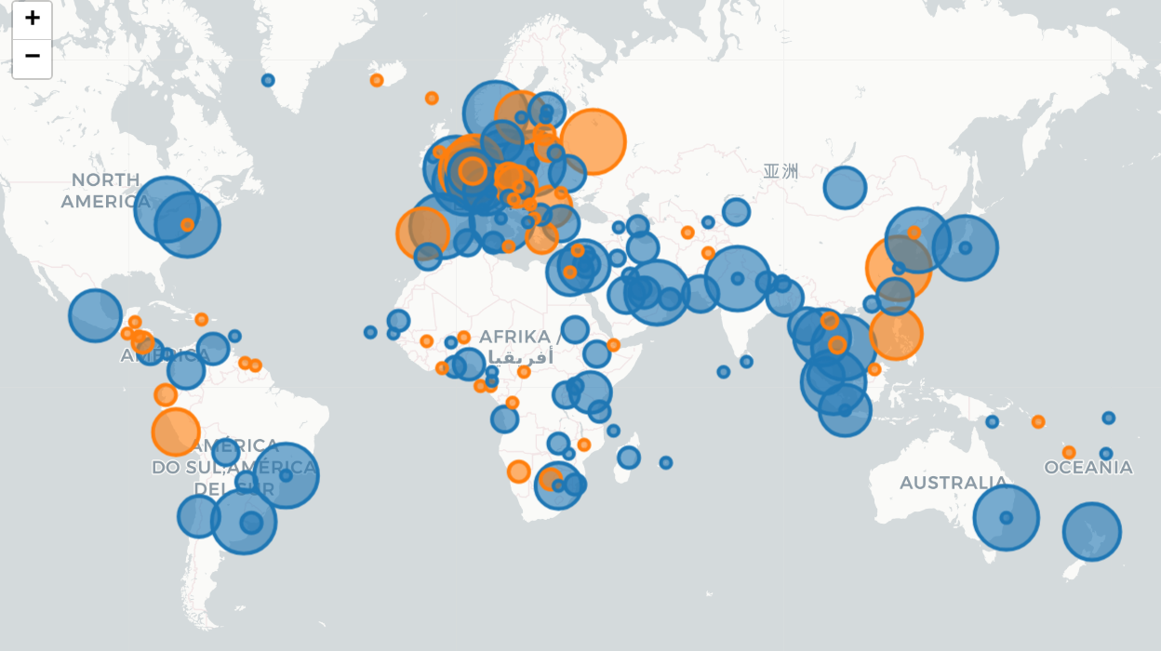
SPACE MONITOR
05 / 10
THE WORLD, WATCHING ITSELF
Every public space partnership, on one map.
Every bilateral and multilateral partnership in the binder, plotted at its host country. Bubble size scales with partnership count; color encodes both parties in the pair.
partnerships by location
strength weighted
7,614 partnerships in scope

Slide 6
SPACE MONITOR
06 / 10
FROM OPEN NEWS TO VETTED INTELLIGENCE
A five-stage pipeline, refreshed every day.
STAGE 01
STAGE 02
STAGE 03
STAGE 04
STAGE 05
Discover
Prefilter
Tag & extract
Draft
Analyst review
26 source adapters — RSS feeds, HTML scrapers, Google News searches across 30 queries — sweep agency and trade press in seven languages.
Cheap LLM classifier triages headlines from noisy sources. Keeps the expensive read off articles that will obviously be skipped.
Every article is tagged by country, then routed through typed extractors: partnerships, contracts, leadership changes. Cheapest model first (Haiku); on low confidence, escalate to a stronger model (Sonnet).
Each finding becomes a structured draft row — countries, organizations, business model, partnership type, strength score, source URL.
Drafts queue in a web UI — or a digest email with one-click magic-link approve / reject. Nothing reaches the live record without a human signing it.
PER ARTICLE
DAILY RUN
MONTHLY
HARD CAP
~$0.004
~$1–2
$30–60
$200 / mo
all stages combined
across 25 sources
all-in AI cost
auto-alarm before breach

Slide 7
SPACE MONITOR
07 / 10
COVERAGE TODAY
25 working sources, seven languages, six continents.
SOURCES
PARTNERSHIPS
LANGUAGES
CADENCE
25
7,614
7
24 h
English, French, Italian, Portuguese, Hebrew, Arabic and Spanish — translated in-pipeline.
Refreshed every day. Missed days are harmless — the pipeline catches up on its own.
Live news adapters across agencies, trade press, and policy outlets.
Historical bilateral and multilateral partnerships, queryable today.
A REPRESENTATIVE SLICE
NASA
USA
ESA
EU
CNES
FR
ASI
IT
CSA
CA
ISRO
IN
SANSA
ZA
PhilSA
PH
INPE
BR
+ 16 more

Slide 8
SPACE MONITOR
08 / 10
THE ANALYST STAYS IN THE LOOP
Automation handles breadth. The analyst owns judgment.
→
Every draft surfaces with the original article visible side-by-side.
DRAFT · PARTNERSHIP_DRAFT
India — France
Every score is a function of the workbook's rubric — not an AI opinion. The analyst can override.
→
CNES and ISRO sign joint statement to extend the Trishna Earth-observation mission and explore co-development of a follow-on infrared imager. Working group convenes in Bengaluru in Q3 2026.
→
Approval files the draft into the live record under a predictable, traceable ID . Rejection keeps the draft on file with a full audit trail .
TYPE
MISSION
G2G cooperation
Earth Observation
BUSINESS MODEL
SOURCE
→
Approve / reject from a one-click email link , in transit, between meetings.
G2G
cnes.fr / 14 Apr 2026
AUTO-SCORED STRENGTH · 4.2 / 5 · AWAITING REVIEW
→
Every AI extraction is a proposal, never a fact . Nothing reaches the binder until a human signs it.

Slide 9
SPACE MONITOR
09 / 10
WHAT IT COSTS, WHAT IT REPLACES
A junior analyst's monthly clipping budget.
MONTHLY RUN-COST
WHAT IT REPLACES
$30–60
~30 hrs/ wk
→
All-in: model calls for extraction, country tagging, prefilter, signal routing, weekly briefings. Hard cap: $200/mo. Daily cost-alarm wired to a webhook.
Manual reading, structuring, and entry across the partnership, contract and leadership-change tables — an analyst's primary recurring task today.

Slide 10
SPACE MONITOR
10 / 10
WHERE IT GOES NEXT
Same rails, more signals.
NEXT 90 DAYS
NEXT 90 DAYS
THIS YEAR
SIPRI defense-spending connector
UCS satellite database
Investment-outlook dossiers
Every spacecraft on orbit, attributed by country and operator, joined to the partnership and contract record.
For every (country × mission) cell the analyst reviews, an auto-built evidence pack — assets, programs, partnerships, and recent news, ready for narrative.
National defense and civil-space budgets refreshed automatically — one less spreadsheet to maintain by hand.
Built once. Refreshes every day. Walks into the room with you.

