Slide 1
The CHAAC UNIT
By Rodney Sanchez and Trevor Sherrard

Slide 2
Robot Video

Slide 3
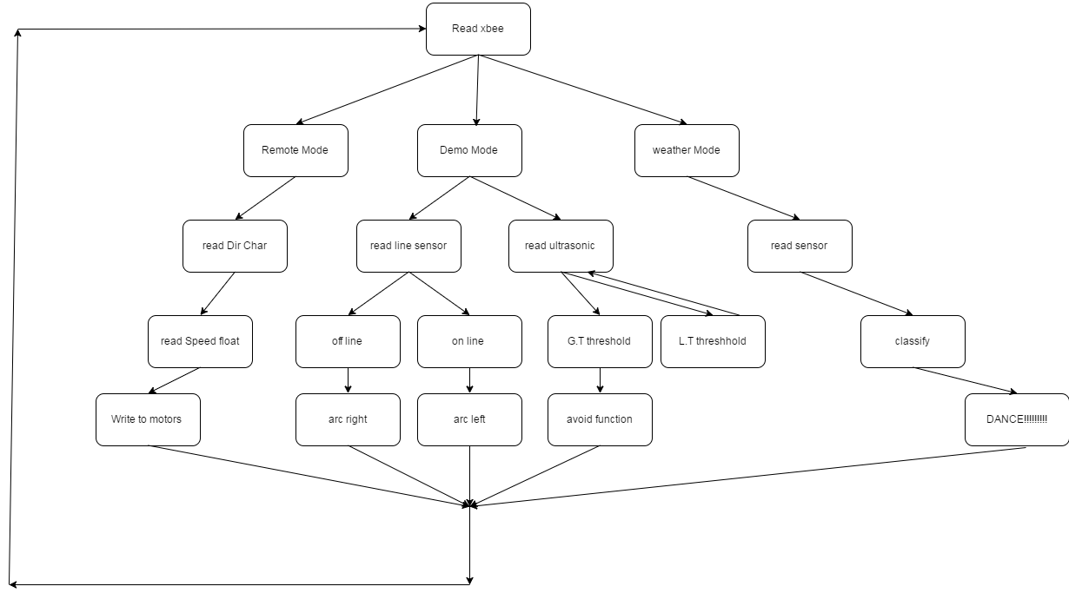
Flow Chart

Slide 4
Hardware
Ultrasonic sensor
Teensy
Raspberry Pi
H-Bridge
Sparkfun BME280
Line Sensor
Phone charger

Slide 5
Problems and Solution
Problems
Detecting Weather
Control of weather data gathering
Remote Control
Serial Communication between the Raspberry Pi and Teensy
Solutions
Created a dataset of Rochester weather
Designed a multivariable logistic regression model
Designed a “control and value” communication scheme used over XBEE wireless serial.

Slide 6
Questions
What is logistic regression?
How was data moved from the controller to the Teensy to the Raspberry Pi?
Any Other Questions?

