Slide 1

Final
Group 4 Project
Chunyu Huang
Guoming Lin
Thuan Bui

Slide 2
Agenda
01
Introduction
02
Business Rules
03
EDA
04
ERD Model
Notes:
Introduction (about dataset, how and where collect, why choose this one) (Ming: )
Business rules + how collect and identify (Jack just help by chatgpt)
EDA analyst + Database in powerPI (Ming: just idea, latter together do in PowerBi)
ERD entity, table, relationship, constrain
Data warehouse (Thuan)
Insight in powerbi (all member)
Future work (what expect to learn and will do) (Jack chatgpt and google)
Reference (if we have)

Slide 3
Agenda
05
Data Warehouse
06
Insight and recommendation
07
Future Work

Slide 4
1. Introduction
About the SuperStore:
Retail dataset tracking U.S. sales, customer behavior, product trends, and regional data. Real transaction records support inventory planning and regional performance analysis. The dataset contains 9,994 order records with detailed financial metrics.
Challenge:
Profitability gaps (high-sales products with low margins).
Customer retention opportunities (loyal buyers vs. one-time purchasers).
Goal:
To improve operation and financial performance this SuperStore.
Discount vs. Profit analyst.

Slide 5

Introduction
Approach:
SQL, SSIS, PowerBI, R programming, Python and Excel.
We found the website on Kaggle.
https://www.kaggle.com/datasets/timchant/supstore-dataset-2019-2022/data

Slide 6
2. Business Rule
Customers and Segments
Each customer belongs to a segment that classifies their type (e.g., consumer, corporate)
Customers must be linked to a location that includes details like ZIP code, region, city, state, and country
Orders
A customer can place multiple orders
An order can have one or multiple products from a customer
Each order includes the order date and ship date
Products and Manufacturer
Each product is assigned to one sub-category and one manufacturer.
A manufacturer can create one or multiple products.
Products have a name and are uniquely identified by a Product ID.

Slide 7
2. Business Rule
4. Categories and Subcategories
Each subcategory belongs to one category.
Each category can have one or many subcategories.
Categories and subcategories organize the product catalog hierarchically.
5. Order Lines
An order line refers to a single product within an order.
Order lines record sales, quantity, discount, profit, and profit margin.
A single order can have one or multiple order lines.
6. Geography
Location information includes Country , State, City, ZIP, and Region for the Customer

Slide 8
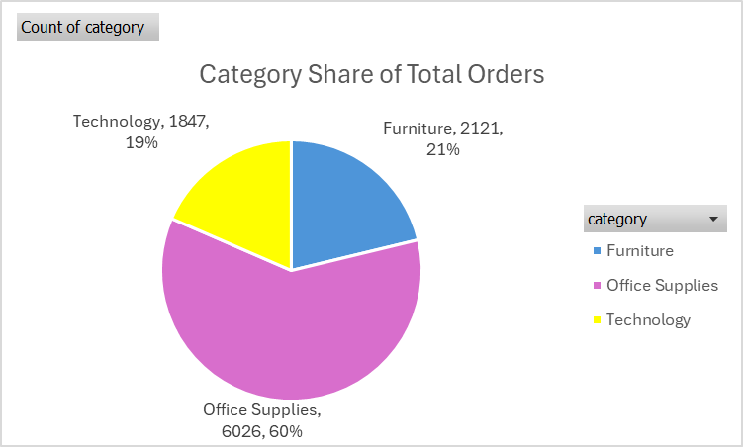
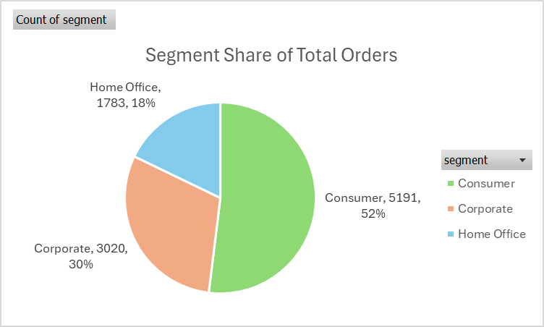
3. EDA
Field | Unique Count
Customers | 793
Manufacturers | 182
Product Names | 1,849
Segments | 3
Categories | 3
Subcategories | 17
Regions | 4
Cities | 531
States | 49

Slide 9
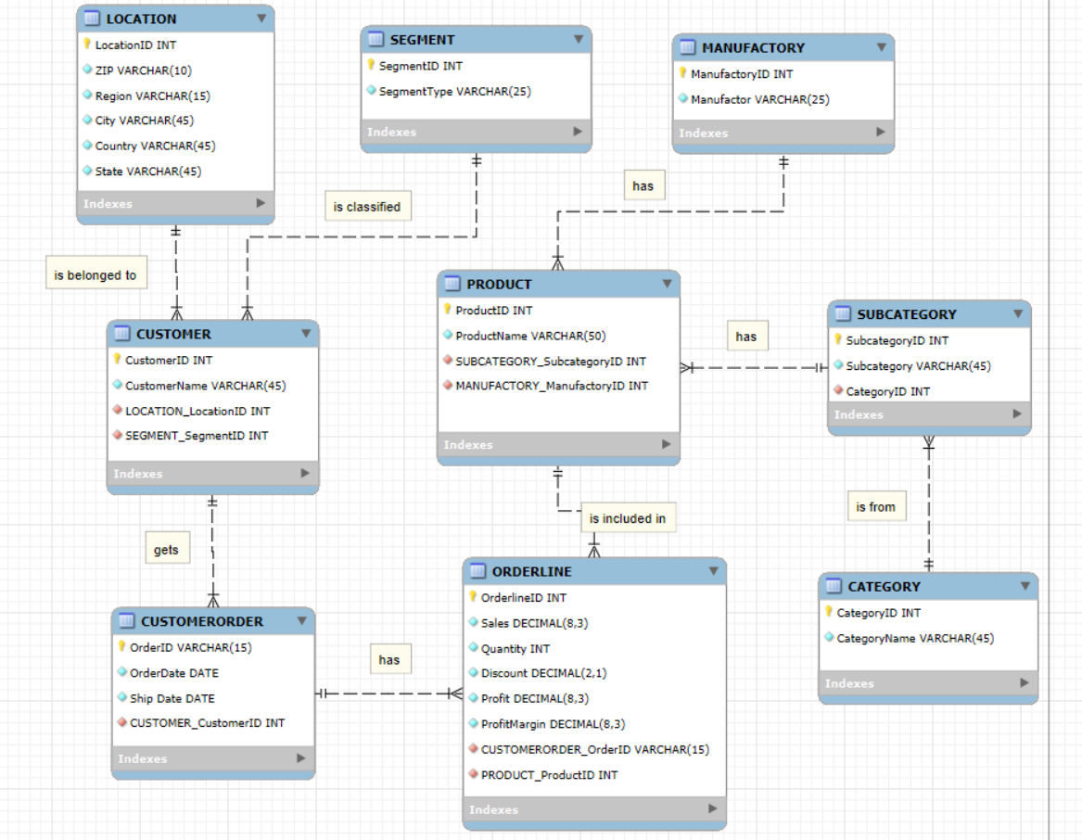
4. ERD Model
9 entities that reach 3NF,
Relationships 1:M
Constrains: ON Update/ Delete Cascade

Slide 10
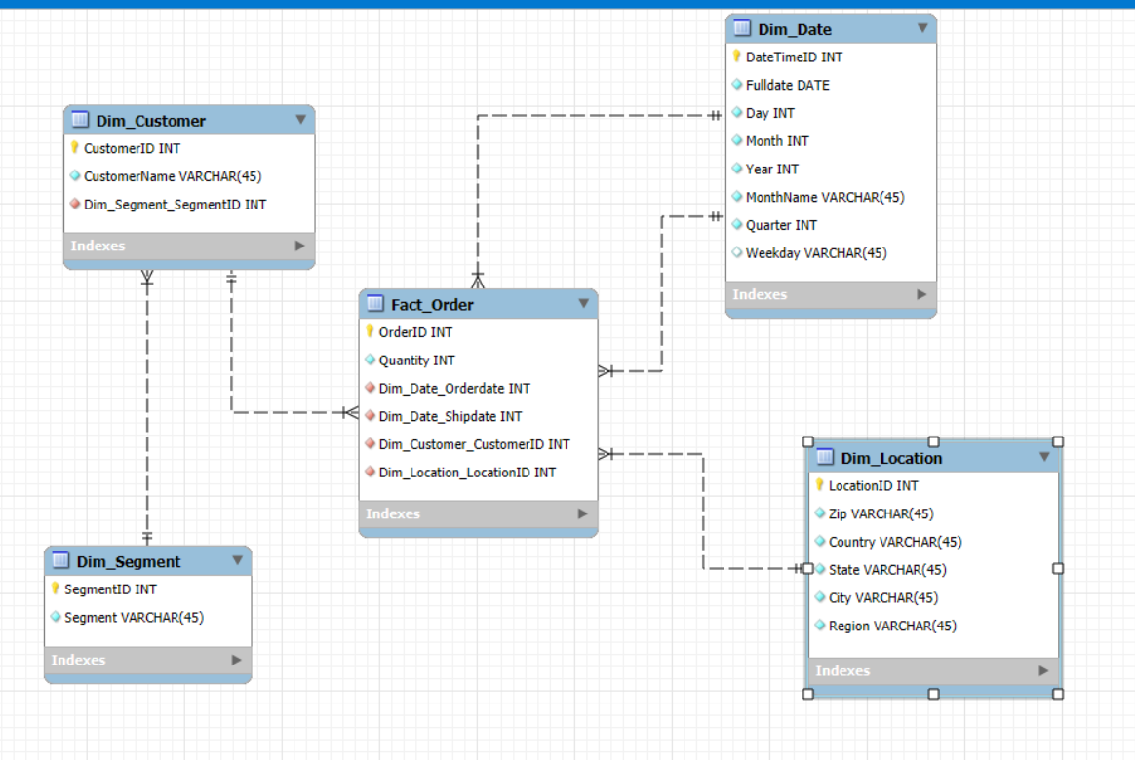
5. Data Warehouse

Slide 11
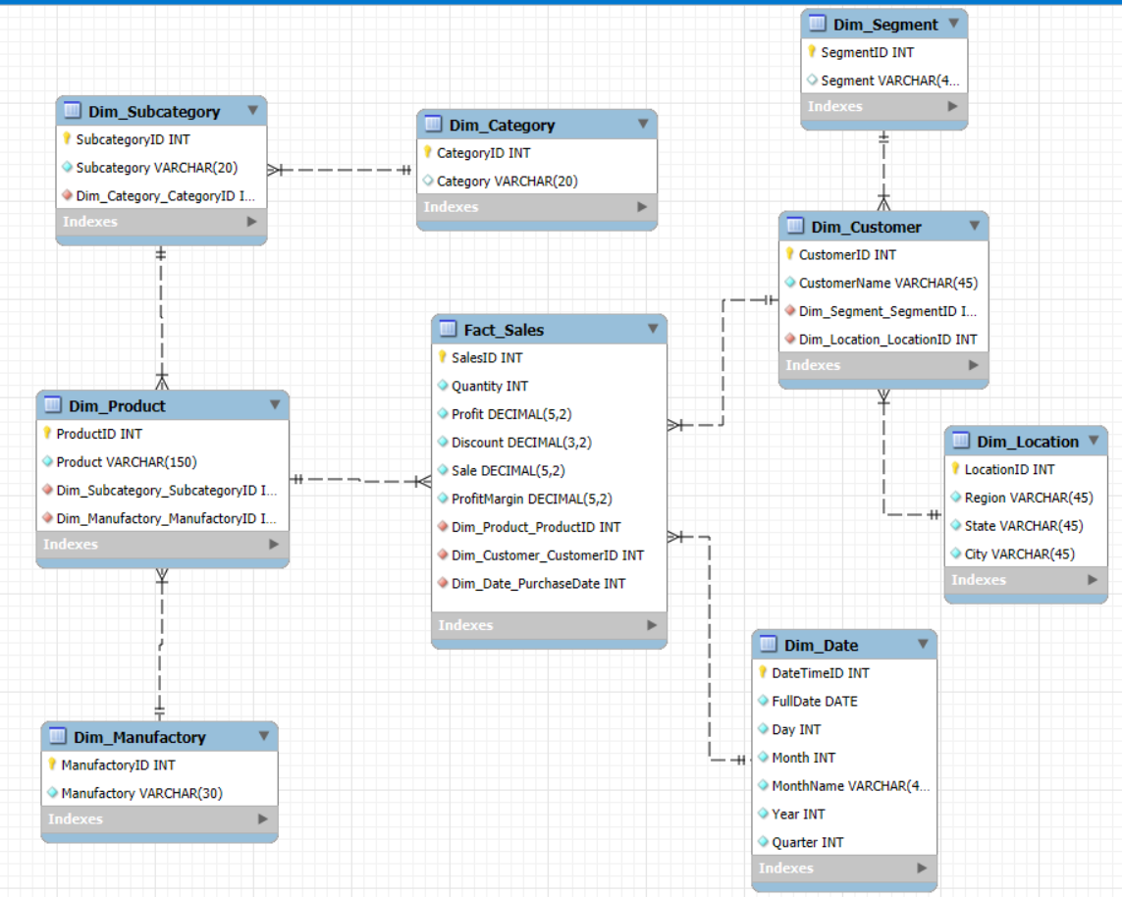
5. Data Warehouse

Slide 12
Insight & Recommendation
06

Slide 13
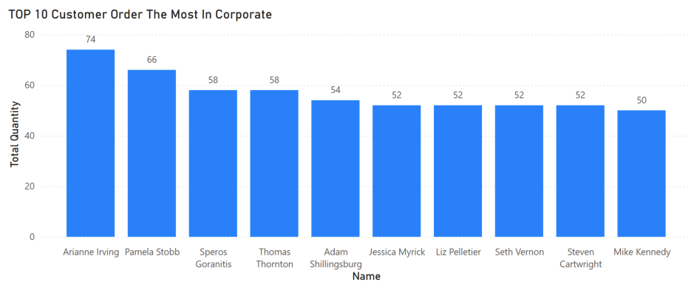
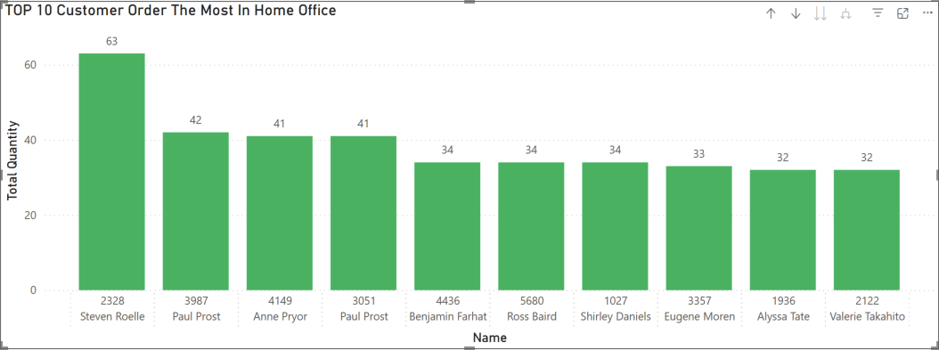

Slide 14
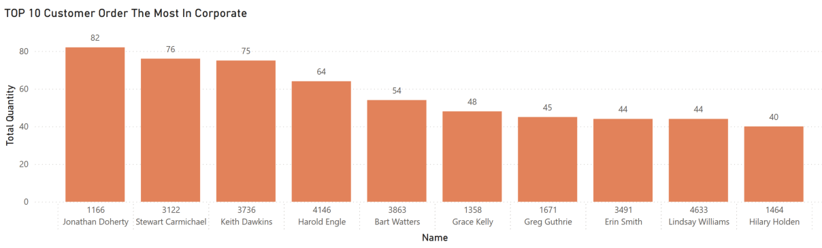

Slide 15
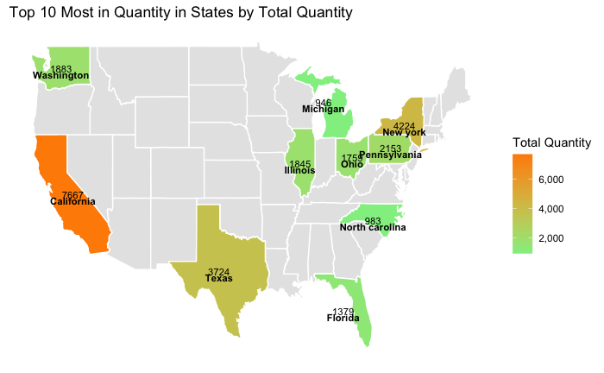

Slide 16
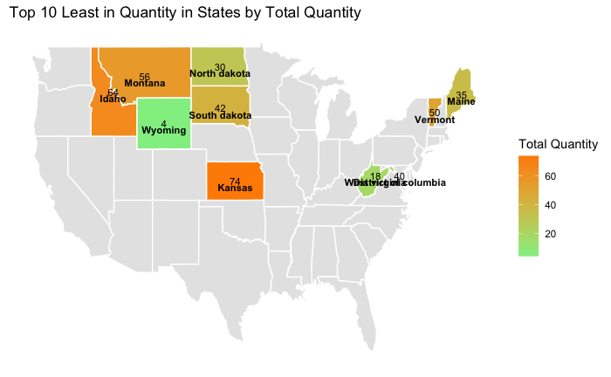

Slide 17
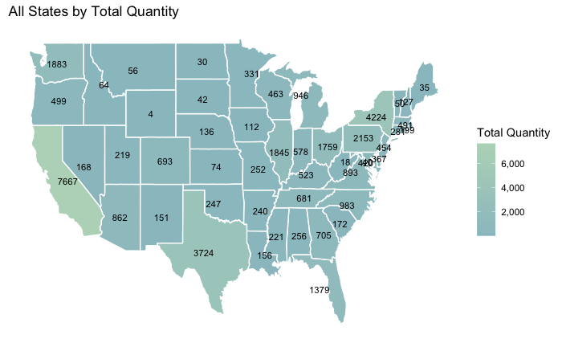

Slide 18
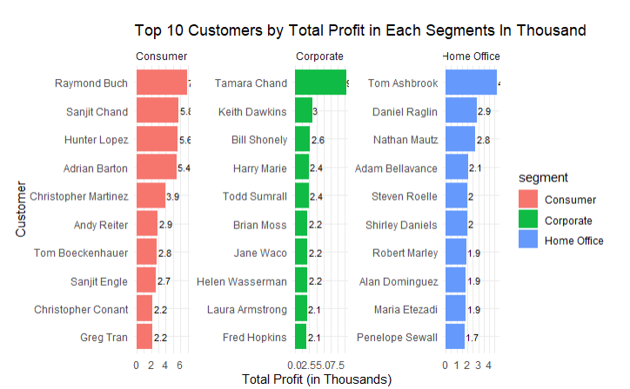

Slide 19
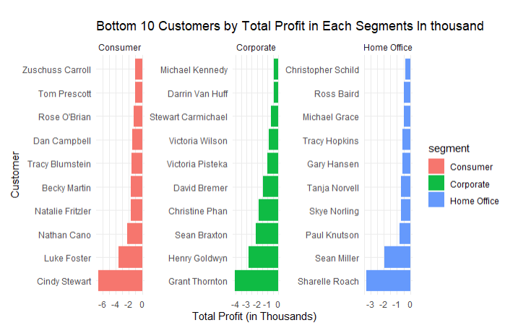

Slide 20
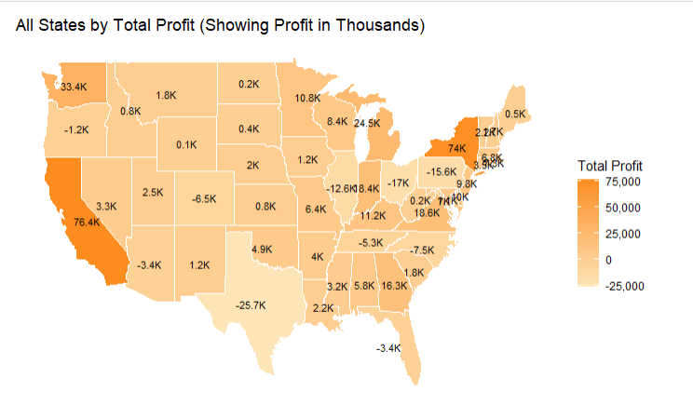
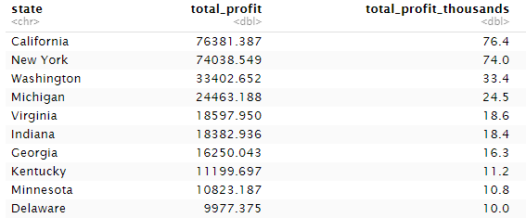

Slide 21
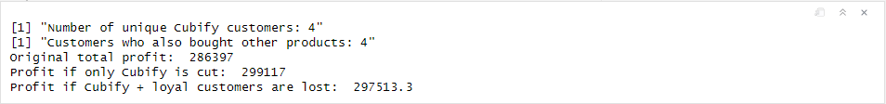
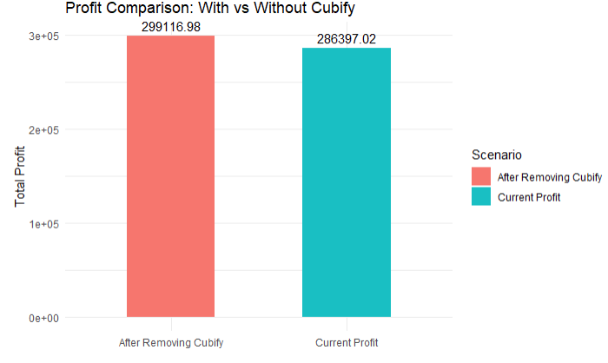

Discount solution (For Cubify)

Slide 22
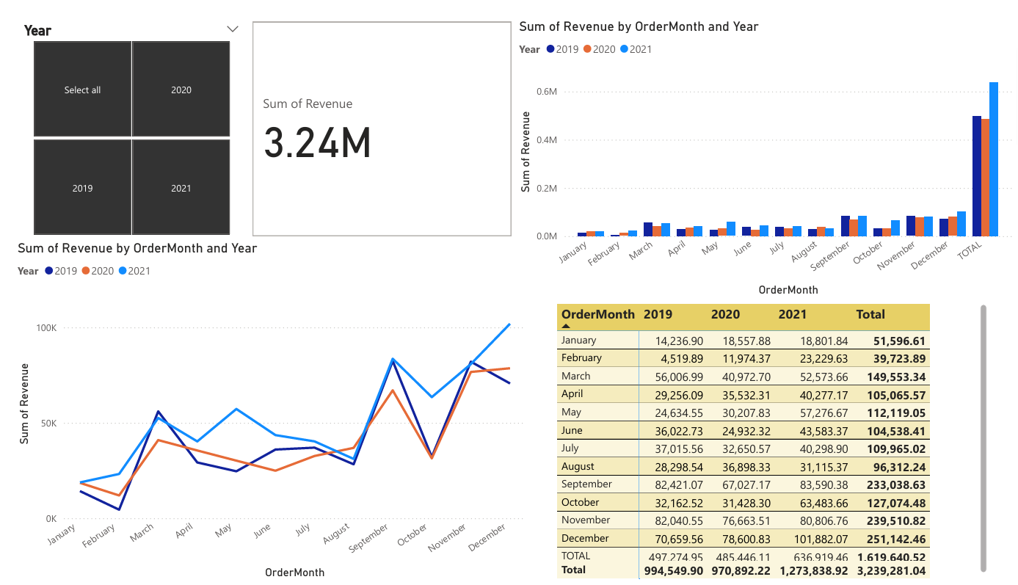

Slide 23
Recommendation
Strengthen Q4 Campaigns
Inventory and Supply Chain Planning
Promotional Timing

Slide 24
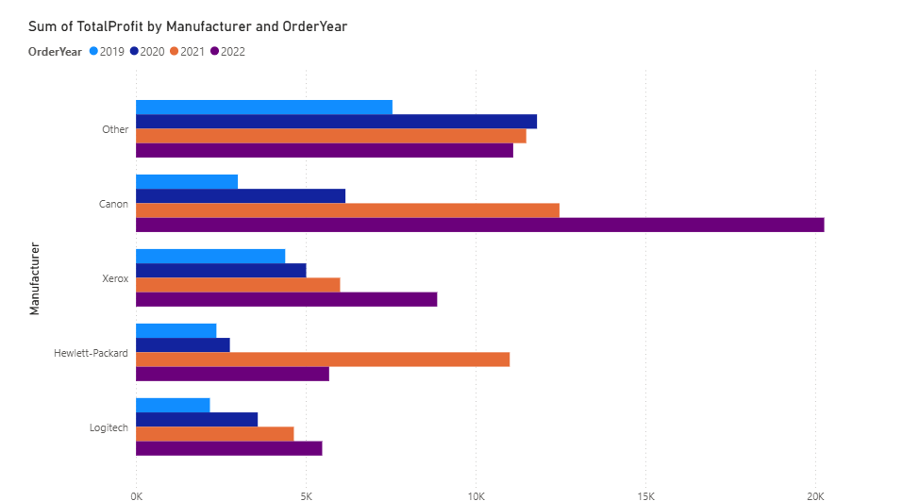
Recommendation
Increase investment in Canon products
Research more for the "Other" category

Slide 25
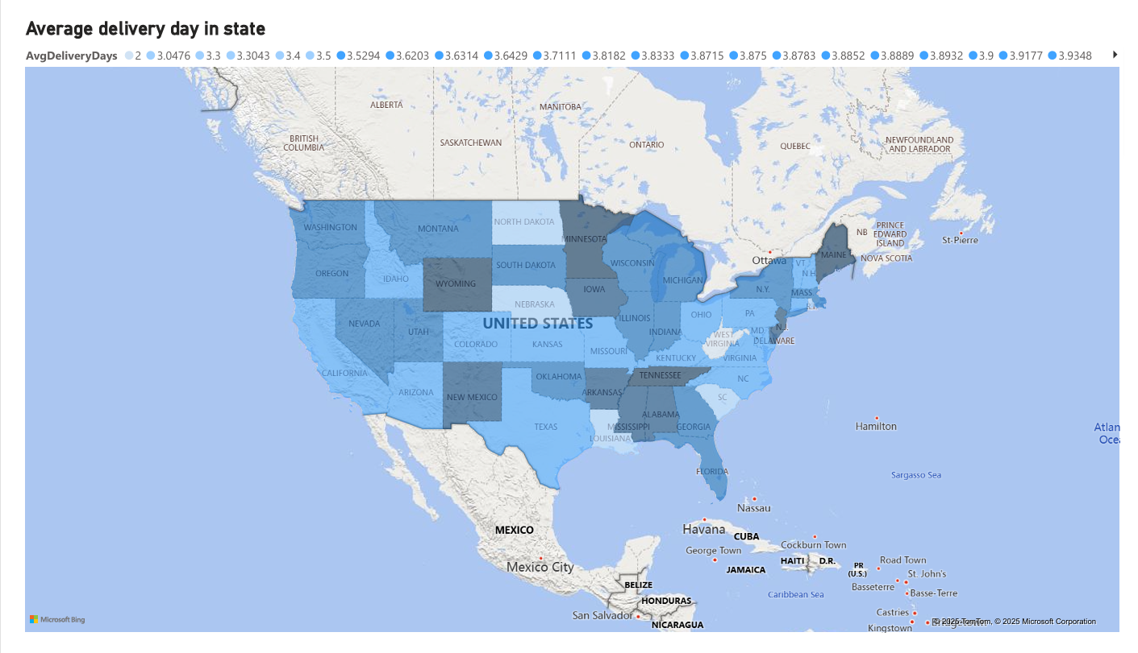
- The average delivery day is from 2 -5.5 days.
- With max delivery day is 7 days and min is 0 days.
- States had highest delivery is Wyoming, Maine,...
- States had lowest delivery is West Virginia, Louisiana.

Slide 26
Recommendation
Investigate the causes of delays
Expand or Reallocate Distribution Centers
Pilot Programs in Underperforming Regions

Slide 27
7. Future work
Due to time constraints and limited experience, there remains considerable potential for improvement
Advanced Tools
Variety of Tools with SQL Connection for Data Visualization
Research deeper and apply More Business Management and Business Analyst into This Dataset
Notes:
Limited in time and knowledge in tool and this field

Slide 28
Thank You

