Slide 1






THE STUDY OF THE IMPACT OF SOCIAL MEDIA MARKETING ON PURCHASE INTENTION: A CASE STUDY OF BLUESEED DIGITAL COMPANY
Bui Duy Thuan
Supervisor, Anupam Mazumdar

Slide 2
Acknowledgement
- Mr. Anupam Mazumdar
- Mr. David Ratcliffe
- Ms. Pham Thi Tuyet Trinh
- Blueseed Digital company
- My participants
- My family and friends

Slide 3
Table of contents
01
04
Introduction
Findings
02
05
Literature review
Conclusion
03
06
Methodology
Reference list

Slide 4
1. Introduction

Slide 5

Background
- Social media
- Social media marketing
(Tuten and Solomon, 2018; Yu et al., 2018).
- Purchase intention
(Kudeshia and Kumar, 2017)
- Blueseed Digital company
Facebook had 75.6 million active users in Viet Nam (Ministry of Information and Communication of the Socialist Republic of Viet Nam, 2022).

Slide 6
Problem statement
The support of Blueseed Digital company in social media marketing was no longer as effective for the clients as it used to be in the past.
Previous studies used quantitative methods and lack of qualitative research (Kim and Ko, 2010; Balakrishnan et al., 2014; Mai and Tran, 2016; Gautam and Sharma, 2017; Laksamana, 2018; Almohaimmeed, 2019).

Slide 7
Purpose of the study
This research aims to investigate the influence of social media marketing on purchase intention of customers in Viet Nam to help firm have in-depth understanding and improve the quality of social media marketing plans.
To explore the factors of social media marketing that affects purchase intention of customers.
To evaluate the impact of social media marketing on purchase intention.
To propose recommendations for improving social media marketing of Blueseed Digital company

Slide 8
2. Literature review
Many studies about the influence of social media marketing on purchase intention were conducted in different countries but rare in Viet Nam and were lack of qualitative research (Kim and Ko, 2010; Balakrishnan et al., 2014; Mai and Tran, 2016; Gautam and Sharma, 2017; Laksamana, 2018; Almohaimmeed, 2019)

Slide 9
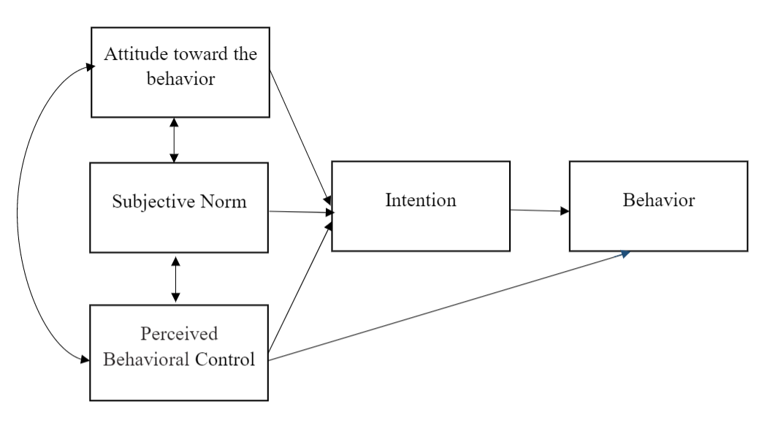
Theory of Planned Behavior
Figure 1: Theory of Planned Behavior (Ajzen, 1991)

Slide 10
Empirical studies
Kim and Ko (2010) | Mai and Tran (2016) | Almohaimmeed (2019)
Quantitative research | Quantitative research | Quantitative research
Measured by 5 factors (entertainment, customization, interaction, word of mouth, and trend) | Measured by 3 factors (online advertising, online communities, electronic word-of-mouth) | Measured by 3 factors (application types, social effects and enabling technologies)
It was initial effort and later expanded and developed in many studies | Same country and topic as this research | One of the newest studies in this topic

Slide 11
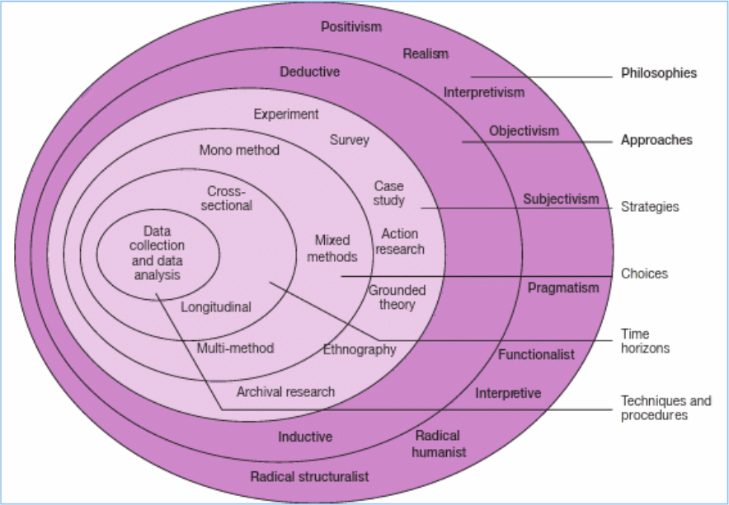
3. Methodology
Figure 2: Research onion model (Saunders et al., 2007)

Slide 12
3. Methodology
- Research philosophy: Interpretivism
- Research approach: Inductive approach
- Research strategy: Case study
- Research choice: Qualitative method
- Time horizons: Cross-sectional
- Data collection method: non-probability purposive sampling through semi-structured interview
- Sample size: 6 participants
- Data analysis technique: thematic analysis

Slide 13
4. Findings
Table 1: Demographic information of participants
Order by day of the interview | Age | Gender | Job | From the point of view of
1 | 23 | Male | Coder | Consumer
2 | 30 | Female | Marketer | Expert in social media marketing
3 | 32 | Female | Sale managers | Manager level
4 | 39 | Male | Digital marketing agency | Expert in social media marketing
5 | 34 | Male | IT helpdesk manager | Manager level
6 | 20 | Female | Student | Consumer

Slide 14
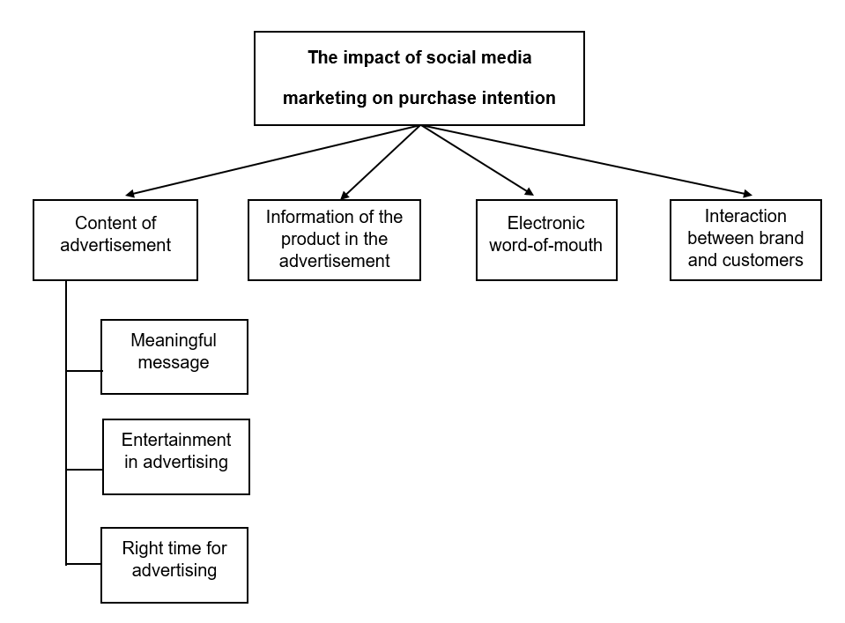
Thematic analysis
Figure 3: Thematic map

Slide 15
Thematic analysis
It carries the meanings and touches my heart... I never want to buy anything just through advertising or marketing... I am quite strict for myself. However, it will be my first priority when looking for products. (IT helpdesk manager).
Theme 1: Content of the advertisement
Subtheme 1: Meaningful message
Subtheme 2: Entertainment in advertising
Subtheme 3: Right time for advertising
The color of the advertisement was vivid, colorful that really encouraged me to buy it. It looks yummy…the song has a catchy tune and upbeat tempo is comfortable to listen to. This makes me want to buy it more. (Coder)
Special days are like Black Friday, holidays, … These days, people go crazy shopping, and I am partly affected by them. But, I also will consider buying it for future usage, even if now, it is totally unnecessary. (Marketer)

Slide 16
Thematic analysis
Theme 2: Information of the product in the advertisement
The information of this product is very little, just about 2 or 3 sentences…some brief information that all computers should have...This pissed me off, because every computer has that same information. So I didn’t buy it. (Coder)

Slide 17
Thematic analysis
Theme 3: Electronic word-of-mouth
I don’t trust most of the advertisements of brands… , I trust KOC. KOC did not receive money to advertise products… KOC gives opinions and shares their experience about products, without bias. If KOCs suggests a product that I do not like, I will give it a second chance to persuade me. (Digital marketing agency)

Slide 18
Thematic analysis
Theme 4: Interaction between brand and customers
It was recommended by many KOLs (influencers). However, the one that persuaded me was the admin of the page…She was nice and willing to listen to my requirements. (IT helpdesk manager)
I saw a good advertisement with attractive content and detailed information about the product... admin changed my mind... He was rude and grumpy. It just liked that I was begging him for the product… I will never buy the product of this brand. (Sales manager)

Slide 19
5. Conclusion
- This influence of social media marketing on purchase intention was measured by 4 themes (“Content of advertisement”, “Information of the product in the advertisement”, “Electronic word-of-mouth” and “Interaction between brand and customers”).
- Social media marketing had huge impact on purchase intention.
(Kim and Ko, 2010; Balakrishnan et al., 2014; Mai and Tran, 2016; Gautam and Sharma, 2017; Laksamana, 2018; Almohaimmeed, 2019).
- This study provided a new model about the impact of social media marketing on purchase intention in Viet Nam. Also, the study deepens the understanding and enrich academic resources in this topic. This study provides valuable insights for future studies in this topic.

Slide 20
Implications
- The advertisement needs to be entertaining, but also delivers meaningful message at the suitable time
- The information of products within an advertisement and the electronic word-of-mouth needs to cooperate harmoniously to have successful marketing.
- The interaction between brand and customer needs to be considered carefully. When promoting products, the marketer should make sure that customers are respected and feel comfortable.
- The marketer should not focus only on one factor, but needs to consider other factors to have a comprehensive strategy for a successful marketing campaign.

Slide 21
Limitations
Sampling method
The consideration of demographics
Recommendation for future research
Having a bigger sample size and age range of the participants.
Use a mixed method of quantitative and qualitative analysis.
Conducted in different settings like urban and rural areas, or age range, or gender differences.

Slide 22
6. Reference list
Ajzen, I. (1991) The theory of planned behavior. Organizational behavior and human decision processes, 50(2), pp. 179-211.
Almohaimmeed, B. M. (2019) The effects of social media marketing antecedents on social media marketing, brand loyalty and purchase intention: a customer perspective. Journal of Business and Retail Management Research, 13(4), pp. 146-157.
Balakrishnan, B. K., Dahnil, M. I. and Yi, W. J. (2014) The impact of social media marketing medium toward purchase intention and brand loyalty among generation Y. Procedia-Social and Behavioral Sciences, 148, pp.177-185.
Gautam, V. and Sharma, V. (2017) The mediating role of customer relationship on the social media marketing and purchase intention relationship with special reference to luxury fashion brands. Journal of Promotion Management, 23(6), pp. 872-888.
Kim, A. J. and Ko, E. (2010) Impacts of luxury fashion brand's social media marketing on customer relationship and purchase intention. Journal of global fashion marketing, 1(3), pp. 164-171.
Kudeshia, C. and Kumar, A. (2017) Social eWOM: does it affect the brand attitude and purchase intention of brands? Management Research Review, 40(3), pp. 310-330.

Slide 23
6. Reference list
Laksamana, P. (2018) Impact of Social Media Marketing on Purchase Intention and Brand Loyalty: Evidence from Indonesia’s Banking Industry. International Review of Management and Marketing, 8(1), pp. 13–18.
Mai, N. K. and Tran, T. H. (2016). The Influence of social media marketing on Vietnamese traveller’s purchase intention in tourism industry in Ho Chi Minh City. Journal of Economics, Business and Management, 4(4), pp. 280-285.
Ministry of Information and Communication of the Socialist Republic of Viet Nam. (2022) Users of apps, digital platforms rise in Vietnam. [Online]. Available from: https://english.mic.gov.vn/Pages/TinTuc/tinchitiet.aspx?tintucid=155671. [Accessed 1 March 2023].
Saunders, M., Lewis, P. and Thornhill, A. (2007) Research methods for business students. 4th ed. Harlow: Pearson.
Tuten, T. L. and Solomon, M. R. (2018) Social media marketing. 3rd ed. Los Angeles: Sage.
Yu, L., Cao, X., Liu, Z. and Wang, J. (2018) Excessive social media use at work: Exploring the effects of social media overload on job performance. Information technology and people, 31(6), pp. 1091-1112.

Slide 24
Thank you!
Do you have any questions?

