Slide 1
Module Name : DAVI Academic Year : AY2526S1
Tan Eu Zin P2415927
And
Ethan Ng Wen Xian P2401377

Slide 2
Objective / Problem Statement
To analyze student academic performance patterns across different educational programs and identify key factors that influence student success, providing actionable insights to improve educational outcomes and support strategies.

Slide 3
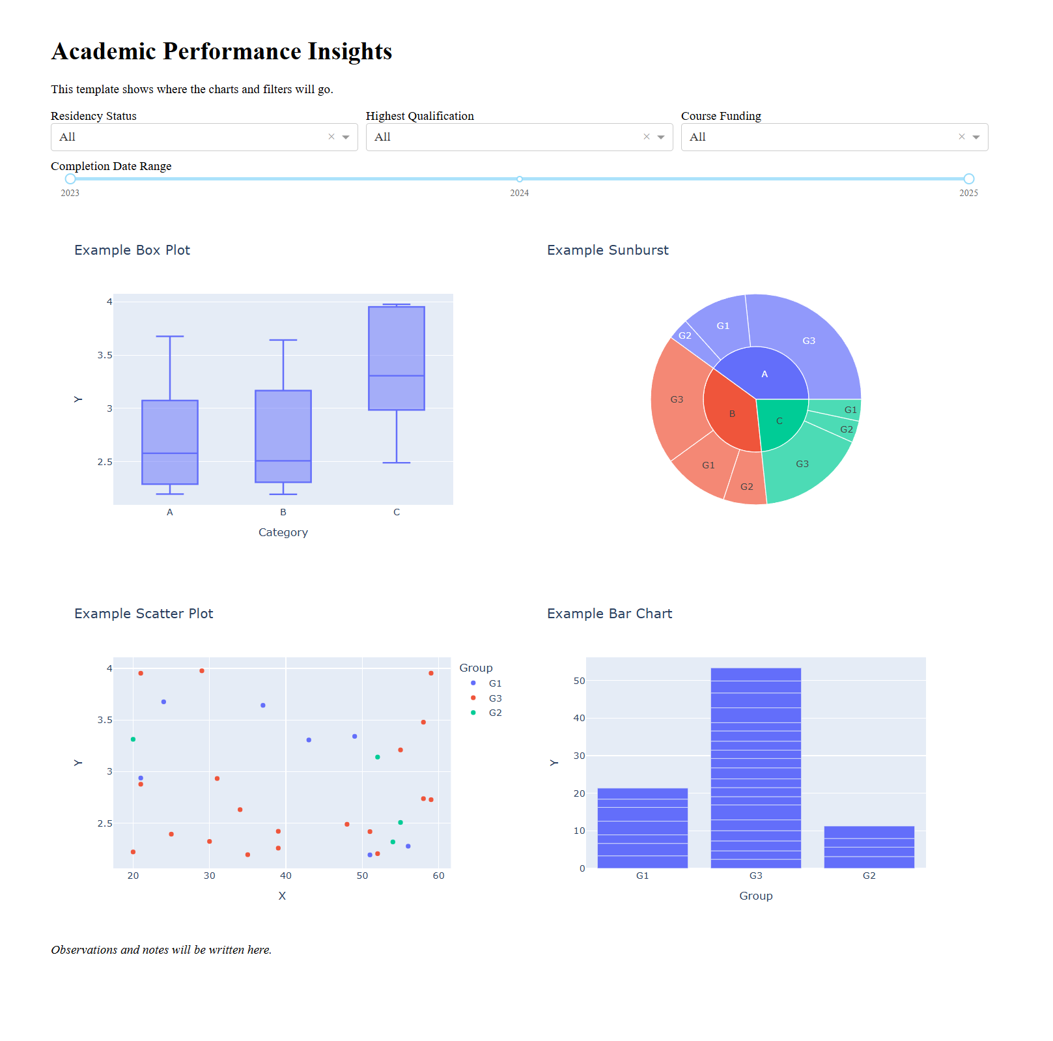
Dashboard Template Design
In this dashboard template, the header is placed at the very top, displaying the dashboard title for clear identification and labelling.
Directly below it is the navigation and filter section, containing dropdown menus for Residency Status, Highest Qualification, and Course Funding, along with a horizontal date range slider for filtering data by completion year. Each dashboard will have their own navigation bar with different filters which suits each dashboards needs.
The main content area is arranged in a grid format beneath the filters — the top row features the first two charts, while the second row displays the remaining two charts.
At the very bottom, there is a designated observations/notes area for writing insights and analysis based on the displayed charts. The charts will follow the 2x2 grid strictly, and all be in the same size each taking up one quarter of space.

Slide 4
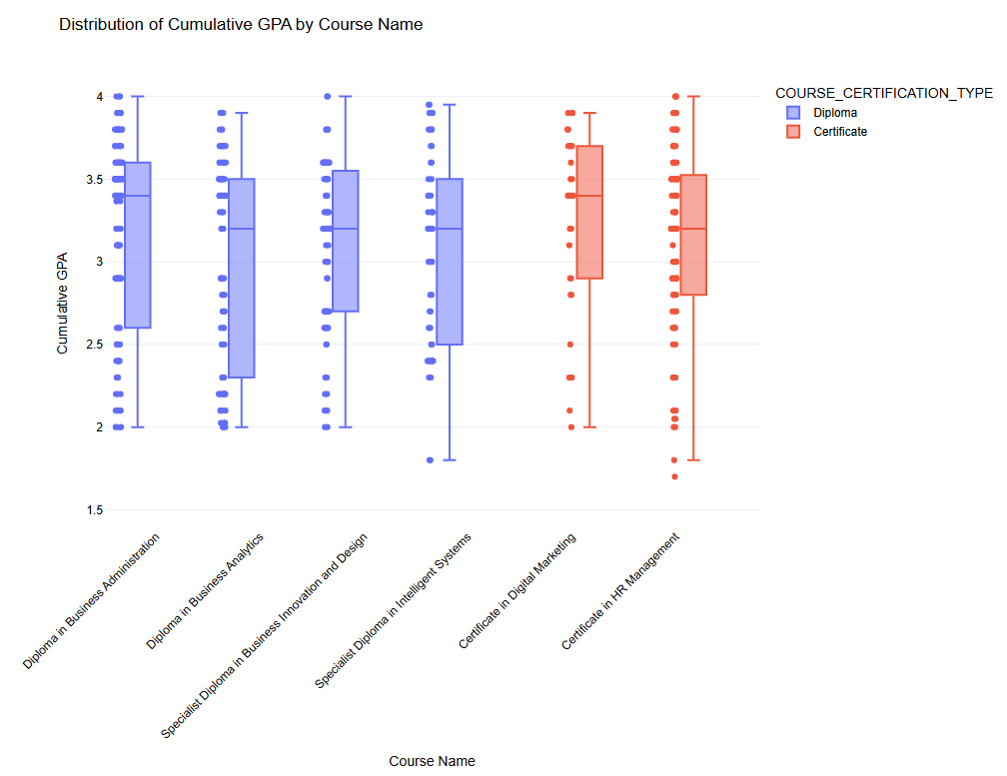
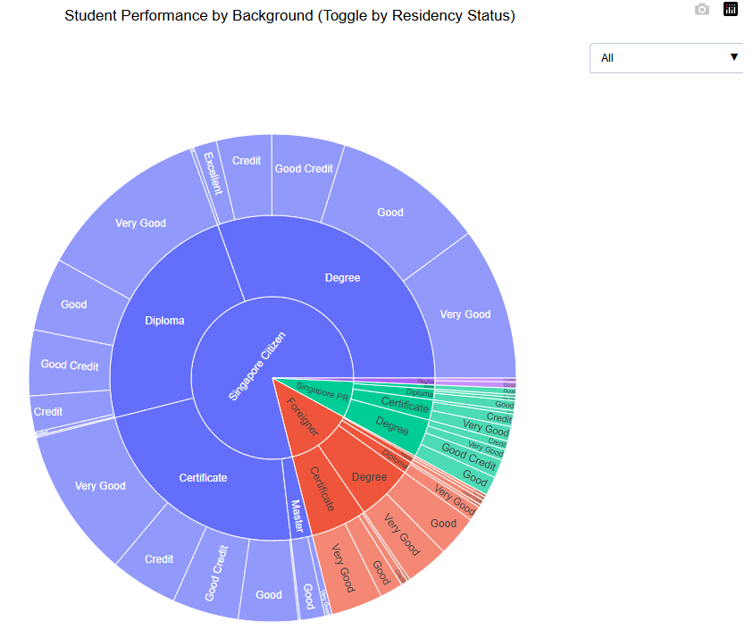
Tan Eu Zin (Charts)
Singapore Citizens dominate the dataset, making up the largest portion of students across all qualification types, especially in Diploma, Degree, and Certificate programs.
Diploma and Degree holders among Singapore Citizens and PRs generally achieve “Good” or “Very Good” performance, with fewer cases in the lower grade bands.
Foreign students have more balanced representation across qualification types but smaller overall proportions, with performance also leaning toward “Good” and “Very Good.”
The plot also highlights underperforming groups, such as specific residency–qualification combinations where a noticeable share of students fall into the “Fail” category, indicating potential need for targeted support. This group is seen to be a small minority of Singaporean Citizens, regardless of their Highest Qualification.
Performance Patterns : Certificate programs generally show slightly higher and more consistent GPAs, while Diploma programs display wider variation and more low-GPA outliers.
Risk Identification : Certain Diplomas (e.g., Business Analytics, Intelligent Systems) have larger GPA spreads, suggesting greater performance disparities and potential at-risk students.
Actionable Insight : Data suggests focused support for underperforming Diploma students and the reason into why Certificate programs achieve more consistent outcomes may be because Certificate courses are easier (which in our real world context is true).

Slide 5
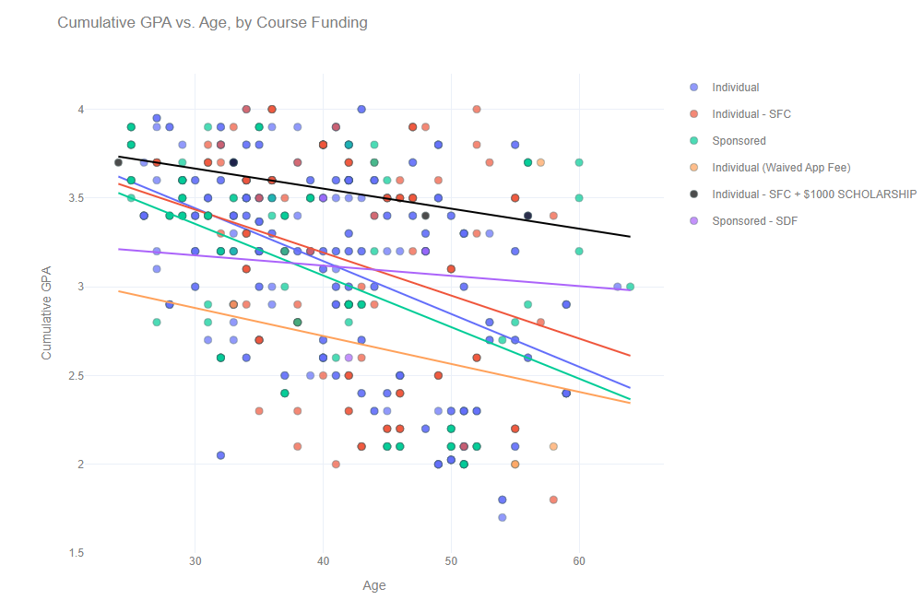
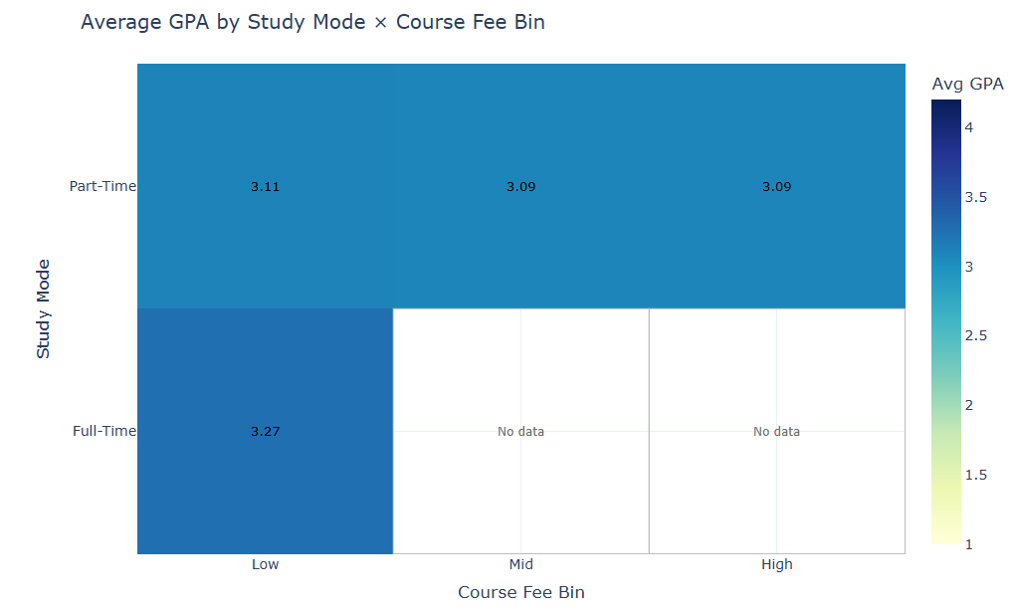
Tan Eu Zin (Charts)
Older students generally have lower GPAs (downward sloping trend line) across most funding types, suggesting that age may be a factor influencing academic performance.
Funding schemes with stronger financial support, such as scholarships or subsidies, seem to reduce the negative impact of age on GPA.
Younger students, particularly those in Individual or Sponsored funding, tend to achieve higher GPAs, indicating that early career stage may be linked to stronger academic outcomes.
Full-Time students in low-fee courses achieve the highest average GPA (3.27), suggesting that lower course costs may reduce financial stress, potentially supporting better academic performance, and when courses are full time it might suggest students can study better as seen with the highest average GPA.
Part-Time students have consistently lower GPAs (around 3.09–3.11) across all fee bins, which could indicate that balancing work and study negatively impacts academic results, regardless of course fee level.
No data for Full-Time students in mid/high-fee courses may point to program structure differences or missing enrolment groups, indicating a possible area for further data collection or investigation.

Slide 6
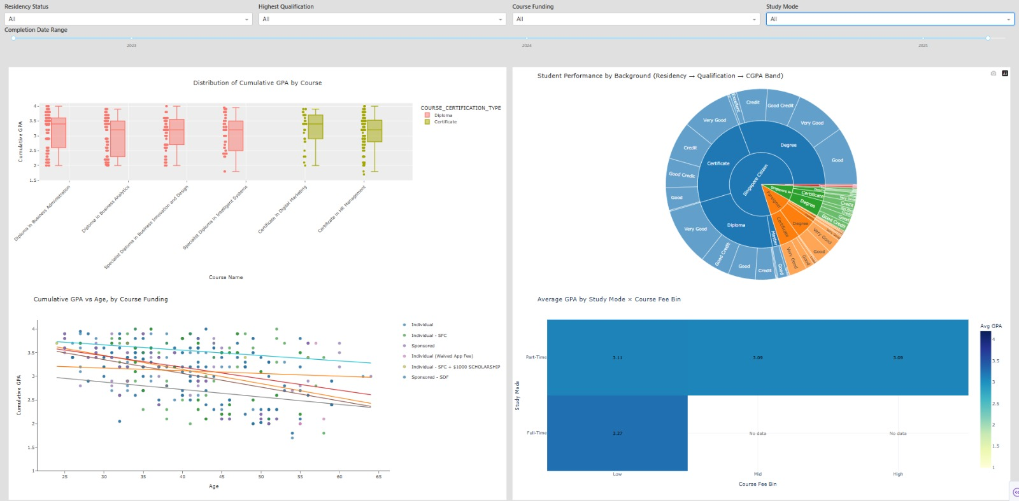
Tan Eu Zin (Dashboard)
Who are our students and what backgrounds predict success?
Our student body consists primarily of Singapore Citizens across all qualification levels, with foreign students representing smaller but high-performing segments. Key success predictors include: younger age (universal advantage regardless of qualification background), comprehensive financial support (scholarships/subsidies reduce age-related performance decline), and full-time study capacity with lower fee burdens. While Certificate programs show more consistent outcomes, the critical finding is that student demographics and support structures matter more than program type - with at-risk profiles being older, self-funded, part-time students regardless of their educational background.

Slide 7
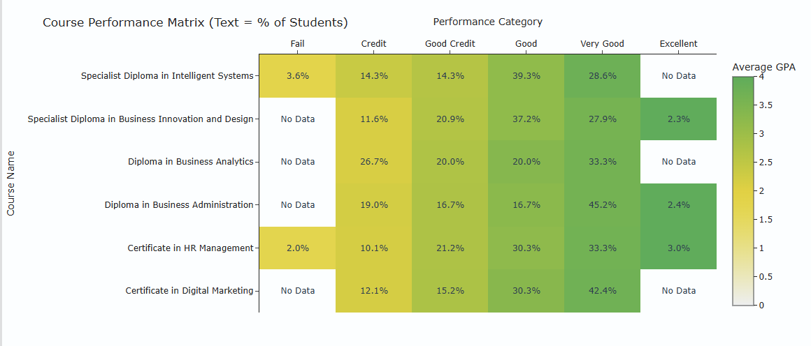
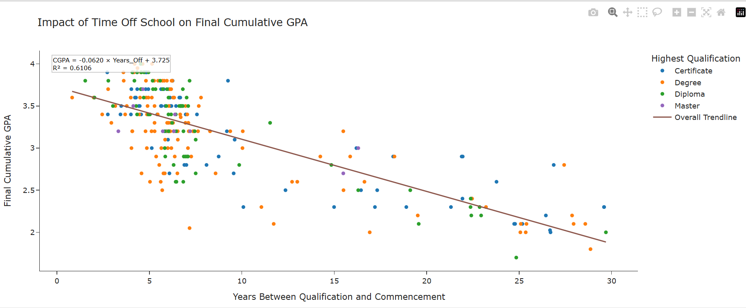
Ethan Ng Wen Xian (Charts)
Chart 1: Course Performance Matrix
Key Insights:
Performance Variation by Level: Certificates show consistent performance (36-42% top grades) while Diplomas demonstrate high variability - from excellent (Business Administration: 47.6%) to concerning (Intelligent Systems: 28.6% with 3.6% failures).
Top Performer: Business Administration (Diploma) leads with 47.6% "Very Good/Excellent" grades, proving diplomas can achieve the highest performance when well-designed.
Risk Programs: Intelligent Systems (3.6% failure rate) and Business Analytics (26.7% stuck in "Credit" grades) require immediate curriculum review and enhanced support strategies.
Key Finding: Program design trumps qualification level - subject matter and delivery approach drive success more than whether it's a certificate or diploma program.
Chart 2: Impact of Time Off School on Final Cumulative GPA
Key Insights:
Universal Educational Decay: Each year away from education correlates with a -0.062 GPA decline (R² = 0.61), affecting all qualification levels similarly - no group shows significant immunity to time gap effects.
Equal Impact Across Qualifications: At 15+ year gaps, Certificate, Degree, Diploma, and Master holders all cluster in the same lower GPA range (2.0-2.5), indicating that time erosion affects everyone equally regardless of prior qualification level.
Critical Risk Threshold: Performance becomes highly unpredictable beyond 15 years, with most students falling below 2.5 GPA across all qualification backgrounds, suggesting that recency of education trumps qualification level.
Strategic Implication: Time gap is the dominant factor - institutions should focus intervention resources on all students with extended gaps rather than assuming higher qualifications provide protection.

Slide 8
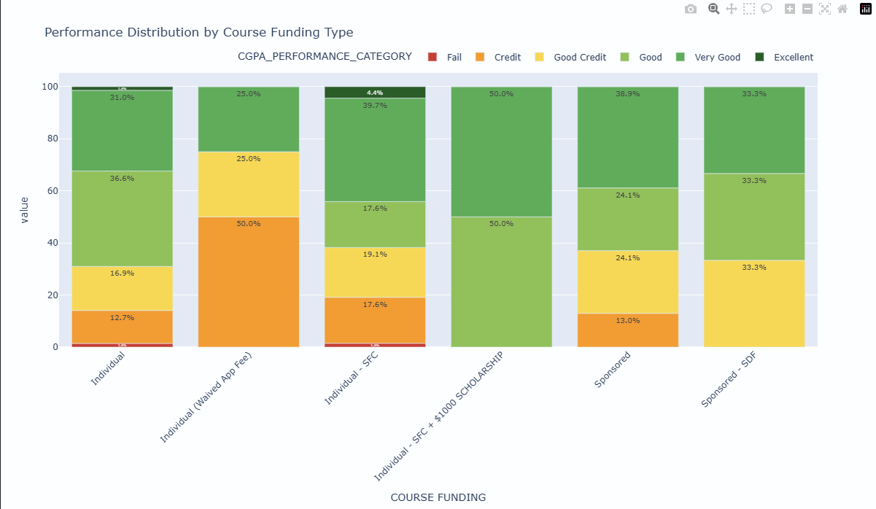
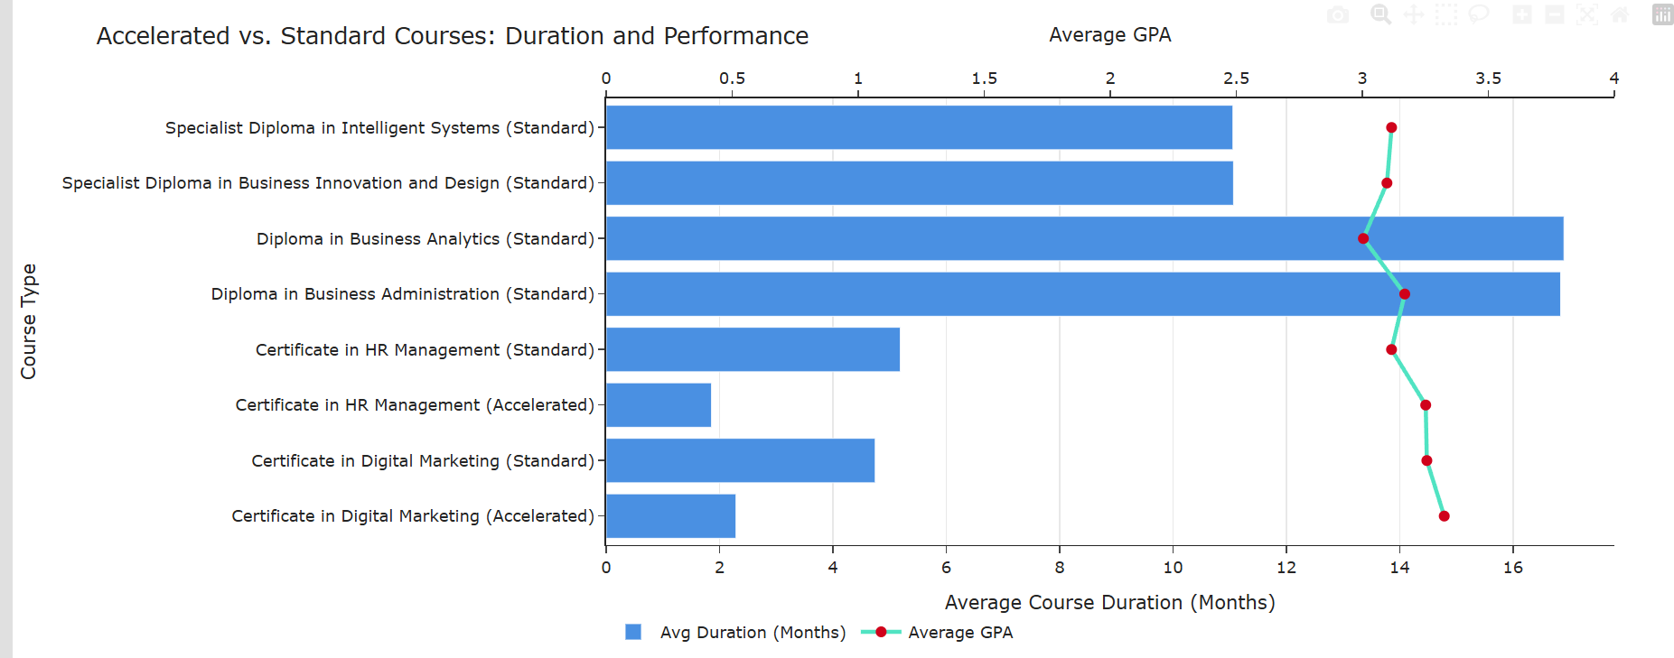
Ethan Ng Wen Xian (Charts)
Chart 3: Accelerated vs. Standard Courses: Duration and Performance
Key Insights:
Efficiency-Excellence: Accelerated programs consistently outperform standard versions - HR Management (3.25 vs 3.12) and Digital Marketing (3.33 vs 3.26) - while requiring 50% less time, challenging traditional assumptions about learning pace.
Intensive Learning Advantage: Both accelerated formats achieve higher GPAs in half the duration (HR: 6→3 months, Digital Marketing: 5→3 months), suggesting concentrated study periods eliminate knowledge decay and attract more motivated student cohorts.
Scalable Success Model: The accelerated approach proves that shorter, intensive learning can simultaneously improve outcomes and reduce institutional resource allocation per successful graduate, offering a win-win for students and institutions.
Strategic Implication: Institutions should expand accelerated program offerings where feasible, as the data shows improved performance with reduced time investment across different subject areas.
Chart 4: Performance Distribution by Course Funding Type
Key Insights:
Top Performers: Individual - SFC + $1000 Scholarship (100% "Good" or better) and Sponsored - SDF (100% "Good Credit" or above) prove that comprehensive financial support delivers optimal outcomes for adult learners.
SkillsFuture Success: Individual - SFC achieves ~63% "Good" or better performance, significantly outperforming basic Individual funding, demonstrating Singapore's SkillsFuture program effectively supports career transitions.
Self-Funded Risk: Individual students show 14.1% credit or worse and Individual (Waived App Fee) has 50% stuck in "Credit" grades, proving minimal/no support is insufficient for this mature student demographic.
Strategic Insight: Government-supported funding models (SFC + scholarships, SDF partnerships) consistently outperform pure self-funding or basic employer sponsorship, justifying expanded investment in these proven approaches.

Slide 9
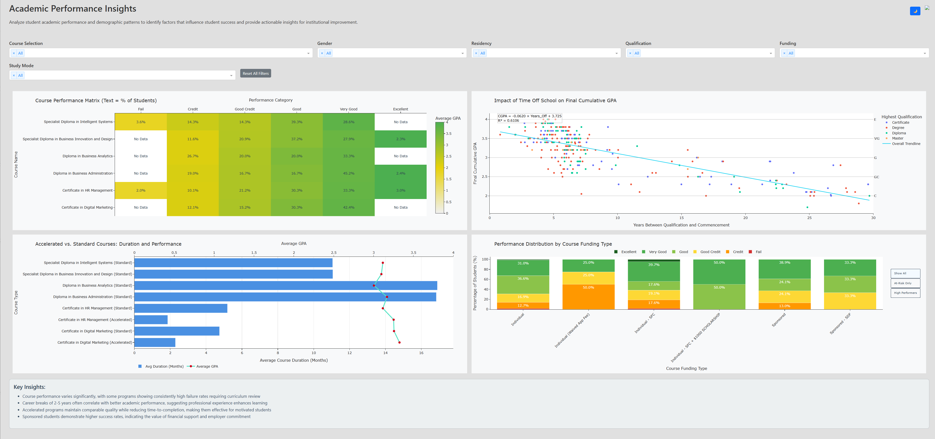
Ethan Ng Wen Xian (Dashboard)
What institutional approaches drive student success?
The integrated dashboard reveals that institutional decisions drive student success more than student characteristics alone. While time gaps universally impact performance across all backgrounds (-0.062 GPA per year), strategic program design (Business Administration: 47.6% top performance vs Intelligent Systems: 28.6%), accelerated learning formats (outperform standard by 0.1-0.2 GPA), and comprehensive financial support (SFC + Scholarship: 100% "Good" or better) create the strongest performance outcomes. Institutions can optimize success by focusing on controllable factors: enhanced program delivery, intensive learning modalities, and robust financial aid packages.

Slide 10
Enhanced Strategic Interventions Integrating Student Success Predictors with Institutional Excellence
Dual-Approach Success Framework:
Student-Institutional Partnership Strategy: Recognize that optimal outcomes require both student support and institutional design optimization, targeting the intersection of high-risk demographics with proven institutional interventions.
Tier 1: High-Impact Institutional Redesign
Accelerate underperforming programs by converting Business Analytics and Intelligent Systems to intensive 3-month formats (proven 0.1-0.2 GPA improvement), incorporating Business Administration's successful curriculum structure (47.6% top performance), and implementing mandatory time-gap bridge programs for students with 5+ year education breaks (addressing -0.062 GPA annual decline).
Expand proven financial architecture by scaling the SFC + Scholarship model (100% "Good" or better outcomes) to cover 60% of self-funded students, creating flexible payment plans specifically for part-time learners, and establishing employer partnerships to convert individual funding to sponsored-SDF arrangements.
Tier 2: Targeted Student Success Support
Deploy precision intervention for high-risk profiles (older, self-funded, part-time students) through personalized academic coaching, flexible scheduling with accelerated weekend intensives, and peer mentorship pairing with high-performing foreign student segments who demonstrate resilience across all demographics.
Optimize study mode pathways by designing a fast-paced, full-time path for those changing careers, offering hybrid part-time accelerated options, and implementing early warning systems that trigger immediate support when performance indicators decline
Success Metrics:
20% improvement in at-risk student GPA within 12 months
250% reduction in diploma program performance variance
80% coverage of financial support for students with 10+ year education gaps
This strategy leverages both who succeeds (student characteristics) and what works (institutional approaches) to create comprehensive, data-driven interventions.

Slide 11
Actionable Recommendations… How do we help to raise the grades (GPA) of students?
Key Strategic Interventions
Restructure at-risk diploma programs (Business Analytics and Intelligent Systems) using proven certificate methodologies with shorter modules, competency-based assessments, and mandatory foundation courses to address the identified performance gaps. Expand financial support by 40% through increased scholarships, payment flexibility plans, and industry partnerships, targeting self-funded students who demonstrate the lowest performance outcomes across all age groups. Implement age-targeted academic support including pre-enrollment bridge programs for students 30+ years old, personalized learning plans with flexible scheduling, and early warning systems to proactively address the clear negative correlation between age and academic performance.

Slide 12
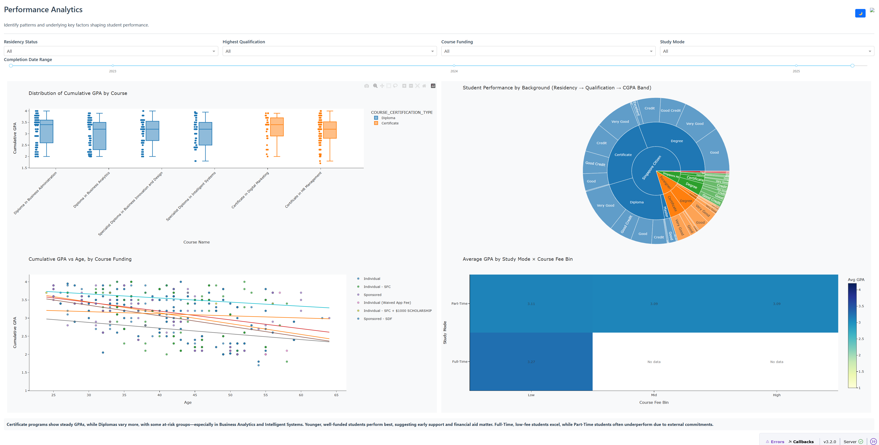
Page 1 of merged dashboard (EuZin's page)

Slide 13
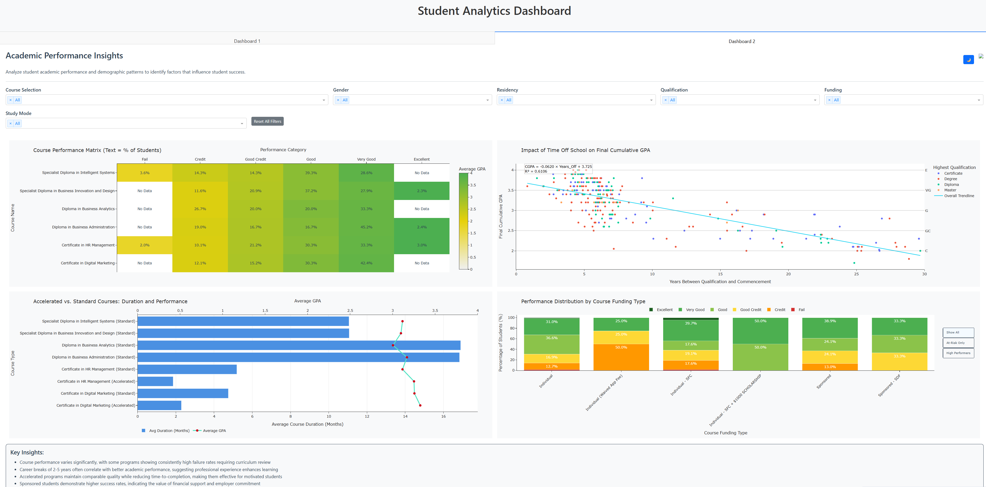
Page 2 of merged dashboard (Ethan's page)

Slide 14
THE END

