Slide 1
Floyd-Warshall Algorithm
Ethan Soo Hon

Slide 2
History of Algorithm
Published by Robert Floyd 1962
Same algorithm as Warshall’s 1962
3 nested for loop version, Peter Ingerman

Slide 3
Algorithm Purpose: Floyd-Warshall
Problem: You have multiple locations and you want to find the shortest distance between every specified location (All pairs, shortest path).
Example: Calculating the distance on road maps between locations.
A city represents a vertex, each road connecting the locations represents an edge and the numerical distance of the connecting roads represents the weight.

Slide 4
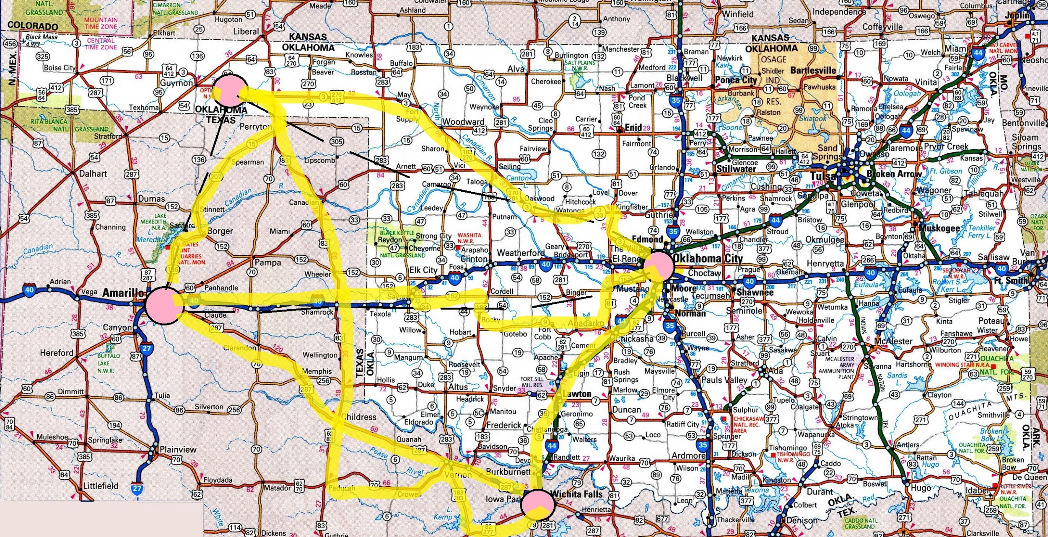
Algorithm Problem Example
150km
100km
150km
200km
100km
200km

Slide 5
Algorithm: Floyd-Warshall
Finds the shortest path between all vertices in a weighted graph.
Negative edge weights are permitted
Negative cycles are not permitted.
Solution is stored in an nxn adjacency matrix representation of the graph.

Slide 6
Floyd-Warshall Pseudocode
let V = # of vertices in graph let dist = V * V solution array for each vertex(v) dist[v][v]=0 #Distance from itself is 0 for each edge(u,v) #Edge weight placed use value inf if edge does not exist dist[u][v] = weight(u,v) for (k from 1 to V) #Each vertex picked as intermediate vertex for (i from 1 to V) #For the ith row for (j from 1 to V) #For the jth col
if(dist[i][k]!=INF && dist[k][j]!=INF) #Ignore if no edge if(dist[i][j] > dist[i][k] + dist[k][j]) dist[i][j] = dist[i][k] + dist[k][j] end if
End if # If Distance in current slot is greater than the distance #it takes for the path to be completed by going through the current intermediate node, update the value

Slide 7
Floyd-Warshall Analysis:
Runtime complexity: ϴ(|V|³)
Every combination of edges is tested
3 nested for loops
ϴ(|V|²)space complexity
Modified to detect negative cycles

Slide 8
Implementation:
Programmed in C++
Graph[][]
- <vector<vector<int>>
- an adjacency matrix representation of a graph
dist[][] - an n x n 2d matrix to store solutions

Slide 9
Problem Statement:
Can Floyd-Warshall’s algorithm be more efficient?
Optimize to cut down on runtime
Solution:
Store calculation dist[i][k] + dist[k][j] in variable to avoid recalculation
if (dist[i][k] != INF && dist[k][j] != INF) conditional
FIRST had in j loop, moved to respective loop levels to reduce number of iterations
Also solution Matrix[i][i] =0 (a diagonal always)

Slide 10
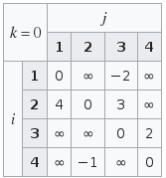
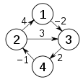
Floyd-Warshall: Demonstration
– Consider running the algorithm on the following
graph
– Initial solution matrix state:

Slide 11
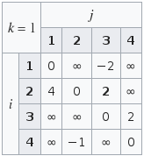
Process:
For your current k loop iteration compare value in D[i][j]⁻¹ to D[i][k]⁻¹ + D[k][j]⁻¹ and choose the lesser value.

Slide 12
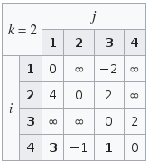
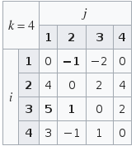
Example:
To compute D[4][1]², you would first look at the value in D[4][1]¹, in this case it is infinity.
Choose min(D[4][1]¹ , D[4][2]¹ + D[2][1]¹).
Update D[4][1]² to 3.
...

Slide 13
Experimental Plan:
Matrix filled with random numbers from -100 to 100 (except 0) with 25% or 75% chance of infinity
Diagonals always filled with 0s
Test F-W on the following sized matrices 100 times each for sparse graphs and dense graphs
5x5, 100x100, 250x250, 500x500, 1000x1000
Test F-W Opt on the same sized matrices 100 times each for sparse graphs and dense graphs

Slide 14
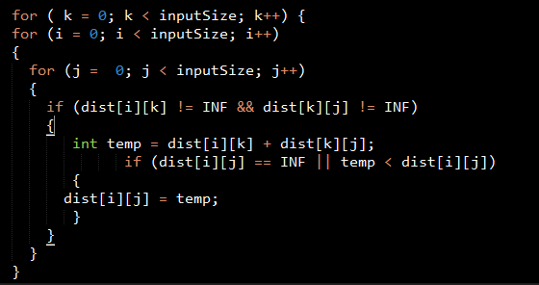
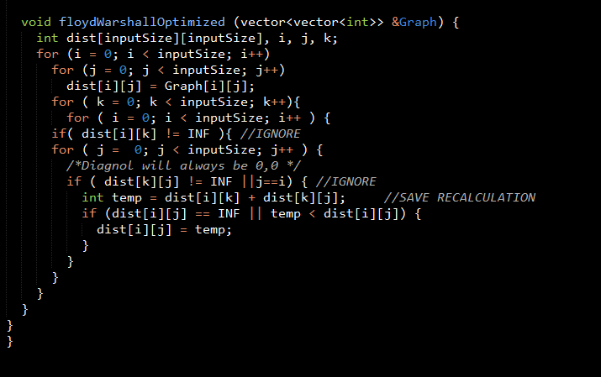
Optimization

Slide 15
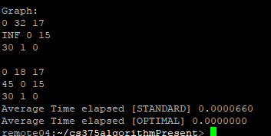
Output Example:

Slide 16
Dense Results:
 |  | Matrix Size
 |  | 5x5 | 100x100 | 250x250 | 500x500 | 1000x1000
Runtime (in seconds) | F-W | 0.0000018 | 0.00776 | 0.11990 | 0.95463 | 7.64519
 | F-W Opt | 0.0000017 | 0.00638 | 0.09828 | 0.77440 | 6.21398

Slide 17
Sparse Results:
 |  | Matrix Size
 |  | 5x5 | 100x100 | 250x250 | 500x500 | 1000x1000
Runtime (in seconds) | F-W | 0.0000032 | 0.00886 | 0.12563 | 0.96632 | 7.88739
 | F-W Opt | 0.0000028 | 0.00714 | 0.10401 | 0.48993 | 6.46476

Slide 18
Complete Results:
 |  | Matrix Size
 |  | 5x5 | 100x100 | 250x250 | 500x500 | 1000x1000
Runtime (in seconds) | F-W | 0.0000018 | 0.00749 | 0.11939 | 0.91303 | 7.54683
 | F-W Opt | 0.0000018 | 0.00643 | 0.10030 | 0.77336 | 6.19756

Slide 19
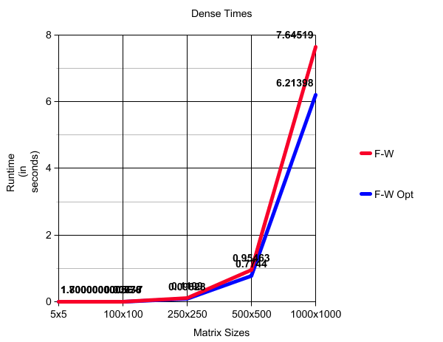

Slide 20


Slide 21


Slide 22
Limitations and Future Work:
Limited by computer speed and storage
Implementation of recursive algorithm
Comparison with more all-pair shortest path algorithms (i.e. fast matrix multiplication algorithms, Johnson’s)
Better data set

Slide 23
Concluding Remarks:
Floyd Warshall is an all pair shortest path algorithm
Useful yet expensive, better with optimization
Works best for dense graphs
Room for improvement

Slide 24
THANKS!
Any questions?

