Slide 1

predicting air pollution
A machine learning study conducted by Ethan Tan (P2012085)

Slide 2

Thought Process
Exploratory Data Analysis
Data Cleaning
Algorithm Selection & Hyper-Parameter Tuning

Slide 3
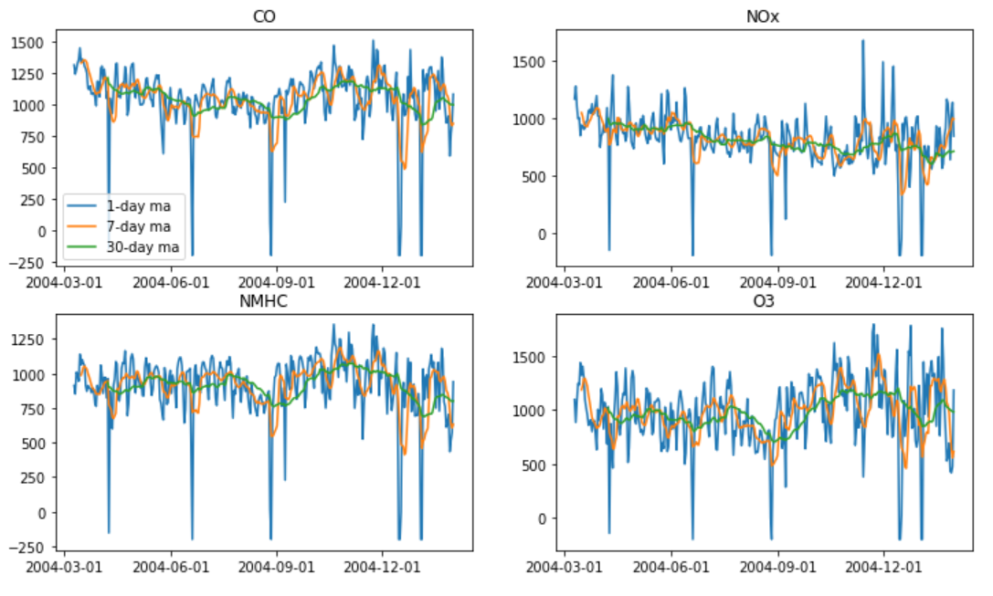
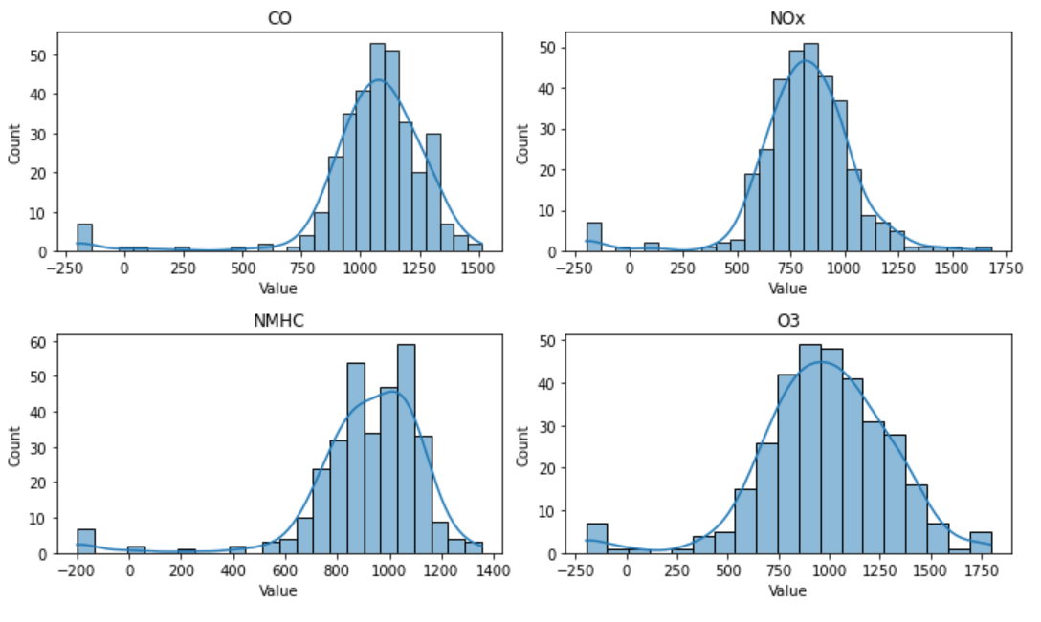
Exploratory Data Analysis
Reasons to clean data:
Negatively skewed
Contains outliers
Very erratic
All the above-mentioned factors will make it hard for any time series model to generalize
During data cleaning, outliers were removed and replaced with more sensible values (for T, RH and Value)
However, the forecast submitted to Kaggle was made using the outliers.
Fig. 1.1. Plotted values before cleaning (with moving averages)
Fig. 1.2. Distributions of Values before cleaning

Slide 4
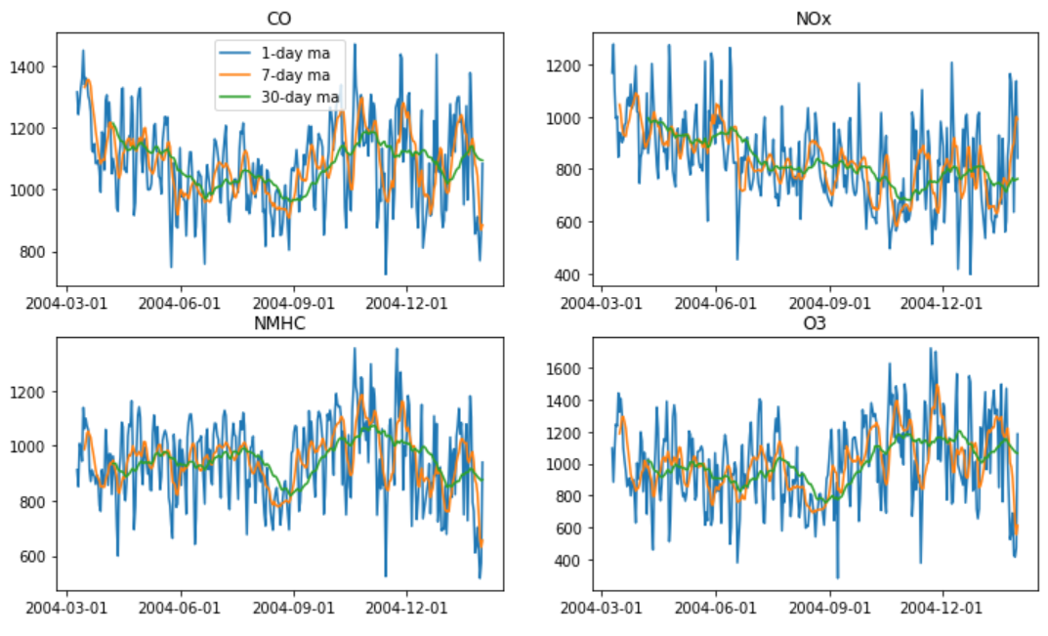
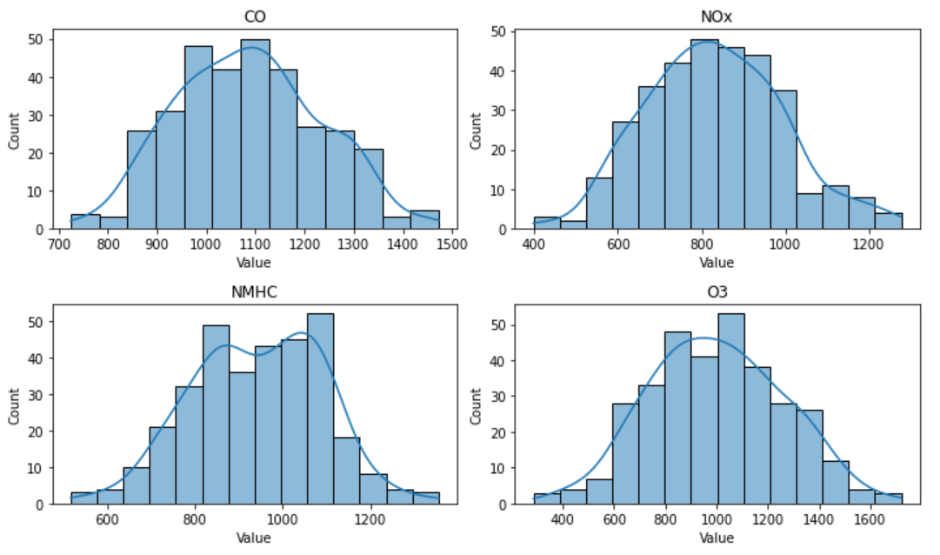
Exploratory Data Analysis
After data cleaning, all the values conform to more normal distributions.
With the data more stable, it will be easier for the models to pick up on any trends within the time series, if any.
This would be better
Fig. 1.3. Plotted values after cleaning (with moving averages)
Fig. 1.4. Distributions of Values after cleaning

Slide 5
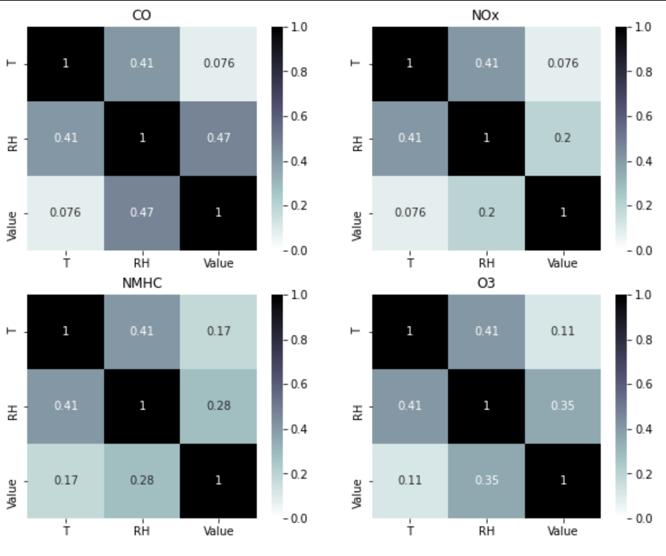
Exploratory Data Analysis
There may be minor correlations between Temperature or Relative Humidity and the Value of each gas produced.
From a logical standpoint, environmental conditions may have effects on the amount or types of air pollution.
SARIMAX should be considered as it takes these explanatory variables into account.
Fig. 1.5. Correlations between variables after cleaning

Slide 6
Algorithm SELECTION
For this time series problem, I considered the SARIMA, SARIMAX and Exponential Smoothing models.
Instead of settling on an algorithm and tuning its hyperparameters afterwards, I decided to tune and compare the algorithms in parallel, as 4 models are required.

Slide 7
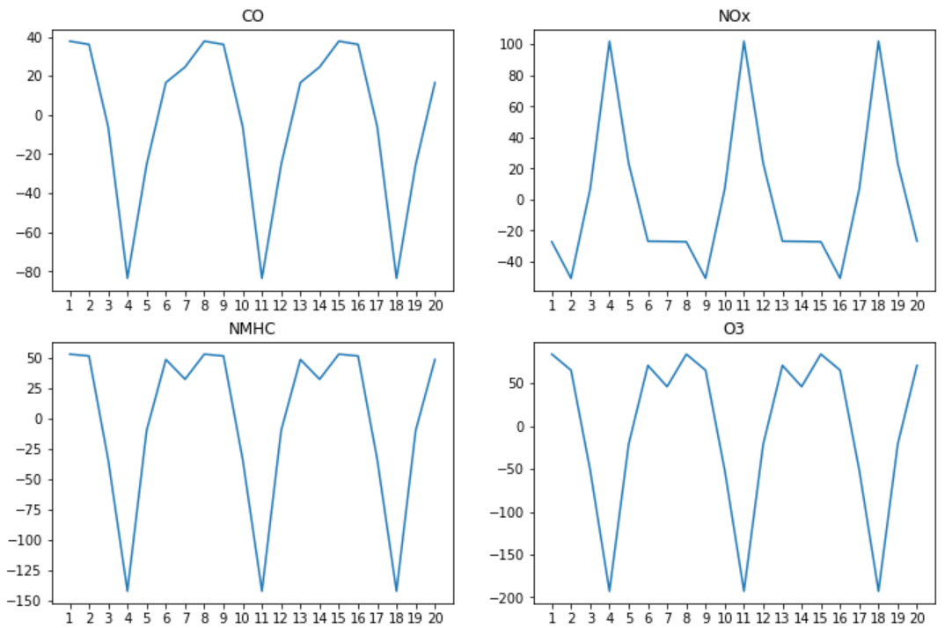
Hyper-Parameter Tuning (SARIMA)
For the SARIMAX model, the hyper-parameters tuned are:
the trend order (p, d, q)
the seasonal order (P, D, Q, m)
the trend type (no trend/constant)
(p, d, q) can be determined using the partial autocorrelation and autocorrelation functions while
(P, D, Q) can be selected using a Grid Search
Fig. 2.1. Line plots of the seasonal components
Before PACF and ACF can be applied to find the trend orders for the models, the data (Value column) has to be stationary first. This means that any seasonal component has to be removed too.
Using the seasonal_decompose function and applying ACF on the seasonal component, m = 7 for all the gases. This can be confirmed visually as the plots above are all indicative of a 7-day cycle. This suggests some form of weekly seasonality (perhaps more pollutive gases are emitted on weekends).

Slide 8
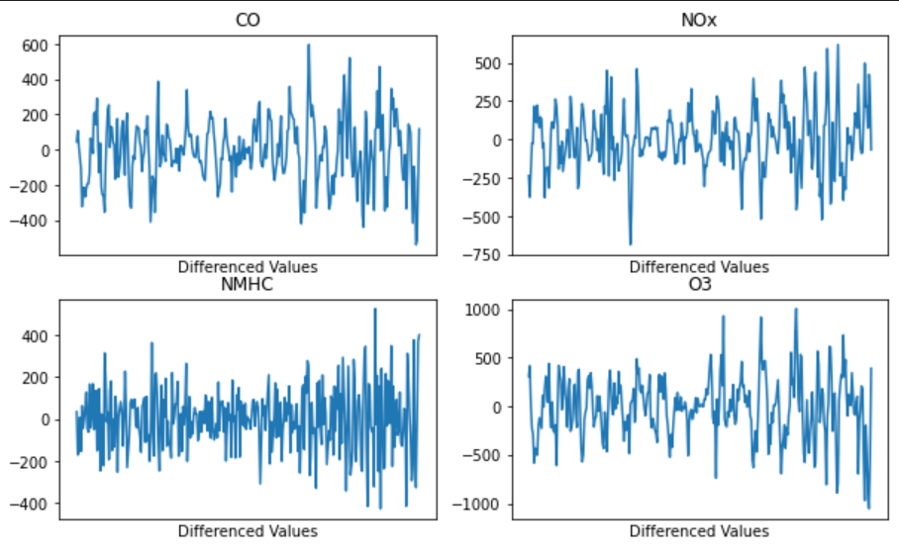
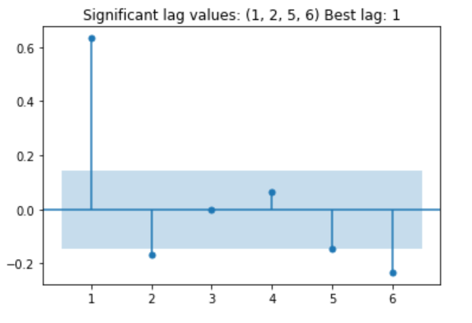
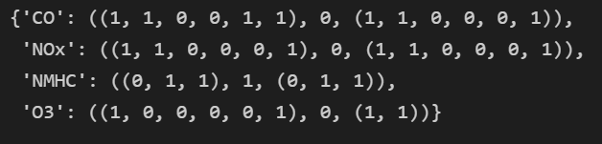
Hyper-Parameter Tuning (SARIMA)
Using the Augmented Dickey-Fuller test (α=0.01), I found that NMHC was the only non-stationary gas (in terms of unit root test)
For each gas, the values were differenced to remove the non-stationary and seasonal components
PACF and ACF were then applied to determine the values for (p, d, q).
p and q were identified programmatically, in the forms of tuples instead of integers as the statsmodels supports partial lag values
Fig. 7.1. Values after differencing
Fig. 7.2. Example PACF plot after differencing

Slide 9
Hyper-Parameter Tuning (SARIMAX)
Grid Search was used to determine:
The seasonal order (P, D, Q)
The trend polynomial (trend)
Which exogenous variables to use
The metric employed for comparison is a weighted sum of the train rmse, test rmse and aic

Slide 10
Hyper-Parameter Tuning (Exp. Smoothing)
I also tested using the ExponentialSmoothing model to model the data

Slide 11
Hyper-Parameter Tuning (Exp. Smoothing)
I also tested using the ExponentialSmoothing model to model the data

Slide 12
Evaluating In-Sample Predictions

Slide 13
Evaluating Out-of-Sample Predictions

Slide 14

Thank you
someone@example.com

