Slide 1

predicting air pollution
A machine learning study conducted by Ethan Tan (P2012085)

Slide 2
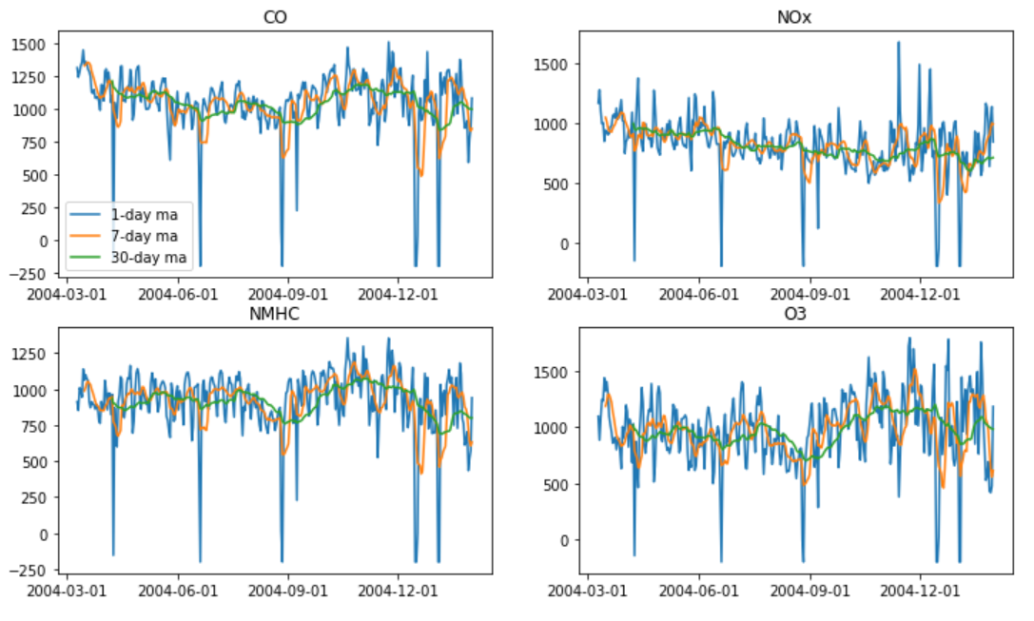
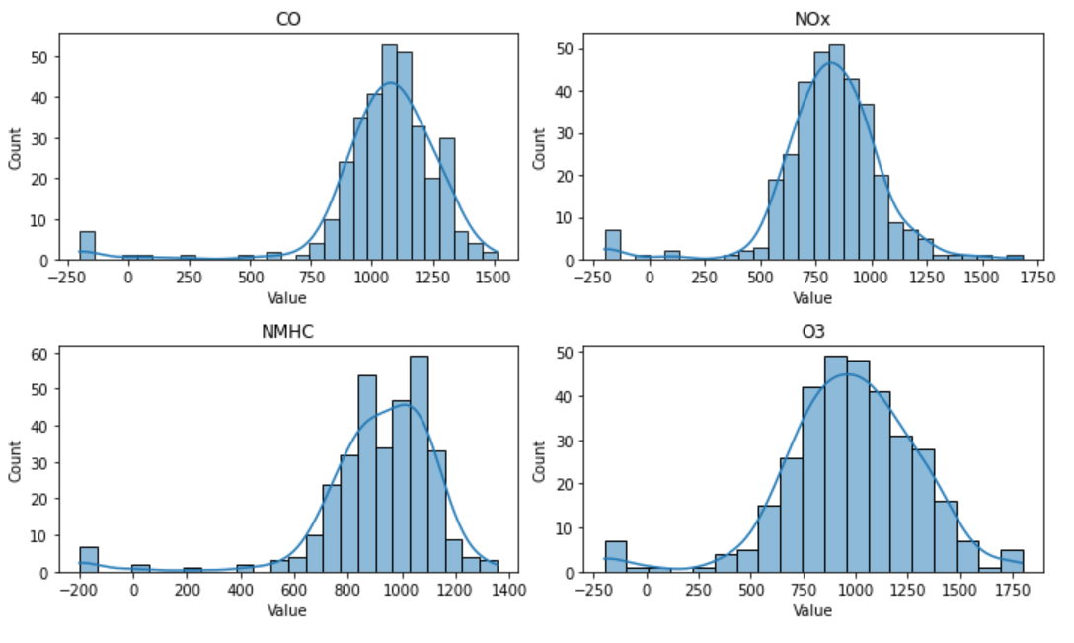
Exploratory Data Analysis
Reasons to clean data:
Negatively skewed
Contains anomalies
Very erratic
All the above-mentioned factors will make it hard for any time series model to generalize
During data cleaning, outliers were removed and replaced (for T, RH and Value)
However, the forecast submitted to Kaggle was made with the outliers not removed
Fig. 1.1. Plotted values before cleaning (with moving averages)
Fig. 1.2. Distributions of Values before cleaning

Slide 3
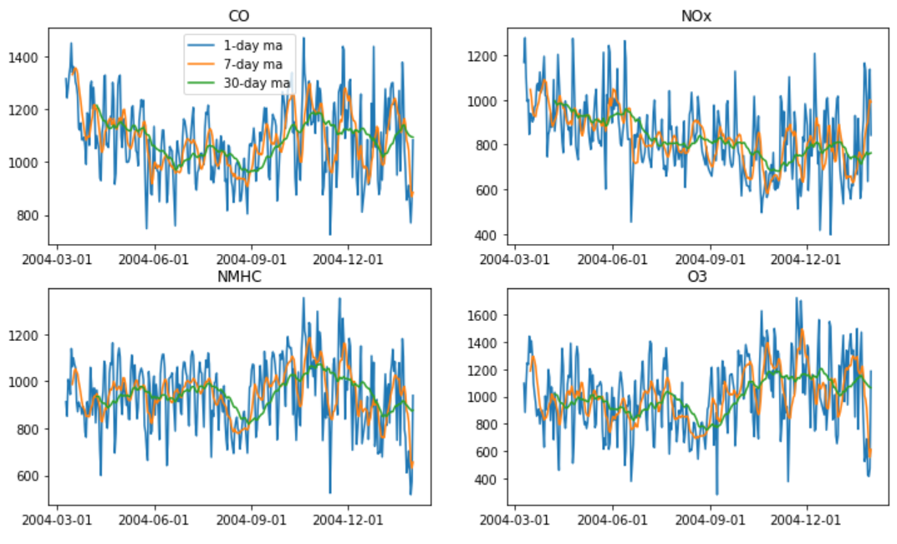
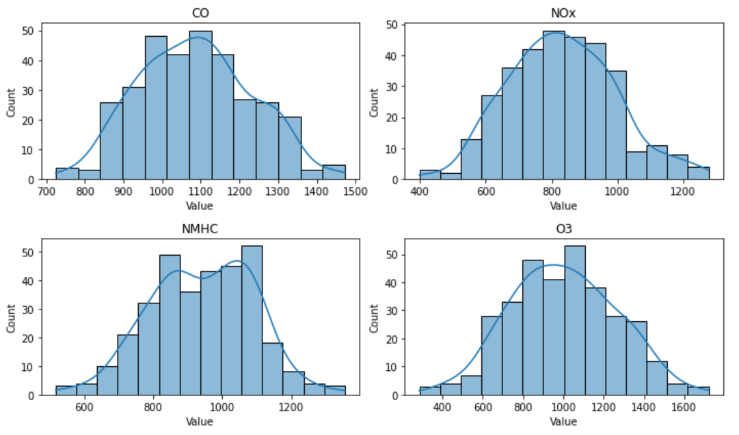
Exploratory Data Analysis
After data cleaning, all the values conform to more normal distributions.
With the data more stable, it will be easier for the models to pick up on any trends within the time series, if any.
The models would not have to accommodate anomalies, therefore yielding more consistent forecasts in the long run.
Fig. 1.3. Plotted values after cleaning (with moving averages)
Fig. 1.4. Distributions of Values after cleaning

Slide 4
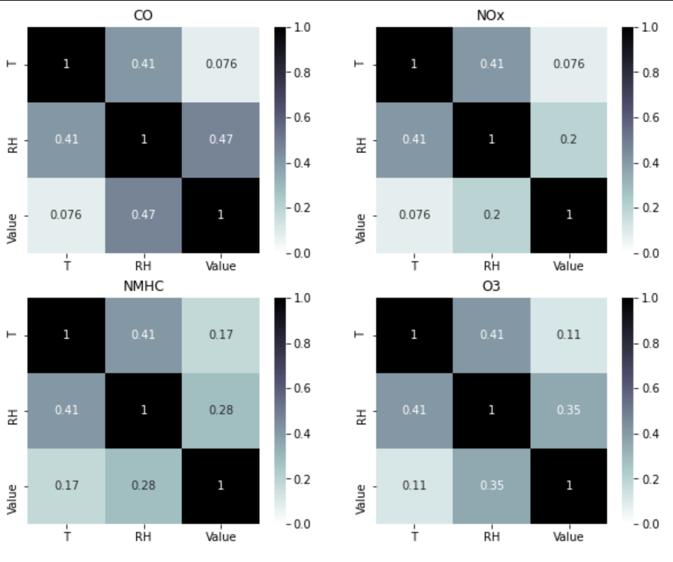
Exploratory Data Analysis
There may be minor correlations between Temperature or Relative Humidity and the Value of each gas produced.
From a logical standpoint, environmental conditions may have effects on the amount or types of air pollution.
SARIMAX should be considered as it takes these explanatory variables into account.
Fig. 1.5. Correlations between variables after cleaning

Slide 5
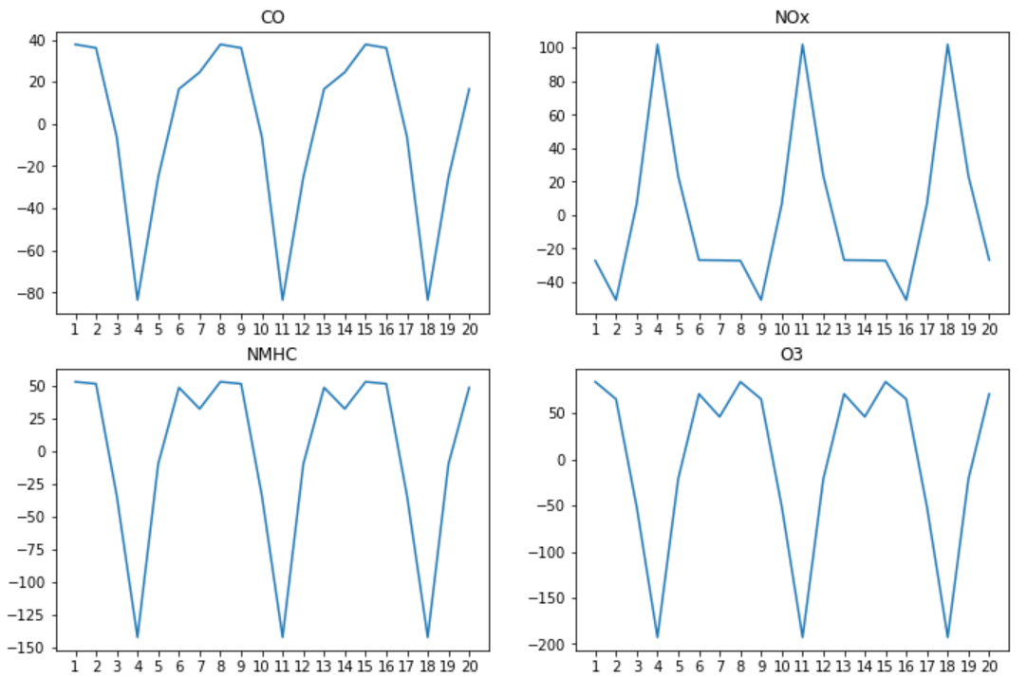
Hyper-Parameter Tuning (SARIMA)
For the SARIMA model, the hyper-parameters tuned are:
the trend order (p, d, q)
the seasonal order (P, D, Q, m)
the trend type (no trend/constant)
(p, d, q) can be determined using the partial autocorrelation and autocorrelation functions while
(P, D, Q) can be selected using a Grid Search
Fig. 2.1. Line plots of the seasonal components
Before PACF and ACF can be applied to find the trend orders for the models, the data (Value column) has to be stationary first. This means that any seasonal component has to be removed too.
Using the seasonal_decompose function and applying ACF on the seasonal component, m = 7 for all the gases. This can be confirmed visually as the plots above are all indicative of a 7-day cycle. This suggests some form of weekly seasonality (perhaps more pollutive gases are emitted on weekends).

Slide 6
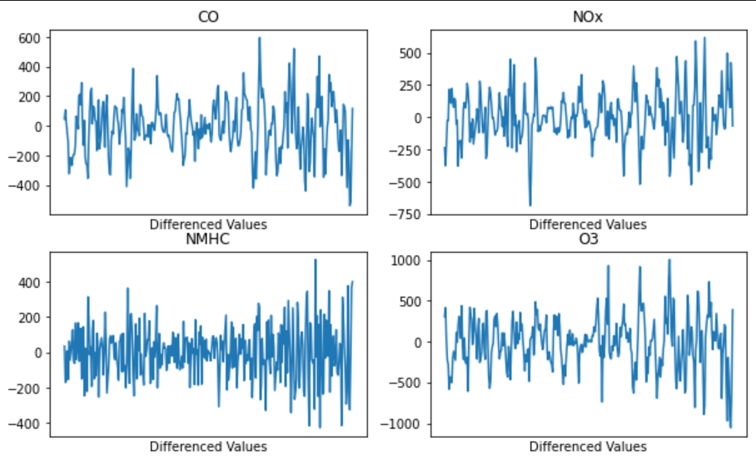
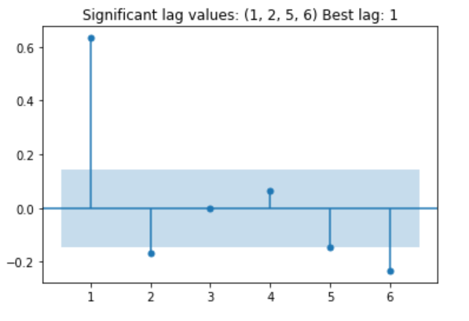
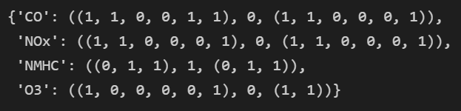
Hyper-Parameter Tuning (SARIMA)
Using the Augmented Dickey-Fuller test (α=0.01), I found that NMHC was the only non-stationary gas (in terms of unit root test)
For each gas, the values were differenced to remove the non-stationary and seasonal components
PACF and ACF were then applied to determine the values for (p, d, q).
p and q were identified programmatically, in the forms of tuples instead of integers as the statsmodels supports selective lag values
Fig. 2.2. Values after differencing
Fig. 2.4. Selected (p, d, q) for each gas
Fig. 2.3. Example PACF plot after differencing

Slide 7
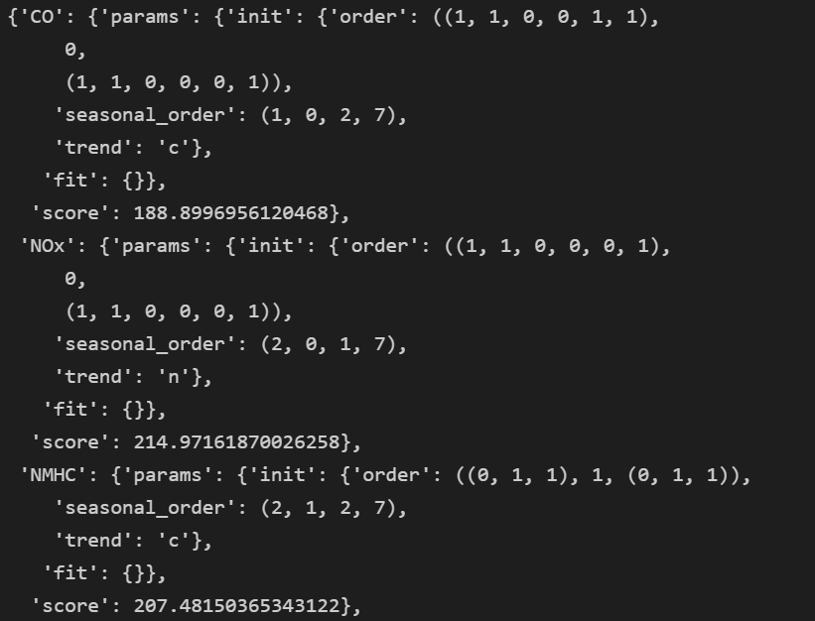
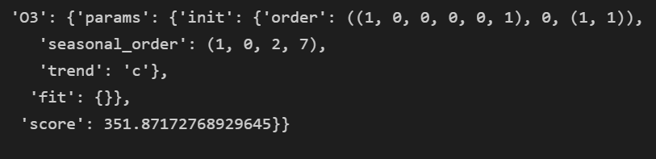
Hyper-Parameter Tuning (SARIMA)
Grid Search was used to determine:
The seasonal order (P, D, Q)
The trend polynomial (trend)
The metric employed for comparison is a weighted sum of the train rmse, test rmse and aic
The weights used were:
test_rmse: 1
train_rmse: 0.25
aic: 0.001
The rationale is that test_rmse is 4 times as important as train_rmse for model evaluation and 100 times as important as aic [merely a tie-breaker] (is 0.001 instead of 0.01 to scale it down as aic is usually of 3 orders of magnitude while the rmse scores are of 2.

Slide 8
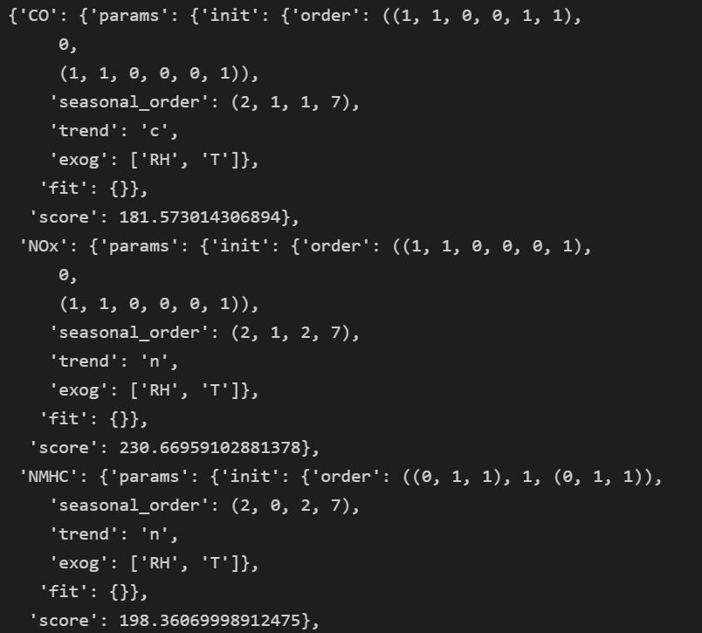
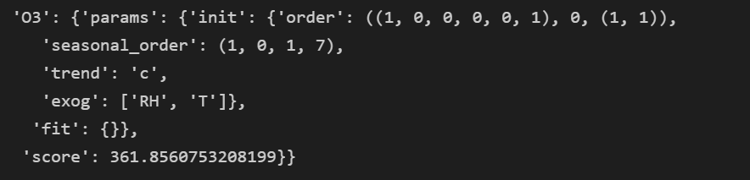
Hyper-Parameter Tuning (SARIMAX)
This Grid Search spanned 2 parts:
The first aimed to find:
The seasonal order (P, D, Q)
The trend polynomial (trend)
The second aimed to find:
Which exogenous variables to incorporate (T or RH or both)
This is the result for part 1
For part 1, all the models were instantiated using both T and RH exogenous variables
The seasonal orders and trend types here differ from their pure SARIMA counterparts

Slide 9
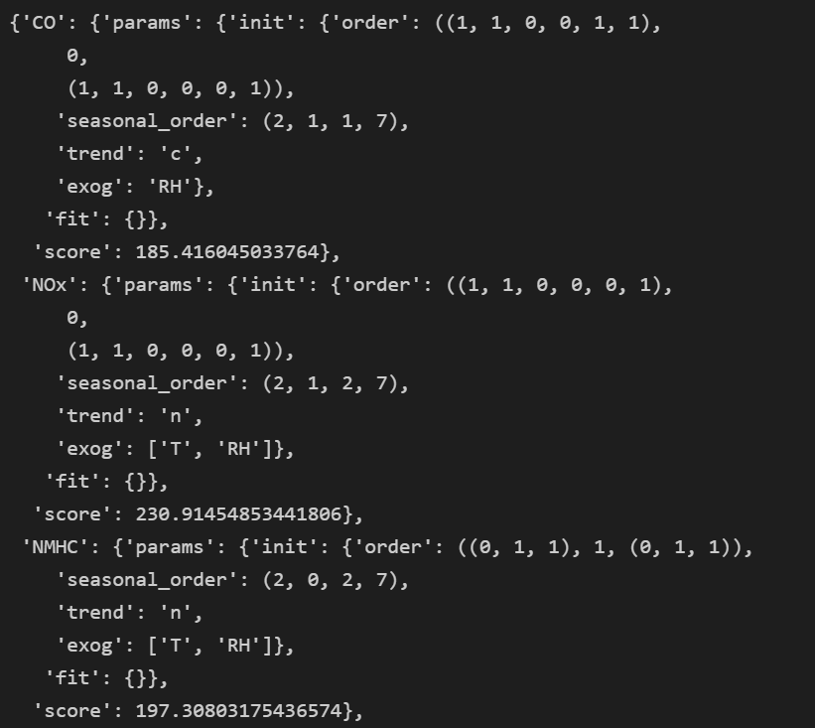
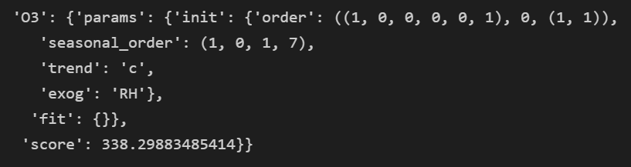
Hyper-Parameter Tuning (SARIMAX)
This Grid Search spanned 2 parts:
The first aimed to find:
The seasonal order (P, D, Q)
The trend polynomial (trend)
The second aimed to find:
Which exogenous variables to incorporate (T or RH or both)
This is the result for part 2
Some models (NOx and NMHC) perform better with both T and RH while others (CO and O3) do better with RH alone
The rest of the params are brought over from part 1 (no change)

Slide 10
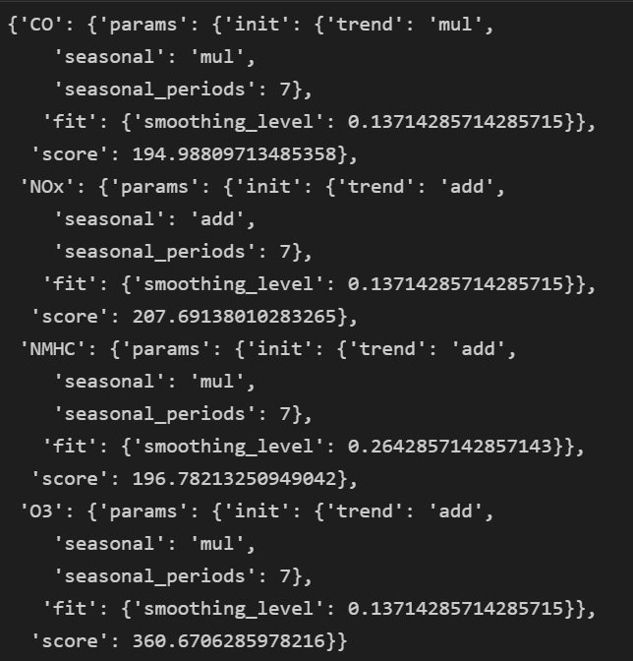
Hyper-Parameter Tuning (Exp. Smoothing)
I also tested using the ExponentialSmoothing model to model the time series
Grid Search was used to find:
the type of trend component
the type of seasonal component
the smoothing level
The best smoothing level is about 0.13 for CO, NOx and O3
The best smoothing level for NMHC, however, is about 0.26

Slide 11
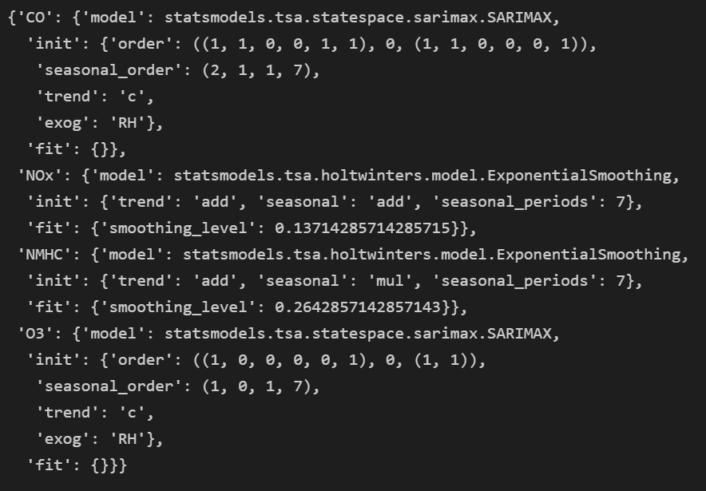
Algorithm Comparison
The 3 models (SARIMA, SARIMAX and ExponentialSmoothing) were compared in terms of the custom (weighted) score.
For each gas, the most optimal model was selected:
CO: SARIMAX
NOx: ExponentialSmoothing
NMHC: ExponentialSmoothing
O3: SARIMAX
SARIMA was not the optimal model for any of the gases

Slide 12
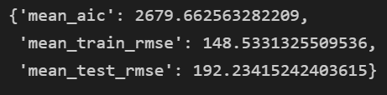
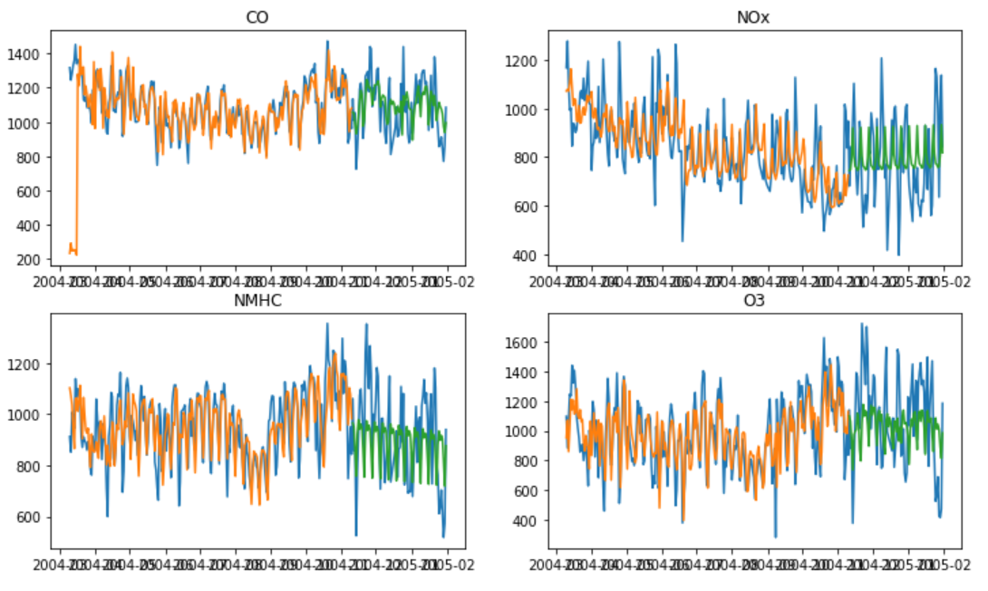
Evaluating In-Sample Predictions
Finally, for in-sample predictions, the data were split into a train (0.75) and test set (0.25).
The best models were then trained using the training data and used to make in-sample predictions.
Plotting the true (blue) values against the training (orange) and testing (green) prediction values produced Fig. 4.1.
The models performed quite well as the predictions overlapped most of the actual values.
The train and test error are also low and quite close
Fig. 4.1. In-sample predictions and actual values

Slide 13
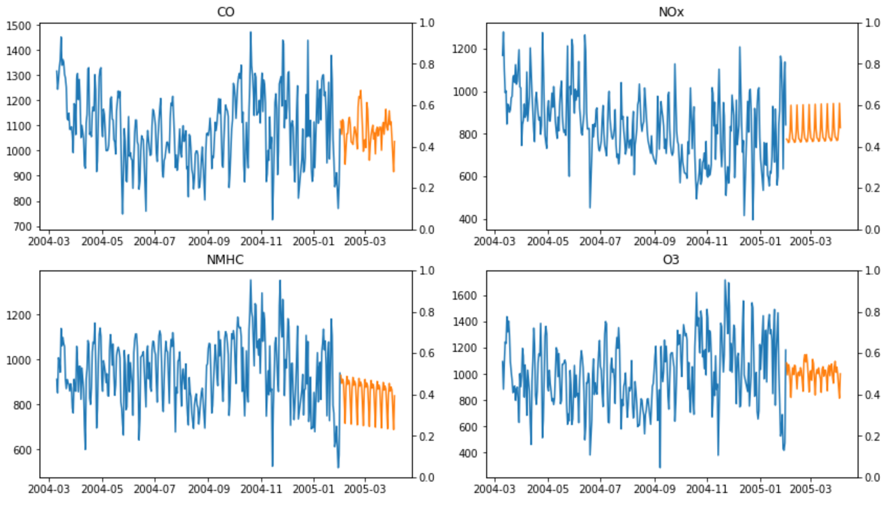
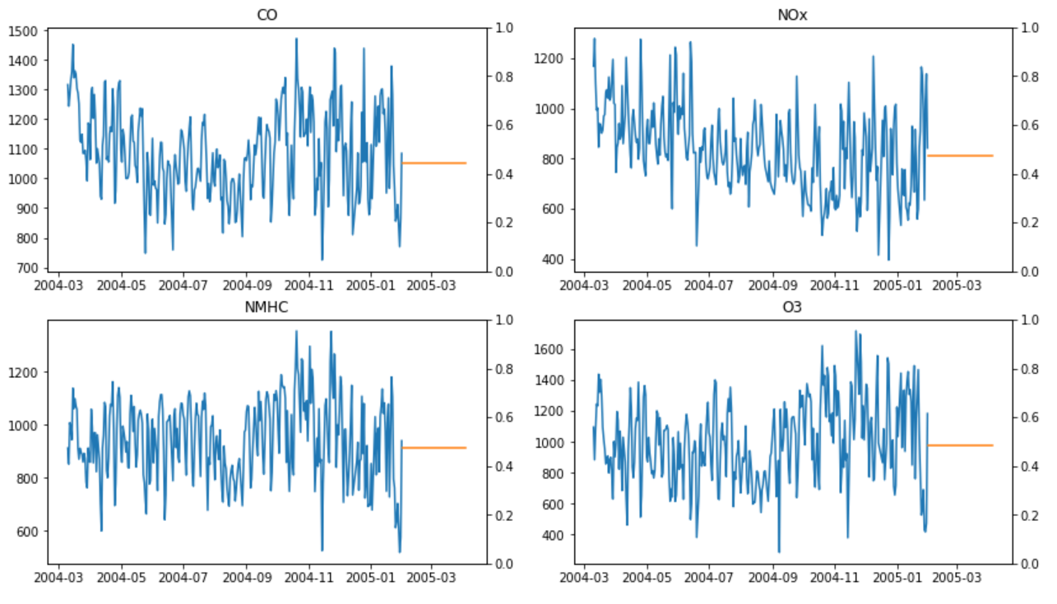
Evaluating Out-of-Sample Predictions
For out-of-sample predictions, 0.75 of the full data provided was used to train the models as using all the data resulted in linear decomposition errors.
There are no true values to evaluate the forecasts against as these are out-of-sample predictions.
However, comparing them to a baseline (constant) prediction, the forecasts seem more reliable as they capture some of the patterns of the data.
Fig. 4.2. Out-of-sample predictions
Fig. 4.3. Baseline (constant) predictions

