Slide 1
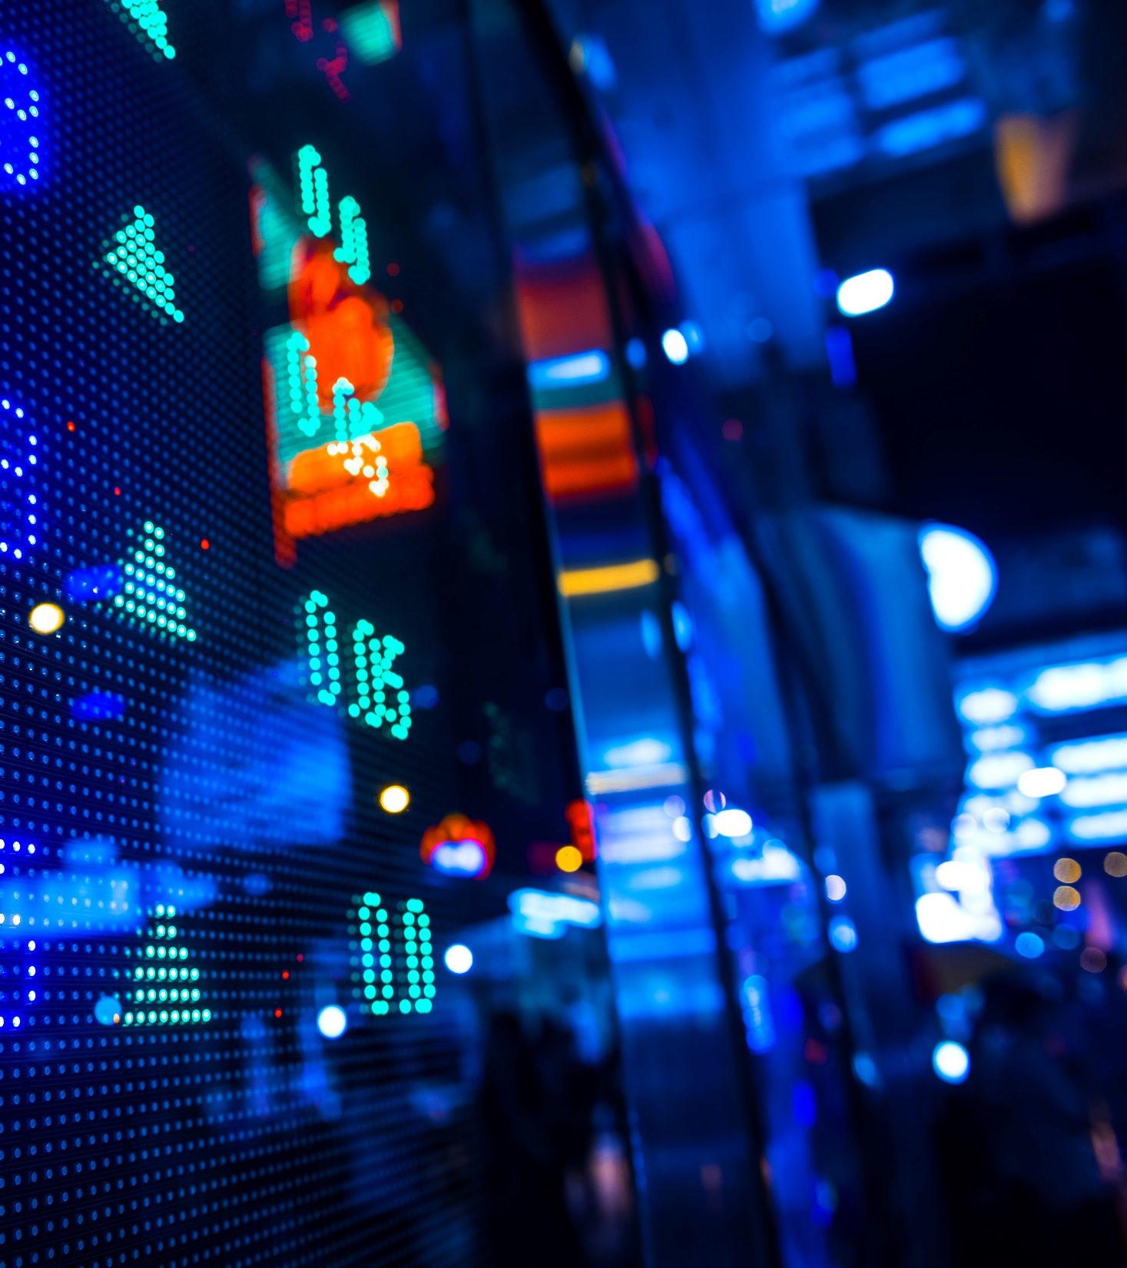
predicting air pollution
A machine learning study conducted by Ethan Tan (P2012085)

Slide 2
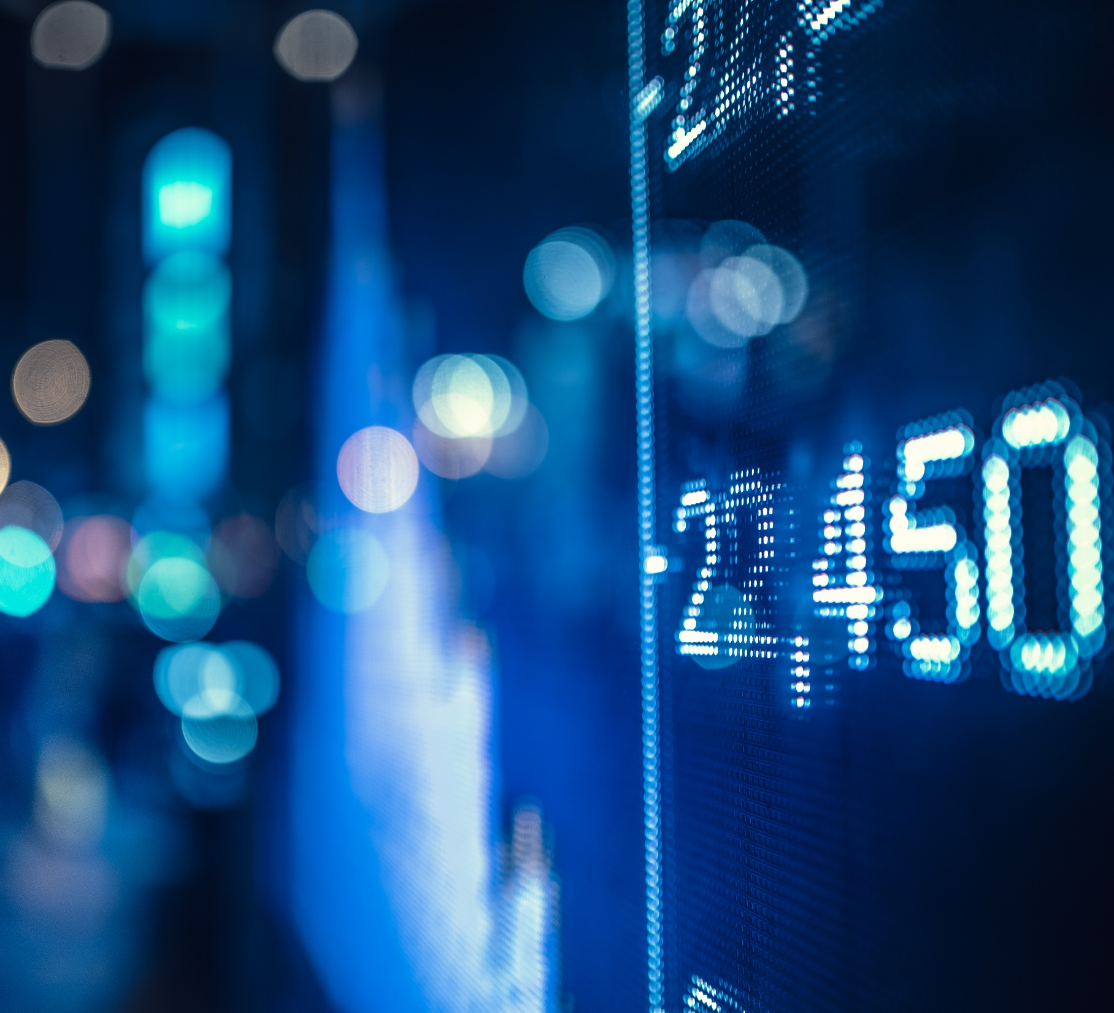
Presentation Flow
Exploratory Data Analysis
Algorithm Selection
Hyper-Parameter Tuning

Slide 3
Exploratory

Slide 4
Investment goals
Milestone 1
Planning
Initial Investment
Milestone 2
Second Investment
Returns
Communication

Slide 5
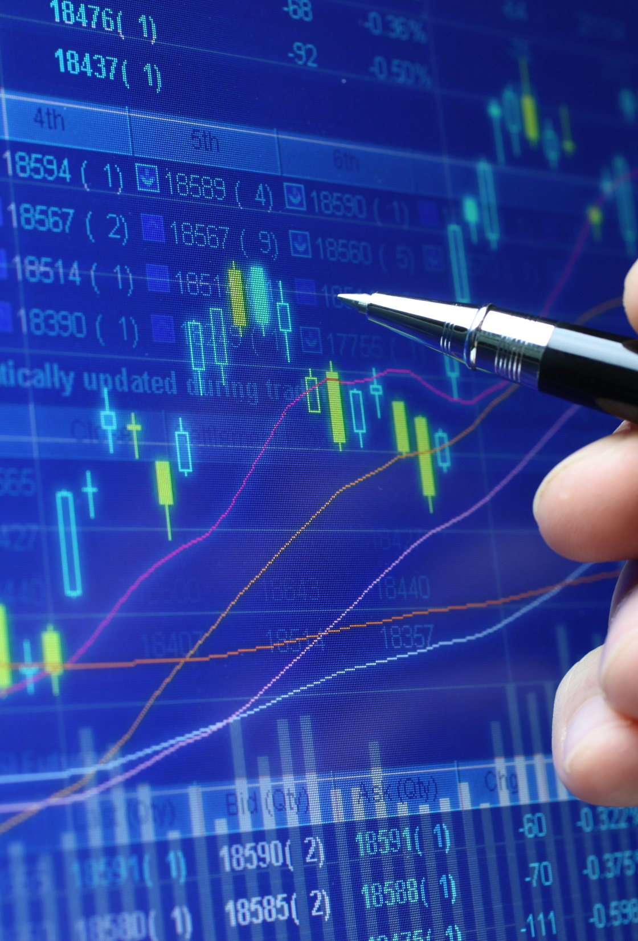
Thank you
someone@example.com

