Slide 1

predicting air pollution
A machine learning study conducted by Ethan Tan (P2012085)

Slide 2

Presentation Flow
Exploratory Data Analysis
Algorithm Selection
Hyper-Parameter Tuning

Slide 3
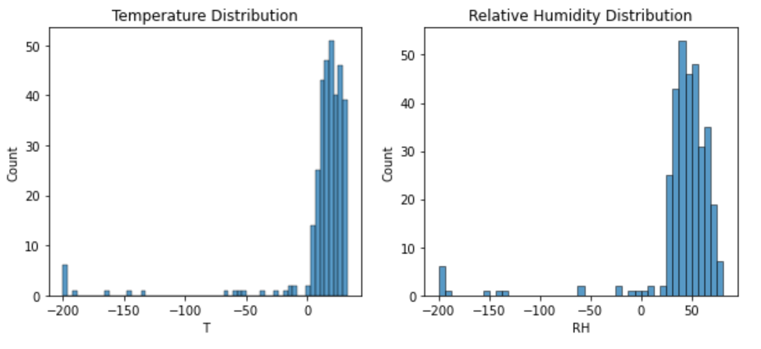
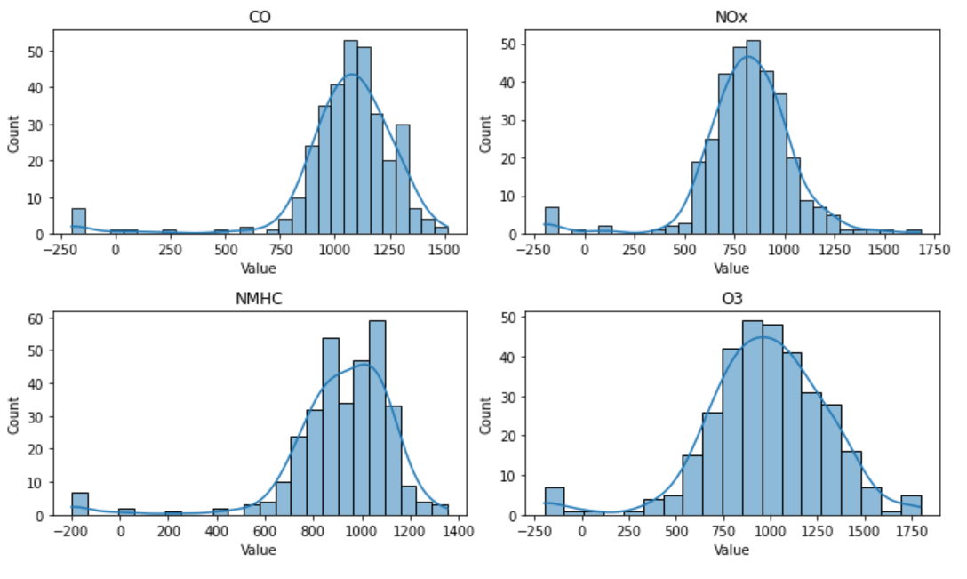
Exploratory Data Analysis
The data is very positively skewed, and contains many outliers which might negatively impact the model’s ability to generalise.
Outliers should be removed (however, the Kaggle submission keeps the outliers)

Slide 4
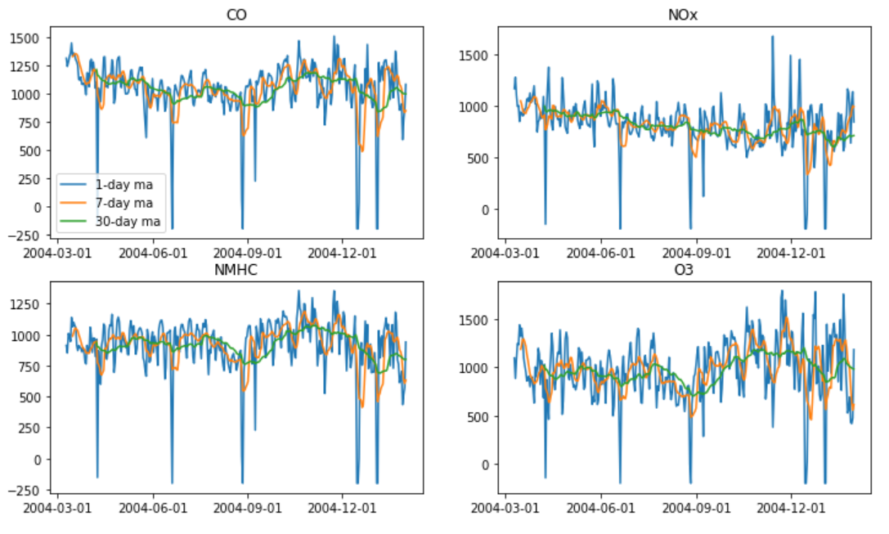
Exploratory Data Analysis
The data is very erratic.
This will potentially pose a problem as there is no clear trend for a SARIMA model to pick up on.

Slide 5
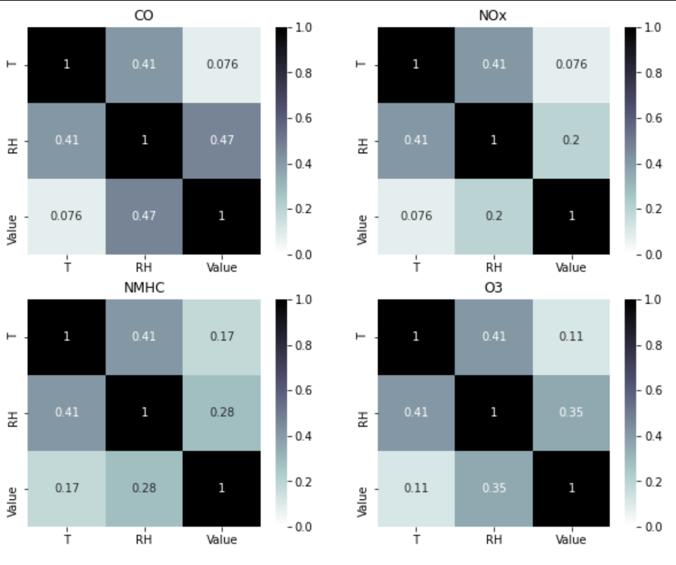
Exploratory Data Analysis
There may be minor correlations between Temperature or Relative Humidity and the Value of each gas produced.
From a logical standpoint, environmental conditions may have effects on the amount or types of air pollution.
SARIMAX should be considered as it takes these explanatory variables into account.

Slide 6
Algorithm SELECTION
For this time series problem, I considered the SARIMAX and Exponential Smoothing models.
Instead of settling on an algorithm and tuning its hyperparameters afterwards, I decided to tune and compare the algorithms in parallel, as 4 models are required.
For this time series problem, I considered the SARIMAX and Exponential Smoothing models.
Instead of settling on an algorithm and tuning its hyperparameters afterwards, I decided to tune and compare the algorithms in parallel, as 4 models are required.

Slide 7
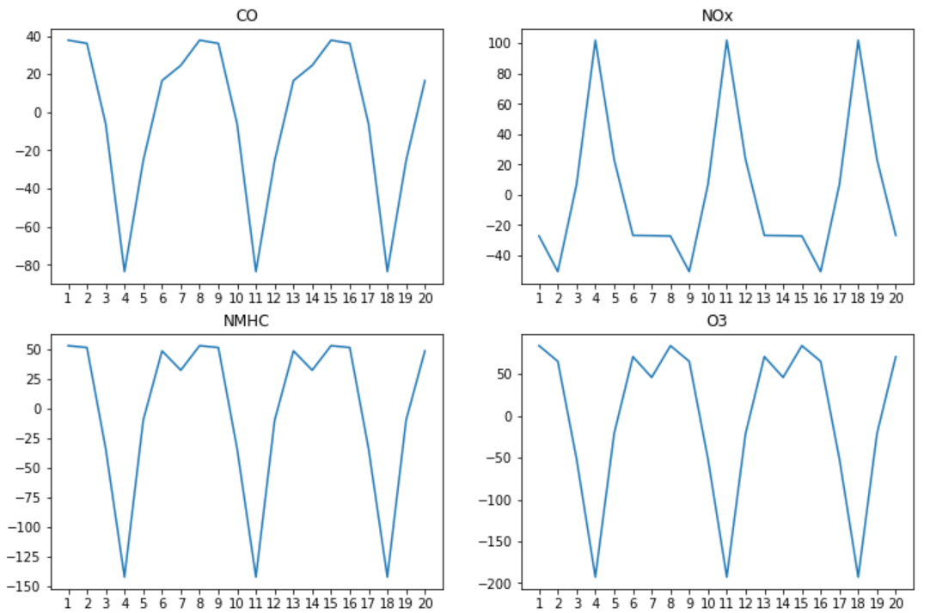
Hyper-Parameter Tuning (SARIMAX)
For the SARIMAX model, the hyper-parameters tuned are:
the trend order (p, d, q)
the seasonal order (P, D, Q, m)
the trend type (no trend/constant)
which exogenous variables to be used
(p, d, q) can be determined using the partial autocorrelation and autocorrelation functions while
(P, D, Q) can be selected using a Grid Search
Before PACF and ACF can be applied to find the trend orders for the models, the data (Value column) has to be stationary first. This means that any seasonal component has to be removed too.
Using the seasonal_decompose function and applying ACF on the seasonal component, m = 7 for all the gases. This suggests some form of weekly seasonality (perhaps more pollutive gases are emitted on weekends).

Slide 8
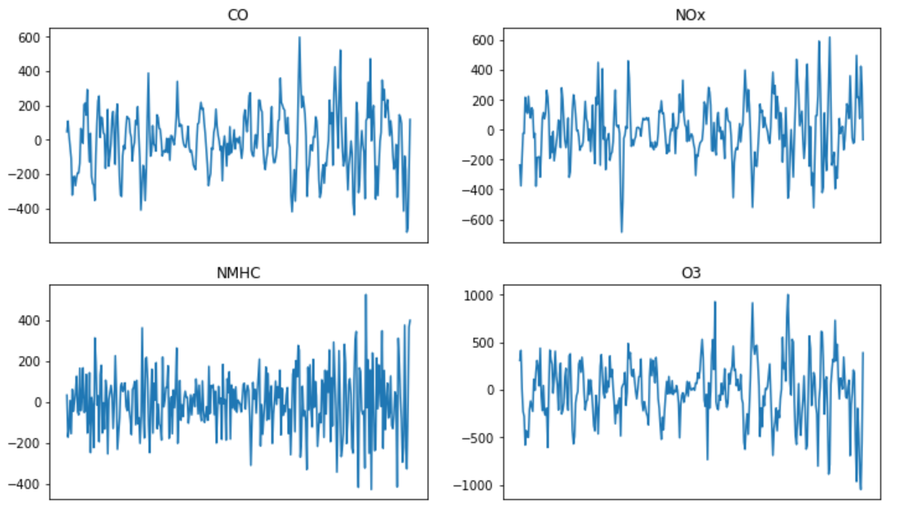
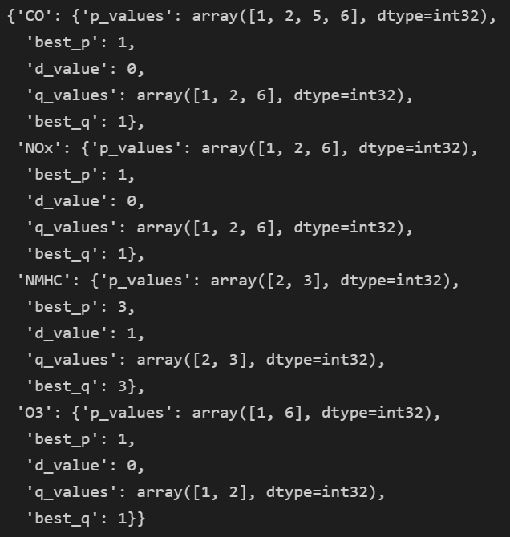
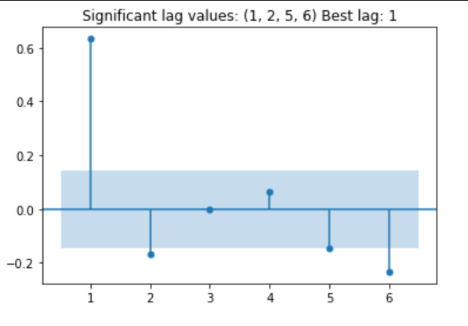
Hyper-Parameter Tuning (SARIMAX)
Using the Augmented Dickey-Fuller test (α=0.01), I found that NMHC was the only non-stationary gas (in terms of unit root test)
For each gas, the values were differenced to remove the non-stationary and seasonal components
PACF and ACF were then applied to determine the values for (p, d, q).
p and q were identified programmatically, in the forms of tuples instead of integers as the statsmodels supports partial lag values
Fig. 7.1. Values after differencing
Fig. 7.2. Example PACF plot after differencing
Fig. 7.3. Selected p, d, q values

Slide 9
Hyper-Parameter Tuning (SARIMAX)
Grid Search was used to determine:
Fig. 7.1. Values after differencing
Fig. 7.2. Example PACF plot after differencing
Fig. 7.3. Selected p, d, q values

Slide 10

Thank you
someone@example.com

