Slide 1
A Quick Study On Customer Segmentation
By Ethan Tan Wee En
P2012085
DAAA/FT/2A/03

Slide 2


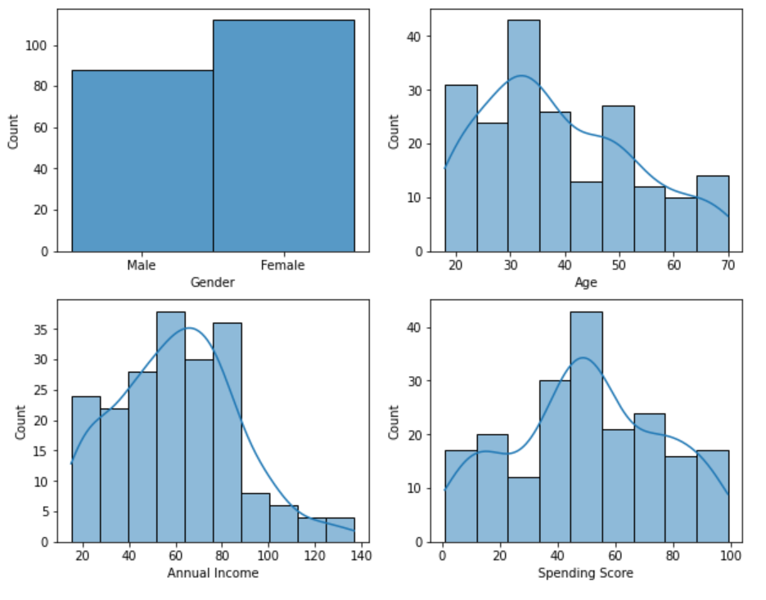
Exploratory Data Analysis
There is more data on female customers than male ones
There is more data on younger customers. This is likely because younger people tend to shop more than older folks.
Annual income is slightly positively skewed, indicating that most customers are have low- to middle-incomes
Spending score seems to be normally distributed

Slide 3
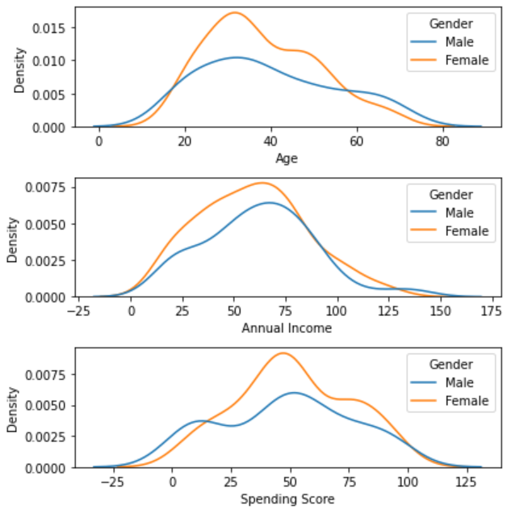
Exploratory Data Analysis
The additional female data is roughly concentrated around the centre for each of ‘Age’, ‘Annual Income’ and ‘Spending Score’

Slide 4
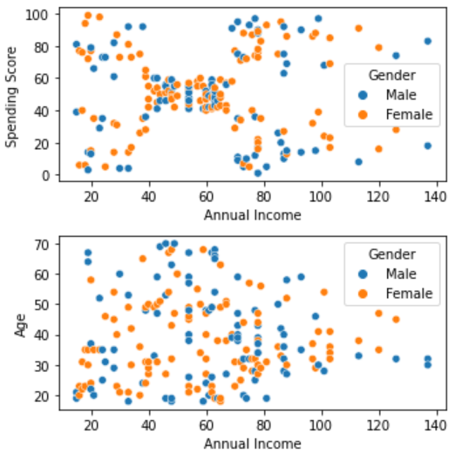
Feature Selection
Gender does not seem to be a good factor for customer segmentation as the data points for both male and female customers are scattered randomly
Furthermore, gender is qualitative and nominal, hence it does not provide much information for comparisons
Gender column to be dropped

Slide 5
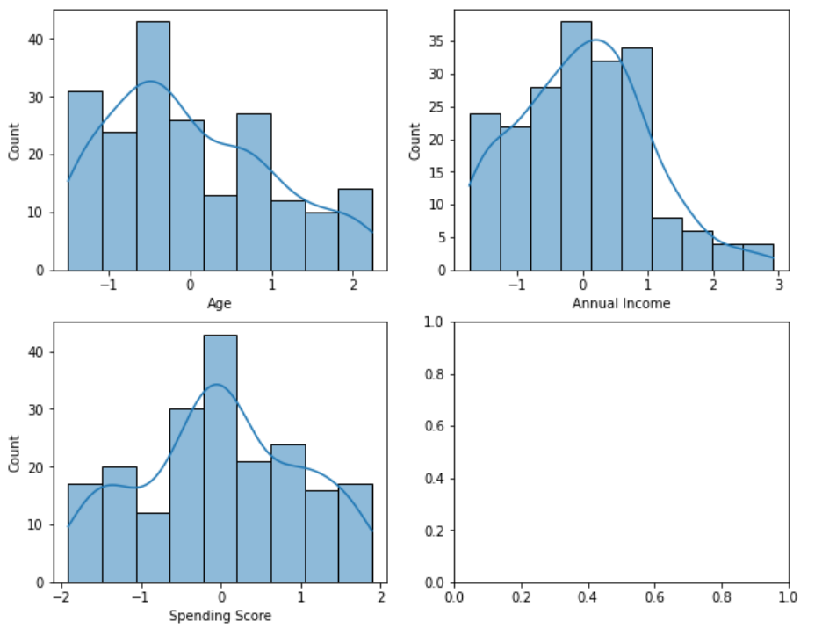
Feature Engineering
Since the data is of roughly the same order of magnitude, standardization will not affect the data points’ positions much.
Nevertheless, it is good to standardize the data as it sets all 3 variables on the same scale
i.e., N~(0, 1)
This will remove any potential bias among the features during clustering for algorithms which use Euclidean distance

Slide 6
Principal Component Analysis
Among the 3 remaining features (Age, Annual Income and Spending Score), they should be checked for redundancy or standardization.
The order of magnitude (scale) of all three variables is approximately equal (about 2). This will be good for the clustering algorithms which use Euclidean distances to find the clusters.
Using Principal Component Analysis as a tool for dimension reduction, the importance of the 3 variables can be examined simultaneously.

Slide 7
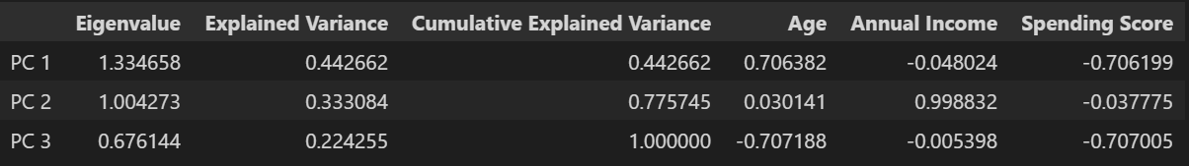
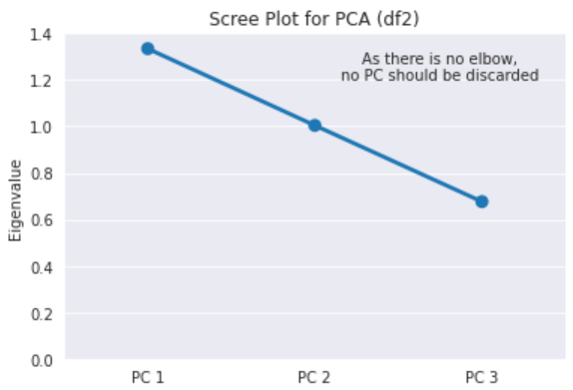
Principal Component Analysis
The 3 Principal Components are all important (carry significant information) as each explains more than 20% of the total variance within the data.
According to the Scree Plot on the right of the PC eigenvalues, there is no elbow, which suggests that all three PCs should be kept.
Keeping all three PCs would be no better than just using the original data. In fact, it would be less informative as the new PCs have no meaning.
For this analysis, it would be desirable to be able to link back to the original meaningful variables.

Slide 8

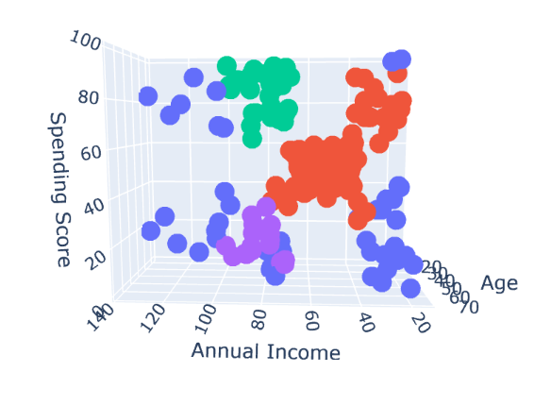

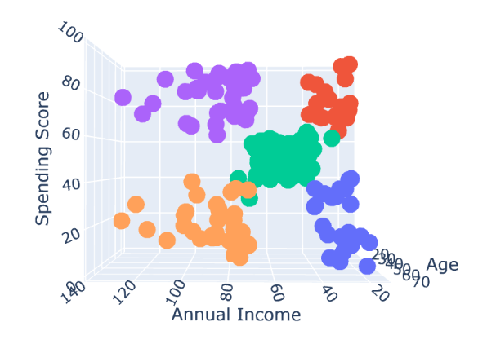

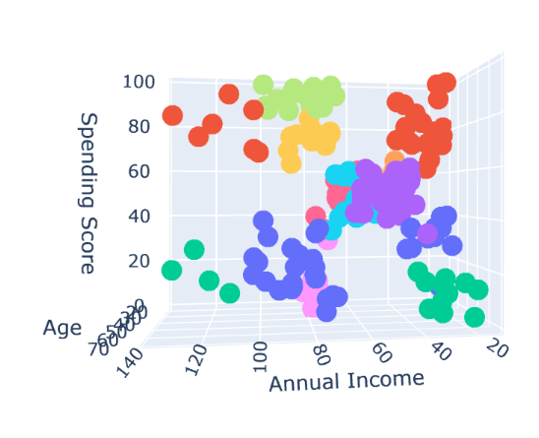
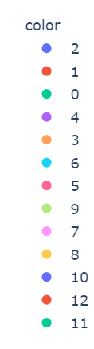
Algorithm Selection
5 different clustering algorithms were compared against one another, using 3 distinct hyper-parameter configurations each.
The main criteria for a good unsupervised learning model in this scenario would be one that:
has a small number of clusters
has roughly even cluster sizes (distance-wise)
has clusters in meaningful locations
Out of all of them, KMeans and AgglomerativeClustering appear the most promising

Slide 9
Hyper-Parameter Tuning (No. Of clusters)
Score | Silhouette | Distance | Count
Measures | the ratio between intra-cluster distances and the inter-cluster distances | the variance in the cluster sizes, distance-wise | the variance in the cluster sizes, count-wise
Rationale
Positive indicator | Higher | Lower | Lower

Slide 10
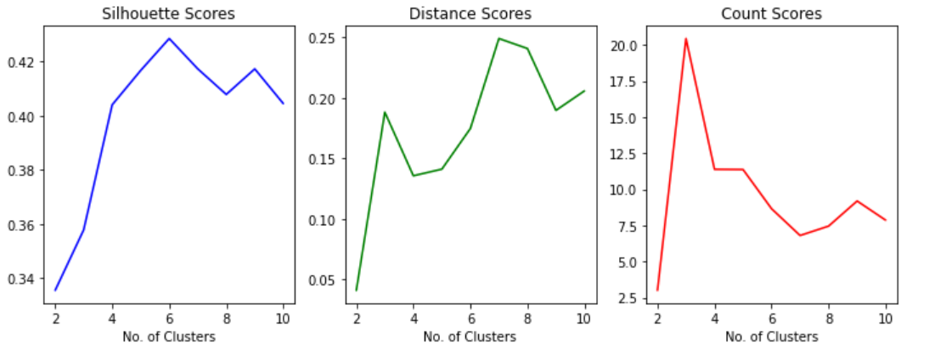
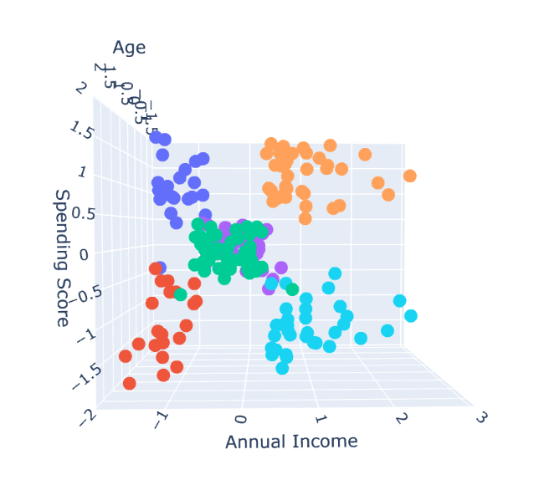
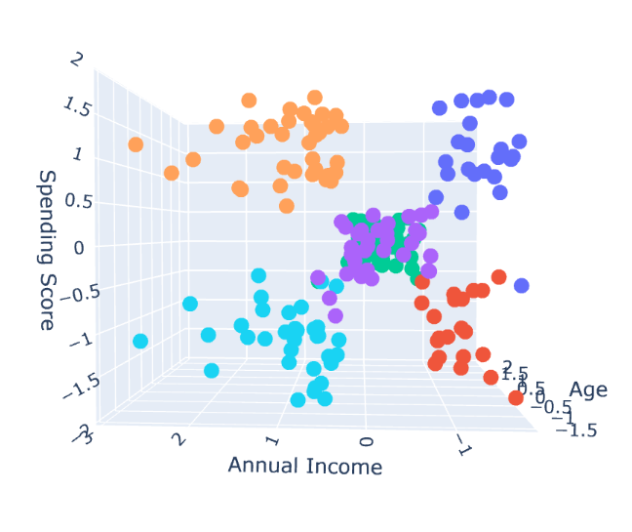
Hyper-Parameter Tuning (Plot)
The silhouette score plot suggests using 5, 6 or 9 clusters.
The distance score plot suggests using 4 to 6 clusters.
The count score plot suggests using 6 to 8 clusters.
All three plots agree that 6 is a suitable number of clusters to use.
Examining the plots visually confirms that 6 is a reasonable number of clusters.

Slide 11
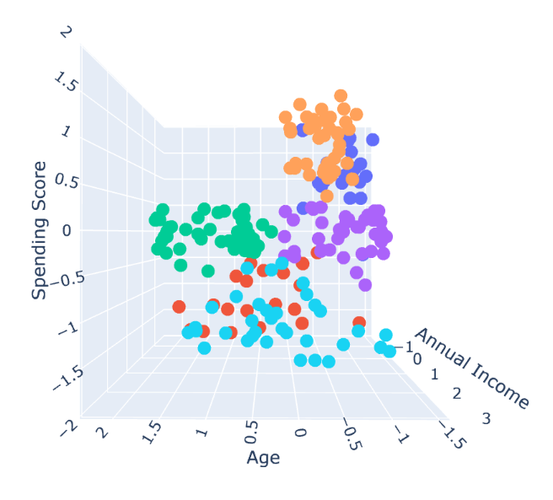
Customer Segmentation
Using the KMeans model with 6 clusters, the mall customers are segregated into 6 distinct meaningful clusters.
The clusters sort of resembles an Urgency-Importance Matrix.
The clusters are:
Red – low-income and low spending score (all ages)
Dark Blue – low-income but high spending score (young)
Purple/Green – middle-income and middle spending score (young/old)
Light Blue – high-income but low spending score (all ages)
Yellow – high-income and high spending score (young)

Slide 12
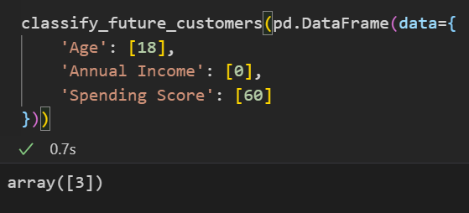
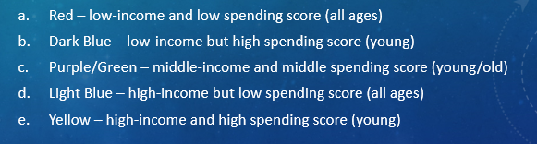
Marketing Strategy
Young people tend to shop more, be more impulsive and less frugal than older people.
The young generation is born into a much more affluent society than the previous generations.
The provided <out/customer-clustering-model.p> is a binary representation of the model used on the unstandardized data, which works almost as well as the standardized one. Using this, future customers can be classified (assuming the customer segmentation pattern does not change.
In an effort to improve sales but not encourage youths to spend beyond their means (dark blue group), marketing strategies should be targeted at high-income but low spending score customers (light blue group).
To enhance the mall’s reputation, perhaps the mall could host a money-saving campaign to educate the youths of the risks of overspending.

