Slide 1
DELE Part B
Ethan (2012085) & Jennifer (2030920)

Slide 2
Background Research – Environment
The state space of the LunarLander-v2 environment consists of 8 values, which are the coordinates of the lander (x, y), the velocity of the lander (x, y), the angle and angular velocity of the lander and whether either or both its legs have come into contact with the ground.
The lander can choose 1 of 4 discrete actions at each timestep: do nothing, fire left engine (to go right), fire main engine (to slow down), fire right engine (to go left). Using just these 4 actions, the lander’s objective is to land on the landing pad (denoted by 2 flags) safely.

Slide 3
Background Research – Environment
Reward Scheme
Reward for moving from the top of the screen to the landing pad with zero speed is about 100..140 points.
If the lander moves away from the landing pad it loses reward.
If the lander crashes, it receives an additional -100 points.
If it comes to rest, it receives an additional +100 points.
Each leg with ground contact is +10 points.
Firing the main engine is -0.3 points each frame.
Firing the side engine is -0.03 points each frame.
Solved is 200 points.
Episode Termination Conditions
The lander crashes
The lander gets outside of the viewport
The lander is not awake

Slide 4
Background Research – RL Algorithms
There are a few ways to go about solving this problem.
For instance, one could use physics and determine a function that stabilises and guides the lander towards the landing pad.
Nevertheless, as we are tasked to use reinforcement learning to solve this environment, we should decide on which RL algorithm to employ
There are a few candidate algorithms, such as DQN, Double DQN, Duelling DQN, Actor-Critic, Proximal Policy Optimization…
As this is a relatively simple environment, we decided to try out simple DQN and Double DQN

Slide 5
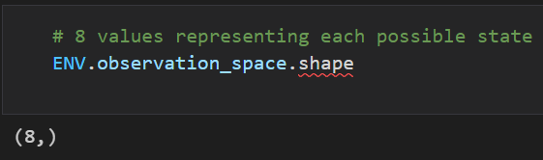
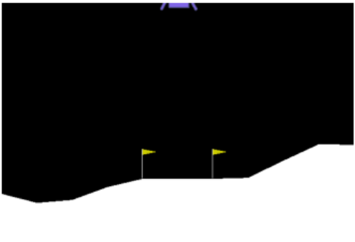
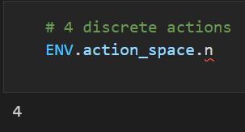
EDA
Lander
8 values which describe the state of the agent
Landing Pad
Snapshot of environment at starting state
4 discrete actions to choose from

Slide 6
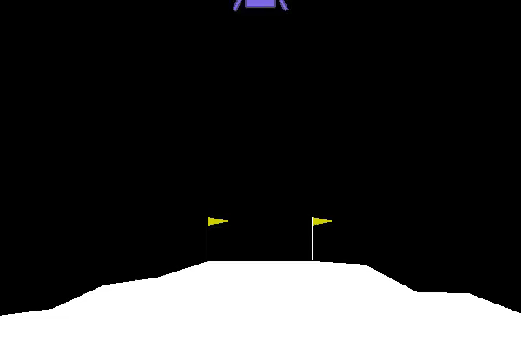
Baseline – Random Policy Agent
From the video on the right, it is quite evident that the passengers aboard a lander that acts randomly are likely to lose their lives.
It keeps crashing at high speeds and often goes into a spin.

Slide 7

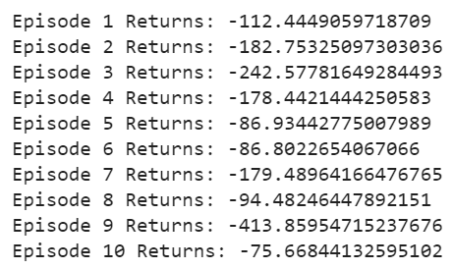
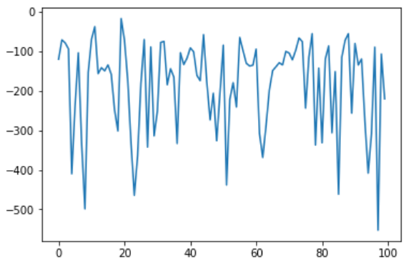
Baseline – Random Policy Agent
Above are the scores of a random agent with respect to the LunarLander-v2 environment
All the scores are negative, which is expected as the lander keeps crashing
Below shows the plot of the scores of a random policy agent attempting to land successfully for 100 episodes
Evidently, there is no learning at all as the mean score is not improving (in fact, it seems like it’s going down)

Slide 8
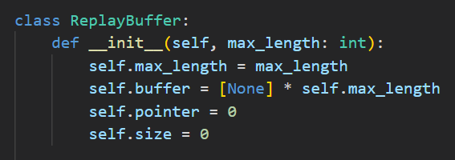
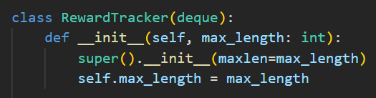
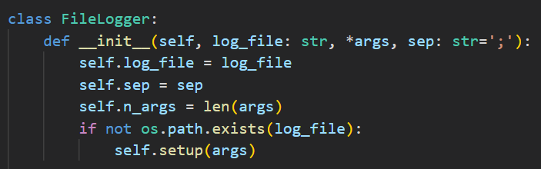
Defining Deep Q-Learning Components
ReplayBuffer class, to store experience for learning.
Implemented as a circular buffer with a fixed maximum length. Improved element access time compared to deque.
RewardTracker class, to track the rolling mean score of an arbitrary agent. Used to determine when the environment is solved.
Implemented as a subclass of deque.
FileLogger class, to save the episodes, steps and scores during training. Used to plot the learning curve of an arbitrary agent.

Slide 9
Double DQN
This algorithm makes use of two deep Q-network, one for approximating the current Q-values and another for approximating the target Q-values.
This algorithm is allegedly more stable and robust as compared to a vanilla DQN.

Slide 10
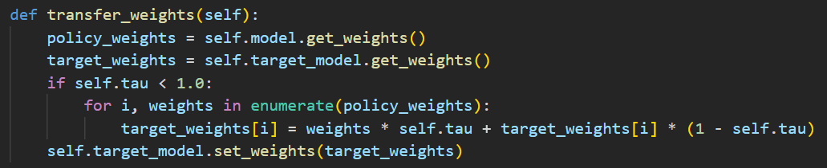
Double DQN
One of the main differences between simple DQN and double DQN is that the weights have to be transferred over from the policy network to the target network periodically.
This introduces a few new hyper-parameters like tau and the interval over which the weights are copied over. In doing so, this algorithm is more complex than vanilla DQN.

Slide 11
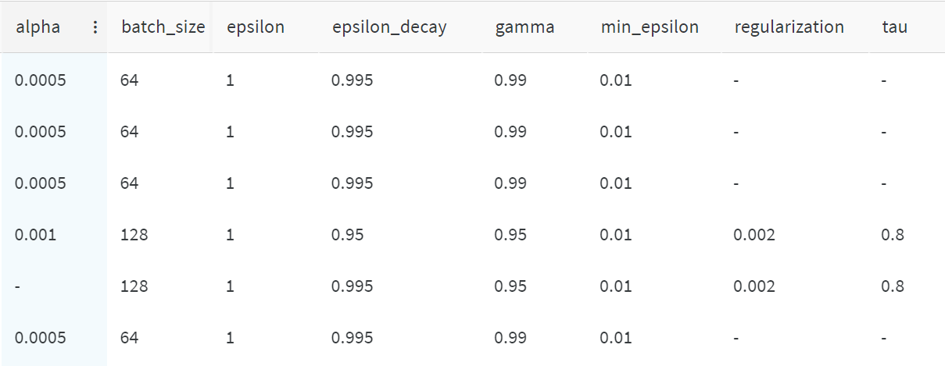
Hyper-Parameter Tuning
Weights and Biases was used for model optimization/hyper-parameter tuning
Many different sets of hyper-parameters were compared, such as batch size, epsilon decay rate, learning rate, discount factor, etc.

Slide 12
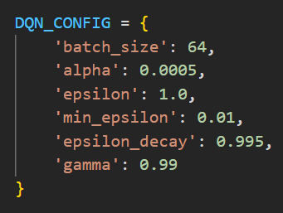
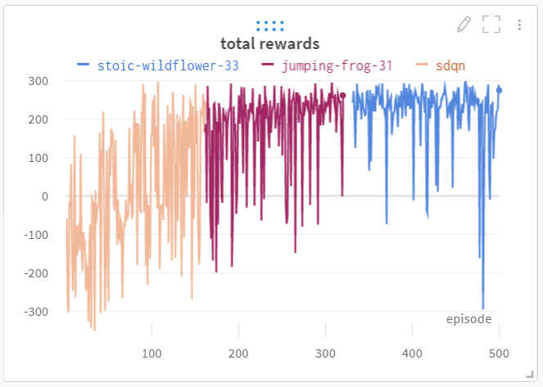
Hyper-Parameter Tuning
The learning progress of each model was tracked and plotted in real time, which was useful in checking if the they were converging or not
Weights and Biases also enabled us to compare multiple runs simultaneously
This was useful in determining the optimal set of hyper-parameters to adopt

Slide 13
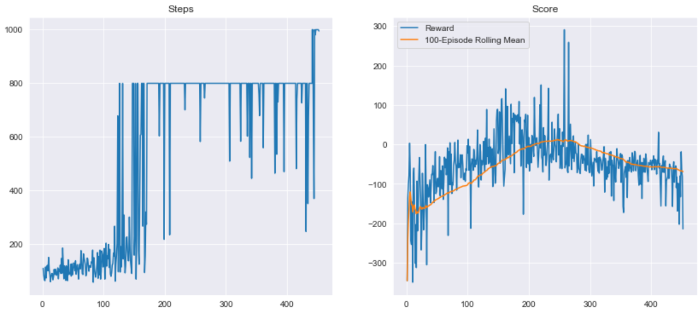
Learning Curve

Slide 14
DQN
This algorithm makes use of only one deep Q-network, which attempts to approximate both the current Q-values, as well as the target Q-values.
Supposedly more unstable, this implementation can often be described as a dog chasing its own tail.
Nevertheless, we tried it out too and, surprisingly, it worked better than double DQN.

Slide 15
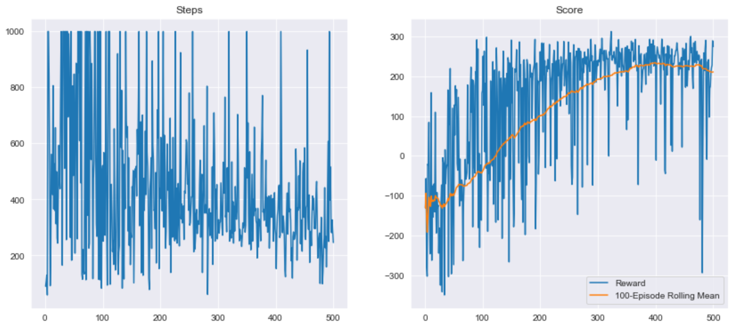
Learning Curve

Slide 16
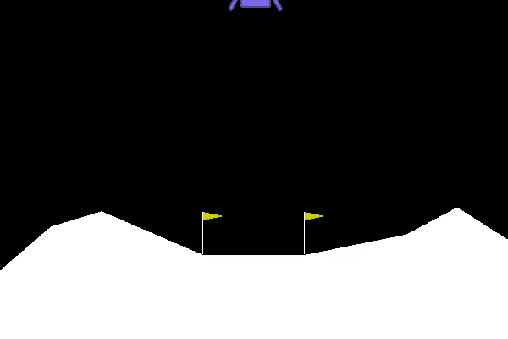
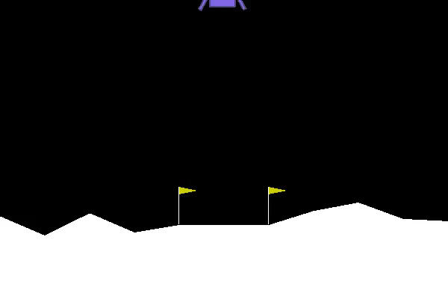
Visualise Performance Improvement
DQN Agent after 50 Episodes
DQN Agent after 100 Episodes

Slide 17
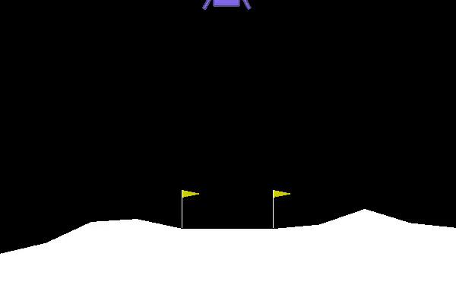
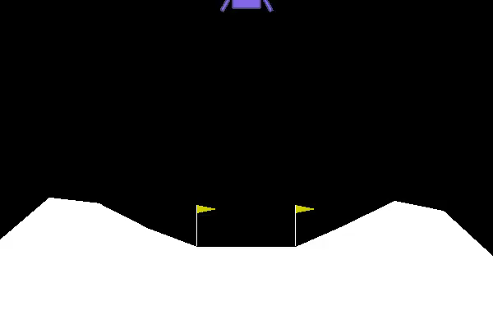
Visualise Performance Improvement
DQN Agent after 350 Episodes
DQN Agent after 360 Episodes

Slide 18
Model Evaluation
The vanilla DQN manged to reach a 100-episode rolling mean score of 225, which is above the required score 0f 200.
From the videos, we can also confirm visually that the lander has learnt to land successfully and safely on the landing pad.
Therefore, we have successfully solved the LunarLander-v2 environment from the OpenAI gym library.

Slide 19
Conclusions
A complex solution is not always the most optimal.
Often, a simpler method is more elegant and yields better results
One just has to have the patience to seek it out
This assignment on reinforcement learning really made us rethink how humans ourselves learn

Slide 20
References
https://wingedsheep.com/lunar-lander-dqn/
https://goodboychan.github.io/python/reinforcement_learning/pytorch/udacity/2021/05/07/DQN-LunarLander.html
https://www.youtube.com/watch?v=UCgsv6tMReY

