Slide 1
DELE CA2 Part A
Ethan Tan (2012085)
DAAA/2B/03

Slide 2
Background Research – CIFAR-10 Dataset
CIFAR-10 is a dataset which comprises 60,000 32x32 coloured images in 10 classes/categories, with 6000 images per class. There are 50000 training images and 10000 test images in total (i.e. 5000 training and 1000 test images per class).
The classes are completely mutually exclusive. There is no overlap between automobiles and trucks. "Automobile" includes sedans, SUVs, things of that sort. "Truck" includes only big trucks. Neither includes pickup trucks.
This ensures that each class is isolated from the rest.
airplane
automobile
bird
cat
deer
dog
frog
horse
ship
truck

Slide 3
Background Research – GANs
Since this is an image generation problem, GANs come to mind. Specifically, non-style-transfer GANs (like CycleGAN/StyleGAN).
Therefore, some candidate GANs include vanilla DCGAN, Conditional DCGAN and WGAN.
All these GANs make use of some convolutional neural network (CNN) for both the generator and discriminator.
Conditional GAN takes an additional feature, which is the desire category of the image.
WGAN uses a specific loss function, known as the Wasserstein Loss function (W in WGAN).
I decided to start with DCGAN and then try out CDCGAN and WGAN if I had time. Unfortunately, I did not have time to try them out
I tried using DCGAN on the entire CIFAR-10 dataset at once. The results were completely unrecognizable.
Thus, I partitioned the dataset by class in hope of generating better quality images.

Slide 4
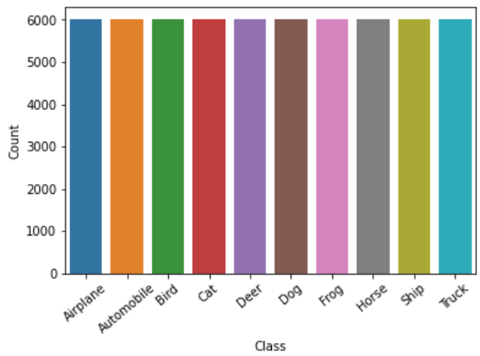
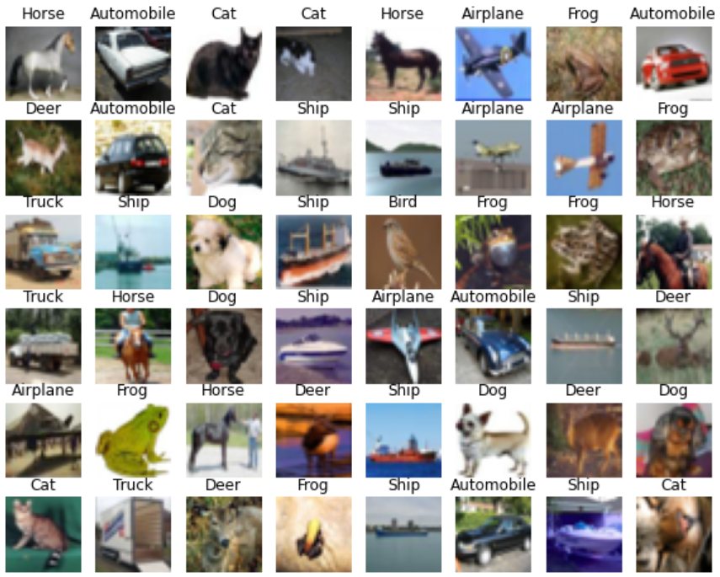
EDA
To begin, I conducted simple exploratory data analysis to ensure the data was indeed as it stated
The classes were balanced with 6000 images from each
The images were an assortment of cats, dogs, cars, etc.
They ranged from poor quality (absolutely weird) to clearly represented
This indicated that I had to perform some data cleaning prior to training the GAN models

Slide 5
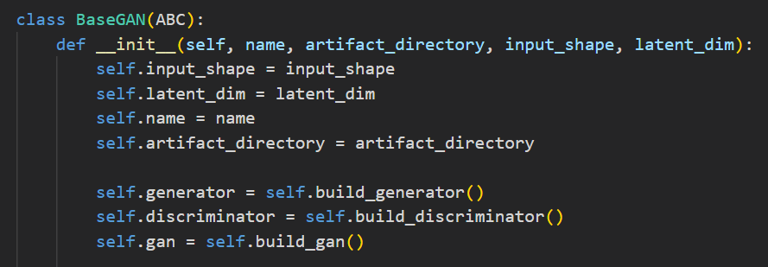
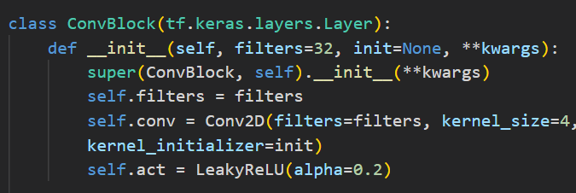
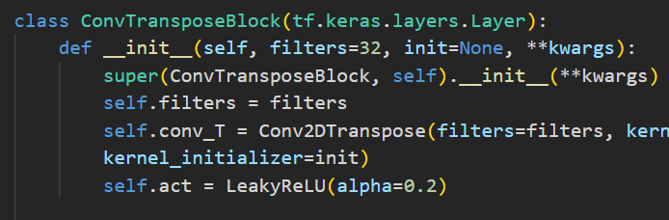
Defining GAN Components
First, I defined an abstract BaseGAN class which was supposed to support all 3 types of GANs (DCGAN, CDCGAN, WGAN)
I then created two custom layers by inheriting tensorflow.keras.layers.Layer
These custom classes simply encapsulated the layers that are reused often in the discriminator and generator respectively
The ConvBlock layer was used for downsampling and feature extraction in the discriminator
The ConvTransposeBlock layer was used for upsampling and feature generation in the generator
This architecture was inspired by VGG

Slide 6

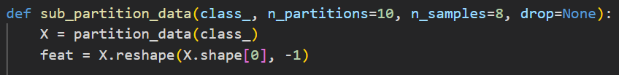
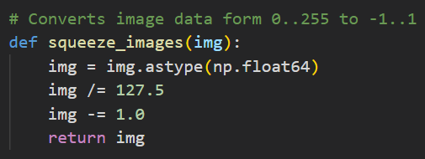
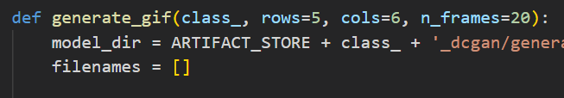
Defining GAN Components
Some other utility functions were also defined, such as:
Data partitioning functions
Image sharpening functions
Pixel value normalisation functions
Label smoothing function
Image/GIF generation functions

Slide 7
Gan Training – Image Selection
Before training any GAN models, I performed very simplistic image selection in an effort to keep only the best quality images for the GANs to learn from

Slide 8
GAN Training – Feature Engineering

Slide 9
Gan Training – Model Architecture
The environment is LunarLander-V2, from Open-AI’s gym toolkit
The task is to land the rover successfully between the flags without crashing or moving off the screen.

Slide 10
Gan Training – Model Tracking
The environment is LunarLander-V2, from Open-AI’s gym toolkit
The task is to land the rover successfully between the flags without crashing or moving off the screen.

Slide 11
Gan Optimization
The environment is LunarLander-V2, from Open-AI’s gym toolkit
The task is to land the rover successfully between the flags without crashing or moving off the screen.

Slide 12
Gan Evaluation – Qualitative / Visual
The environment is LunarLander-V2, from Open-AI’s gym toolkit
The task is to land the rover successfully between the flags without crashing or moving off the screen.

Slide 13
Gan Evaluation – Quantitative / Numeric
The environment is LunarLander-V2, from Open-AI’s gym toolkit
The task is to land the rover successfully between the flags without crashing or moving off the screen.

Slide 14
Image Generation

Slide 15
Conclusions
Image generation is no easy feat, by any means. (I’m not a great artist)
GANS are a really fascinating part of machine learning
They make us rethink what is possible using math and quite frankly,
opens us to new possibilities
Neural networks may be incorporated into our lives right under our very noses

Slide 16
References
https://machinelearningmastery.com/how-to-develop-a-generative-adversarial-network-for-a-cifar-10-small-object-photographs-from-scratch/
https://machinelearningmastery.com/how-to-implement-the-inception-score-from-scratch-for-evaluating-generated-images/
https://machinelearningmastery.com/how-to-implement-the-frechet-inception-distance-fid-from-scratch/
https://towardsdatascience.com/gan-ways-to-improve-gan-performance-acf37f9f59b
https://machinelearningmastery.com/how-to-train-stable-generative-adversarial-networks/

