Slide 1
An Analysis on COE in SG
By Ethan Tan
p2012085
DAAA/1B/03

Slide 2
Overview of this Exploratory Data Analysis (EDA)
Identify Objectives
Obtain & Clean Data
Extract Insights
Find factors which influence COE pricing (premiums & PQPs)
Find correlations and relationships among the factors
Treat missing data
Standardize data formatting
Treat anomalies
Remove unnecessary data
* Accomplished in PDAS (Programming for Data Analytics) CA2
Answer Objectives
Provide Recommendations

Slide 3
Flow of this Presentation
Introduction
Analysis
Conclusion
Provide background
Explain how the COE bidding system works
Introduce the objectives
Provide some examples of factors involved in the study
Gain insights
Gain insights into the data through means of data visualisation
Plot appropriate charts to view relationships
Provide recommendations
Provide some suggestions to the audience to help them make more informed decisions when purchasing their COEs

Slide 4
Pre-Introduction

Slide 5
Purpose
Provide recommendations to get the best COE prices
Suggest when to purchase a COE and what to look out for
Why

Slide 6
Audience
People who are new to Singapore’s COE Bidding System, especially soon-to-be first-time car buyers
This presentation is aimed at those who have low to moderate income
Who

Slide 7
Assumptions
For the sake of the subsequent analysis, the following assumptions will be made:
Private Hire Car Companies will not be considered (e.g. Uber, Grab)
Parallel Importers will not be considered
Data is valid and representative of past years (2014 - 2018)

Slide 8
Introduction

Slide 9
A Brief Introduction to COE
What is COE? COE stands for Certificate of Entitlement, and is required for any who intends to drive on Singapore roads. COE, along with a valid driving licence, are a must-have for every Singaporean driver.
How much does one COE cost? Well, it differs every time, but it is undoubtedly very costly. COE makes up a large percentage of car prices in Singapore.
If one were to buy a $100k 1.6L Honda Civic when the COE premium is considered low, the COE price would still be at least $35k.
That’s 35% of the car’s base price!

Slide 10
A Brief Introduction to COE
Despite the monumental cost of purchasing a COE, each COE is only valid for 10 years, after which one has to buy a new one, renew their existing COE or stop driving.
The cost of COE renewal as dictated by Prevailing Quota Premium (PQP), is not cheap either, sometimes even surpassing that of a new COE. This makes many Singaporeans opt to buy new COEs rather than renew their existing ones.

Slide 11
A Brief Introduction to the Bidding System
COEs are obtained through a process known as a bidding system. Car owners submit their bids (which is the amount they are willing to pay) when the bidding session opens (which is twice a month).
There will be a quota each time, which is the number of COEs released during that bidding session.
When the bidding session closes, the highest bids placed will be granted COE at the cost of the lowest reserve bid.

Slide 12
A Brief Introduction to VQS
The quota is determined by the Vehicle Quota System (VQS) and is based on:
Number of vehicles deregistered (expired or scrapped)
Number of temporary COEs that were expired or cancelled
Allowable vehicle population growth
Taxis are exempt from COE requirement, since 2012
For the sake of keeping the subsequent analyses focused,
private hire car companies (i.e. Uber, Grab) and parallel
imported cars will be ignored

Slide 13
Objectives of this EDA
Find factors of which influence COE premium
Find correlation among the factors

Slide 14
Examples of Factors to be Studied
Quota
Date
Bidding Session

Slide 15
Analysis

Slide 16
Vehicle Category
Which vehicles pay more for COE?
Factor 1

Slide 17
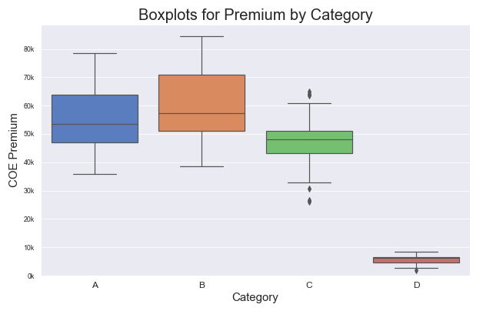
Premium by Category
Category is the most defining factor when it comes to COE pricing, with Categories A and B topping the charts.
We can’t comment too much on Category C, since it is reserved for corporate purposes.
Since Category D is for motorcycles, the premium for Category D is obviously always the lowest.
These are the definitions of the above categories:
Internal Combustion Engine (ICE) cars with an engine capacity of at most 1600cc and Electric cars with engine power of at most 97kW
Internal Combustion Engine (ICE) cars with an engine capacity of at least 1600cc and Electric cars with engine power of at least 97kW
Goods Vehicles (like trucks, lorries) and Buses
Motorcycles

Slide 18
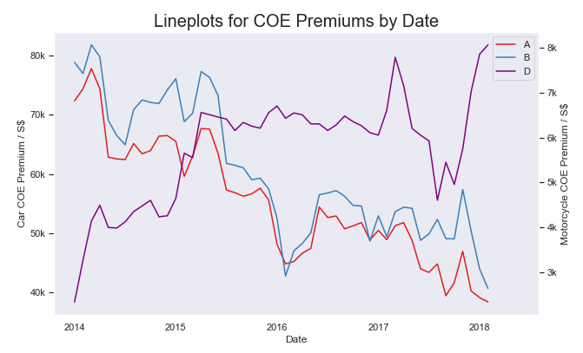
Premium by Category
It is worth noting that there is a disparity between car COEs and motorcycles’, and that the motor vehicle landscape is shifting in favour of car owners.
First, the proportion of COE in comparison to the vehicle’s base price is absurd. Motorcycle COEs can be higher than the motorcycle models themselves, whereas car COEs are rarely, if not never, more expensive than the cars themselves.
Second, COE premiums for cars are going down whereas that for motorcycles is on the incline.
There is much more to this phenomenon, but it is outside the scope of this analysis.
Going forward, Categories C and D will be excluded from the analyses.

Slide 19
Quota
How many new cars can there be?
Factor 2

Slide 20
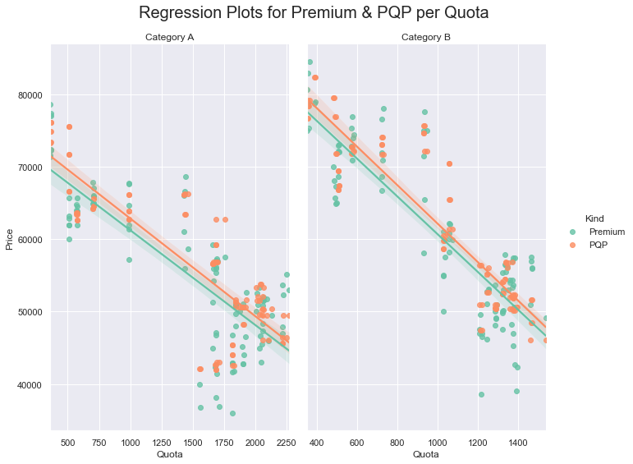
Premium per Quota by Category
As COE quota increases, both the COE premium and Prevailing Quota Premium (PQP) increase.
This can be explained with basic economics.
In summary, value (of any arbitrary product/service):
decreases with supply for a fixed demand
increases with demand for a fixed supply
This is an oversimplified elaboration.
Since it’s a bidding system, higher quota means less competition for COEs. Bids will thus be less aggressive. This will lead to a reduced lowest reserve bid.
Therefore, premium is quite strongly negatively correlated to quota.

Slide 21
Bidding Session
When to buy?
Factor 3

Slide 22
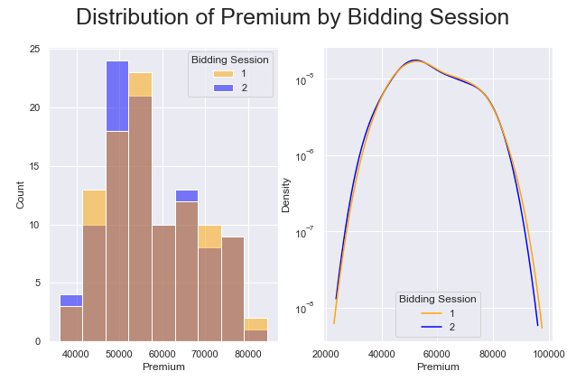
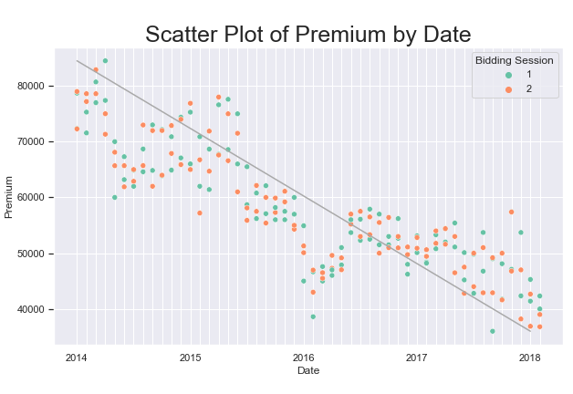
Premium by Bidding Session
This is an interesting one.
When charting the distribution of COE premiums by bidding session from a broad perspective, there seems to be little to no difference in COE premium.
COE premium appears to be about the same regardless of whether it was purchased in the beginning or the middle of the month.
In addition, variations and residuals appear random and roughly equally distributed.
Nonetheless, a month-wise comparison yields different results...

Slide 23
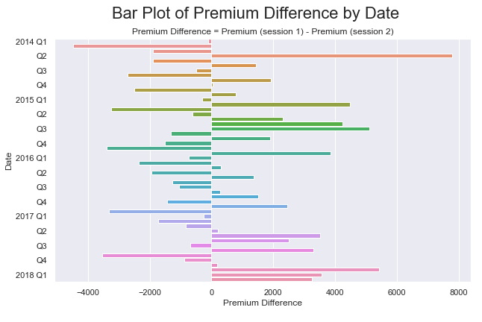
Premium by Bidding Session
Premium differences do not seem so evenly distributed when graphed month-wise.
It would be easier to compare the two sessions using a histogram or boxplot.

Slide 24
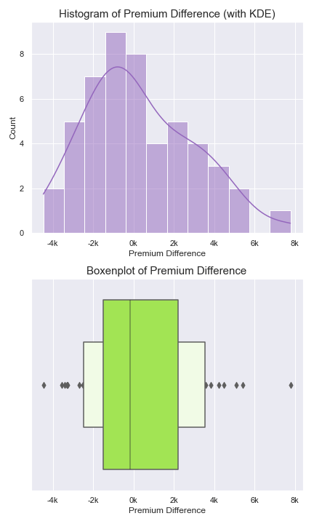
Premium by Bidding Session
The distribution of premium differences (session 1 - session 2 of the same month) is positively skewed with a mean of roughly -$1000. There is thus a significant difference in COE premium between the two sessions.
The differences can be summarised in the following table:
More often than not, the resulting bid value of the 2nd bidding session is higher than that of the corresponding 1st.
Nonetheless, the 1st bidding session may occasionally produce a much higher COE bid price than its 2nd session counterpart.
Session | Variability | Tendency
1 (1st week) | Greater | Lower
2 (3rd week) | Lower | Higher

Slide 25
Premium by Bidding Session
Hence, session 1 is more risky.
As generalised by the concept “High risk, high reward”, session 1 would usually grant a S$1000 discount, but is subject to preposterous peaks occasionally.

Slide 26
Quota ~ Bidding Session
Which session has greater supply?
Correlation 1

Slide 27
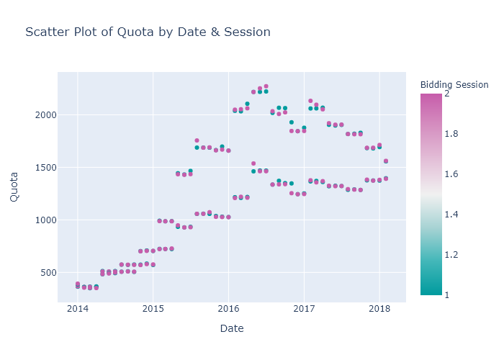
Quota by Bidding Session
There is not much difference between COE quotas for bidding sessions 1 and 2, even though the premium varies.

Slide 28
Quota ~ Year
Longer wait … cheaper?
Correlation 2

Slide 29
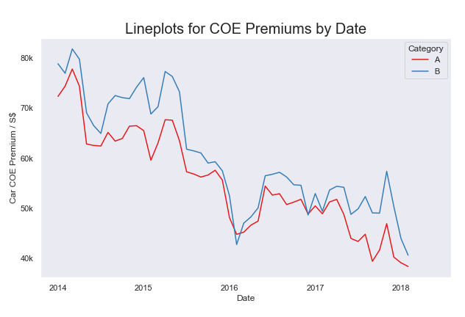
Quota ~ Year
Earlier, we mentioned that car COE premiums are on the decline.
It is possible that this observation can be explained by COE bidders are becoming more passive.
However, correlation does not always imply causation.
Perhaps it might be better explained by another factor behind the scenes...

Slide 30
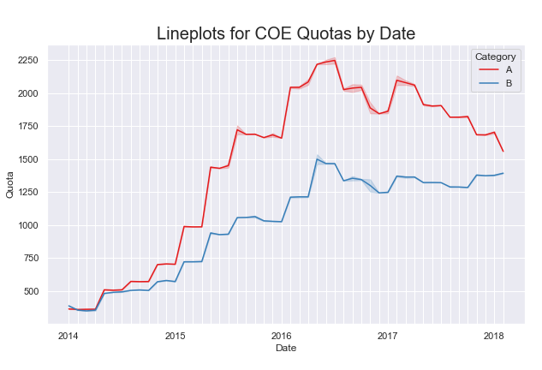
Quota ~ Year
COE Quotas have been increasing.
As we mentioned earlier, premium decreases with quota.
Hence, this might be a better explanation for why COE premiums for both Category A and B vehicles have been decreasing, rather than the shift in bidders’ attitudes.

Slide 31
Quota ~ Deregistered
More deregistered - Higher quota?
Correlation 3

Slide 32
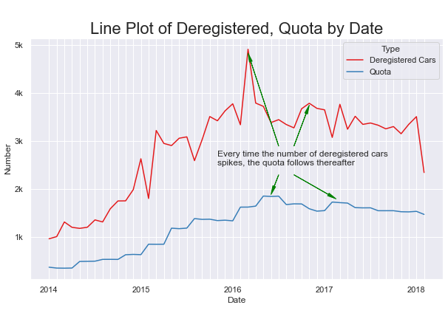
Quota ~ Deregistered
Notice how quota crests just after car deregistration peaks?
Quota is quite related to number of cars deregistered in the previous quarter.
The number of vehicles deregistered in the previous quarter of the year is actually one of the factors considered during the calculation of the supply of COEs.

Slide 33
Deregistered ~ Month
Is there a pattern in car deregistrations?
Correlation 4

Slide 34
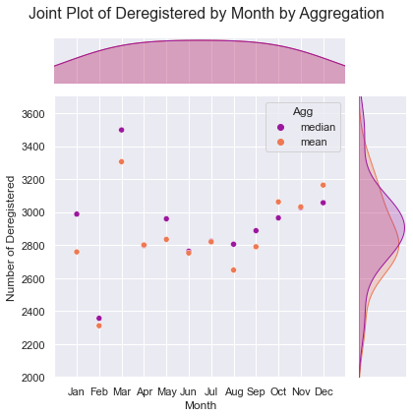
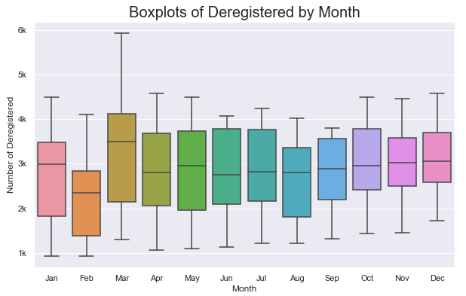
Deregistered ~ Month
Now let’s see if there’s a pattern in deregistration rates over the months.
March seems to have the greatest number of car deregistrations over the years.
But does this translate to higher quota automatically?

Slide 35
Quota ~ Month
Pattern in quota distribution?
Correlation 5

Slide 36
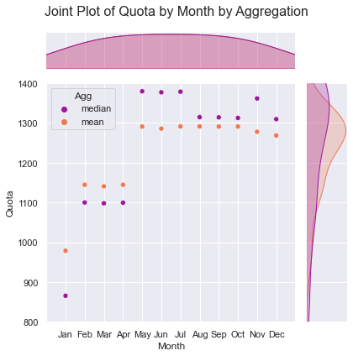
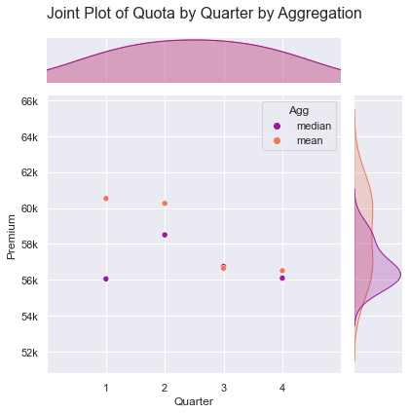
Quota ~ Month
No, number of cars deregistered cannot be used to solely explain quota trends.
In the preceding slide, we observed that March tends to have the greatest number of car deregistrations each year.
However, from the figure on the right, March does not have the greatest COE supply in the year. In fact, quota tends to increase toward the end of the year.
Well, then does this translate to premium?

Slide 37
Premium ~ Month
Pattern in pricing?
Correlation 6

Slide 38
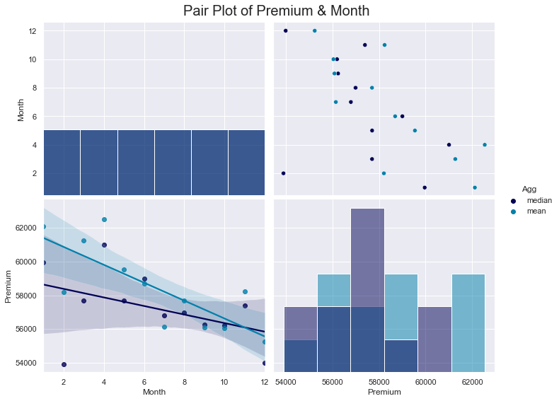
Premium ~ Month
Surprisingly, yes.
It can be seen that COE premiums decrease toward the end of each year (general trend).
There is one anomaly though (red circle). February also seems to have generally low COE premiums too.
December is a pretty good bet nonetheless.

Slide 39
Quota, Successful Bids, Received Bids
Relationship?
Correlation 7

Slide 40
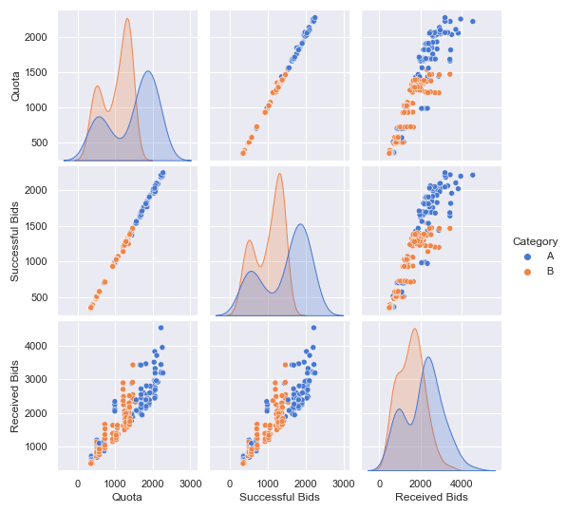
Quota ~ Bids(success) ~ Bids(received)
Quota and number of successful bids have a strong linear positive correlation.
This is not surprising as the number of successful bids is at its corresponding quota.
Quota and number of bids received also share a strong positive correlation.
Car dealerships would regulate the number of bids they submit according to the COE quota.
Furthermore, Category A seems to have higher quotas consistently (as the blue cluster is above the orange one).

Slide 41
Population, Registered, Deregistered
Relationship?
Correlation 8

Slide 42
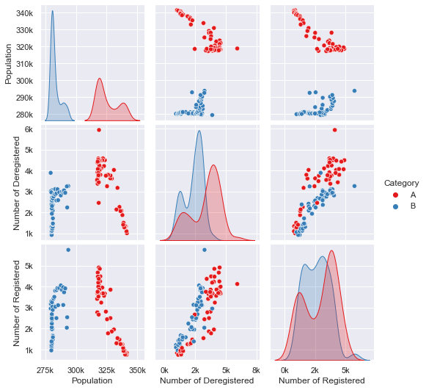
Population ~ Deregistered ~ Registered
There are more Category A cars registered in Singapore than Category B cars.
The number of cars registered is positively correlated to the number of cars deregistered.
The distribution of Category B cars registered is bimodal.
There is greater variation in population, number of cars registered and number of cars deregistered for Category A than Category B (histograms have wider bases).

Slide 43
Trends over Time
What happened over time?
Final Correlations

Slide 44
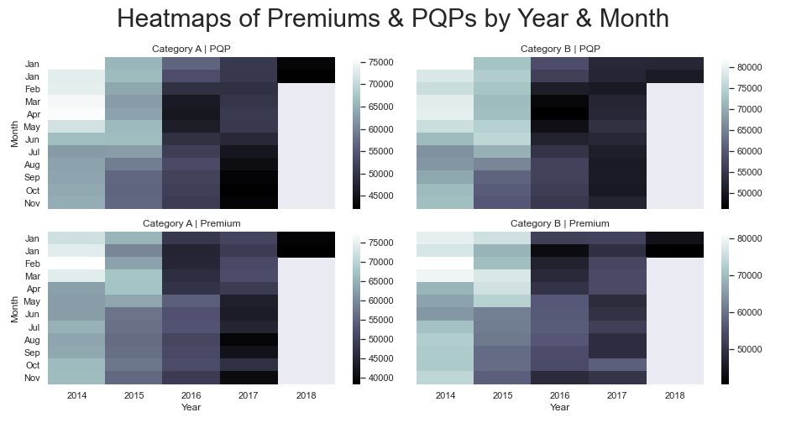
Premium, PQP ~ Year, Month
PQP has been steadily decreasing over the past few years, with the exception of mid-2016.
COE premium, however, oscillates every 12 months (roughly). Following this pattern, if the year is odd, one should purchase a COE in the tail end of the year. Otherwise, one should purchase a COE early in the year.

Slide 45
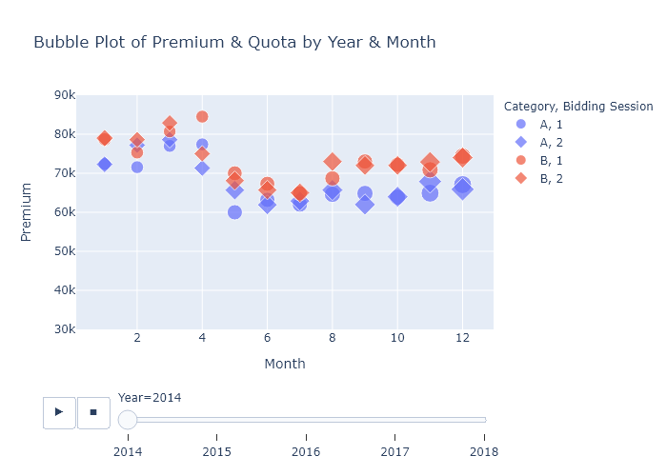
Premium, Quota ~ Year, Month
An animation to wrap things up.
COE premiums have been dropping over the last few years.
COE quota for Category B has been increasing whereas COE quota for Category A peaked in 2016-2017.
The tail-end of each year tends to offer the lowest COE prices, with the exception of 2016.

Slide 46
Conclusion

Slide 47
Recommendations
Buy a COE in the tail end of the year if the year is odd. Otherwise, buy a COE early in the year. COE premium oscillates every 12 months.
If the above is too complicated, try to buy a COE in December.
Bid for a COE in the 1st session (first week) to get a more guaranteed discount. Do note that doing this carries a low risk of even higher payment on rare occasions.
Armed with this new information, I hope you can make better informed decisions when buying a new car.

Slide 48
References
Private Hire Car Companies Driving COE Premiums (https://www.techinasia.com/uber-bids-continue-prop-car-coe-prices-singapore; https://www.straitstimes.com/singapore/transport/private-hire-demand-pushes-up-car-coe-premiums)
Taxis Exempt from COE (https://www.sgcarmart.com/news/article.php?AID=6475#:~:text=Taxis%20will%20be%20removed%20from,Authority%20(LTA)%20announced%20today.&text=Under%20the%20new%20move%2C%20taxi,under%20the%20Vehicle%20Quota%20System.)
More Detailed Explanation on COE (https://ucars.sg/blog/complete-guide-coe-bidding/)

