Slide 1
Fashion MNIST Image Classification
By: Ethan Tan (2012085) DAAA/2B/03

Slide 2
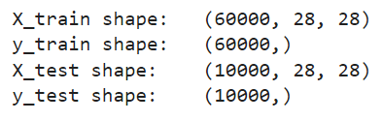
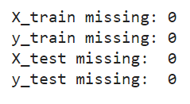
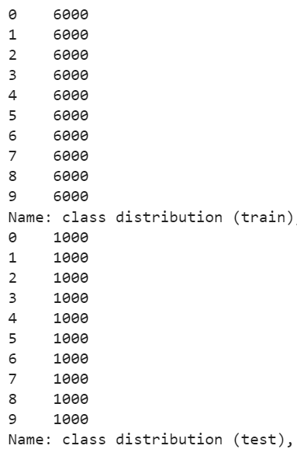
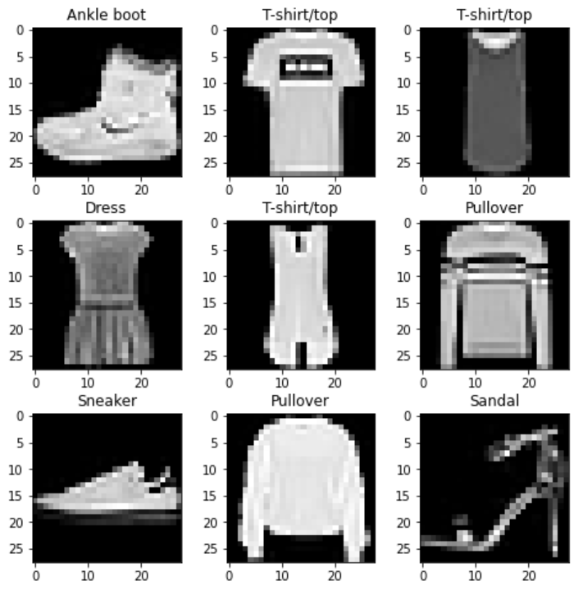
Exploratory Data Analysis
The data are of grayscale 28 by 28 pixel images, of fashion items
The labels are easily corroborated with human judgment
There are no missing values
The class distribution is perfectly balanced
In general, the data is very clean without intervention

Slide 3
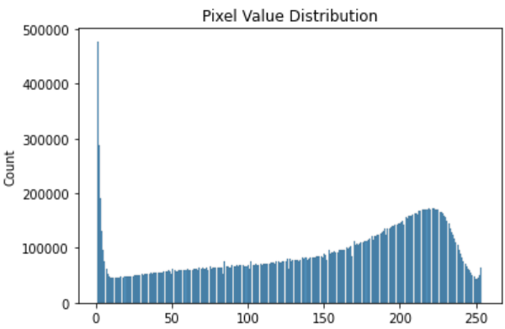
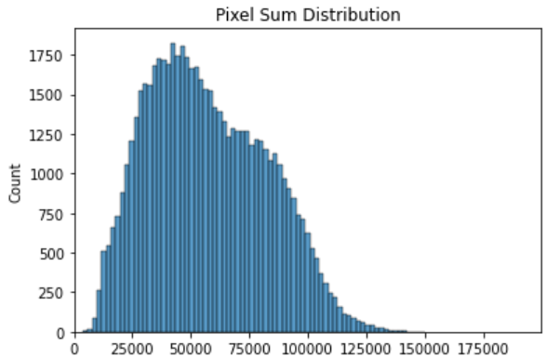
Exploratory Data Analysis
The pixel value distribution centres around 220, which means that most pixels are bright
Since there are not that many pixels with values around 128, the contrast is moderately high
According to the pixel sum distribution, which is the distribution of the sum of pixel values per image, there are no images totally black (0) or totally white (255 * 28 * 28 = 199920)

Slide 4
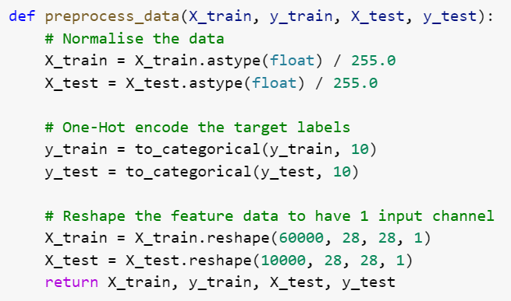
Feature Engineering
To smoothen the learning process of the neural network, normalization was carried out
Since 255.0 is the known maximum pixel value (from EDA), the data are divided by 255.0
Target labels are also one-hot encoded
The feature data are also reshaped to include 1 input channel

Slide 5
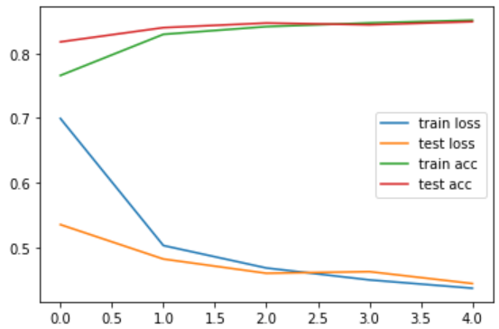
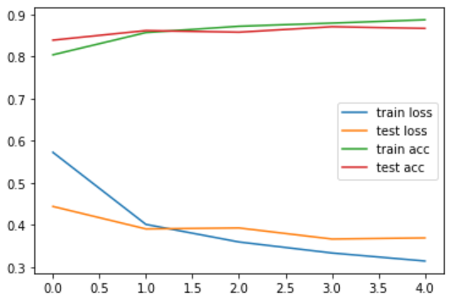
Model – Baseline
A simple one-layer Dense Neural Network (above) achieves an accuracy of 0.84 quite easily with no overfitting
A simple Convolutional Neural Network (below) [1 Conv layer] achieves an improved accuracy of 0.86 with minimal overfitting
A more complex CNN (not shown) could achieve a divergent accuracy of 0.92 and 0.89 for the training and validation data partitions respectively
The baseline models are relatively decent by themselves already

Slide 6
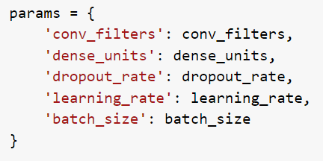
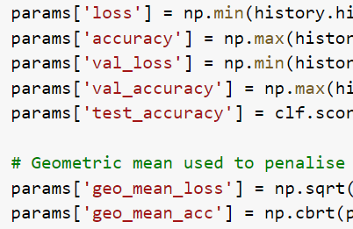
Model – Hyper-Parameter Tuning
Random search was used to find the best performing set of parameters
An early stopping callback was introduced to end training prematurely upon overfitting
Custom metrics was used to evaluate each model, with the geometric mean of loss and accuracy used as they penalise large differences, which represents overfitting
Following hyper-parameter tuning, the models were fine tuned manually until an acceptable performance was achieved

Slide 7
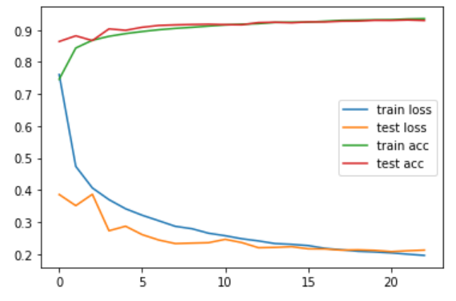
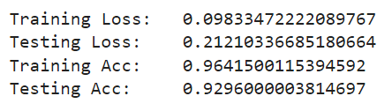
Model – Final Model
The final model made use of early stopping and learning rate scheduler callbacks to mitigate overfitting and to implement a decaying learning rate respectively
The final model used convolutional layers with increasing number of filters to maximise feature extraction, followed by dense layers with decreasing number of units to converge the classification process
Only 1 max pooling layer (pool size 2, stride 2) was used to avoid excessive data reduction
From the learning curve plot, overfitting was very minimal (despite higher accuracy on training data)

Slide 8
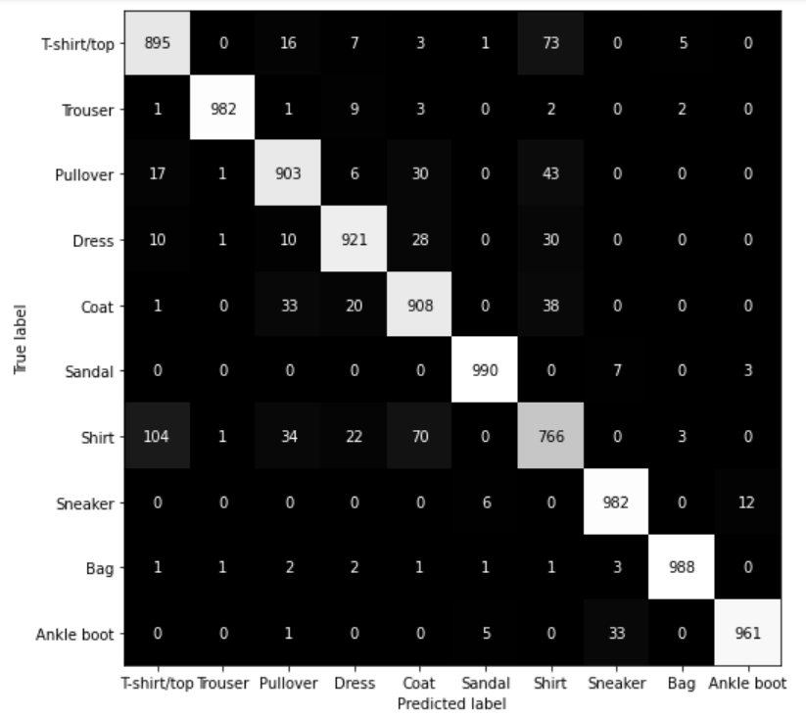
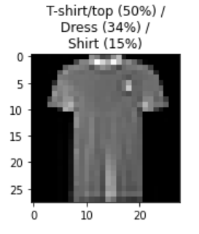
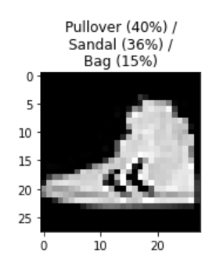
Model – Evaluation
From the confusion matrix, most are correctly classified
The most common mistake is the misclassification of shirts as t-shirts and vice versa
This is of no surprise, given the low resolution of the images and their undeniable similarities
Some mistakes are unacceptable, however, like the ankle boot at the bottom right (None of the top 3 choices are right; in fact, they are all wrong)
The model tends to confidently misclassify dresses as t-shirts (below)

