Slide 1
CIFAR-10 Image Classification
By: Ethan Tan (2012085) DAAA/2B/03

Slide 2
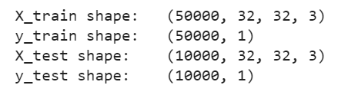
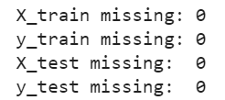
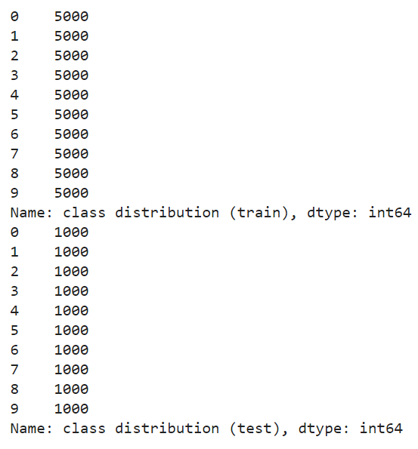
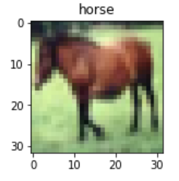
Exploratory Data Analysis
The data are of 32 by 32 pixel coloured images
There are no missing values
The class distribution is perfectly balanced

Slide 3
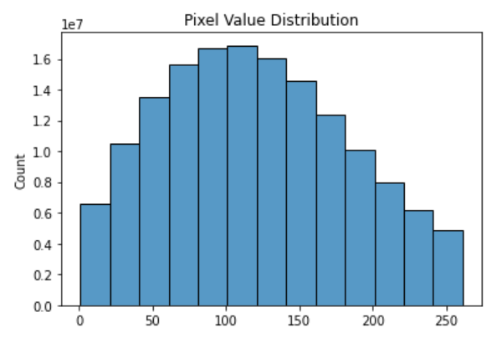
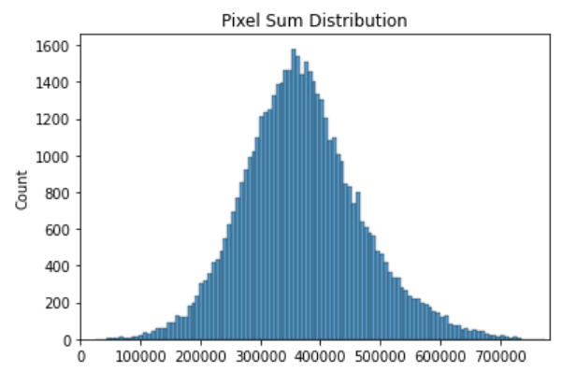
Exploratory Data Analysis
Unfortunately, the pixel value distribution (above) is clustered at around ~120
This means that the images are of low contrast
(128 is midway between 0 and 255)
The pixel sum distribution (below) follows a normal distribution, which means that most images (if not all) are sufficiently coloured
There are no fully black or fully white images

Slide 4
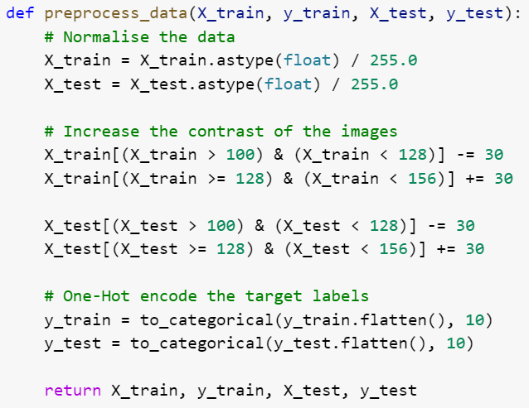
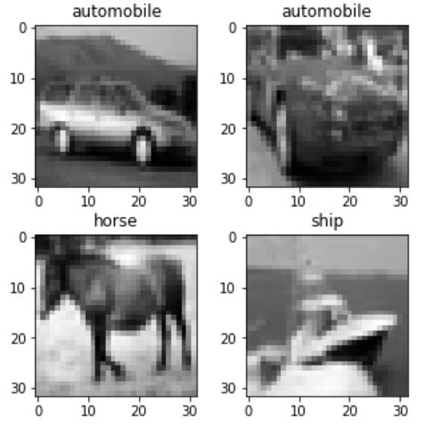
Feature Engineering
The data was normalized by dividing all the pixel values by 255.0 (which is the largest possible value for a colour pigment)
Contrast was increased by decreasing the values near and below 128 and increasing those near and greater than or equal to 128
Target labels were one-hot encoded
A grayscale version of the data was also prepared
Image augmentation would be tested later for comparison

Slide 5
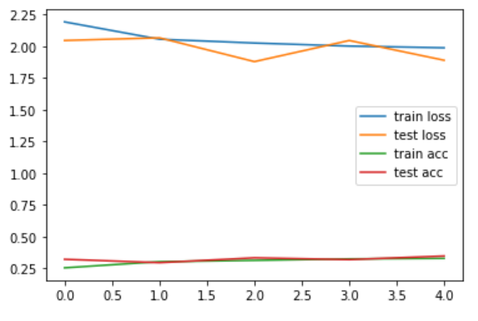
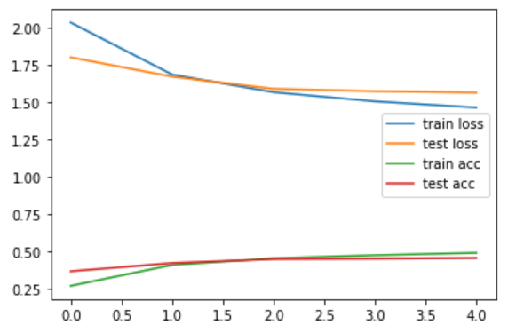
Model – Baseline
A simple DNN (above) scores ~0.3 for accuracy
A simple CNN (below) [1 convolutional layer] performs better, with an improved accuracy of ~0.45
A third slightly more complex CNN scores 0.54 but is heavily overfitted
All 3 baselines are quite bad

Slide 6
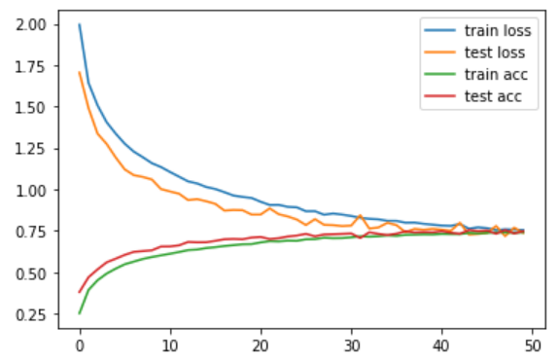
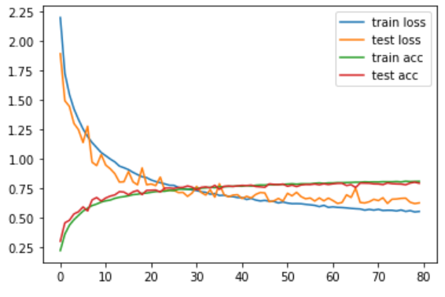
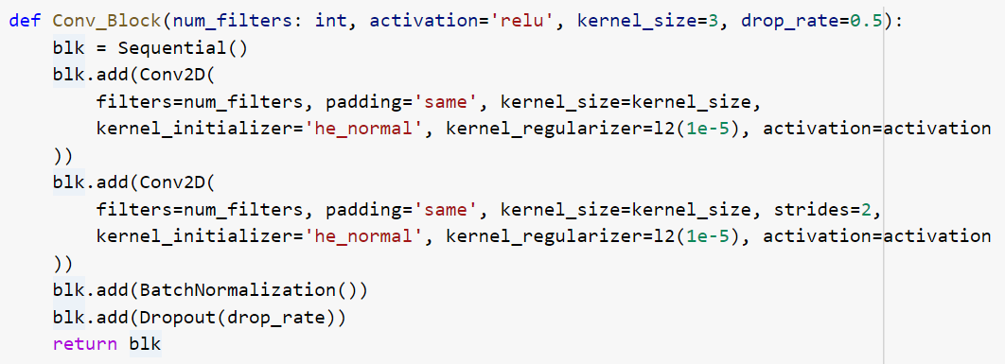
Model – Hyper-Parameter Tuning
Using classical architecture (above plots), a decent score of ~0.78 accuracy was achieved, with slight overfitting
After this, I decided to change the architecture to a block-wise one (inspired by VGG blocks)
The convolutional blocks implemented kernel regularization and specified kernel initializer

Slide 7
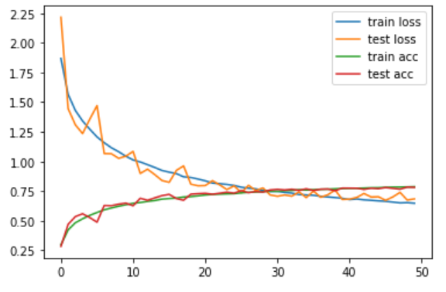
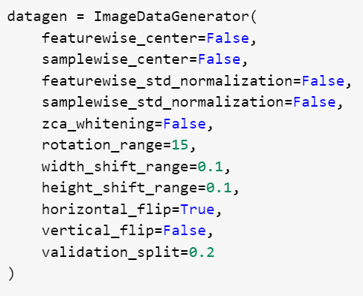
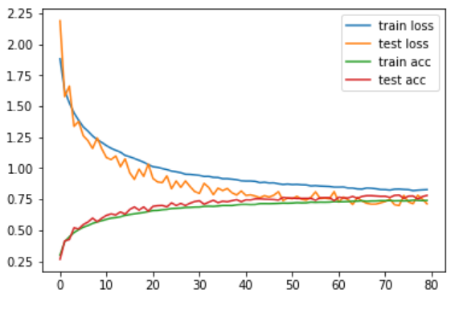
Model – Hyper-Parameter Tuning
Learning Curve with Grayscale Data
The use of image augmentation was attempted
It achieved roughly the same accuracy as the model without it
The learning curve was not smooth and it took extremely long (~1h) to converge, even with a relatively high learning rate
The grayscale version performed similar to the coloured one, but with more overfitting
Therefore, the final model used coloured data with no image augmentation
Learning Curve with Augmentation

Slide 8
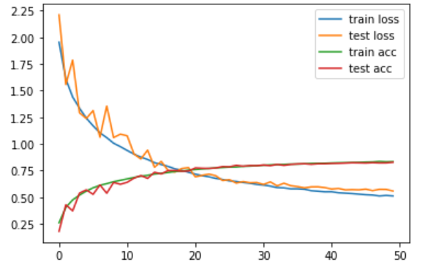
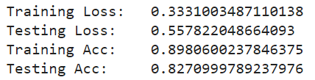
Model – Final Model
The final model made use of fewer but deeper convolutional blocks than the ones during hyper-parameter tuning
A decaying learning rate was used with an SGD optimizer
From its learning curves, I would say it is not overfitted despite the discrepancy between its performance on the training and testing data partitions
A testing accuracy of ~0.82 is significantly better than that of the baseline models (~0.5)

Slide 9
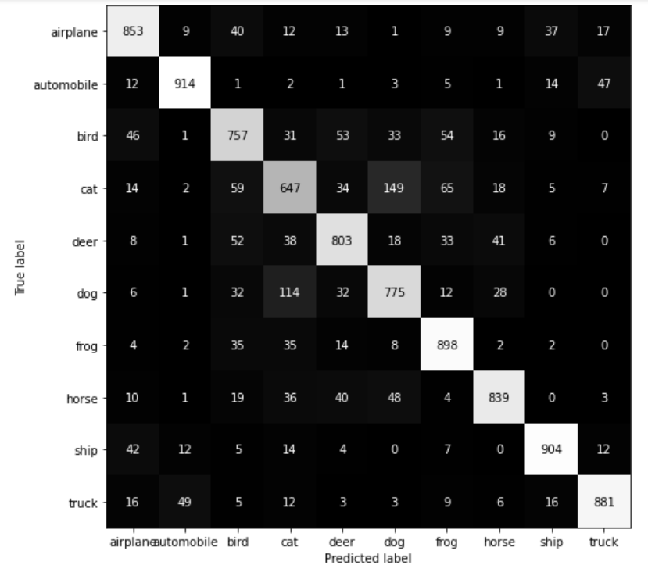
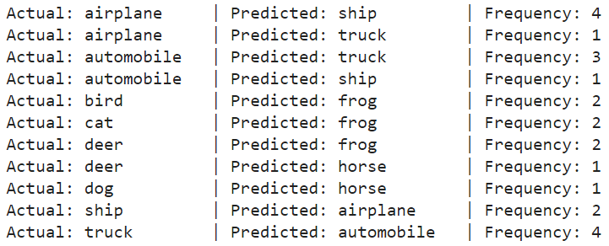
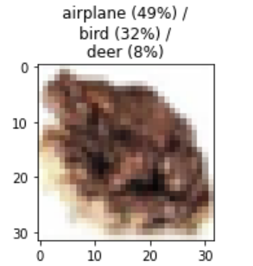
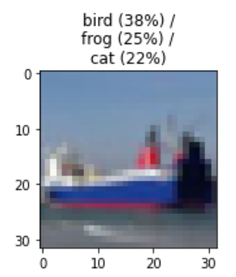
Model – Evaluation
From the confusion matrix, the model has trouble classifying cats and dogs correctly, often mistaking them for each other
In general, the model predicts vehicles better than animals
Given the resolution of the images, this is a reasonable shortcoming
For the most confident predictions, the model always gets the general type correct (vehicle/animal)
For the bottom left image, of which the model is unsure, I also cannot deduce what it is
The model predicts the ship image (bottom right) to be an animal, and is therefore wrong on all accounts

