Slide 1
Fashion MNIST Image Classification
By: Ethan Tan (2012085) DAAA/2B/03

Slide 2
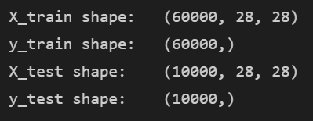
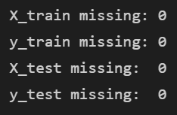
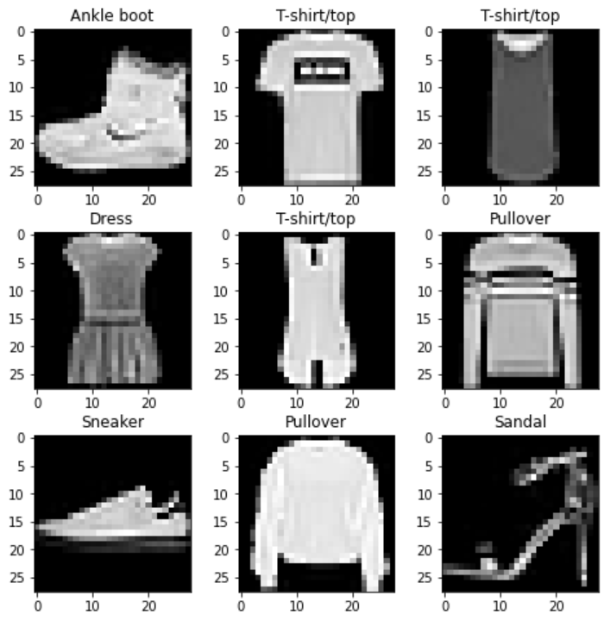
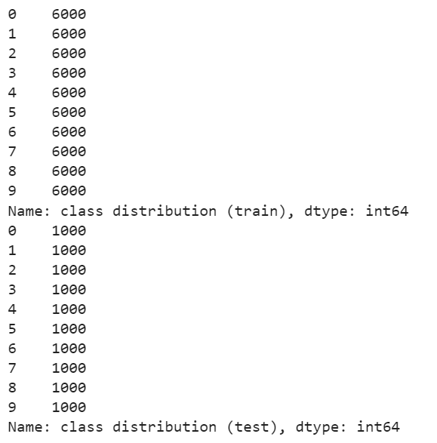
Exploratory Data Analysis
The data are of 28 by 28 pixel images, of fashion items.
The labels are easily corroborated with human judgment
There are no missing values
The class distribution is perfect
In general, the data is very clean without intervention

Slide 3
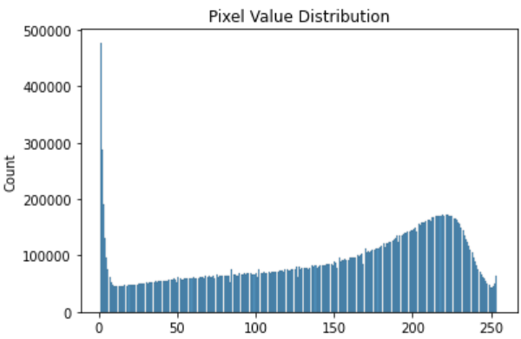
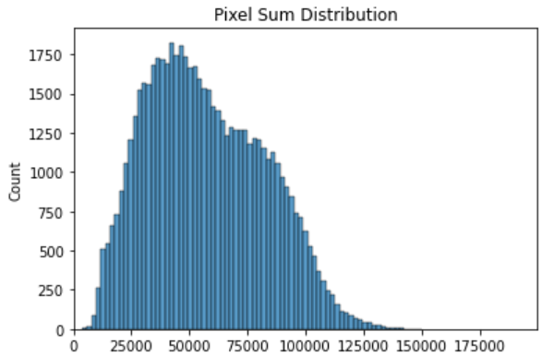
Exploratory Data Analysis
The pixel value distribution centres around 220, which is quite bright
Since there are not that many pixels with values around 128, the contrast is moderately high
According to the pixel sum distribution, which is the distribution of the sum of pixel values per image, there are no images totally black (0) or totally white (255 * 784 = 199920)

Slide 4
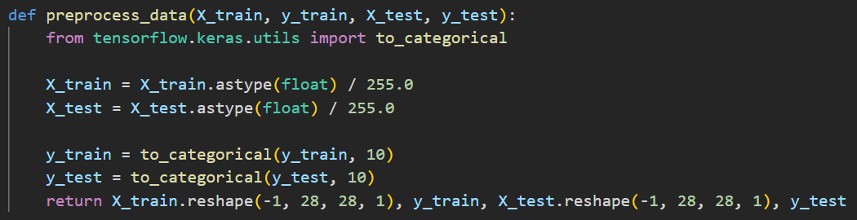
Feature Engineering
To smoothen the learning process of the neural network, normalization was carried out
Since 255.0 is the known maximum pixel value (from EDA), the data are divided by 255.0
Target labels are also one-hot encoded

Slide 5
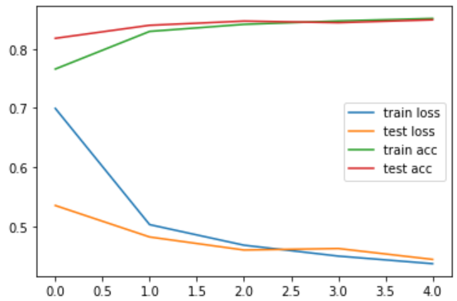
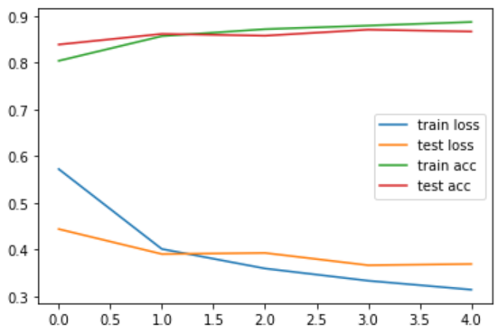
Model – Baseline
A simple one-layer Dense Neural Network (above) achieves an accuracy of 0.84 quite easily with no overfitting
A simple Convolutional Neural Network (1 Conv layer) achieves an improved accuracy of 0.86 with minimal overfitting
A more complex CNN (not shown) could achieve a divergent accuracy of 0.92 and 0.89 for the training and validation data partitions respectively

Slide 6
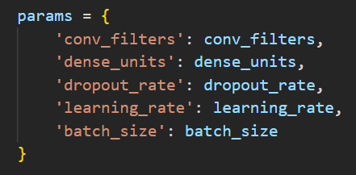
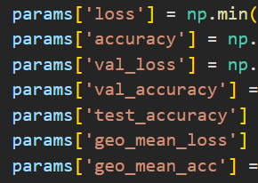
Model – Hyper-Parameter Tuning
Random searching was used to find the best set of parameters
An EarlyStopping callback was introduced to stop training prematurely upon overfitting
Custom metrics was used to evaluate each model, with geometric means of loss and accuracy used to penalise large differences, which represents overfitting
Following hyper-parameter tuning, the models were fine tuned manually until a suitable performance was achieved

Slide 7
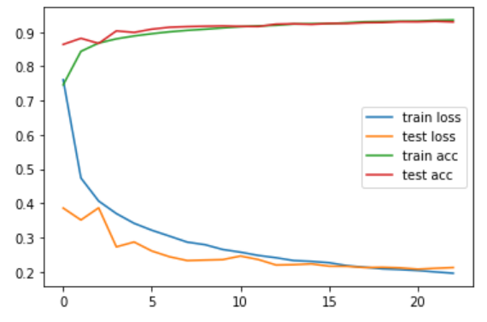
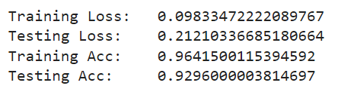
Model – Final MOdel
The final model made use of early stopping and learning rate scheduler callbacks to mitigate overfitting and to implement a decaying learning rate respectively
The final model used convolutional layers with increasing number of filters to maximise feature extraction, followed by dense layers with decreasing number of units to converge the classification process
Only 1 max pooling layer was used to avoid excessive data reduction
Overfitting was very minimal

Slide 8
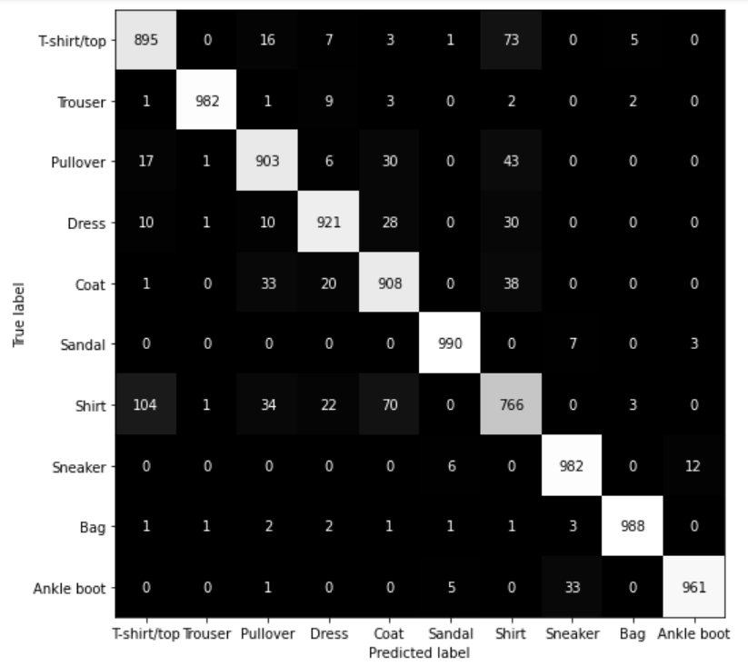
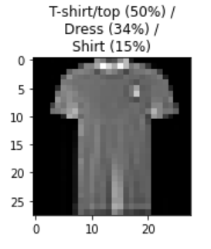
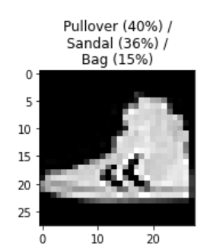
Model – Evaluation
From the confusion matrix, most are correctly classified
The most common mistake is the misclassification of shirts as t-shirts and vice versa
This is of no surprise, as they are very similar
Some mistakes are unacceptable, however, like the ankle boot on the bottom right (None of the top 3 choices are right; in fact, they are all off)
The model tends to misclassify dresses as t-shirts

