Slide 1
Healthcare in SG
PDAS: CA1
Ethan Tan
p2012085
DAAA/1B/03

Slide 2
Dataset Sources
Title | Source File | File Name | Dataset Source (URL)
Obesity Rates | obesity-rates.py | obesity-rates.csv | https://data.gov.sg/dataset/common-health-problems-of-students-examined-obesity-annual
Defective Vision Rates | defective-vision-rates.py | defective-vision-rates.csv | https://data.gov.sg/dataset/common-health-problems-in-students-defective-vision-annual
Number of Pharmacists | number-of-pharmacists.py | number-of-pharmacists.csv | https://data.gov.sg/dataset/number-of-pharmacists

Slide 3
Data Summaries
Custom functions were used to generate (numerical) summaries on the data
Functions used can be found in src/utils directory
Export describe function to be employed in main source code files
Summaries are logged to the console

Slide 4
Obesity Rates: Content
Columns | Data Type | Purpose
Year | integer | Show trends in obesity across the years
Gender | string | Compares obesity rates between male and female children
Age Group | string | Compares obesity rates among older and younger children
Number of Diagnosed Obese (per 10, 000) | integer | Shows proportion of obese children

Slide 5
Obesity Rates: Processing
Data Visualisation:
Used normal curve function to generate a normal curve for the distribution of the number of obese children
Styling:
Used seaborn style for colour scheme

Slide 6
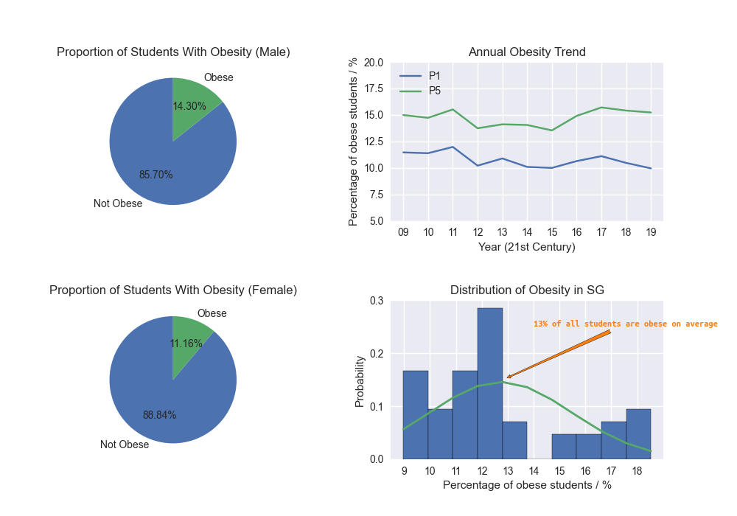
Obesity Rates: Insights
Pie Charts: males have a higher chance of becoming obese (on average)
Line Chart: Older children are more likely to be obese
Histogram: Approximately 13% of all Singaporeans students are obese

Slide 7
Obesity Rates: Peculiarities
There was a decrease in the percentage of obese children from 2011 to 2017

Slide 8
Defective Vision Rates: Content
Columns | Data Type | Purpose
Year | integer | Show trends in defective vision across the years
Gender | string | Compares defective vision rates between male and female children
Number of Diagnosed with Visual Acuity (per 10, 000) | integer | Shows proportion of defective vision in children

Slide 9
Defective Vision Rates: Processing
Data Visualisation:
Used offset (variable w) to create grouped bar chart
Styling:
Used seaborn-colorblind style for colour scheme

Slide 10
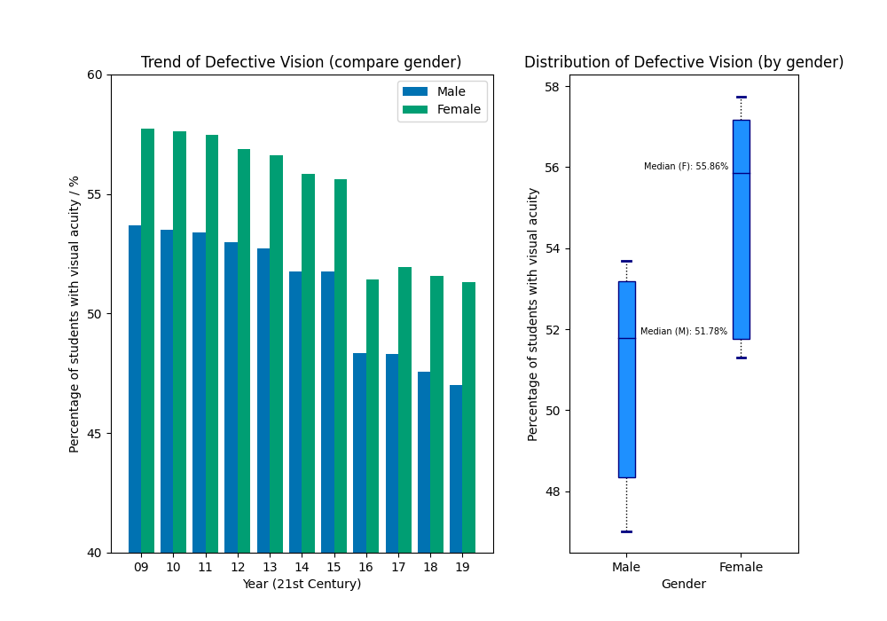
Defective Vision Rates: Insights
Grouped Bar Chart: Defective vision rates have been declining since 2009
Boxplot: Females are 4% more inclined to have visual acuity than their male counterparts (for students)

Slide 11
Defective Vision Rates: Peculiarities
Observation: Steep drop from 2015 to 2016
Possible Reason: Launch of VisionSave campaign
Details: VisionSave aims to provide optimal optical outcome for Singaporeans, through innovative eye care research, treatment and delivery in Singapore and the region

Slide 12
Defective Vision Rates: Anomalies
Defective vision rates increased from 2016 to 2017

Slide 13
Number of Pharmacists: Content
Columns | Data Type | Purpose
Year | integer | Show trends in pharmacist jobs across the years
Sector | string | Compares number of pharmacists in each sector (private, public, inactive)
Count | string | Shows proportions of pharmacists in each sector

Slide 14
Number of Pharmacists: Processing
Data Visualisations:
Used NumPy’s polyfit method to create trendlines for scatterplot
Overlapped individual bar charts to produce stacked bar chart
Styling:
Used ggplot style for colour scheme

Slide 15
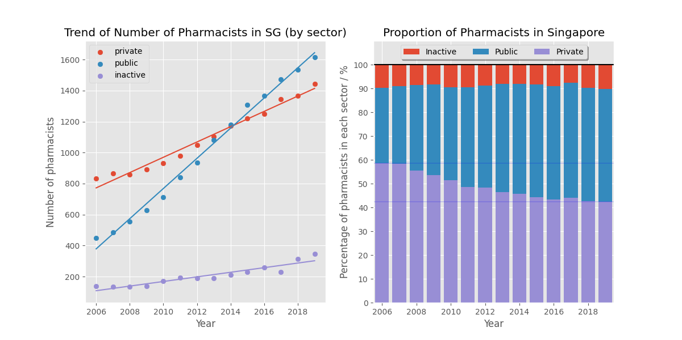
Number of Pharmacists: Insights
Scatterplot:
The number of pharmacists are increasing steadily
The rate at which the number of public pharmacists is increasing is greater than that of private ones
The proportion of public pharmacists exceeded that of private ones in 2014

Slide 16
Number of Pharmacists: Insights
Stacked Bar Chart:
The proportion of inactive pharmacists is roughly 10% of all pharmacists in Singapore
The proportion of private pharmacists in Singapore has been declining whilst that of public pharmacists has been on the increase

