Slide 1
“ To Eat or not to eat ”
— that is the question
A machine learning study by Ethan Tan (p2012085)

Slide 2
Purpose
Given a mushroom, identify if it is safe for consumption
The metric of interest is most likely to be recall (sensitivity)
It is likely more important to identify as many poisonous mushrooms as possible at the expense of classifying edible mushrooms wrongly, rather than to merely try to correctly classify as many mushrooms as possible
One possible scenario could be a restaurant sourcing for new mushrooms to be used in their new recipe
Customer safety would thus be of utmost importance
Nonetheless, accuracy would be our choice metric for this study as it is the simplest to use to evaluate our model

Slide 3

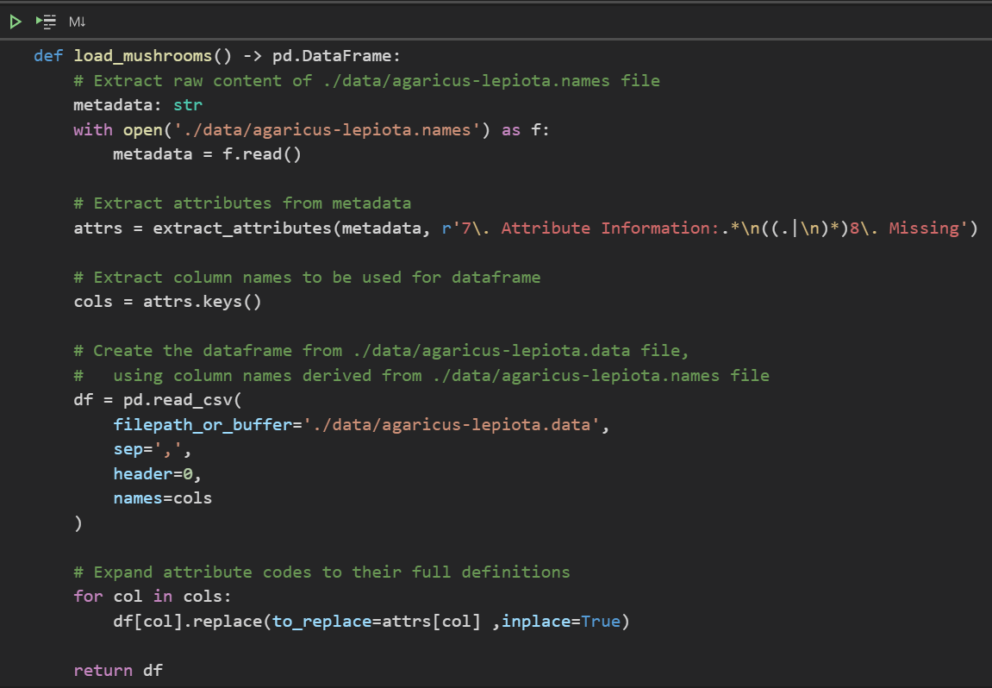
Import Data
To begin, we import the data from the .names and .data files
As the expanded feature definitions are contained in the .names file, we write a function to extract the attributes and their values, and convert everything into a pandas DataFrame
extract_attributes is a user-defined function (UDF) that can be found in utils/extraction.py
extract_attributes makes use of Regular Expressions (regex) to perform its task

Slide 4
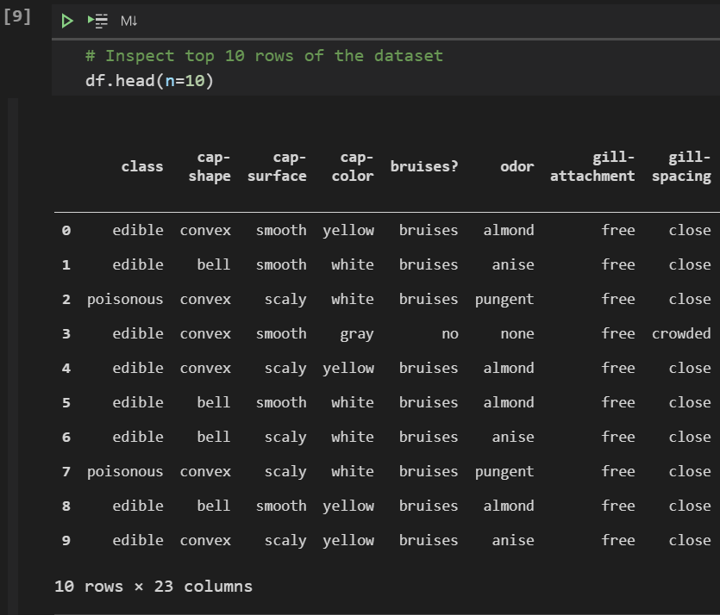
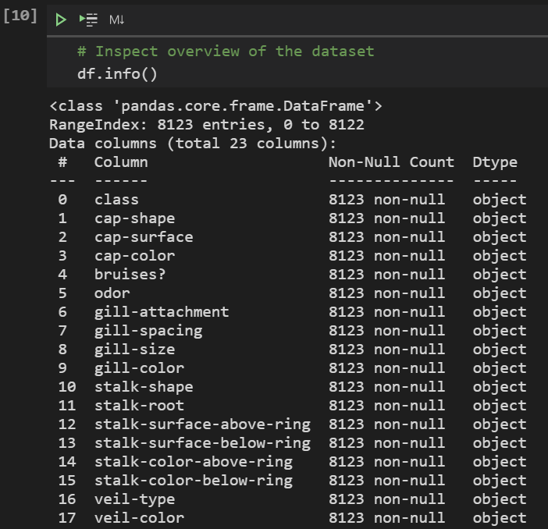
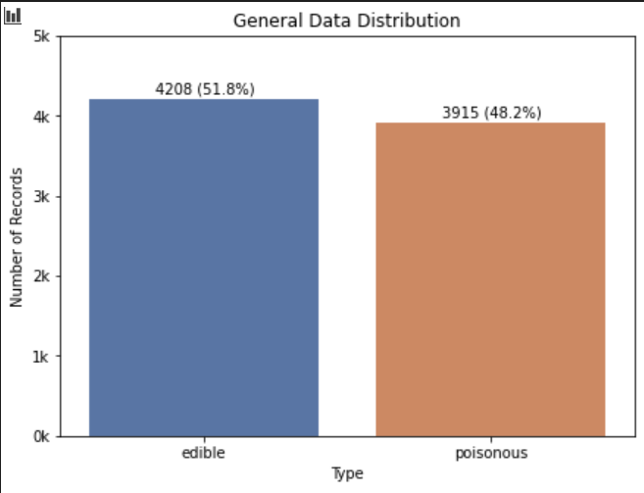
Exploratory data analysis
To begin, we inspect the data and view any patterns in its distributions
All the features are categorical
The data is rather balanced, as can be seen from the bar graph

Slide 5
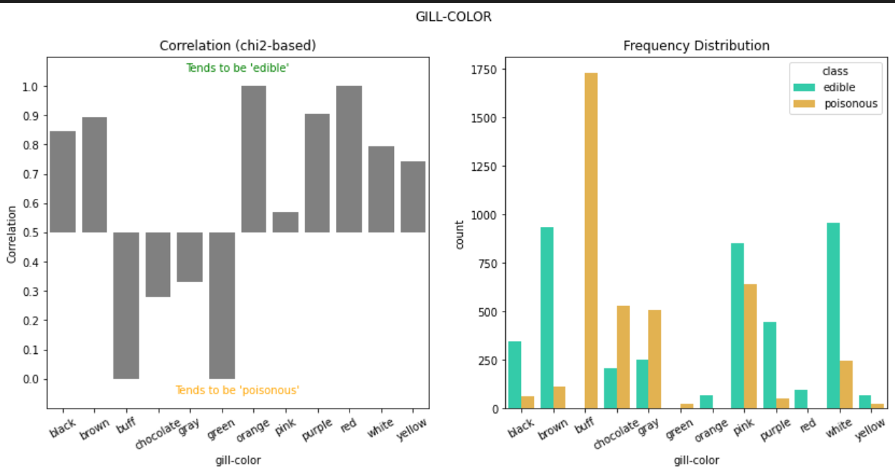
Exploratory data analysis
I used a chi2-based correlation
This is how it works:
The more edibility is evenly distributed among a certain attribute, the less it is correlated to edibility
For example, among 1,000 mushrooms with pink gills, if 500 are edible and the rest are poisonous, then pink gills is not a good indicator of whether a mushroom is poisonous
No columns/features were removed solely based on their correlations with the edibility

Slide 6
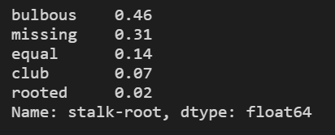
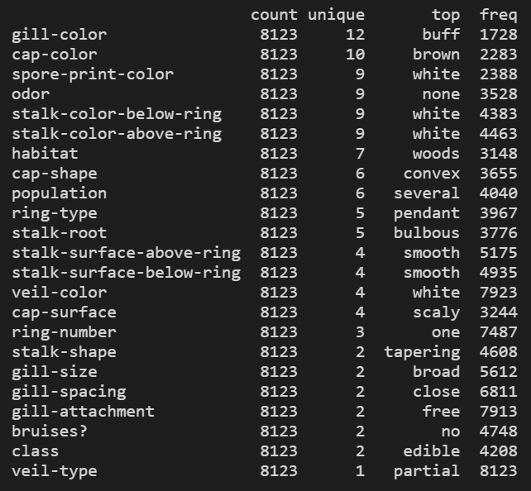
Feature Selection
The columns “stalk-root” and “veil-type” were removed
Stalk-Root:
because there are a lot of missing values (31%, in fact)
imputation would either introduce bias or misrepresent the data
there are enough dimensions beside stalk-root, so removal is harmless
Veil-Type
because there is only one unique value (partial veil)
it is therefore redundant

Slide 7
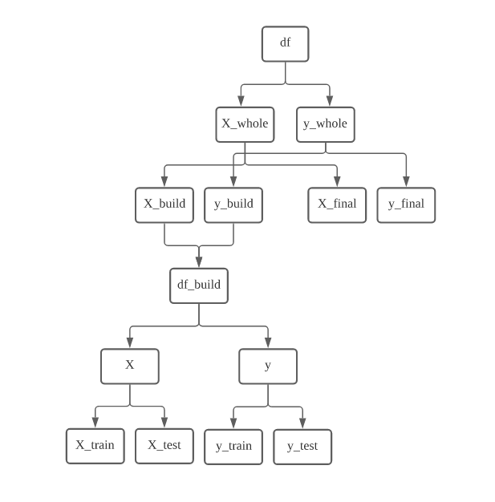
Data Partition
Final Evaluation
The data is partitioned in this same way for regression.
It prevents data leakage from the test set and preserves a fragmented copy of the original dataset for final evaluation of the machine learning pipeline
df and df_build are mutable
X_build, X_final, y_build and y_final can be thought of as X_train, X_test, y_train and y_test for the final model respectively

Slide 8
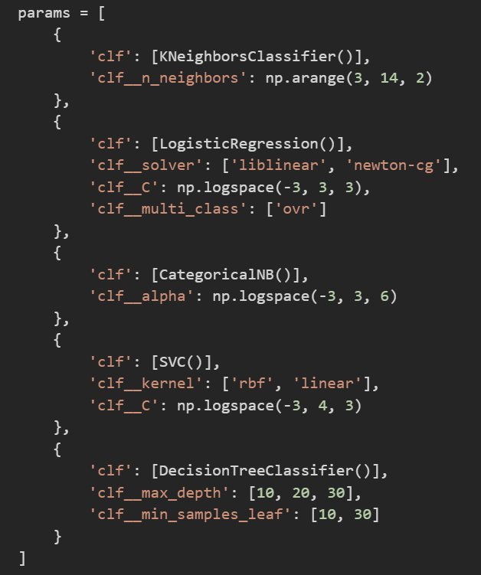
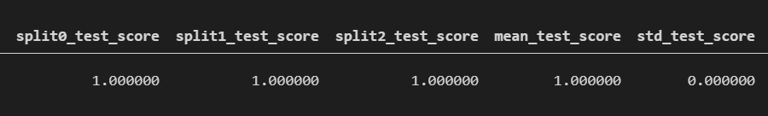
Best Algorithm
GridSearchCV was used to find the best performing algorithm
The different estimators (knn, logistic regression, Naïve Bayes, svc, decision tree) were tested as a parameter, together with 6 different combinations of their key hyper-parameters
Logistic regression was selected as it performed the most consistently as seen below

Slide 9
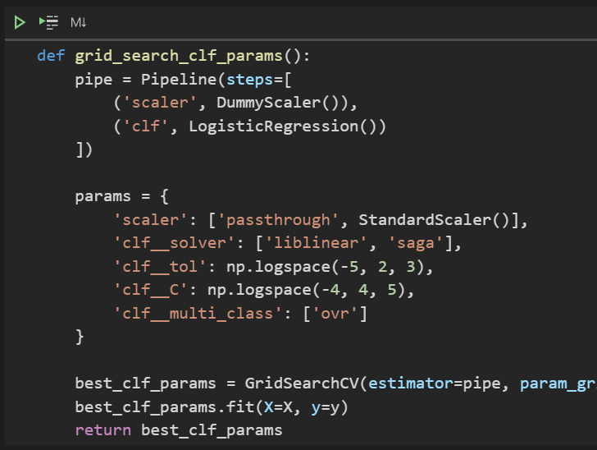
Best Hyper-Parameters
GridSearchCV was also used to narrow down the hyper-parameters that performed best in the situation
Scaling was also compared against no scaling, and it turned out that scaling was not required in this case
At the time I performed the grid search, I obtained {'clf__C': 100.0, 'clf__multi_class': 'ovr', 'clf__solver': 'liblinear', 'clf__tol': 1e-05, 'scaler': 'passthrough’} as the best set of parameters.

Slide 10
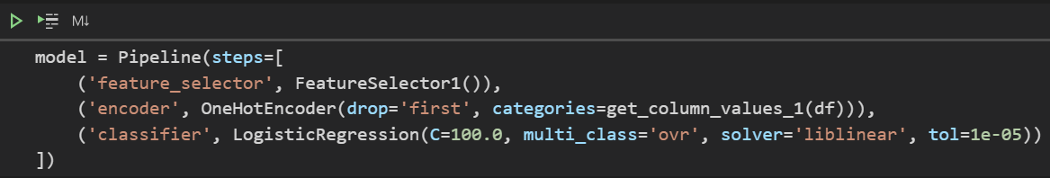
ML Pipeline
I implemented my machine learning pipeline in a way such that it performed all the necessary transformations internally
It would just take in X as the raw data without the ‘class’ column and y as only the ‘class’ column of the raw data
Feature selection and One-Hot encoding are performed within the pipeline, so the process of fitting and scoring the model would be cleaner

Slide 11
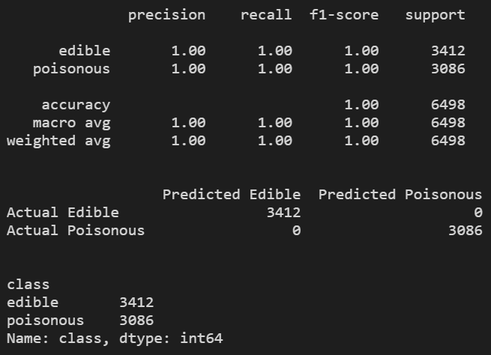
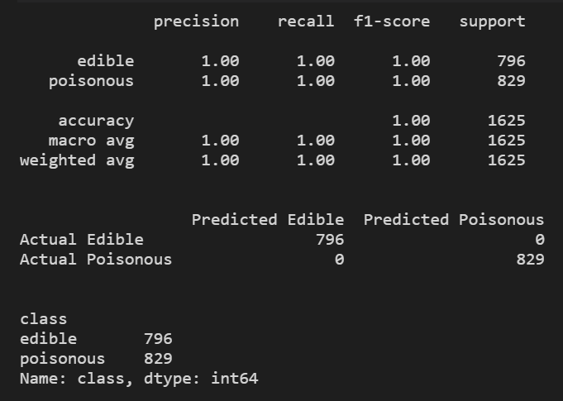
Model Evaluation
The top image displays the model’s performance when evaluated against the set of data wherewith it was trained (y_build) while the bottom one displays its performance on the testing data (y_final)
Perfect scores were obtained for both instances of evaluation, which indicates that the model is quite well-fitted and is able to generalize the data well
As mentioned at the beginning, recall is of concern as it measures how sensitive the model is when making predictions

