Slide 1
Trading Trade-Offs
A machine learning study by Ethan Tan (p2012085)

Slide 2
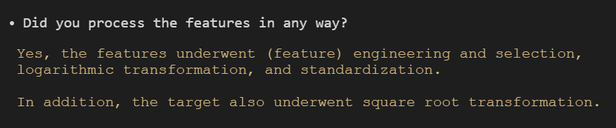
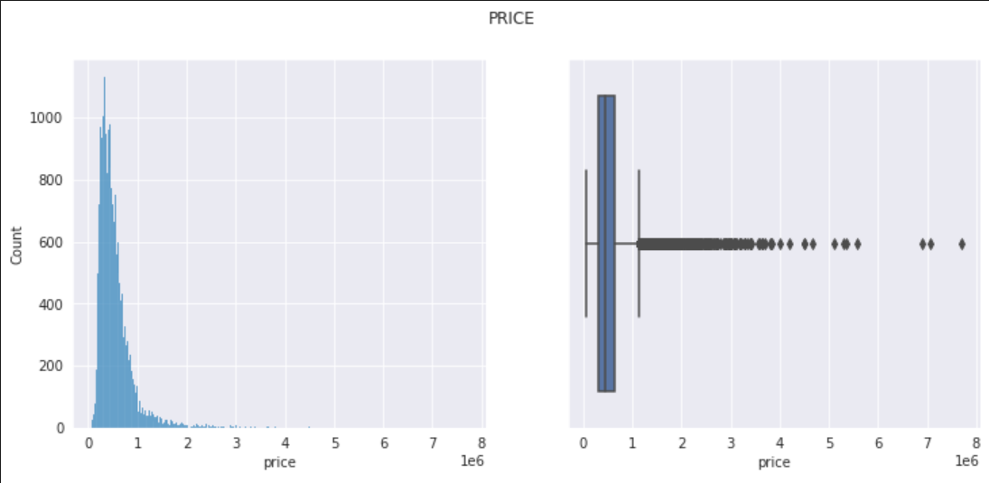
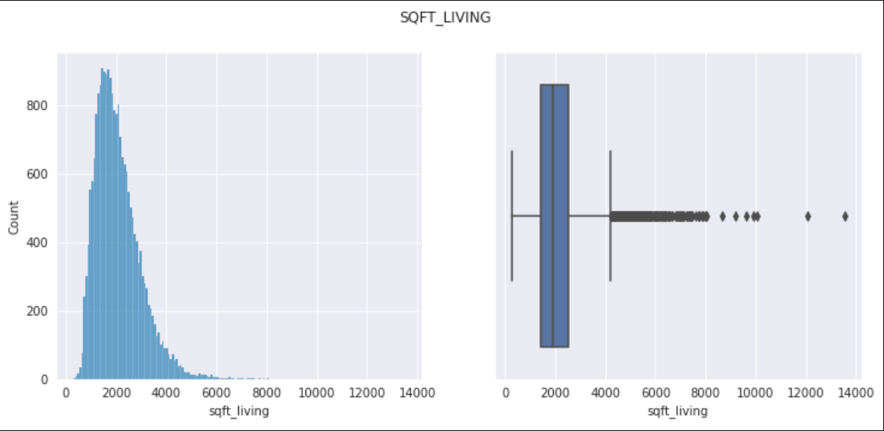
Exploratory Data Analysis
Many of the features are extremely positively skewed
Perhaps some (logarithmic/root) transformation could be applied to the data to make it conform more to a Normal distribution
It is easier for many machine learning algorithms to work with normally distributed data, especially if they are parametric

Slide 3
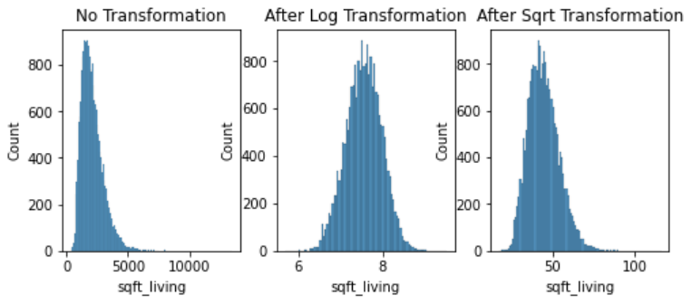
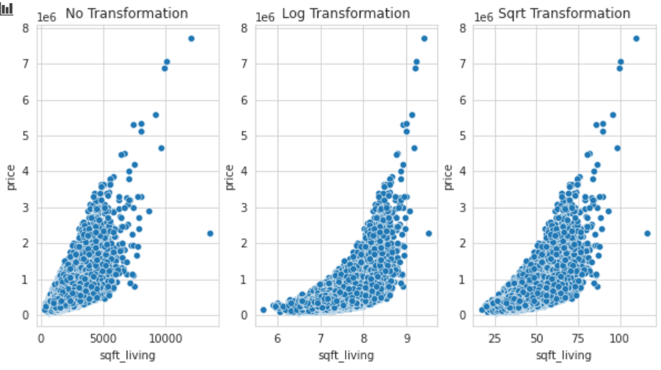
Exploratory Data Analysis
This plot shows the distribution of the values after no transformation, logarithmic transformation and root transformation respectively
As seen above, the logarithmic transformation is quite successful in producing a rather Normal distribution
This plot shows the correlation of the features with price after no transformation, logarithmic transformation and root transformation respectively
As seen above, the logarithmic transformation bends the distribution (makes it non-linear)
To counter this, perhaps price should be transformed also

Slide 4
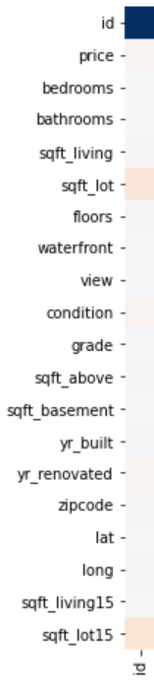
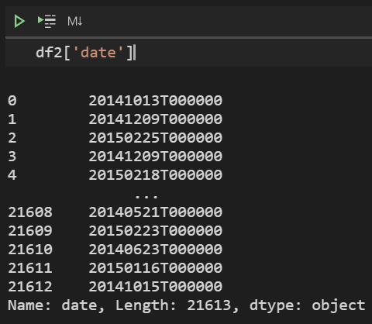
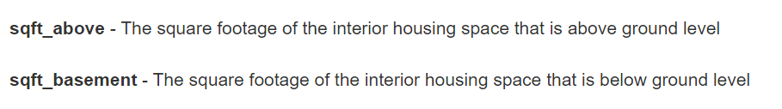
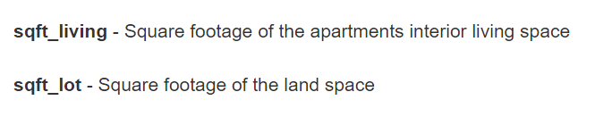
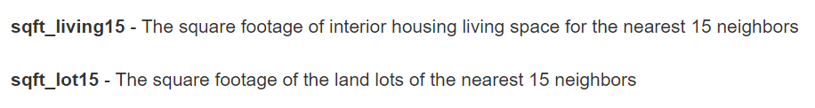
Feature Engineering and Selection
id was removed because it held no information for the machine learning model to learn from
date was removed after its date parts (year, month, day) were extracted during feature engineering
sqft_above, sqft_basement, sqft_lot were removed because they were all interrelated with sqft_living
sqft_lot15 was removed because it was interrelated to sqft_living15

Slide 5
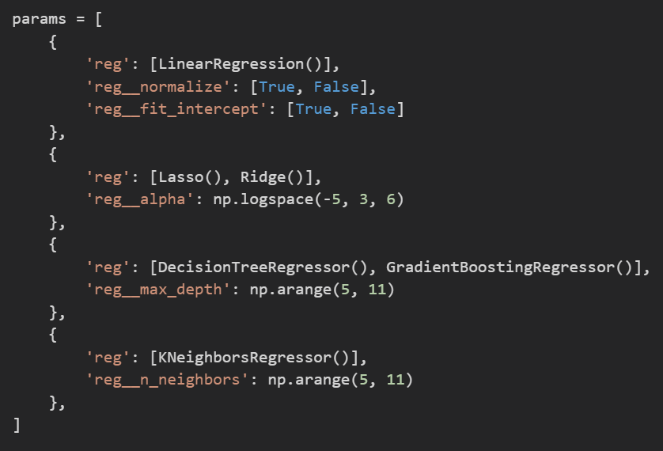
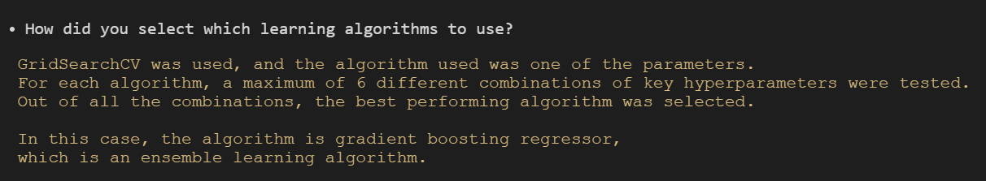
Algorithm Selection
Multiple algorithms were tested initially, with a maximum of 6 different combinations of their hyper-parameters
This was meant to level the playing field for algorithms with poor default hyper-parameters (in this scenario)
The GradientBoostingRegressor algorithm topped the charts, occupying the top 6 positions
This isn’t particularly surprising, as it deploys ensemble learning, which is typically more accurate than individual algorithms

Slide 6

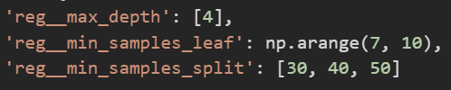
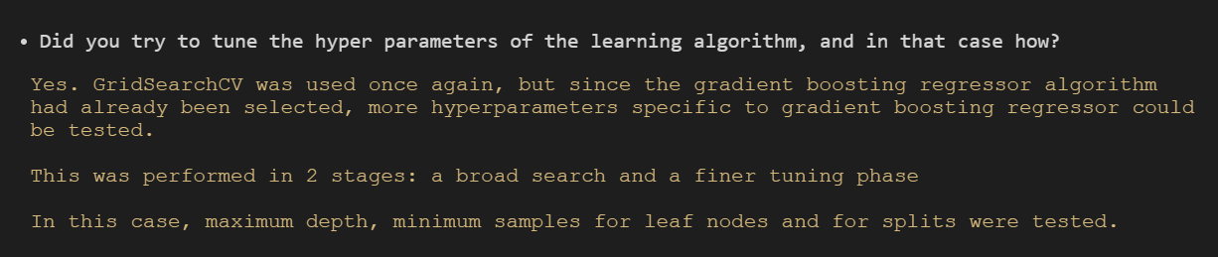
Hyper-Parameter Tuning
2 sets of GridSearchCV were used to tune the hyper-parameters of the GradientBoostingRegressor algorithm, namely maximum depth, minimum samples for leaf nodes and minimum samples for splits
The first was a broader search, while the second narrowed down the best hyper-parameters to {4, 7, 30}
min_samples_leaf and min_samples_split could be reduced further to improve performance, but I did not want to overfit the model
If the performance of the model was substandard, I would have tuned the hyper-parameters further

Slide 7
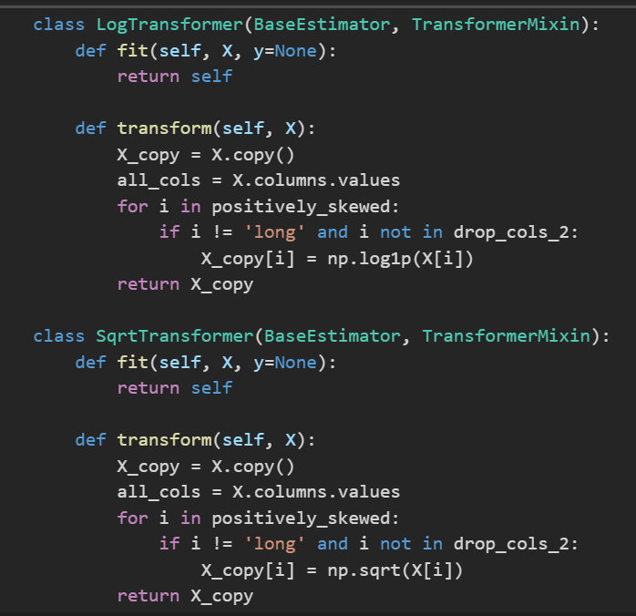
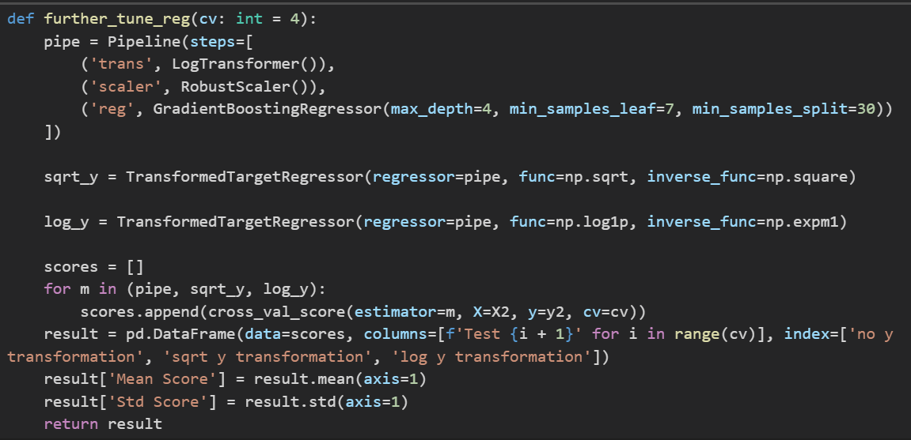
X & y Transformations
For the X transformations:
I defined two custom transformer classes: log and sqrt, which were used to transform the feature variables
GridSearchCV was used to compare the performance of using different scalers and transformers for the feature variables
LogTransformer with RobustScaler performed the best as the transformer and scaler for the feature variables respectively
After finding the best X transformer, the next thing to do was to find the best y transformer (including none)
For the y transformation:
A for loop was used to compare log, square root and no transformation for the target variable (price)
TransformedTargetRegressor was used as a wrapper for the machine learning pipeline built thus far
Square root worked the best among the three

Slide 8
Machine Learning Pipeline
A custom feature engineering and feature selection transformer classes were defined
The machine learning pipeline was then assembled, incorporating the feature engineering and selection transformers, the logarithmic X transformer and a robust scaler, before piping the transformed data to an instance of the GradientBoostingRegressor class with max_depth=4, min_samples_leaf=7 and min_samples_split=30
After building the pipeline, it was wrapped in a TransformedTargetRegressor, which is the square root y transformer, with square as the inverse function

Slide 9
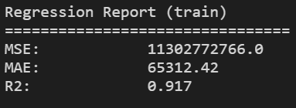
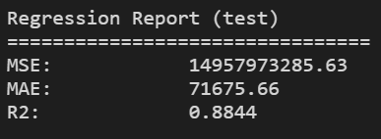
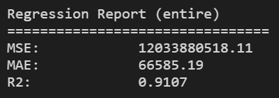
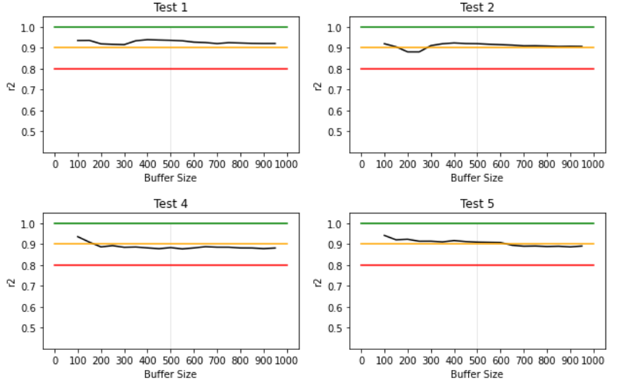
Model Evaluation
The machine learning model was then evaluated against the data wherewith it was trained, the testing data and the entire dataset in terms of mean squared error, mean absolute error and the coefficient of determination (r²)
Given a regression problem, it is impossible to predict an exact value with machine learning. Therefore, the metrics by which a regression machine learning model is evaluated take into account the margin of error which the model makes
For example, r2 shows the proportion of variance attributed to variance in the feature values. Hence, an r2 score close to 1 suggests success for a machine learning model
In this case, 0.88 for a test score is considerably good.
Since the difference in r2 between the train and test sets (build and final) was < 5%, the model was not overfitted and could generalize the data reasonably well
The model was also evaluated against random samples of the data in different sample sizes (called buffers in this case)
It seems to perform quite consistently within the 0.8 - 1.0 band, hovering around 0.9, especially if the sample size is at least 500

Slide 10
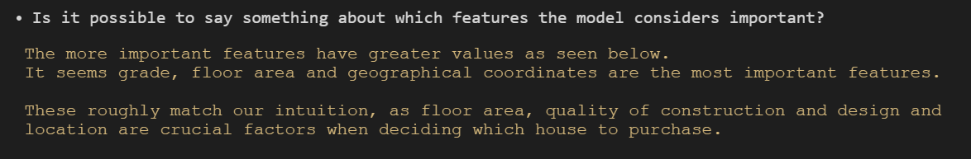
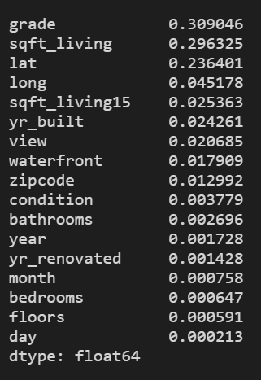
Feature Importances
These importances are exclusive to our dataset and are in no way universal
For example, in Singapore, however, the number of bedrooms could be a more important factor than the view
Keeping these statistics in mind, we can get a sense of how the housing market in King County works
In this way, we can learn from the machine learning model after it has “learnt” from the data we provided it

