Slide 1
“ To Eat or not to eat ”
— That IS the question
A machine learning study by Ethan Tan (p2012085)

Slide 2
Purpose
Given a mushroom, identify if it is safe for consumption
The metric of interest is most likely to be recall (sensitivity)
It is likely more important to identify as many poisonous mushrooms as possible at the expense of classifying edible mushrooms wrongly, rather than to merely try to correctly classify as many mushrooms as possible
One possible scenario could be a restaurant sourcing for new mushrooms to be used in their new recipe
Customer safety would thus be of utmost importance
Nonetheless, accuracy would be our choice metric for this study

Slide 3

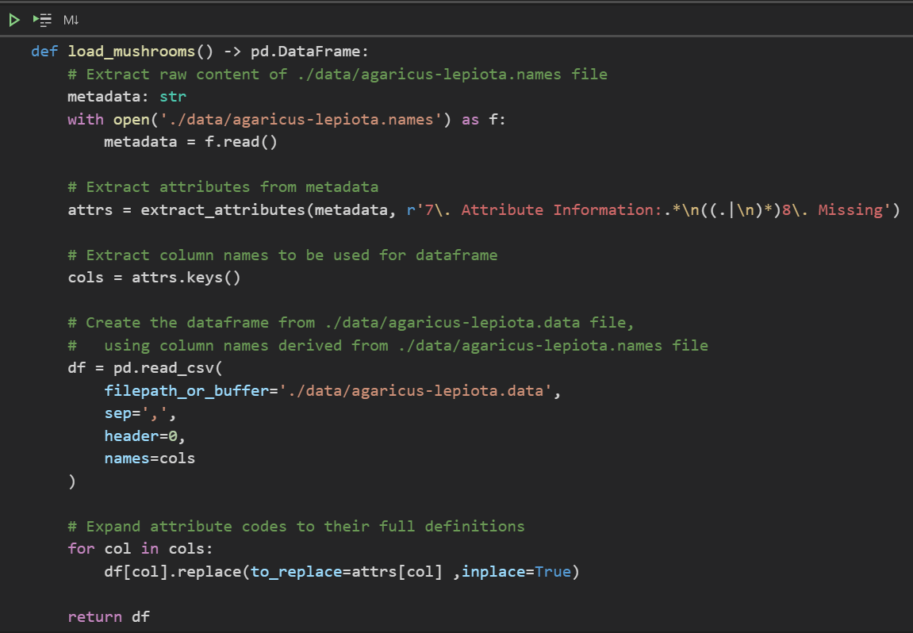
Import Data
To begin, we import the data from the .names and .data files
As the expanded feature definitions are contained in the .names file, we write a function to extract the attributes and their values, and convert everything into a pandas DataFrame
extract_attributes is another user-defined function (UDF) that can be found in utils/extraction.py

Slide 4
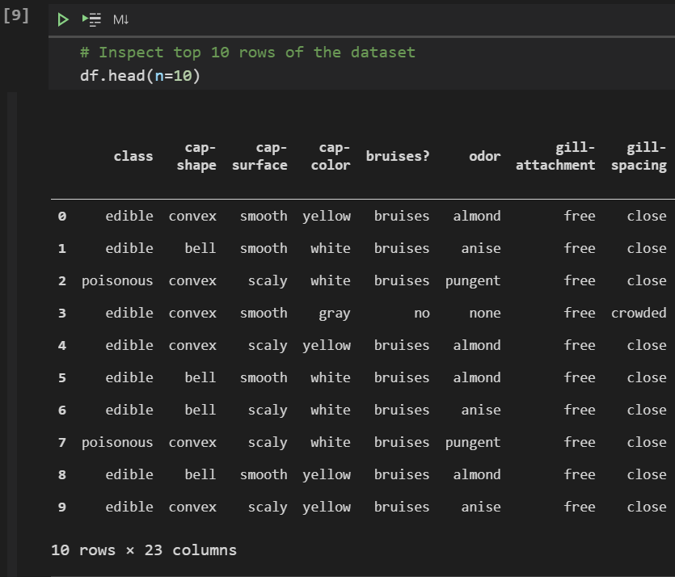
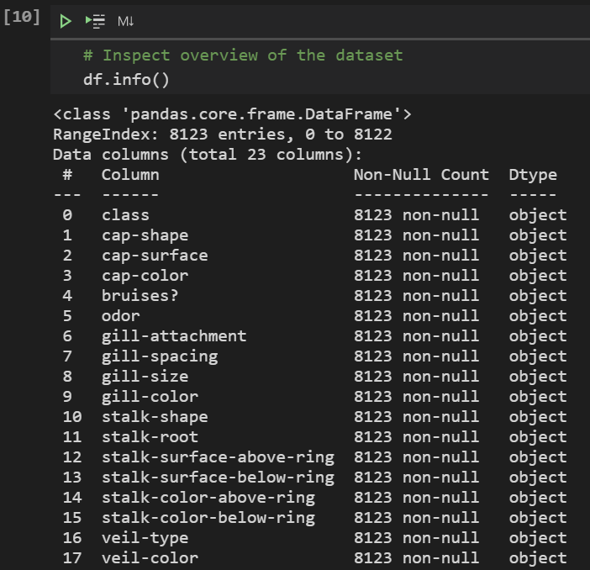
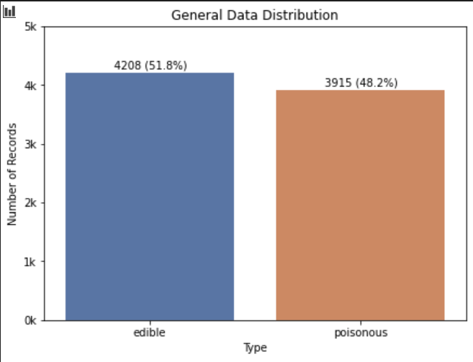
Exploratory data analysis
To begin, we inspect the data and view any patterns in its distributions

Slide 5
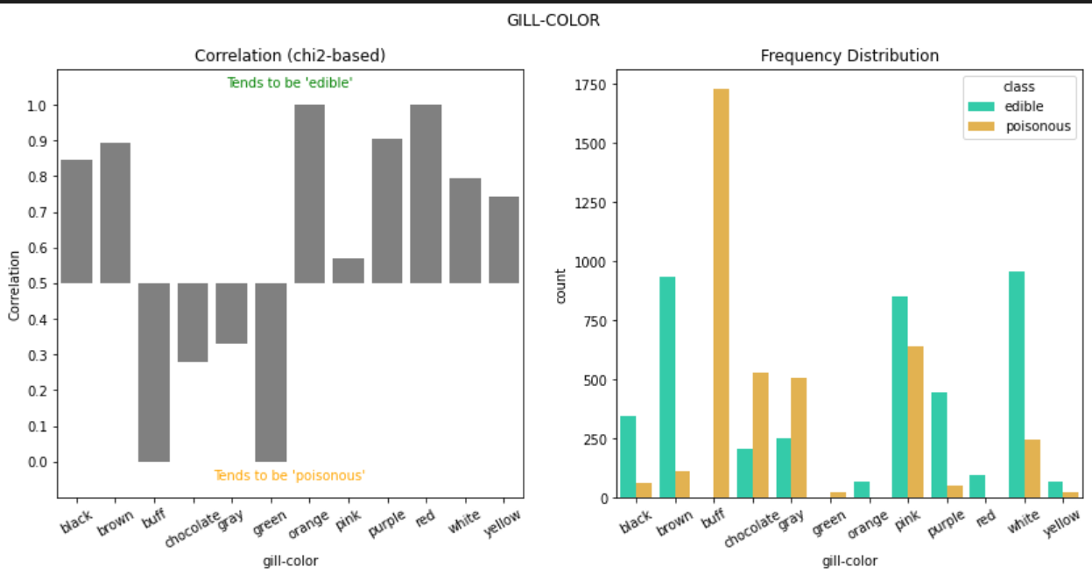
Exploratory data analysis
I used a chi2-based correlation
This is how it works:
The more edibility is evenly distributed among a certain attribute, the less it is correlated to edibility
For example, among 1,000 mushrooms with pink gills, if 500 are edible and the rest are poisonous, then pink gills is not a good indicator of whether a mushroom is poisonous
No columns/features were removed solely based on their correlations with the edibility

Slide 6
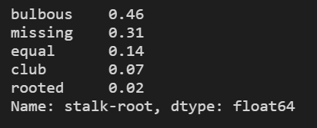
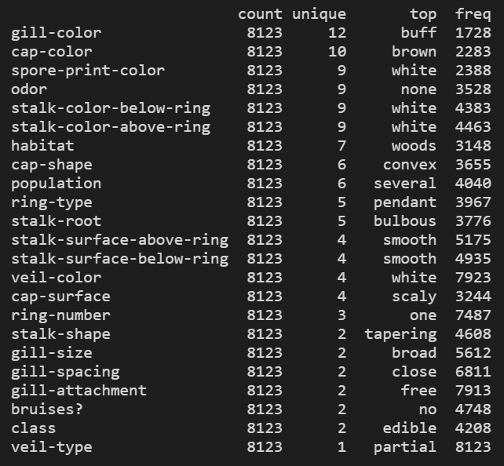
Feature Selection
The columns “stalk-root” and “veil-type” were removed
Stalk-Root:
because there are a lot of missing values (31%, in fact)
imputation would either introduce bias or misrepresent the data
there are enough dimensions beside stalk-root, so removal is harmless
Veil-Type
because there is only one unique value (partial veil)
it is therefore redundant

Slide 7
Data Partition
The data is partitioned in the same way for regression.
It prevents data leakage from the test set and preserves a fragmented copy of the original dataset for final evaluation through the machine learning pipeline
df and df_build are modifiable
X_build, X_final, y_build and y_final can be thought of as X_train, X_test, y_train and y_test for the final model respectively

Slide 8
Best Algorithm

Slide 9
Best Hyper-Parameters

Slide 10
ML Pipeline

Slide 11
Model Evaluation

