Slide 1
“ To Eat or not to eat ”
— That IS the question
A machine learning study by Ethan Tan (p2012085)

Slide 2
Purpose
Given a mushroom, identify if it is safe for consumption
The metric of interest is most likely to be recall (sensitivity)
It is likely more important to identify as many poisonous mushrooms as possible at the expense of classifying edible mushrooms wrongly, rather than to merely try to correctly classify as many mushrooms as possible
One possible scenario could be a restaurant sourcing for new mushrooms to be used in their new recipe
Customer safety would thus be of utmost importance
Nonetheless, accuracy would be our choice metric for this study

Slide 3

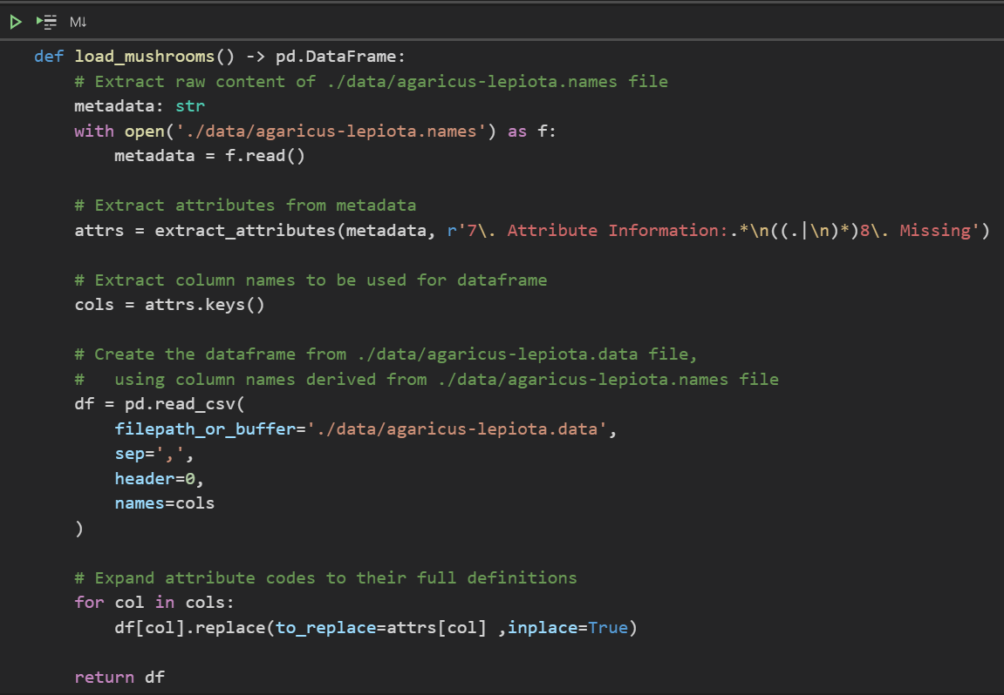
Import Data
To begin, we import the data from the .names and .data files
As the expanded feature definitions are contained in the .names file, we write a function to extract the attributes and their values, and convert everything into a pandas DataFrame
extract_attributes is another user-defined function (UDF) that can be found in utils/extraction.py

Slide 4
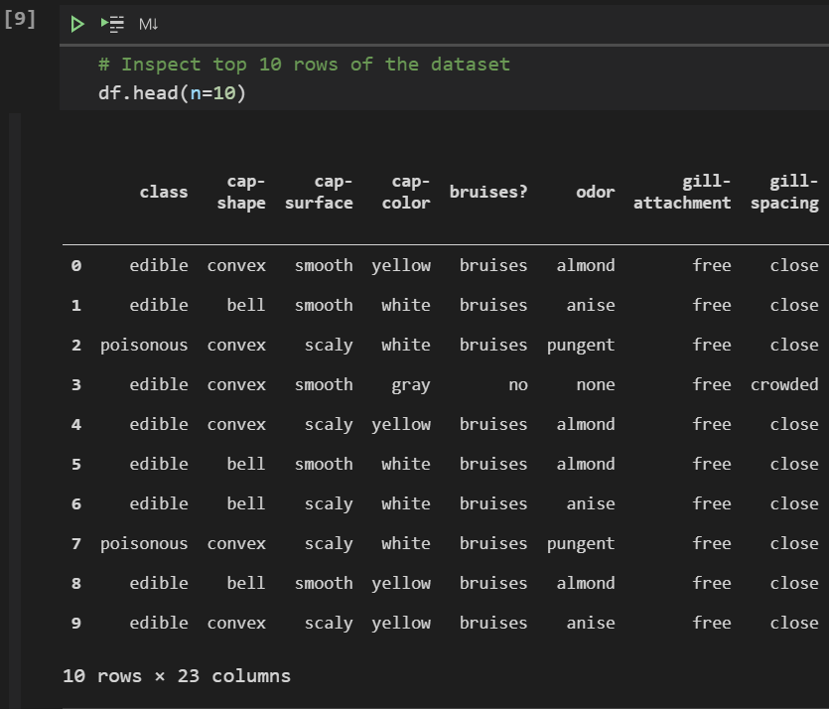
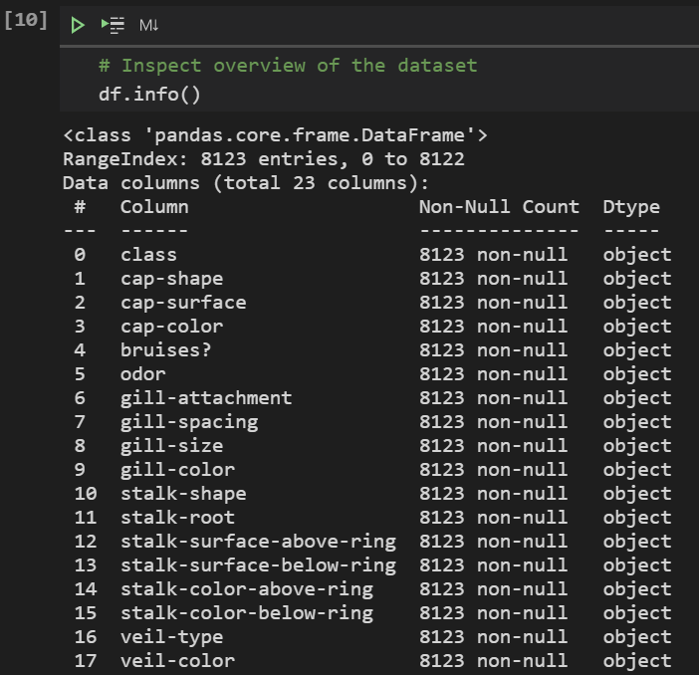
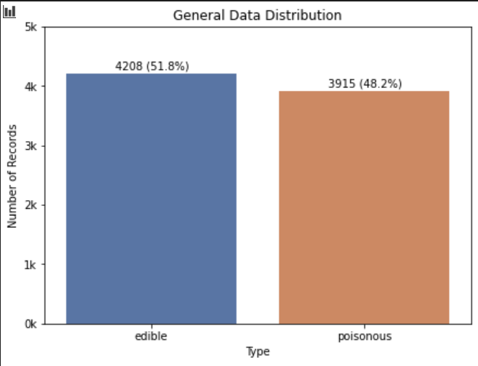
Exploratory data analysis
To begin, we inspect the data and view its summary

