Slide 1
Trading Trade-Offs
A machine learning study by Ethan Tan (p2012085)

Slide 2
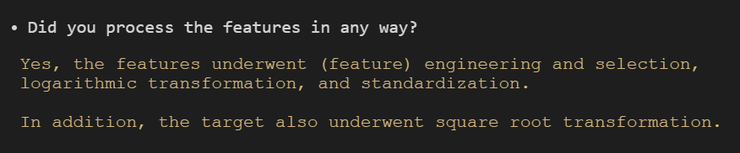
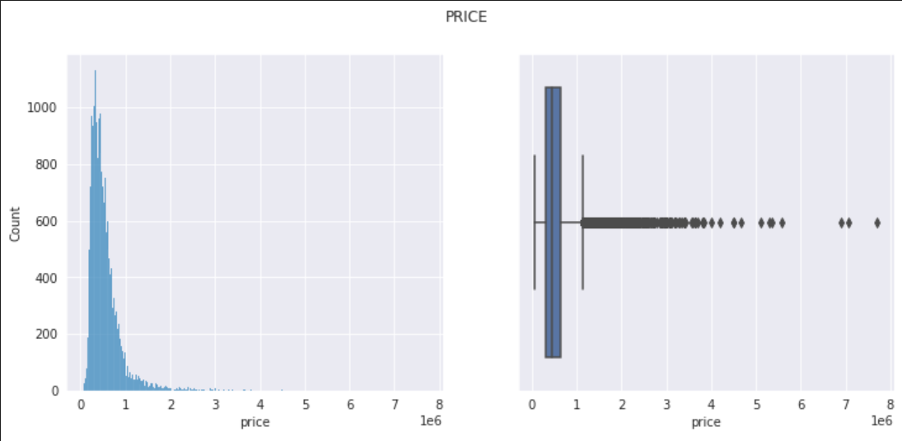
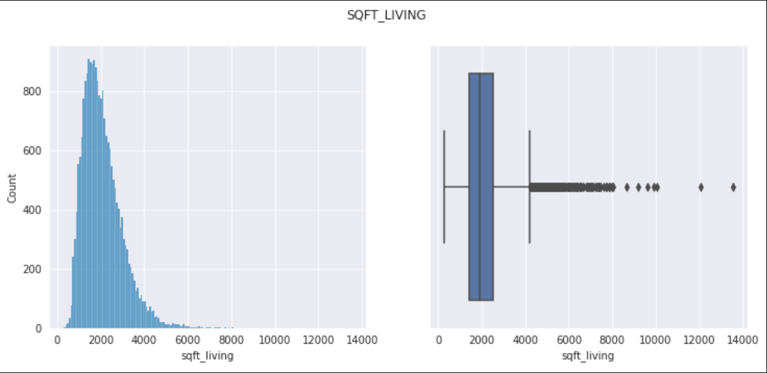
Exploratory Data Analysis
Many of the features are extremely positively skewed
Perhaps some (logarithmic/root) transformation could be applied to the data to make it conform more to a Normal distribution
It is easier for many machine learning algorithms to work with normally distributed data, especially if they are parametric

Slide 3
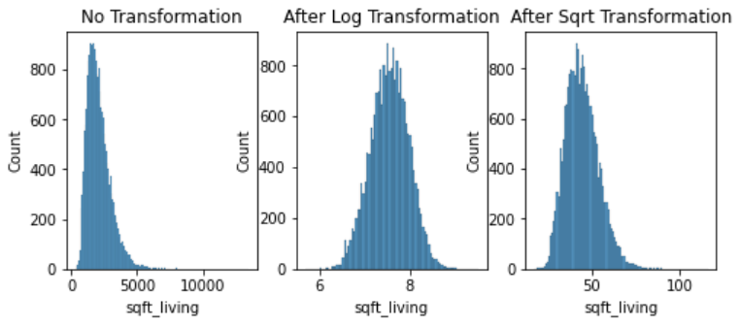
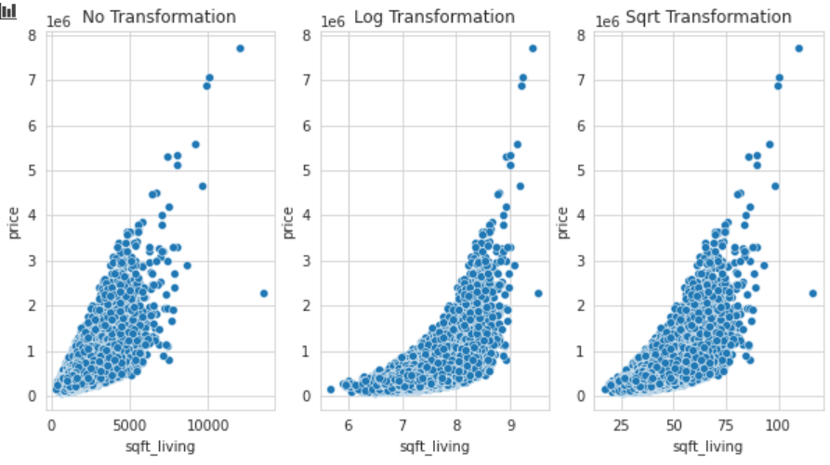
Exploratory Data Analysis
This plot shows the distribution of the values after no transformation, logarithmic transformation and root transformation respectively
As seen above, the logarithmic transformation is quite successful in producing a rather Normal distribution
This plot shows the correlation of the features with price after no transformation, logarithmic transformation and root transformation respectively
As seen above, the logarithmic transformation bends the distribution
To counter this, perhaps price should be transformed also

Slide 4
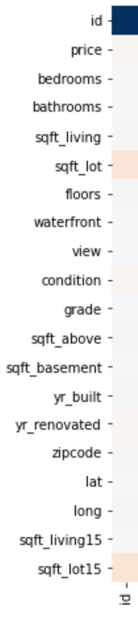
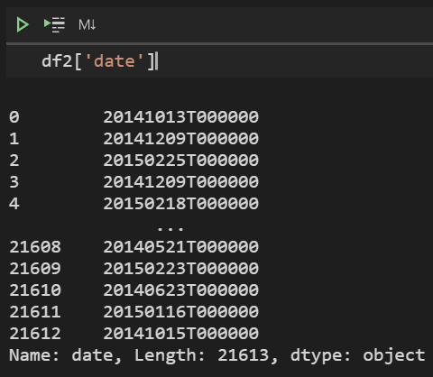
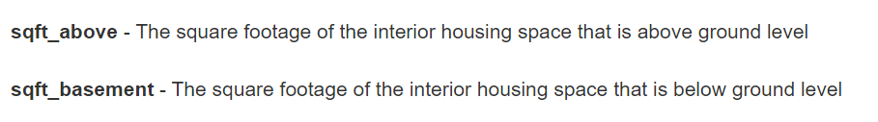
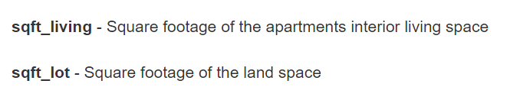
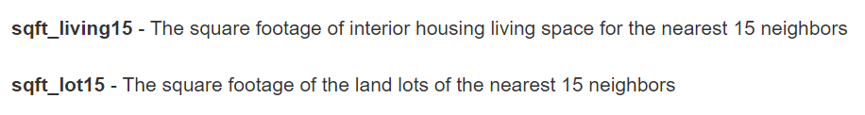
Feature Engineering and Selection
id was removed because it held little to no information for the machine learning model to learn from
date was removed after its date parts (year, month, day) were extracted during feature engineering
sqft_above, sqft_basement, sqft_lot were removed because they were all interrelated with sqft_living
sqft_lot15 was removed because it was interrelated to sqft_living15

Slide 5
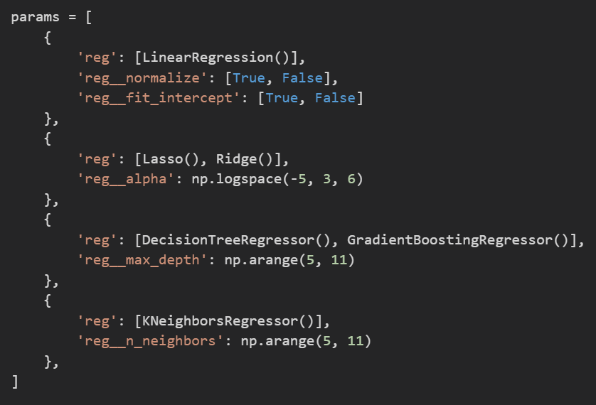
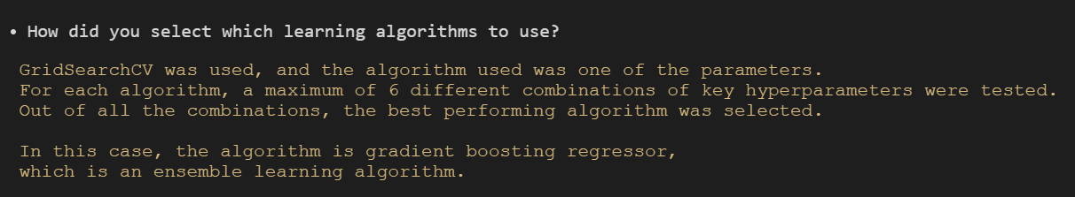
Algorithm Selection
Multiple algorithms were tested initially, with a maximum of 6 different combinations of their hyper-parameters
This was meant to level the playing field for algorithms with poor default hyper-parameters (in this scenario)
The GradientBoostingRegressor algorithm topped the charts, occupying the top 6 positions
This isn’t particularly surprising, as it deploys ensemble learning

Slide 6

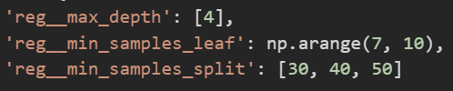
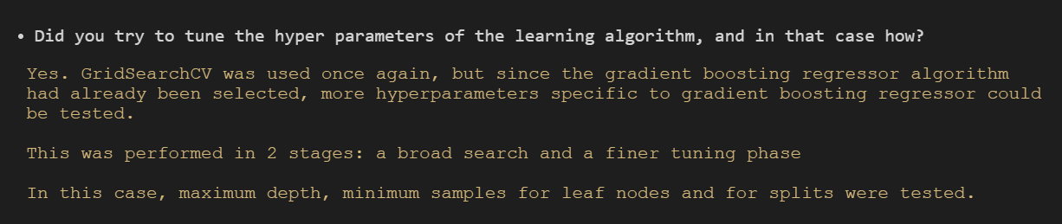
Hyper-Parameter Tuning
2 sets of GridSearchCV were used to tune the hyper-parameters of the GradientBoostingRegressor algorithm, namely maximum depth, minimum samples for leaf nodes and minimum samples for splits
The first was a broader search, while the second narrowed down the best hyper-parameters to {4, 7, 30}
min_samples_leaf and min_samples_split could be reduced further to improve performance, but I did not want to overfit the model
If the performance of the model was substandard, I would have tuned the hyper-parameters further

Slide 7
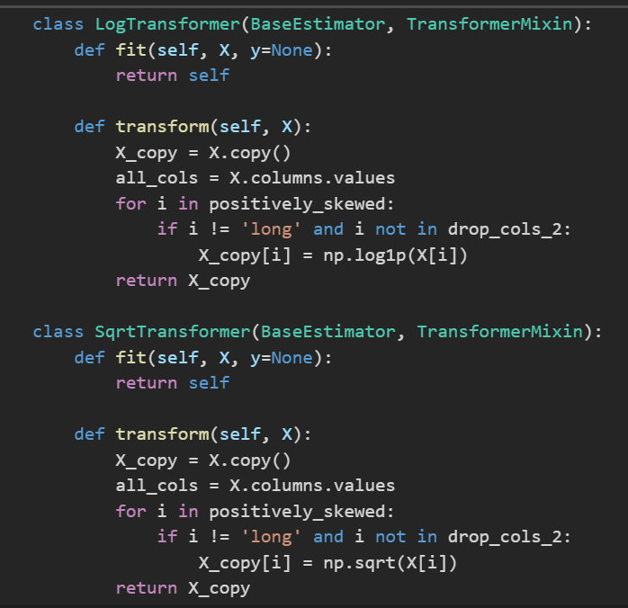
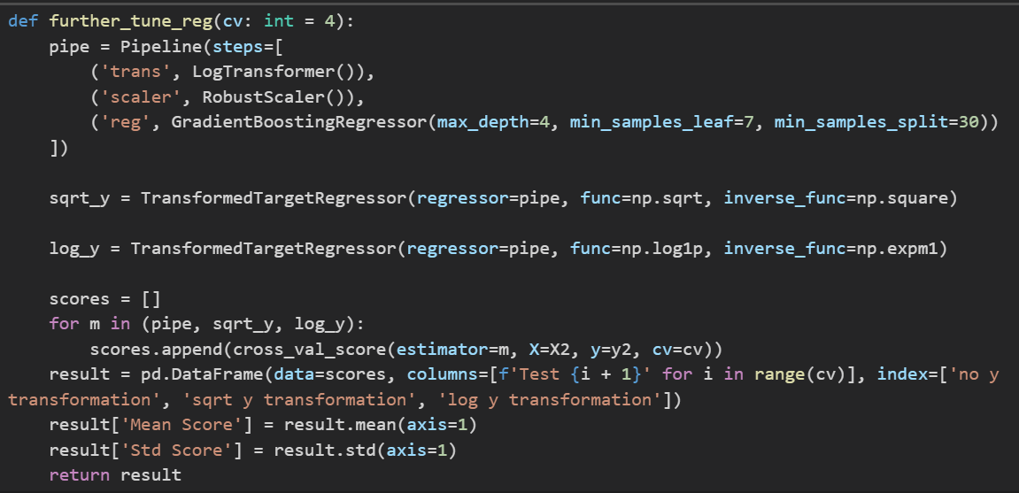
Transformations
I defined two custom transformer classes: log and sqrt, which were used to transform the feature variables.
GridSearchCV was used to compare the different scalers and transformers for the feature variables
LogTransformer with RobustScaler performed the best as the X transformer
For the target transformation, a loop was used to compare

Slide 8
Machine Learning Pipeline
A custom feature engineering and feature selection transformer classes were defined.
The machine learning pipeline was then assembled, incorporating the feature engineering and selection transformers, the robust scaler and the logarithmic X transformer, before piping the transformed to an instance of the GradientBoostingRegressor class with max_depth=4, min_samples_leaf=7 and min_samples_split=30
After building the pipeline, it was wrapped in a TransformedTargetRegressor, which is the square root y transformer, with square as the inverse function

Slide 9
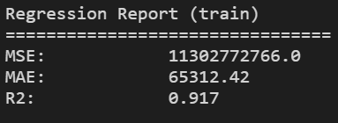
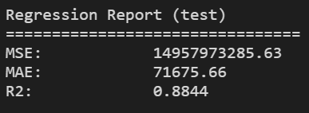
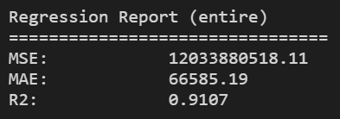
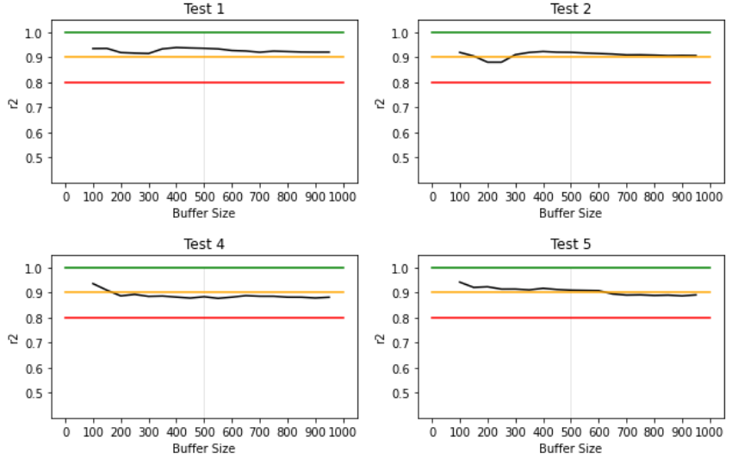
Model Evaluation
The machine learning model was then evaluated against the data wherewith it was trained, the testing data and the entire dataset in terms of mean squared error, mean absolute error and the coefficient of determination (r²)
Since the difference in r2 between the train and test sets (build and final) was < 5%, the model was not overfitted and could generalize the data comparably well.
The model was also evaluated against random samples of the data in different sample sizes (called buffers in this case)
It seems to perform quite consistently within the 0.8 - 1.0 band, hovering around 0.9, especially if the sample size is at least 500

Slide 10
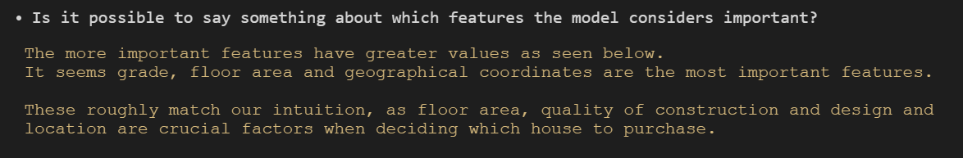
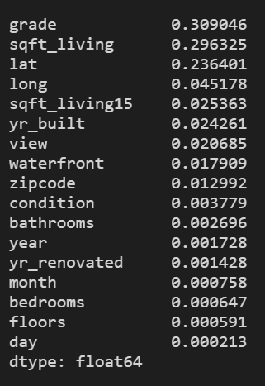
Feature Importances
These importances are exclusive to our dataset and are in no aspect universal
For example, in Singapore, however, the number of bedrooms could be a more important factor than the view, given that Singapore is very urbanised

