Slide 1
DENG CA2
Group Name: FYRE
Done By:
Rachel Tan Min Zhi p2011802
Fleming Siow p2011828
Pek Yi Chern p2012184
Ethan Tan p2012085

Slide 2
Problems when importing to OLTP
Table | Issues | Fixes
Playlist | Duplicated values | Used cte’s and the ROW_NUMBER() function to drop duplicate values and reorder PlaylistId
PlaylistTrack | Duplicated values Initial PlaylistId values referenced the PlaylistId of the duplicated values. | Used CASE statement to update PlaylistId according to the new Playlist table Used method as stated above to drop duplicate values
Artist Genre | Due to being in unicode format, the “import JSON” method shown in Practical E does not work. | Specified ‘SINGLE_NCLOB’ rather than ‘SINGLE_BLOB’ in OPENROWSET function.
Track | Cannot import because some records have double quotes (“”) inside them. | Specified FIELDQUOTE = '0X0FF2' when importing.

Slide 3
Problems when importing to OLTP
Table | Issues | Fixes
Album Customer Employee Invoice InvoiceLine MediaType | No issues. | -

Slide 4
ETL Process
Extract | Unnecessary columns like ‘ReportsTo’ from Employee table and ‘SupportRepId’ from Customer table were filtered out before extracting. Every column from each table was scrutinized to determine if they were insightful. With respect to this, the entire Playlist and PlaylistTrack tables were not transferred over.
Transform | Converted all cases of ‘USA’ to ‘United States’ in Customer table (inconsistent data)
Load | Insightful and cleaned columns were then inserted into their respective tables and columns in the data warehouse.

Slide 5
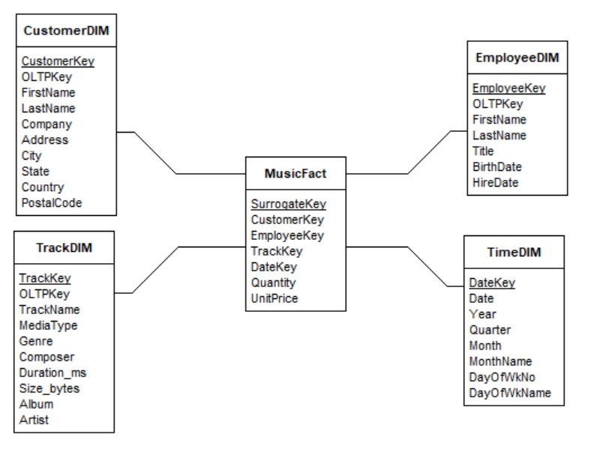
Reason for using Star Schema
Star Schema requires fewer linkages than Snowflake Schema
Faster and simpler queries
Snowflake Schema is unnecessary as there are minimal subgroups.

Slide 6
Reason for creating Dimension Tables
EmployeeDim
Store Employee information for the purpose of improving operational efficiency
CustomerDim
Store Customer information to gather insights from customer preferences and improve customer loyalty
TrackDim
Store Invoice details
Tables such as Genre and Album were collapsed as these tables merely hold the definition, i.e., there is no loss of information

Slide 7
Metrics in Fact Table
Metrics | Description
Quantity | No. of items bought in each record. Can be multiplied with UnitPrice to give total sales for each record. As of time of data insertion, all transactions have 1 quantity.
UnitPrice | Price of the track bought in each record. Stored in fact table to reduce table joins and because it is quantitative. As of time of data insertion, all instances of UnitPrice are either 99.00 or 199.00

Slide 8
Time Dimension
Defined a Start and End Date in DATE format (‘yyyymmdd’)
This date range exceeds the range of the actual data to make the data warehouse more flexible for queries and accommodate for new record insertion.
Starting with the Start Date:
Used DatePart() function to get Year, Quarter, and Month
Used Format() function to get MonthName and DayOfWkName
Used DatePart() function to get DayOfWkNo, and CASE statement to realign Monday as Day 1 of the week
Repeat for every date, up until the End Date
Attributes
Date
Year
Quarter
Month
MonthName
DayOfWkNo
DayOfWkName

Slide 9
Surrogate Keys
Used the IDENTITY constraint to create surrogate keys for the Music Fact table and the Customer, Employee and Track Dimension tables.
The MusicFact also contains the EmployeeKey, CustomerKey, TrackKey foreign keys which are linked to the surrogate keys in the EmployeeDim, CustomerDim, TrackDim tables respectively.
Table | Surrogate Key
EmployeeDim | EmployeeKey
CustomerDim | CustomerKey
TrackDim | TrackKey
MusicFact | SurrogateKey

Slide 10
Reason for using Surrogate Keys
Surrogate keys are unique since it is system-generated. Hence, it reduces the likelihood of the system to create and store a duplicated value.
Natural keys do not stand the test of time. For instance, a change in management could result in massive changes in the DW if the format of the Customer ID was to change from “GO-A015” to “FB-A015”. As surrogate keys lack any business meaning, there will be no need to change it in the future.

Slide 11
Thank You!

