Slide 1
DENG CA2
Group Name: FYRE
Done By:
Rachel Tan Min Zhi p2011802
Fleming Siow p2011828
Pek Yi Chern p2012184
Ethan Tan p2012085

Slide 2
Problems when importing to OLTP
Table | Issues | Fixes
Playlist | Duplicated values | Used cte’s and the ROW_NUMBER() function to drop duplicate values and reorder PlaylistId
PlaylistTrack | Duplicated values Initial PlaylistId values referenced the PlaylistId of the duplicated values. | Used CASE statement to update PlaylistId according to the new Playlist table Used method as stated above to drop duplicate values
Artist Genre | Due to being in unicode format, the “import JSON” method shown in Practical E does not work. | Specified ‘SINGLE_NCLOB’ rather than ‘SINGLE_BLOB’ in OPENROWSET function.
Track | Cannot import because some records have double quotes (“”) inside them. | Specified FIELDQUOTE = '0X0FF2' when importing.

Slide 3
Problems when importing to OLTP
Table | Issues | Fixes
Album Customer Employee Invoice InvoiceLine MediaType | No issues. | -

Slide 4
ETL Process
Extract | Unnecessary columns like ‘ReportsTo’ from Employee table and ‘SupportRepId’ from Customer table were filtered out before extracting. Every column from each table was scrutinized to determine if they were necessary for the queries we plan on writing.
Transform | Converted all cases of USA to United States in Customer table (inconsistent data)
Load | Shortlisted and cleaned columns were then inserted into their respective tables and columns in the data warehouse.

Slide 5
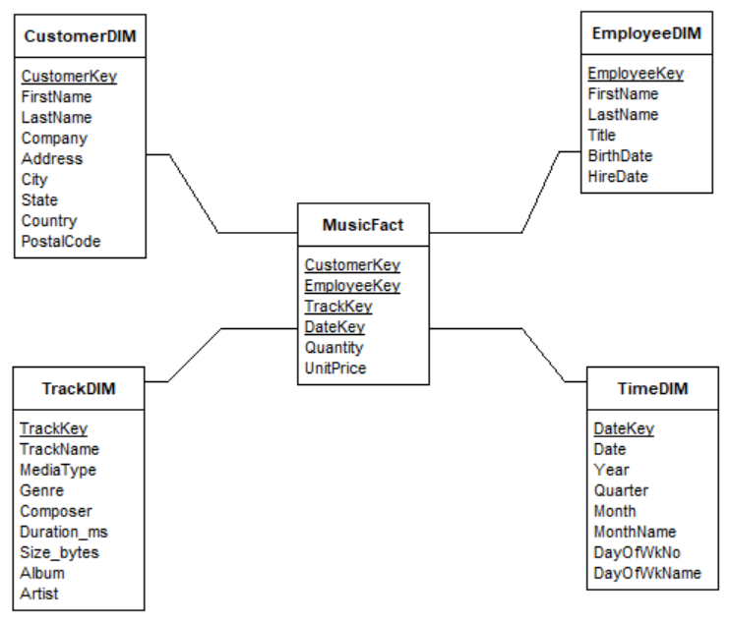
Reason for using Star Schema
Star Schema requires fewer linkages than Snowflake Schema
Faster and simpler queries
Dimension tables are practically normalized already
Snowflake Schema is unnecessary

Slide 6
Metrics in Fact Table
Metrics | Description
Quantity | No. of items bought in each record. Can be multiplied with UnitPrice to give total revenue for each record. As of time of data insertion, all instances of Quantity are 1
UnitPrice | Price of the track bought in each record. Stored in fact table to reduce table linkage. As of time of data insertion, all instances of UnitPrice are either 99.00 or 199.00

Slide 7
Time Dimension
Attributes
Date
Year
Quarter
Month
MonthName
DayOfWkNo
DayOfWkName
Defined a Start and End Date in DATE format (‘yyyymmdd’)
Starting with the Start Date:
Used DatePart() function to get Year, Quarter, and Month
Used Format() function to get MonthName and DayOfWkName
Used DatePart() function to get DayOfWkNo, and CASE statement to realign Monday as Day 1 of the week
Repeat for every date, up until the End Date

Slide 8
Surrogate Keys
The MusicFact contains the EmployeeKey, CustomerKey, TrackKey foreign keys which are linked to the surrogate keys in the EmployeeDim, CustomerDim, TrackDim tables respectively.
Table | Surrogate Key
EmployeeDim | EmployeeKey
CustomerDim | CustomerKey
TrackDim | TrackKey

Slide 9
Thank You!

