Slide 1
DOAA CA1
By
Ethan Tan
P2012085
DAAA/2B/03

Slide 2
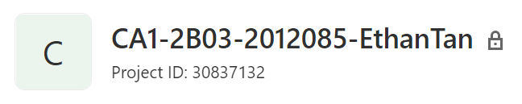
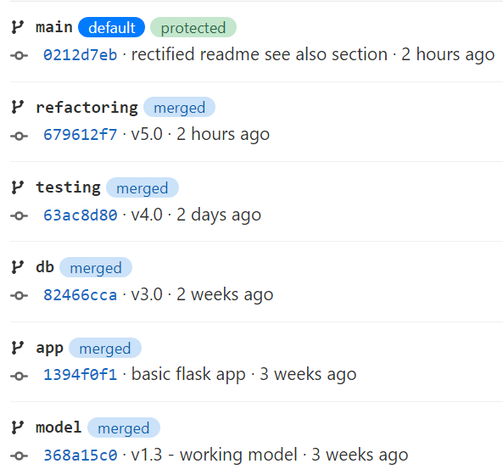
GitLab Repository
The repository can be found at https://gitlab.com/2b03.2012085.ethantan/ca1-2b03-2012085-ethantan.git, as indicated in README.md
The 6 branches used are as follows:
main (main branch)
model (develop ML model)
app (application without db)
db (data persistence)
testing (unit testing)
refactoring (refactoring code)

Slide 3
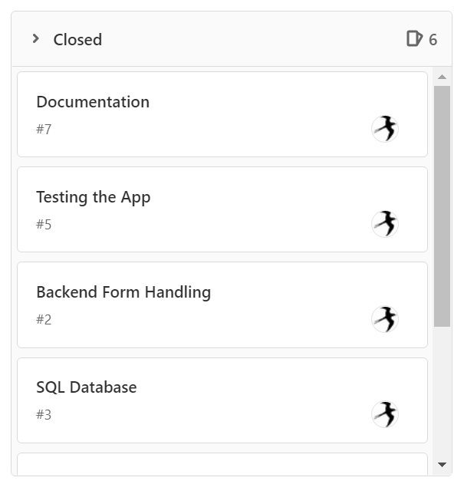
Scrum Board
Most of the issues have been resolved and closed, with the exception of deployment
The 7 issues are:
User Interface
Backend Form Handling
SQL Database
Machine Learning Model
Testing the App
Deploying the App (not done)
Documentation

Slide 4
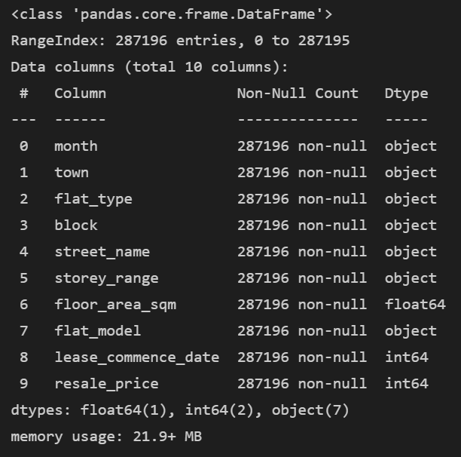
Obtaining Data
The data was sourced from Kaggle at: https://www.kaggle.com/sveneschlbeck/resale-flat-prices-in-singapore
It is a resale housing prediction dataset based on Singapore
It contains details such as floor area, type of flat, year of lease commencement and resale price
The problem is a regression one
For simplicity, a Linear Regression model was chosen

Slide 5
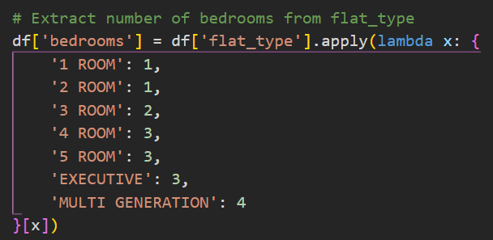
Feature Engineering
Anomalies (floor area >= 200) were removed
Month was converted to date type and renamed to “approval_date”
“lease_commence_date” was renamed to “lease_commencement_year”
Number of bedrooms was extracted from the flat type
Unused columns were dropped

Slide 6
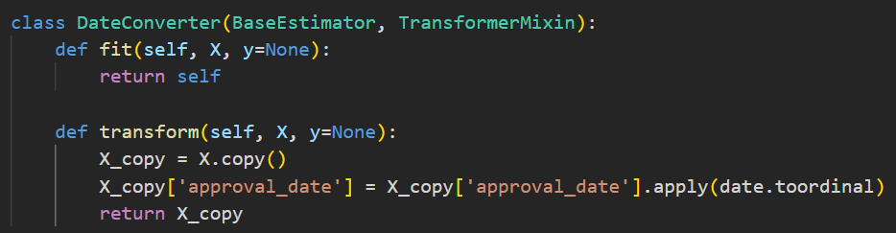
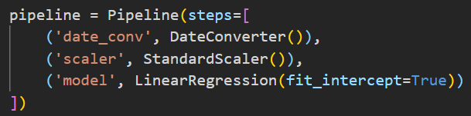
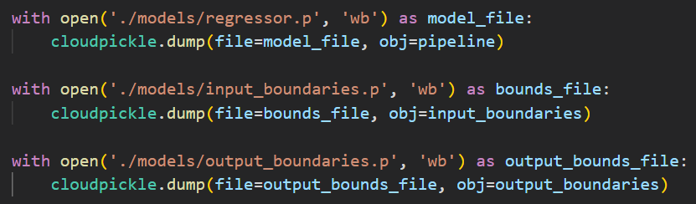
Machine Learning Model
A custom transformer was used to pre-process the approval date column, converting it to integer type before scaling
A pipeline was used to integrate data pre-processing before predicting
Using cross-validation, the ML pipeline scores 0.78 consistently
The model was exported using cloudpickle, an extension of pickle which is able to serialize non-default Python constructs
The input and output boundaries were also exported for data validation
The binaries were then copied over to the app/static/dist directory

Slide 7
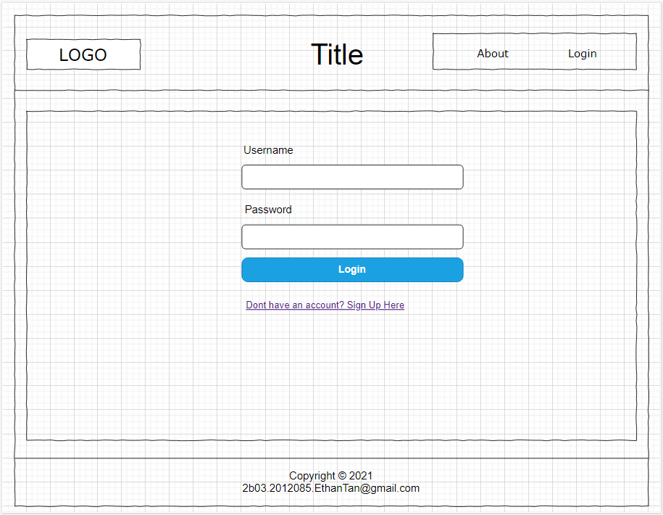
Website Wireframe
The wireframe was made using diagrams.net, and saved as a .drawio file under doc/
The wireframe depicted 5 pages:
Login Page
Sign-Up Page
About Page
Home (new prediction) Page
Home (prediction history) Page
The UI for the application mostly followed the wireframe
However, some unplanned changes were made later on

Slide 8
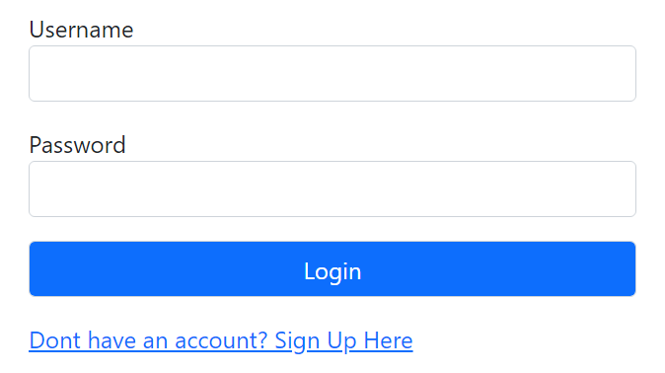
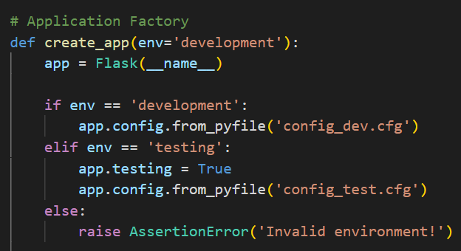
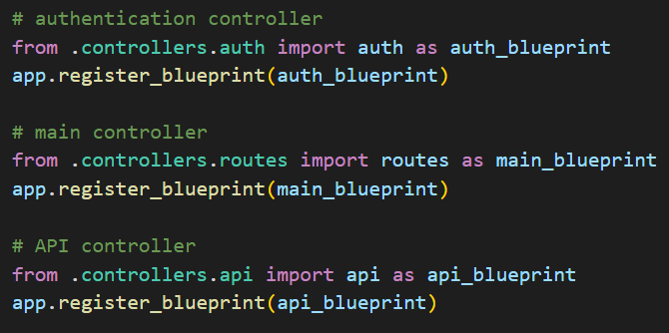
User Interface
The application was developed using the Flask micro-framework
An application factory design was used to accommodate various configurations
Blueprints were used to implement the controllers in a modular fashion
Using Jinja’s templating engine, layout.html defined a standard structure for the web pages and macros were used to replace repetitive HTML

Slide 9
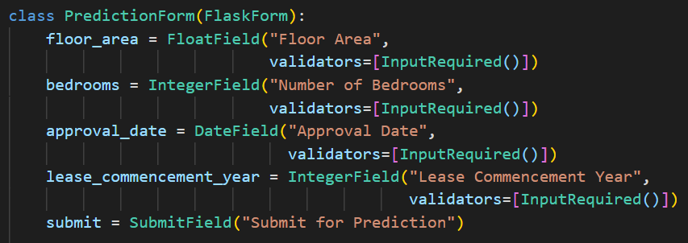
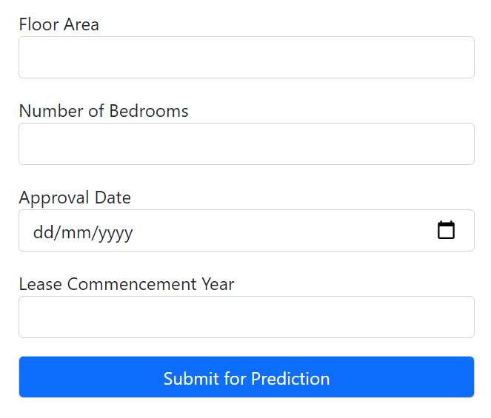
Backend – Send in Prediction
Flask WTF module was used to implement the prediction form
Default validators and custom validators were used to prevent users from entering invalid data
The form is posted to the endpoint /predict

Slide 10
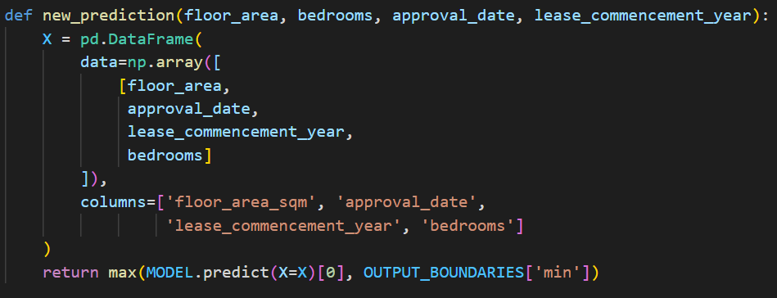
Backend – Obtain Prediction
Once the prediction is sent, the data is posted to /api/predict to obtain the predicted resale price
The predicted price is capped at a minimum of S$5000, because that was the lowest value in the dataset

Slide 11
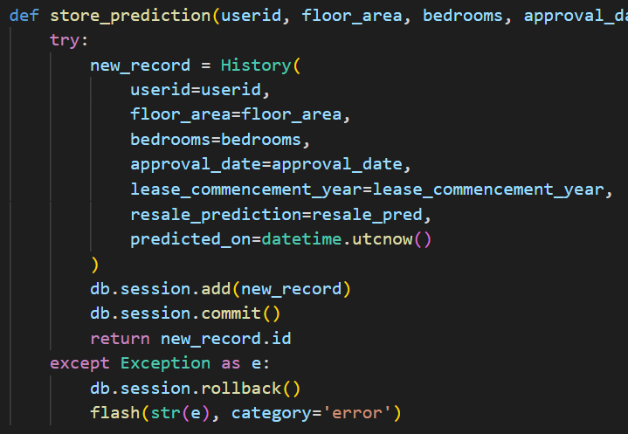
Backend – Store Prediction
SQLAlchemy ORM was used to model and save data to the database for data persistence
The database engine used is SQLite
The predictions are tagged by user id so that users can only view their own past predictions

Slide 12
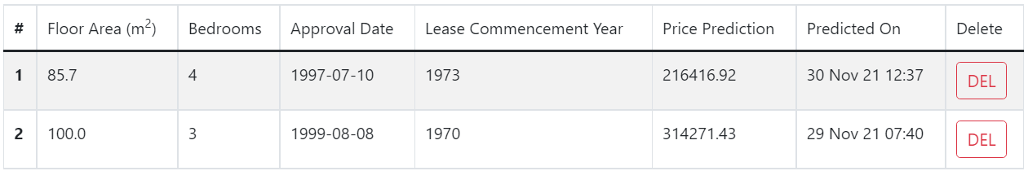
Backend – Review History of Predictions
At the website, once a user is logged in, he/she is able to view all his/her past predictions under Home > Prediction History
Above the prediction history table, regression plots for the latest prediction will be displayed (if there is at least one record)

Slide 13
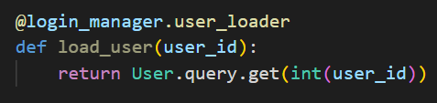


Backend – Login Credentials
Flask-Login, a Flask extension, was used to manage user sessions
If a user is not logged in, he/she will only be able to view the about page and the login/sign-up page
If a user is logged in, he/she can view the about page, home page and can log out at any time
Flask-Login manages logins
Navbar of a guest user
Navbar of a logged in member

Slide 14
Backend – Remove History Record
A user can delete any of his/her past predictions by clicking on the DEL button beside any of the prediction records
A form will be sent to the backend, which will send a DELETE request to /api/delete/<pred_id>, where id is the id of the record
Users can only view and delete their own prediction records

Slide 15
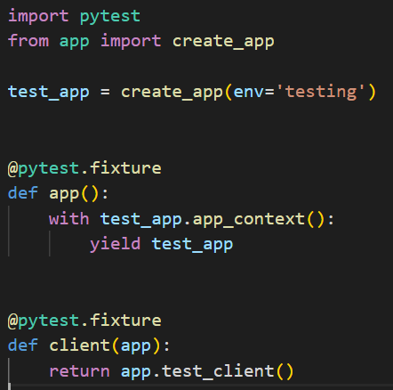
Testing – Setup
PyTest was the tool of choice for unit testing
Since an application factory was used, it was easy to configure the testing environment
PyTest fixtures app and client were defined to allow the API endpoints to be easily accessed and tested

Slide 16
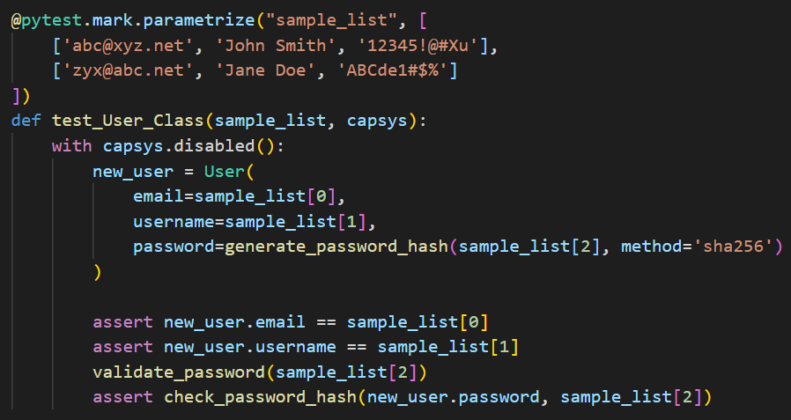
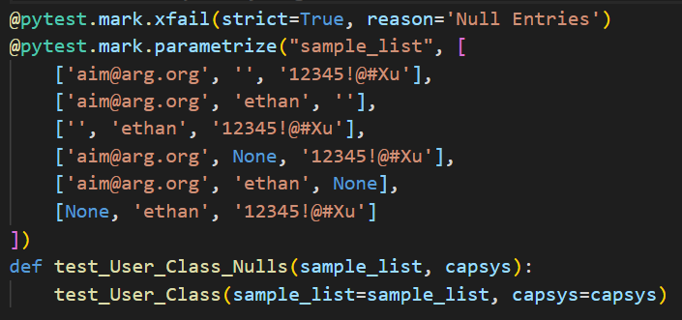
Testing – Database Models
Unit testing was conducted on both the User and History classes
PyTest’s parametrize decorator was used to run the tests against multiple samples
Some tests were expected to fail due to null, invalid or data that were out of range

Slide 17
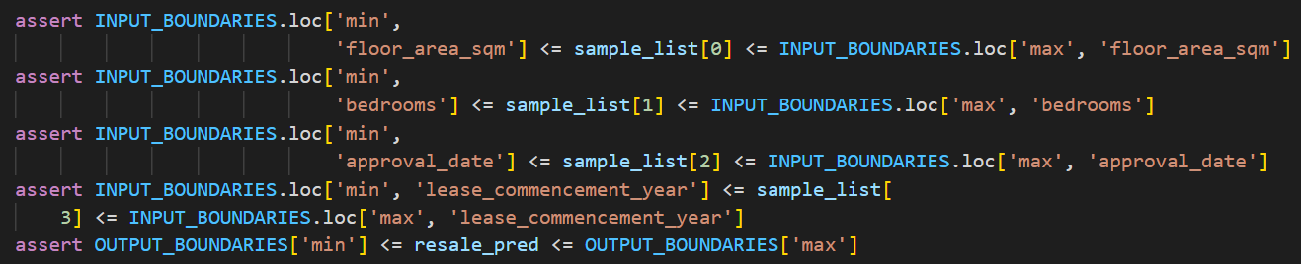
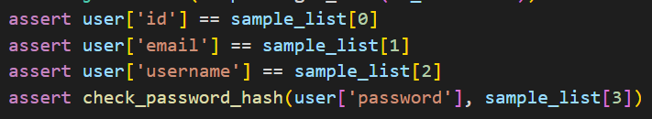
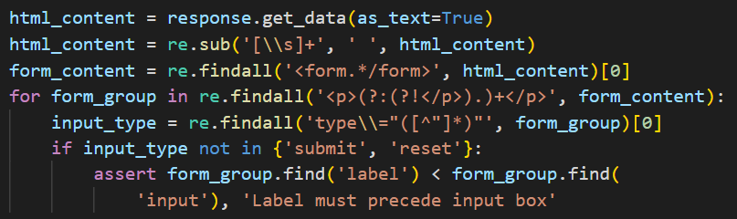
Testing – APIs / GUI
Example of Range Testing
API endpoints were also set up to test the components of the app
Example of Validity Testing
Example of Consistency Testing
The GUI was also tested to ensure that the formats were consistent. One example is that form labels must come before the input boxes

Slide 18
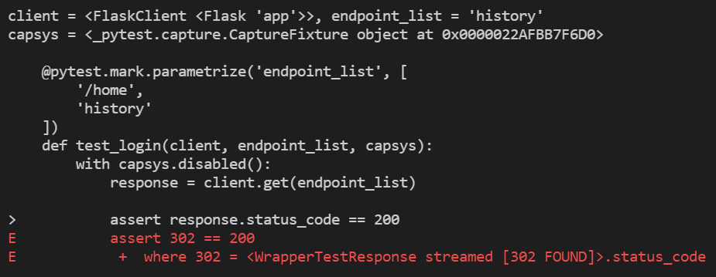
Testing – Results
Most of the tests passed
The majority of failures were expected
There were, however, two unexpected failures as the tests expected to retrieve response code 200, whereas the endpoints returned redirects

