Slide 1
DOAA CA1
By
Ethan Tan
P2012085
DAAA/2B/03

Slide 2
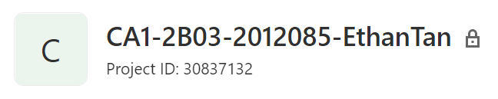
GitLab Repository
The repository can be found at https://gitlab.com/2b03.2012085.ethantan/ca1-2b03-2012085-ethantan.git, as indicated in README.md

Slide 3
Importing Data
The dataset was sourced from Kaggle
It entails resale flat details and their corresponding prices in Singapore
It is available at this link: https://www.kaggle.com/sveneschlbeck/resale-flat-prices-in-singapore

Slide 4
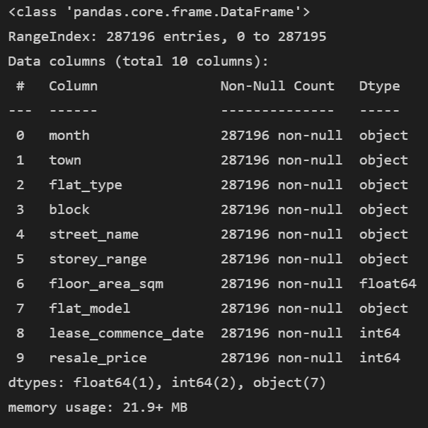
Data Inspection
The dataset contains common details like the month of approval, type of flat and floor area, etc.
Most of the columns are not quantitative
There are no missing values

Slide 5
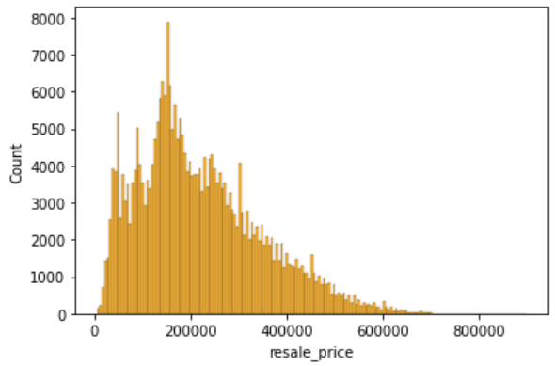
Exploratory Data analysis
The resale prices are very positively skewed
The lowest recorded price is S$5000 while the highest can be more than S$600,000
The majority of flats are between S$100k and S$300k

Slide 6
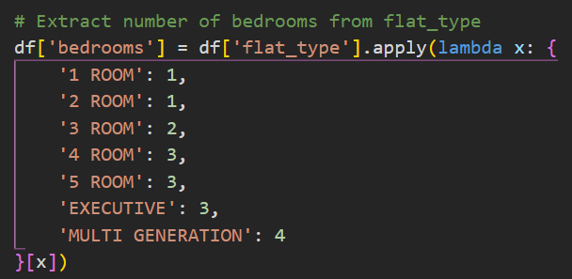
Feature Engineering
Anomalies (floor area >= 200) were removed
Month was converted to date type and renamed to “approval_date”
“lease_commence_date” was renamed to “lease_commencement_year”
Number of bedrooms was extracted from the flat type
Unused columns were dropped

Slide 7
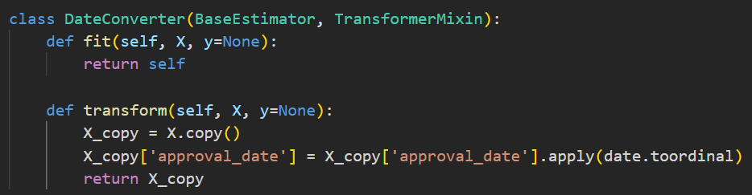
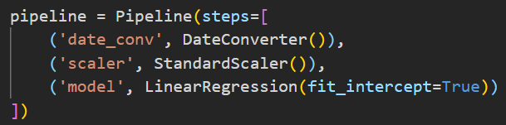
Machine Learning Model
Only 4 features were retained: floor area, bedrooms, approval date and lease commencement year
A custom transformer was used to pre-process the approval date column, converting it to integer type
A pipeline was used to integrate data pre-processing before predicting
Using cross-validation, the ML pipeline scores 0.78 consistently

Slide 8
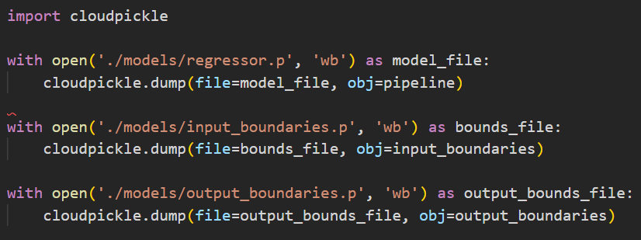
Exporting the Models
I used cloudpickle to export the models as it is able to serialize non-default Python constructs, such as the custom transformer and ML pipeline
The input and output boundaries were also exported for data validation
The binaries were then copied over to the application/static/dist directory

Slide 9
Exporting the Models
I used cloudpickle to export the models as it is able to serialize non-default Python constructs, such as the custom transformer and ML pipeline
The input and output boundaries were also exported for data validation
The binaries were then copied over to the application/static/dist directory

Slide 10
Wireframe

Slide 11
User Interface

Slide 12
User Interface

Slide 13
Login Credentials

Slide 14
Data Persistence

Slide 15
New Prediction

Slide 16
Prediction History

Slide 17
Application Testing

Slide 18
Model Testing

Slide 19
API Testing

Slide 20
GUI Testing

