Slide 1

Yelp Dataset Analysis With Hadoop, Pig, Spark, Hive and Tableau
TEAM
YELP
WQD7008 PARALLEL AND DISTRIBUTED COMPUTING
No. | MATRIC ID | NAME
1 | 17186722/2 | CHEN BAOGANG
2 | S2191604 | ONG HORNG NENG
3 | 22052733 | RAJASEGARAN A/L M SIVAANANDAN
4 | S2179001 | NG CHENG WEI
5 | 22056764 | DEVAYANI A/P BALKRISHNAN

Slide 2
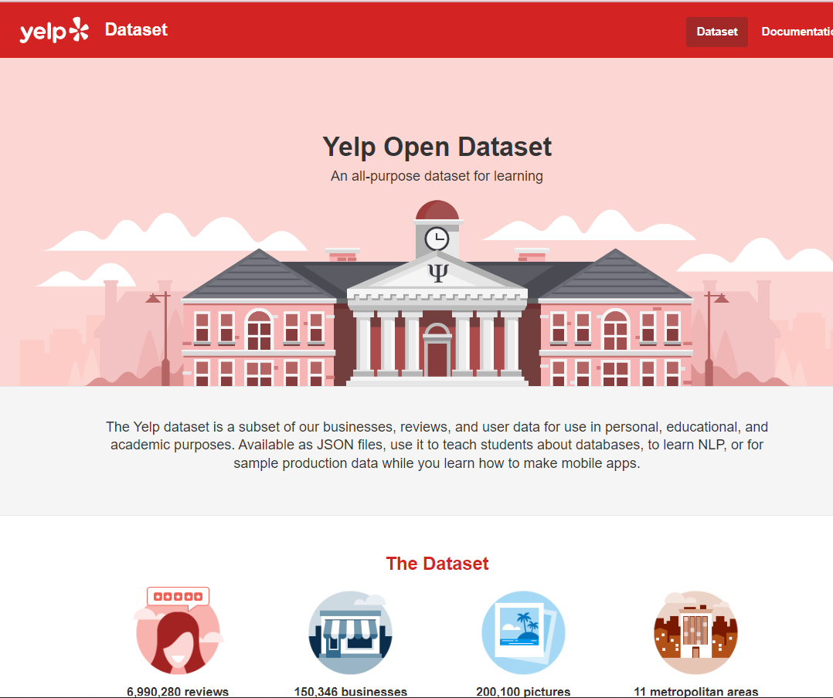
INTRODUCTION
Yelp is a widely-used public database that allows individuals to access information about businesses.
The database contains:
6.9 million reviews 1.9 million users
2014 June 2022
150,000 businesses
4 GB (compressed), 9 GB (uncompressed)
from
to
The yelp dataset was explored using different big data technologies such as hadoop, yarn, pig, spark, and hive to discover data insights that can help improve business performance

Slide 3



OBJECTIVES
Using hadoop hdfs and yarn to perform word count task
Using hadoop hdfs, yarn, Pig, Spark and Hive to conduct data analysis
Using Tableau to visualize the output

Slide 4
Data Collection
This dataset was obtained from Yelp: https://www.yelp.com/dataset.
Consists of five data feeds, which are business, review, pictures
In this project, we focus on the review dataset which is 5.34Gb in size

Slide 5
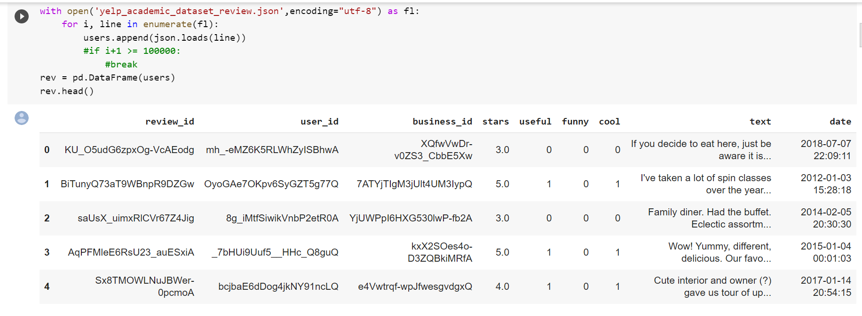
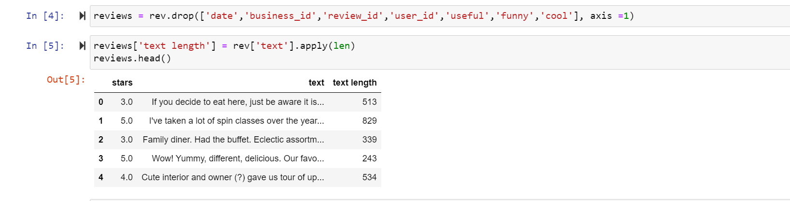
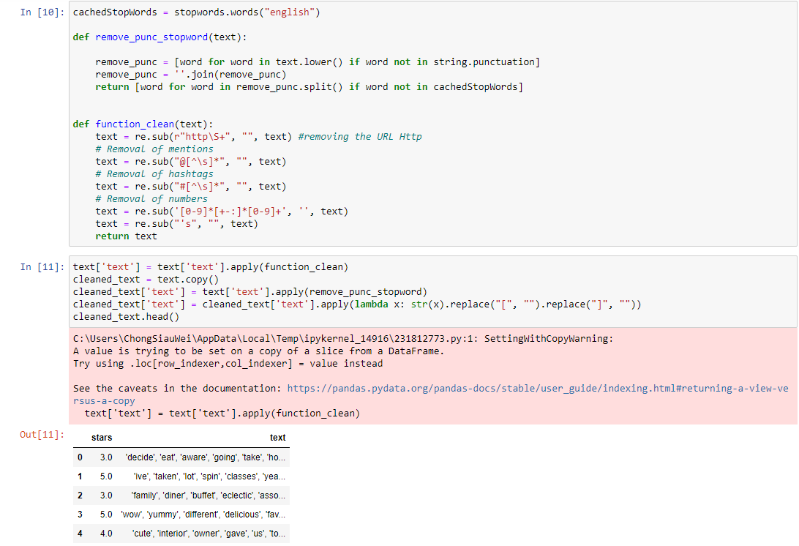
Data Pre-Processing
Import data
Json file is loaded and converted into dataframe
03
Data Export
Processed data is then export into csv file and ready for next step analysis
Data Cleaning
Tokenizing the dataset and remove null values, punctuations, duplicate rows and non-english word
01
02

Slide 6

Methodology
System Design
Word count task
Data Analysis By Hadoop, Pig , Spark and Hive

Slide 7
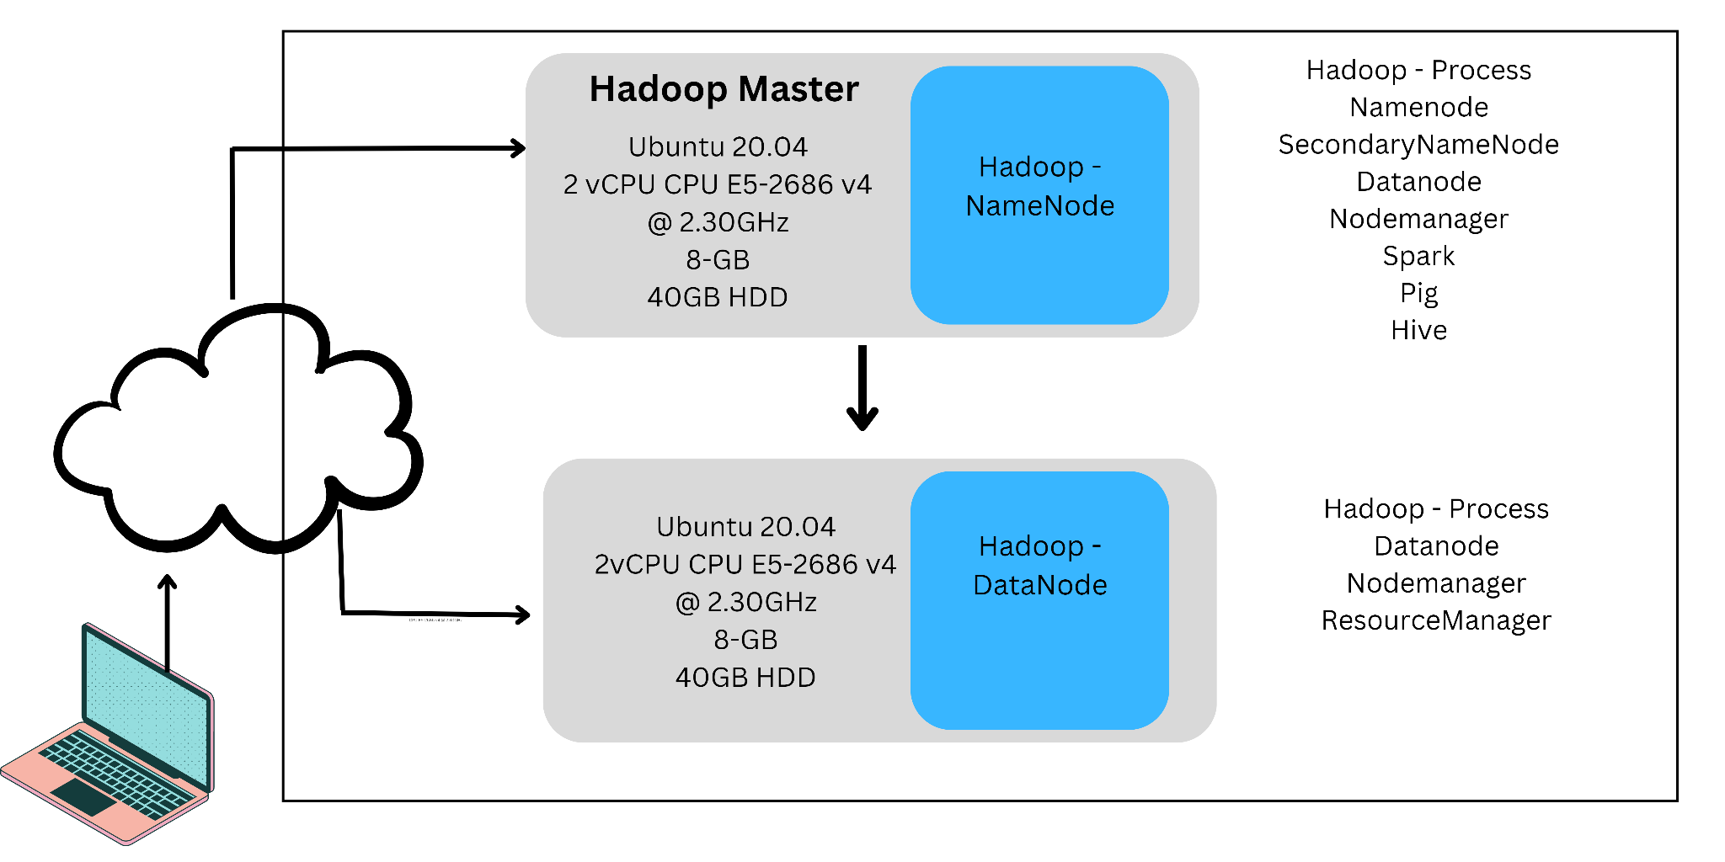
System Design
Overview
Two AWS EC2 instances
data storage is done by uploading data from a local host into a Hadoop HDFS cluster
Output is rendered and shown in a graphical manner using Tableau

Slide 8
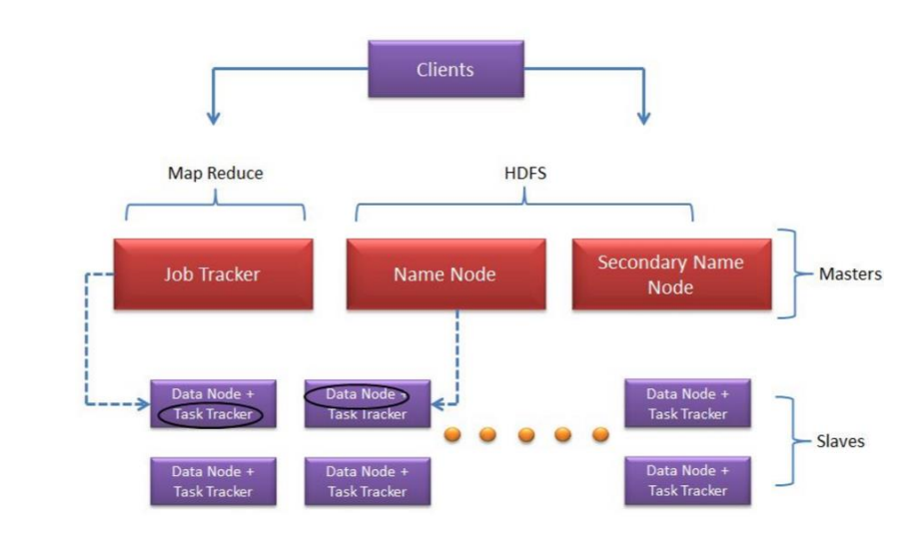
System Design
Hadoop Components
NameNode
Secondary NameNode
Secondary NameNode
DataNode
MapReduce
YARN
HDFS

Slide 9
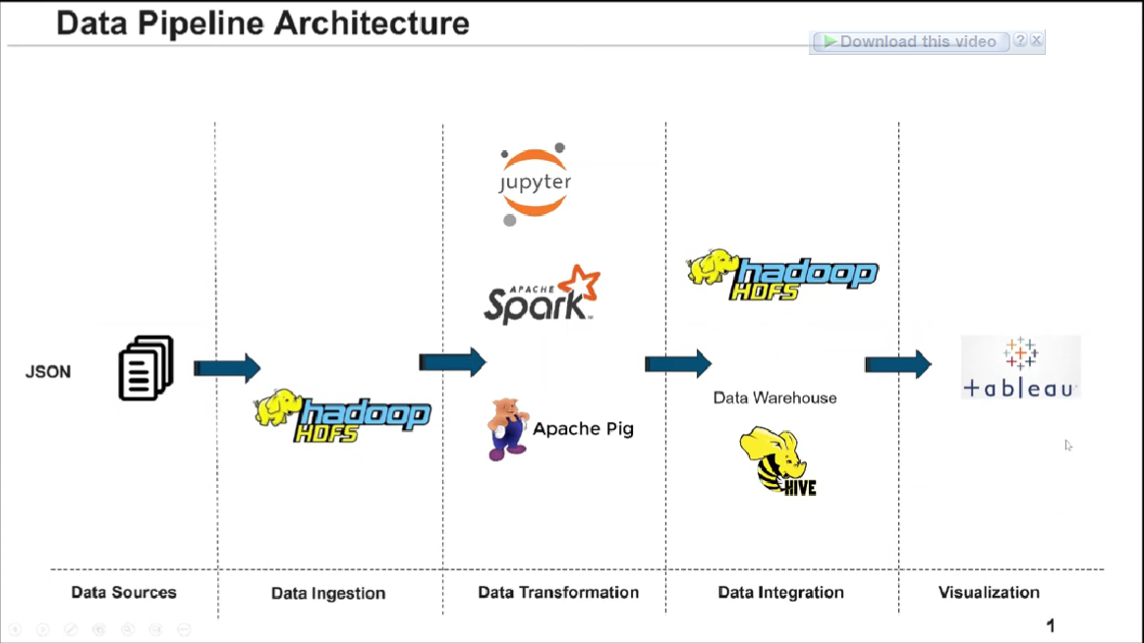
System Design
Project Components
AWS cloud service
VMware
Jupyter Notebook
HDFS
YARN
Pig , Spark ,Spark
Tableau

Slide 10
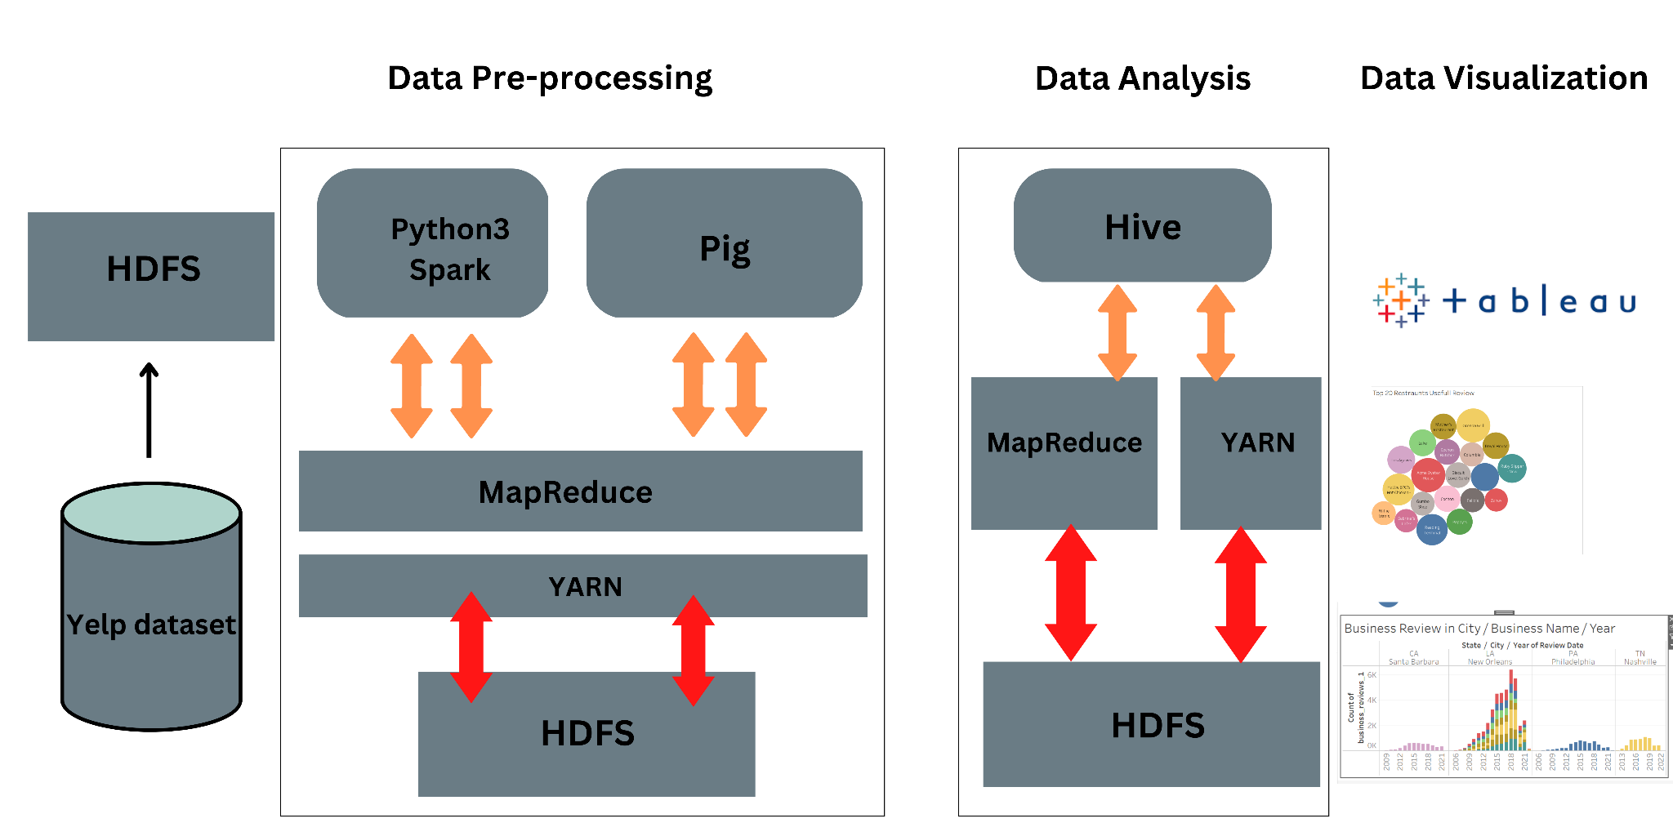
System Design

Slide 11
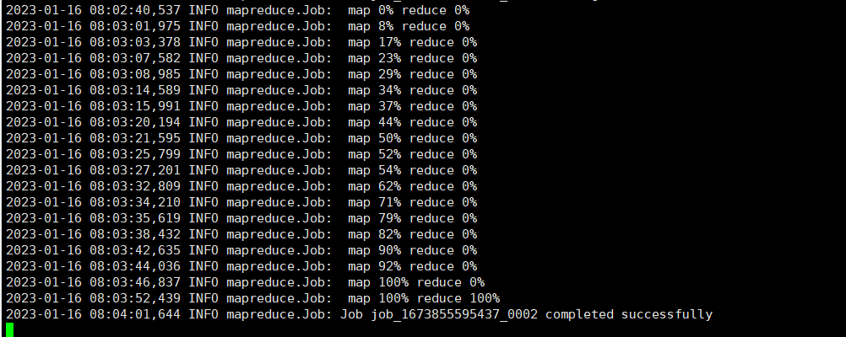
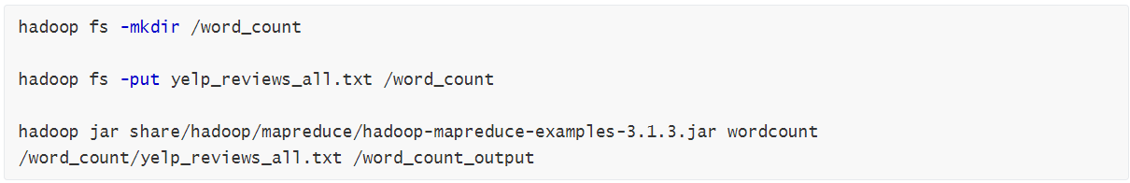
Word Count Task
:
Upload data into hadoop hdfs
Run WordCount task with Mapreduce
Use Hadoop/Yarn MapReduce technology, take the Yelp review dataset as input, and count the number of times different words appear in each review. Then, the program outputs the count of each word.

Slide 12
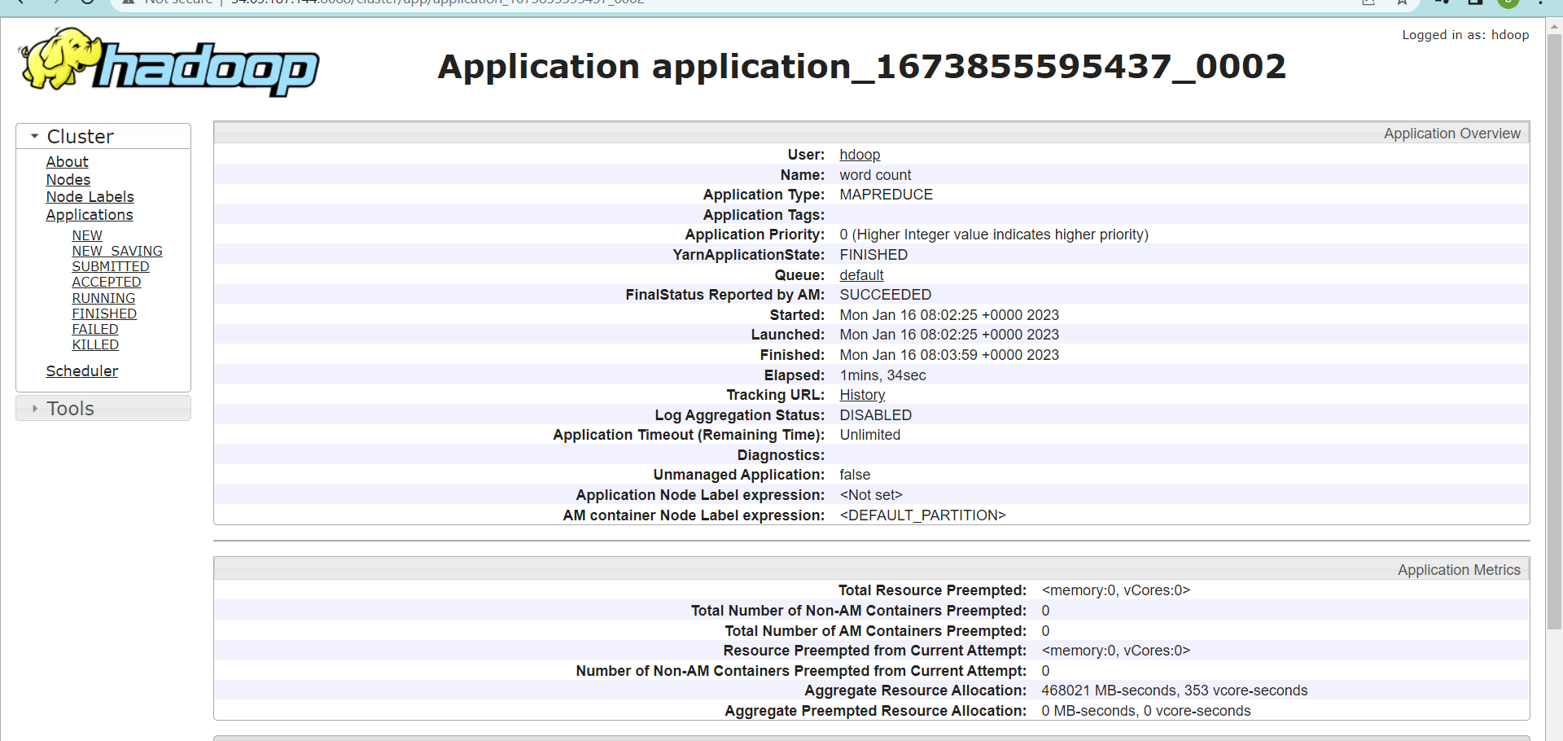
Word Count Task
completed the map and the reduce process in just 1 minute and 34 seconds

Slide 13
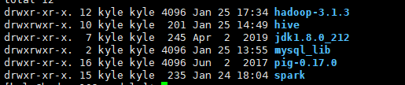
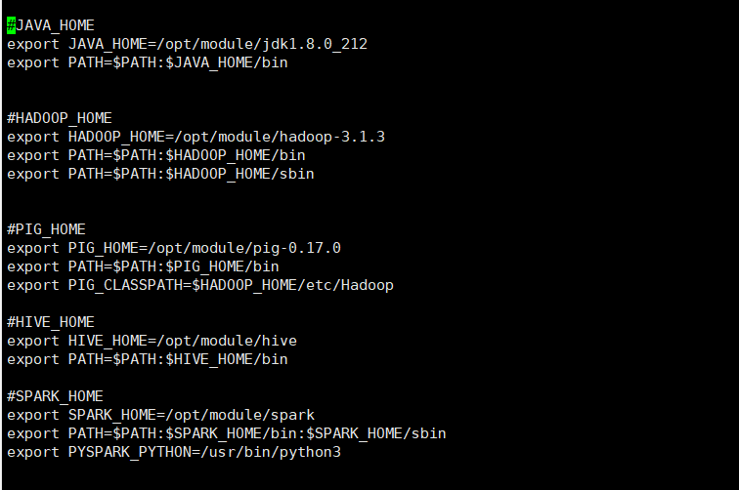
Data Analysis By Hadoop, Pig , Spark and Hive
Installed softwares and
Set environment variables
Hadoop.3.1.3
Hive
Pig
Spark
Python 3

Slide 14
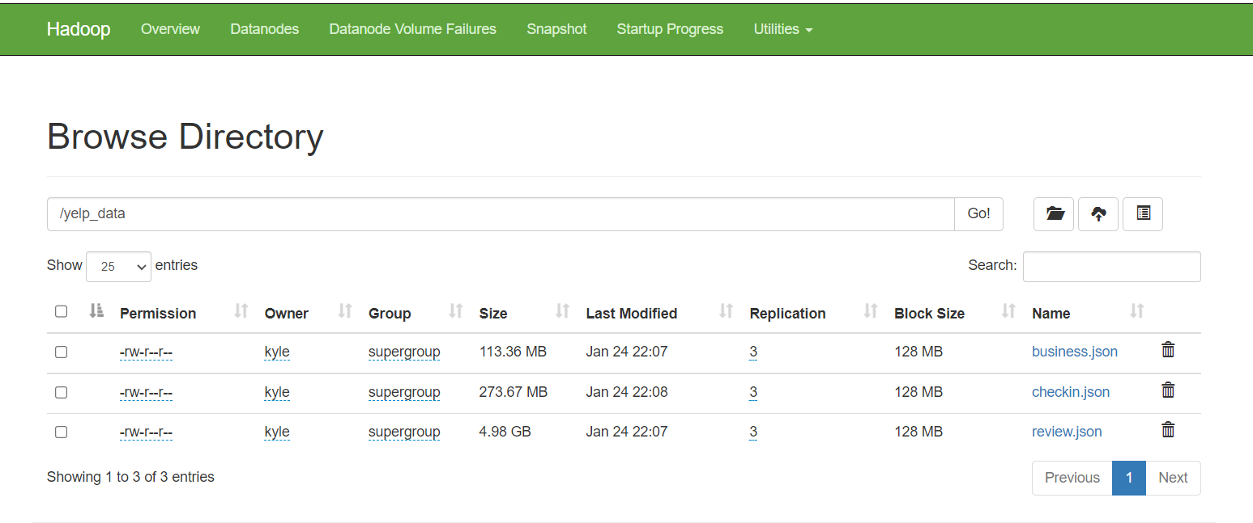
Data Analysis By Hadoop, Pig , Spark and Hive
Ingest dataset into HDFS
After the data is successfully imported into hadoop, the HDFS Web UI displays business.jon, checkin.json, and review.json files

Slide 15
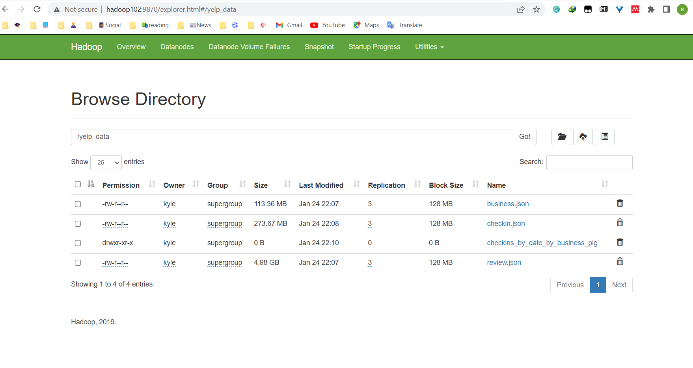
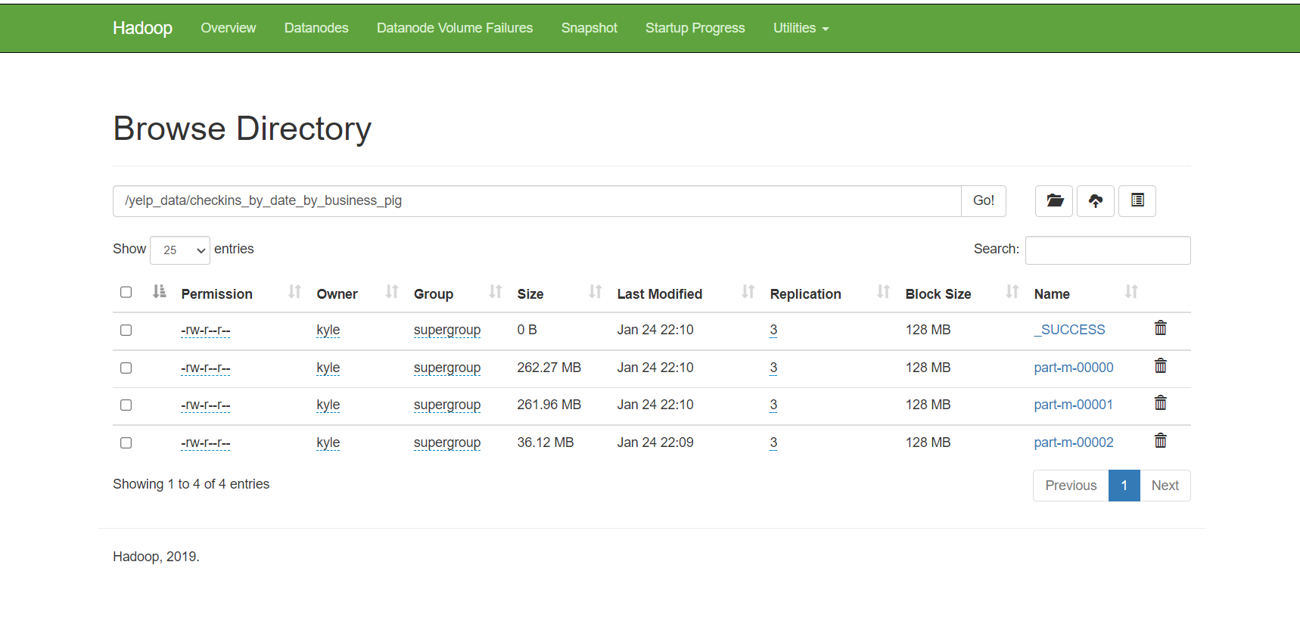
Pig Task
Run Pig Script

Slide 16
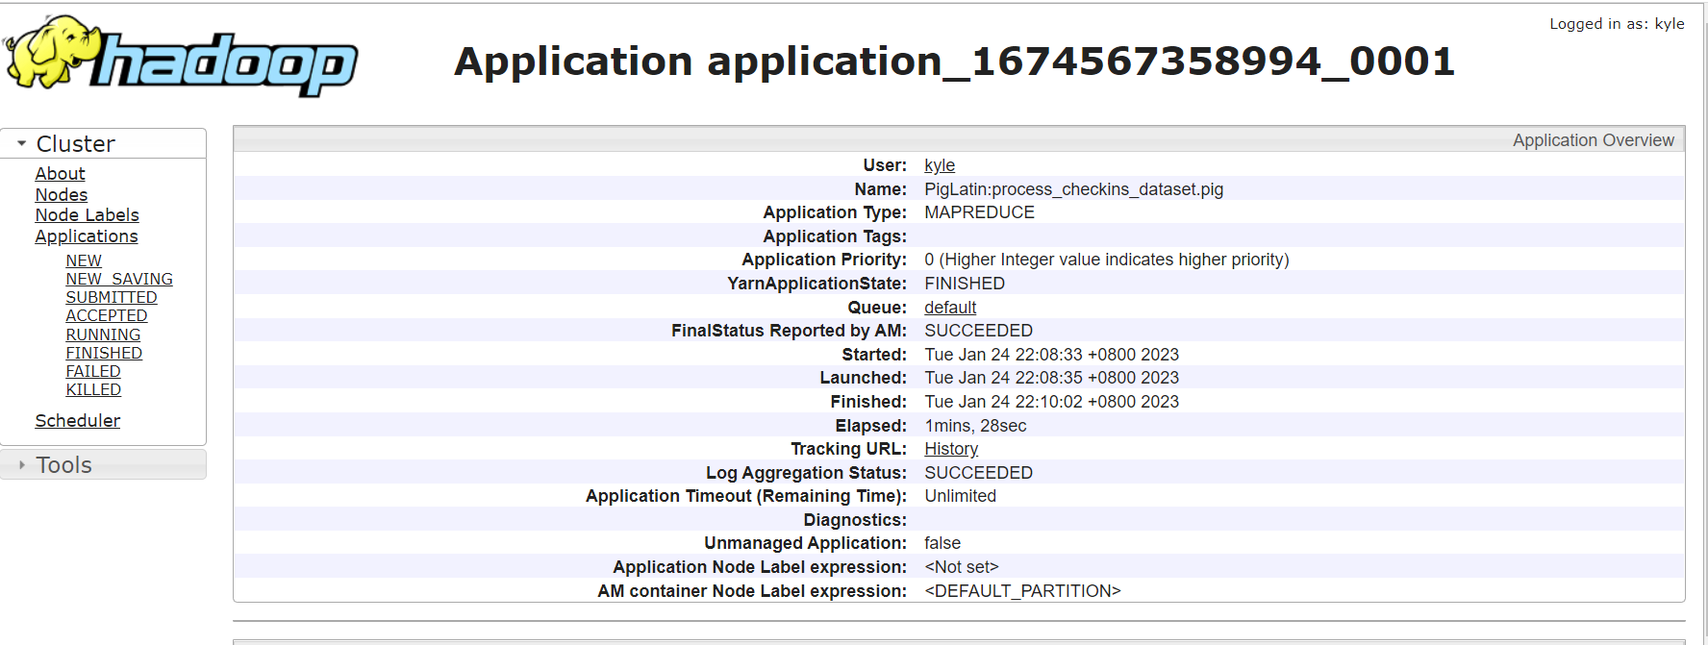
Pig Task
Completed the Pig Task process in just 1 minute and 28 seconds

Slide 17
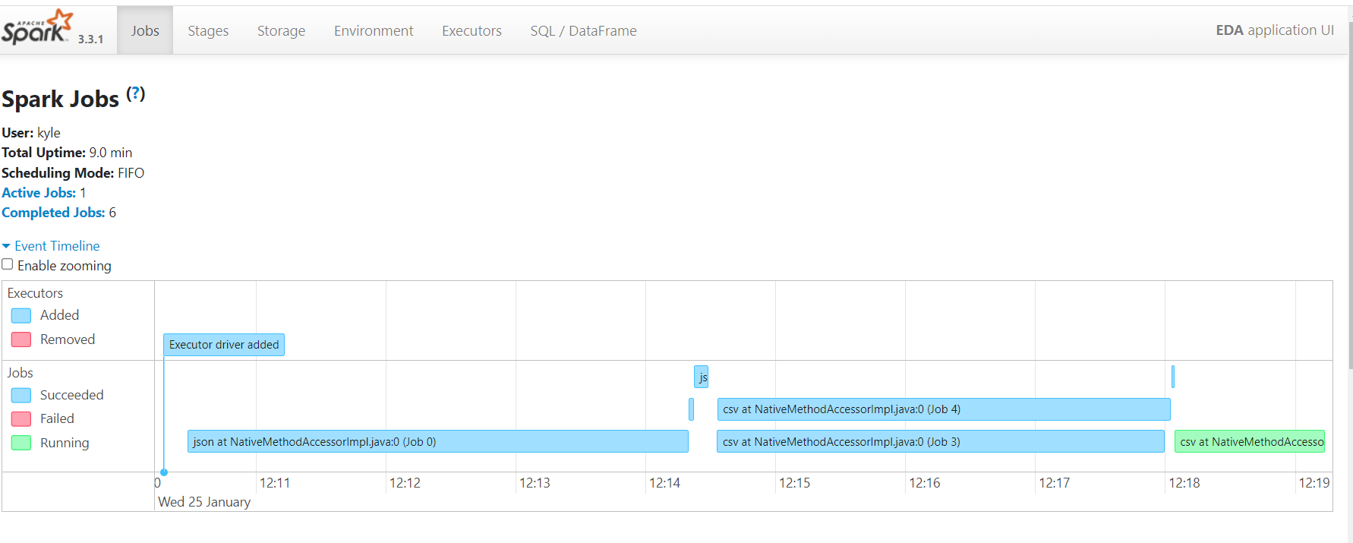
Spark Task
Event Timeline

Slide 18
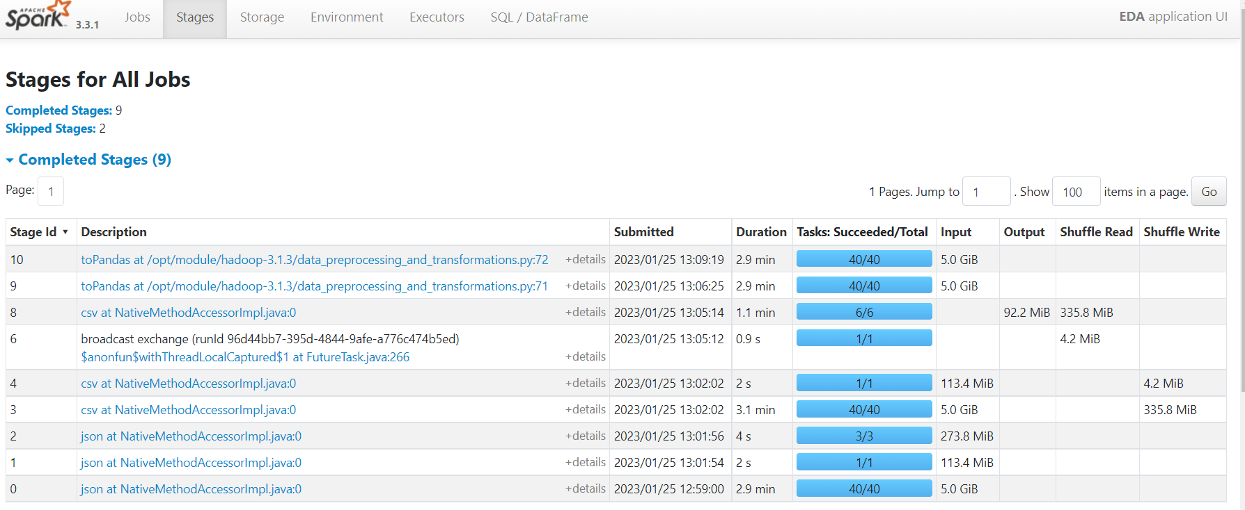
Spark Task
Stages for all jobs in Spark

Slide 19
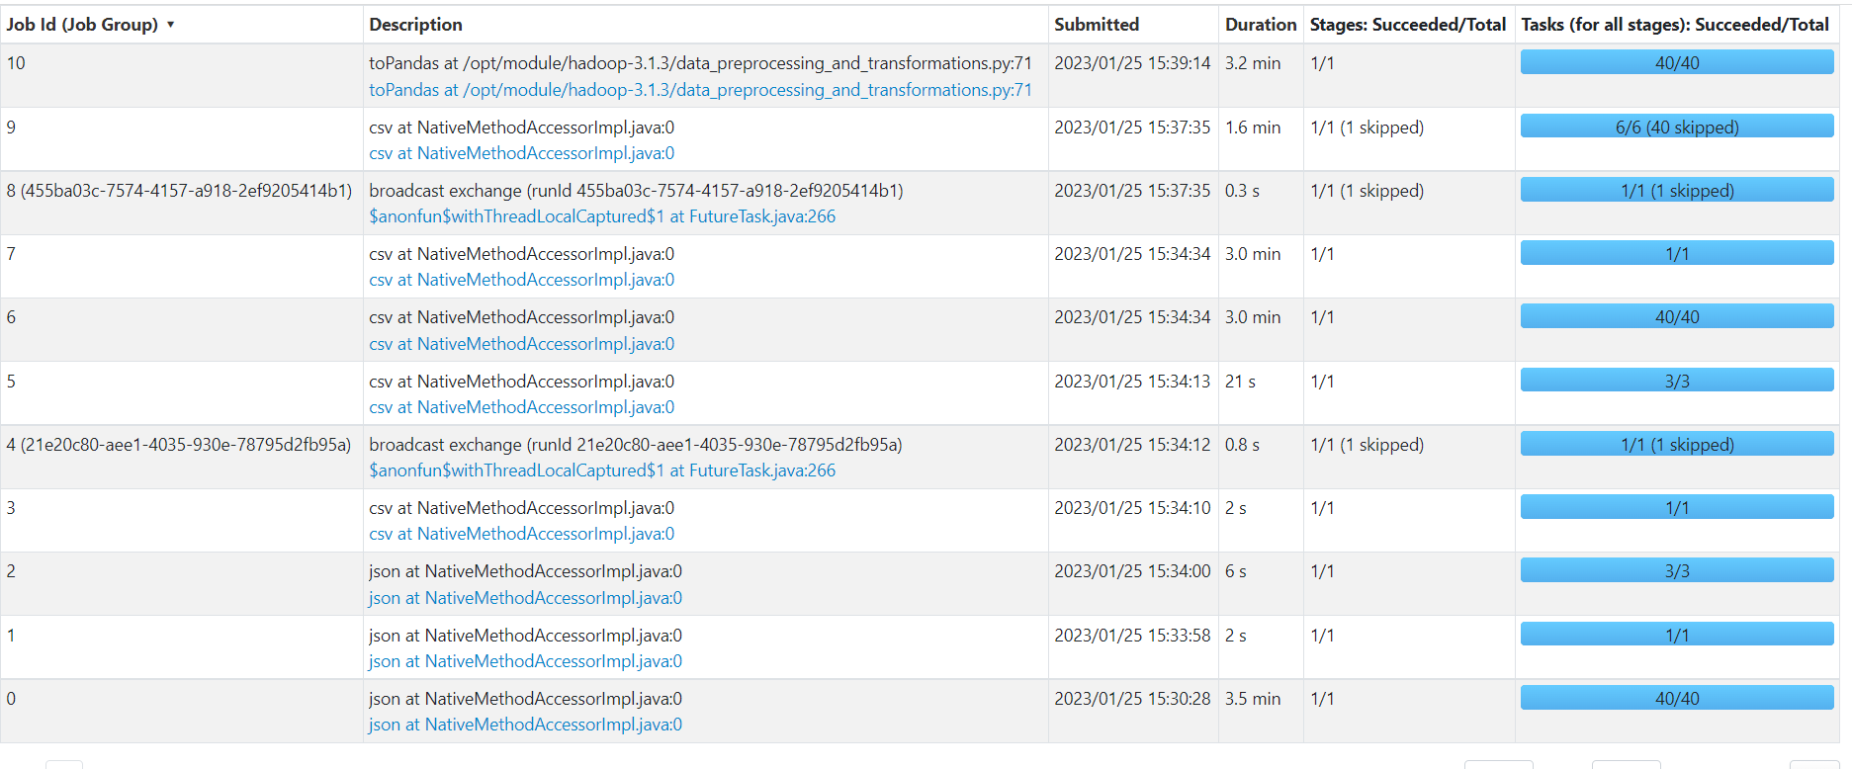
Spark Task
Stages for all jobs in Spark

Slide 20
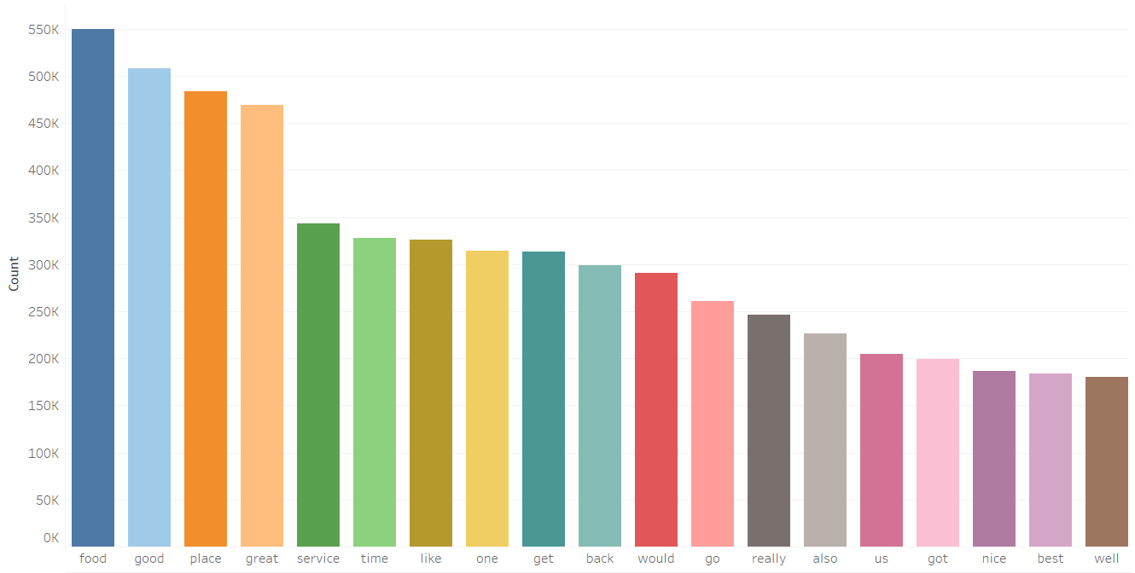
Visualization By Tableau
Word Count
We have found which are the Top 5 words with the most number of occurrences in yelp review dataset:
food
good
place
great
service

Slide 21
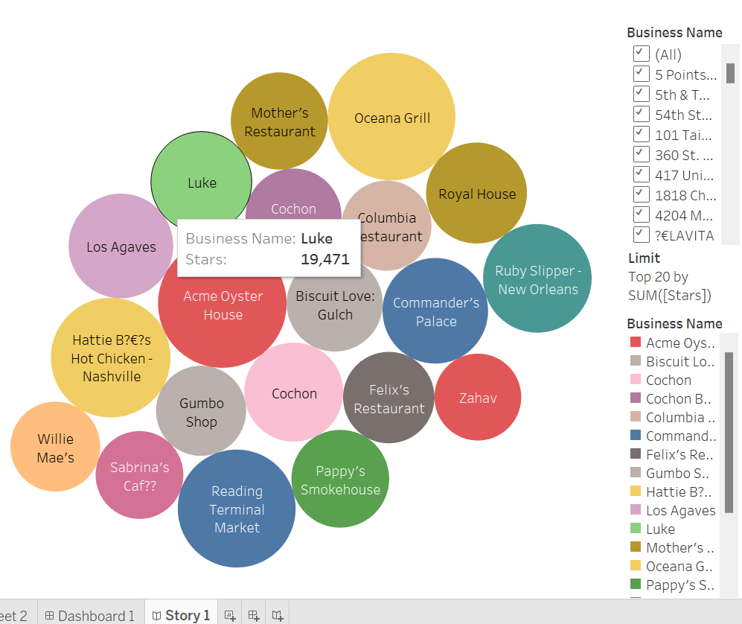
Visualization By Tableau
Data Analysis
From the bubble chart,
we have found which cities
have good reviews

Slide 22
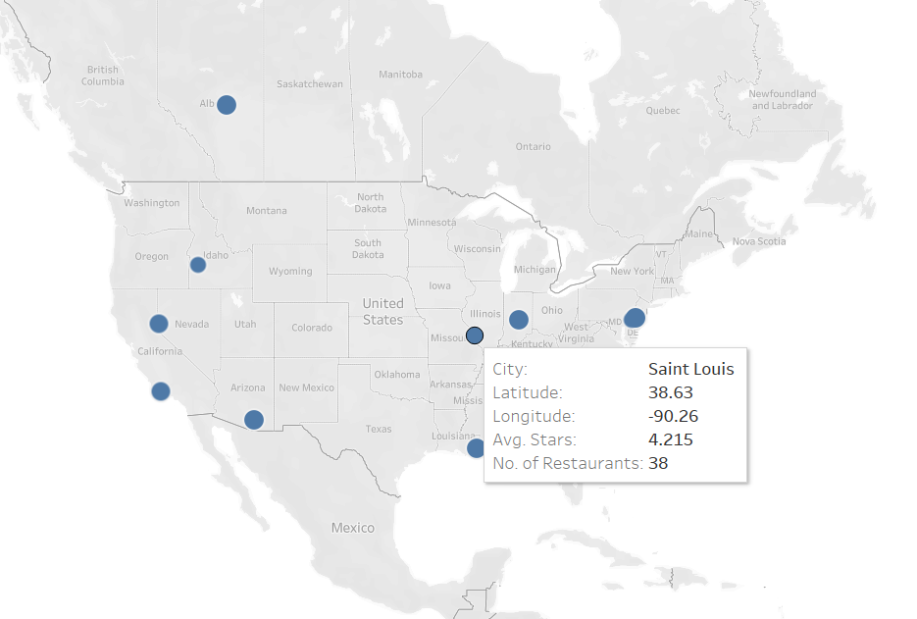
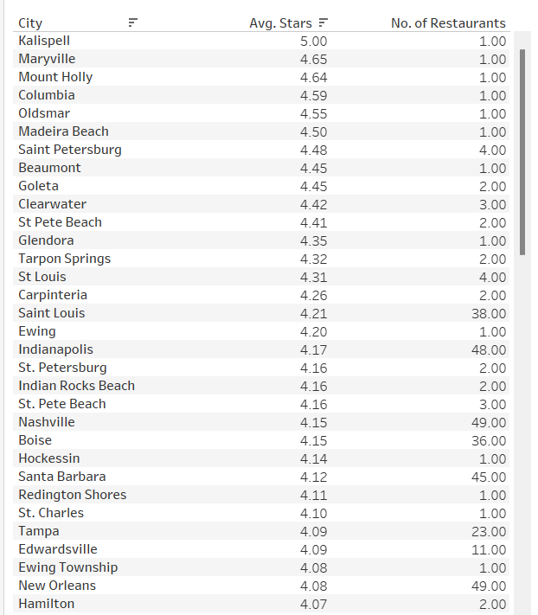
Visualization By Tableau
Data Analysis

Slide 23
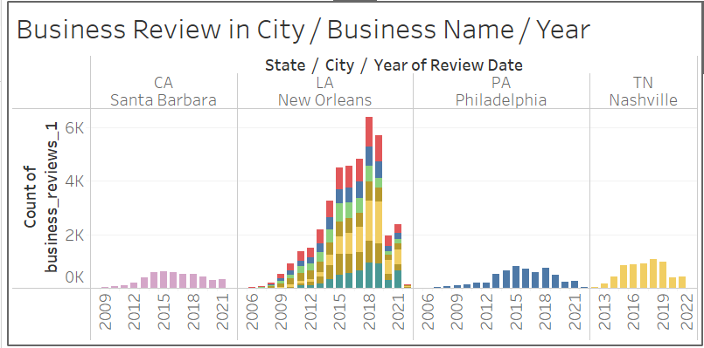
Visualization By Tableau
Data Analysis

Slide 24
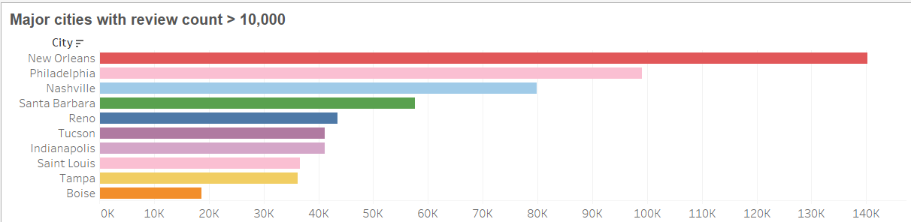
Visualization By Tableau
Data Analysis

Slide 25
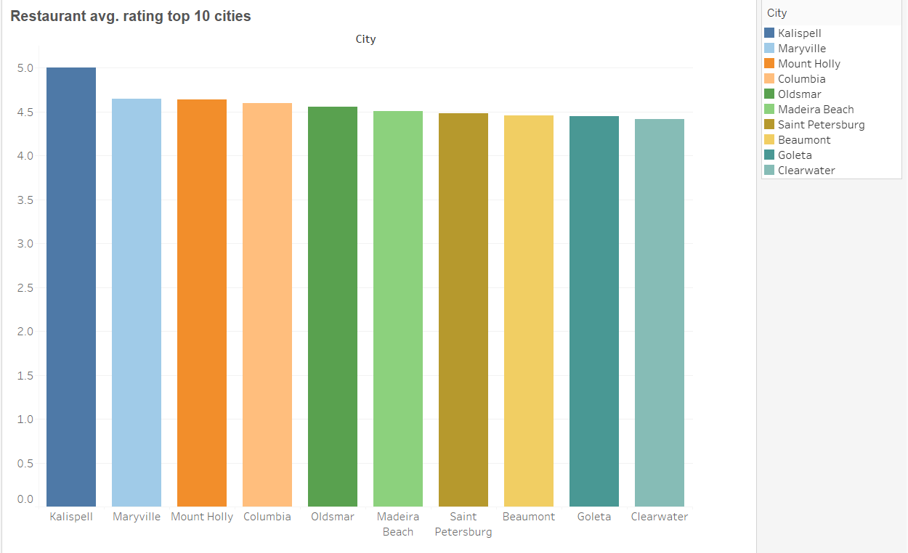
Visualization By Tableau
Restaurant avg rating
with top 10 cities

Slide 26
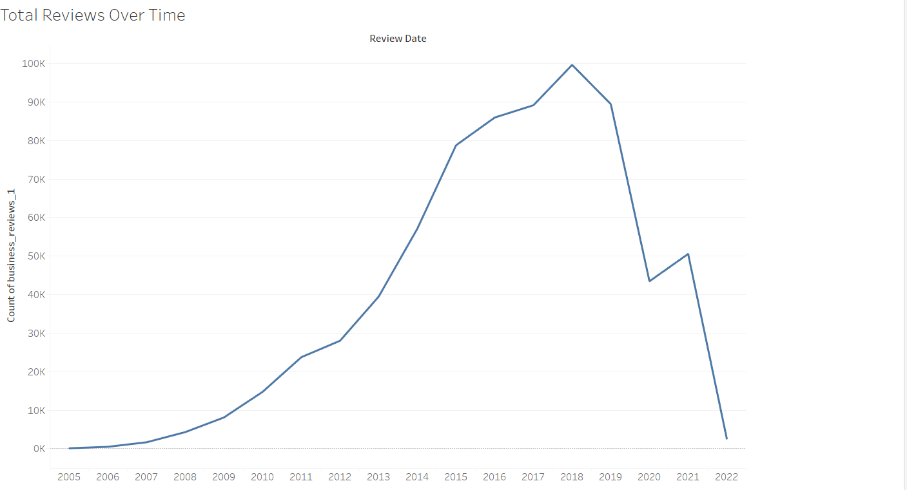
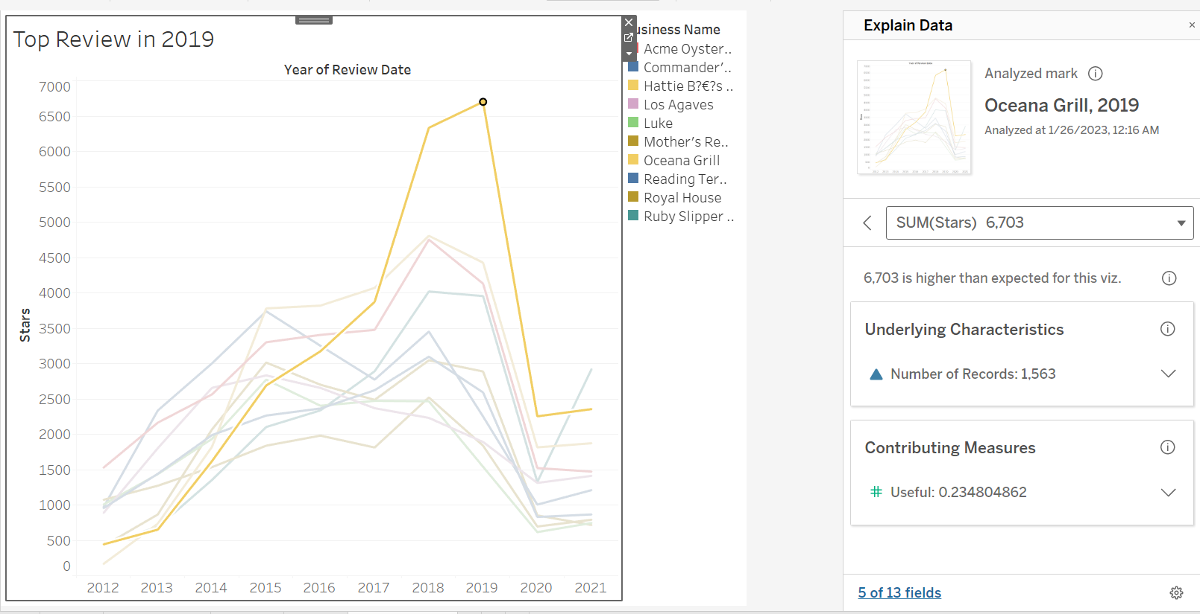
Visualization By Tableau
Top Review Over Time

Slide 27
Results and Discussion
In the word count task, the top 10 words with the most number of occurrences in yelp review dataset are food, good, place, great, service, time, like, one, get and back, and food appears more than 549,000 times at most
Next is the data analysis task , the bubble charts were used to represent and highlight correlations between numerical variables. The first graph shows the top restaurants with useful reviews and a business named Luke had the highest value with over 19000 cumulative stars. Next, New Orlean - LA and Philadelphia - PA are the top 2 cities/states with the highest reviews and ratings
In 2020 sharp drops in rating and reviews due to Covid-19 lockdown in the United States. Restaurants closed and people were not going to shop often. According to (Sedov, 2022) during 2020, the first year of the COVID-19 pandemic, restaurants suffered from reduced consumer traffic due to multiple factors: lockdowns, operations restrictions and social distancing.
New Orlean - LA and Philadelphia - PA are top 2 city/states with highest reviews
Ocena Grill (Philadelphia-PA) contributes highest spike in customer review
In accumulated customer reviews from 2005-2022 Acme Oyster House (LA) - contain huge reviews among all Restaurants

Slide 28
CONCLUSION
Distributed file systems such as Hadoop offer a relatively simple means of taking advantage of the parallel processing required within distributed file systems.
The hdfs mapreduce system not only helped us process files exceeding 4GB, but can even do:
Data cleaning
SQL query
Table building
Data analysis
With tableau, our data output was visualized in an engaging and intuitive way to show different information for different business views.

Slide 29

THANK YOU

