Slide 1

Better Quiz App
Project Release Plan
January 23 2018
α Team
Ethan O’Brien (Product Owner)
Ruben Ayestas (Scrum Master)
Roman Sul
Yang Zheng
Emmett Greenberg
Donovan Buccat

Slide 2
Better Quiz App
Project Release Plan
January 23 2018
A website that will allow for a more dynamic quiz dialog between teachers and their students.
High level goals: Quiz creation, class management by teacher-users, quiz grading, question database pool with dynamic feedback based on results.

Slide 3
Better Quiz App
Project Release Plan – User Stories
January 23 2018
Sprint 1 user stories: As a student I want to be able to see questions to be
taken.
As a student I want to be able to take quizzes in order to gain practice and knowledge.
As a student I want to see my results to know what to improve.
As a teacher I want to be able to grade quizzes.

Slide 4
Better Quiz App
Project Release Plan – User Stories
January 23 2018
Sprint 2 user stories:
As a teacher I want to be able to create quizzes for my
students.
As a teacher I want to be able to view the students in
my class and their quiz results.
As a teacher I want to be able to determine the number
of questions in a quiz.

Slide 5
Better Quiz App
Project Release Plan – User Stories
January 23 2018
Sprint 2 (cont.)
As a student I want to be able to see my past quizzes so that I can see what areas I need to improve upon.

Slide 6
Better Quiz App
Project Release Plan – User Stories
January 23 2018
Sprint 3 user stories:
As a teacher I want to be able to view class statistics in
order to improve my teaching methodology/strategy.
As a teacher I want to be able to create a timed quiz.
As a student I want to my multiple classes easily
available in order to receive as much practice as I need.

Slide 7
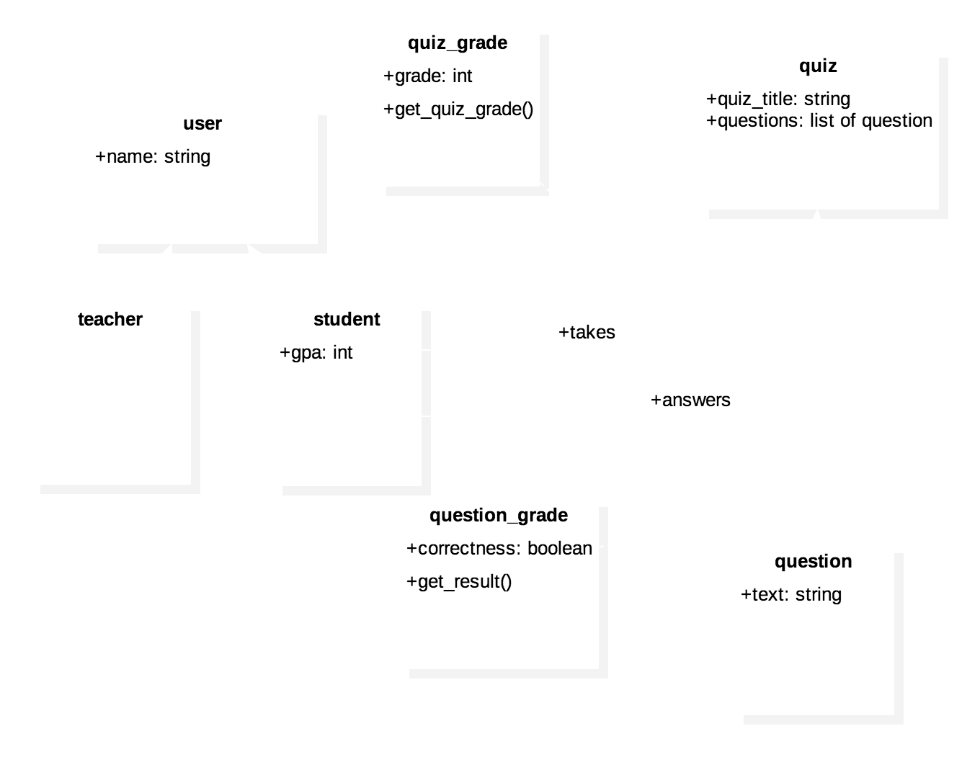
Better Quiz App
Project Release Plan – Architecture
January 23 2018

Slide 8
Better Quiz App
Project Release Plan – Challenges/Risks
January 23 2018
Challenge 1: Creating users with different privileges (teacher vs. student).
Challenge 2: Creating a database with questions, correct and incorrect answers, and tagging which is which.

Slide 9
Better Quiz App
Project Release Plan – Technologies
January 23 2018
Technology 1: Django/SQLite3 for database management, and overall framework.
Technology 2: HTML and CSS for displaying pages and their styles.

