Slide 1

LOAN DECISION SYSTEM
Haris Humayun, Elma Hsieh, James Muguiyi, Ethan Pochna

Slide 2
Table of Contents
Improvement from Previous Methods
Data & Preprocessing
Model Selection
Prototype Demo
Future Considerations

Slide 3
Current Business Practices
Metric | Value
Annual Applications | 10,000
Manual Review Time | 30–40 minutes / application
Officer Cost | $50 / hour
Cost per Application | $30
Total Annual Review Cost | $300,000
Error Type | Estimated Cost per Case
False Approval (Bad approved) | $780
False Rejection (Good denied) | $1,500
False approvals are ~0.52x more costly than false rejections.

Slide 4
Target Model Performance ( Cost Benefit Analysis)
Bad Precision | Bad Recall | F₀.₇₂ | TP | FP | Annual Savings | Status
0.60 | 0.70 | 0.63 | 3,640 | 2,427 | −$728K | Unprofitable
0.65 | 0.65 | 0.65 | 3,380 | 1,820 | −$39K | ~ Almost Breakeven
0.70 | 0.65 | 0.68 | 3,380 | 1,449 | +$506K | Profitable
0.70 | 0.75 | 0.72 | 3,900 | 1,671 | +$586K | Profitable
0.75 | 0.70 | 0.73 | 3,640 | 1,213 | +$1.06M | Profitable
0.80 | 0.65 | 0.74 | 3,380 | 845 | +$1.39M | Profitable

Slide 5
Dataset & Preprocessing
~10,000 applicants, 23 numeric credit behavior features, binary target (Good/Bad)
⁠Identified missing codes: -7 = “Never occurred”, -8/-9 = insufficient or missing credit history
Evaluated feature correlations, missingness, outliers, and multicollinearity, etc.
Imputed missing codes with median (for -8/-9) and column.max + column.std (for -7) without removing meaningful borrower groups

Slide 6
Excluded Models
KNN
Kernel SVM
Deep Learning
Highly sensitive to missing values, which are prevalent in this dataset.
Performance degrades in higher-dimensional feature spaces.
The model lacks clear interpretability, making it difficult to justify lending decisions.
High computational complexity for training at this sample size.
Sensitivity to feature scaling and missing value imputation.
The need for additional calibration steps to obtain probability outputs.
The dataset size is small for deep neural architectures.
Interpretability is critical in credit risk applications, particularly for explaining automated denials.
Model complexity adds governance and validation overhead

Slide 7
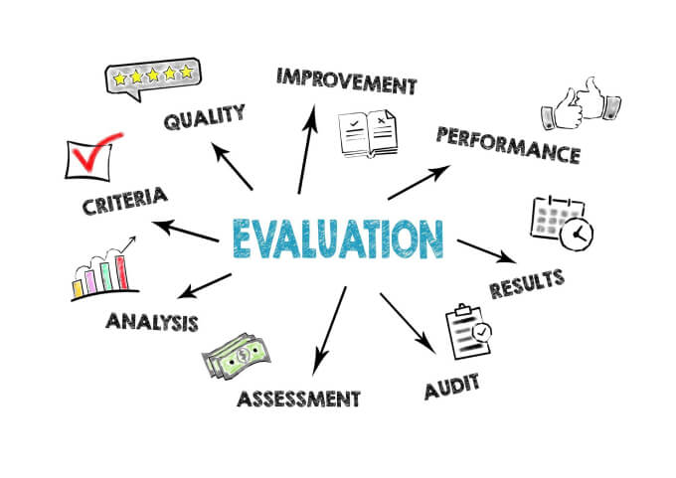
Models Trained & Selected
Models Trained:
Logistic Regression
Random Forest
XG BOOST
Decision Tree
Falling Rule List
Model Chosen: RANDOM FOREST
→ Highest Savings
→ Highest Relative Precision

Slide 8
Model Selection: Hyperparameter Tuning
Round 1: Narrow Down
Round 2: Hyperparameter Search
Model | Average AUC
Logistic Regression | 0.7979
Random Forest | 0.7951
XG Boost | 0.7778
Decision Tree | 0.6854
Model | Optimal Model AUC
Logistic Regression | 0.7981
Random Forest | 0.7976
Falling Rule List | 0.7822

Slide 9
Model Selection: Threshold Tuning
Logistic Regression | F(0.72) | Precision
0.45 | 0.7404 | 0.7115
0.50 | 0.7395 | 0.7328
0.55 | 0.7370 | 0.7526
Random Forest | F(0.72) | Precision
0.45 | 0.7330 | 0.6997
0.50 | 0.7391 | 0.7230
0.55 | 0.7423 | 0.7517
Falling Rule List | F(0.72) | Precision
0.45 | 0.7248 | 0.6769
0.50 | 0.7236 | 0.7200
0.55 | 0.7167 | 0.7427
IS FRL INTERPRETABILITY WORTH THE LOWER PERFORMANCE?
NO.
FRL Scalability
SHAP Interpretability

Slide 10
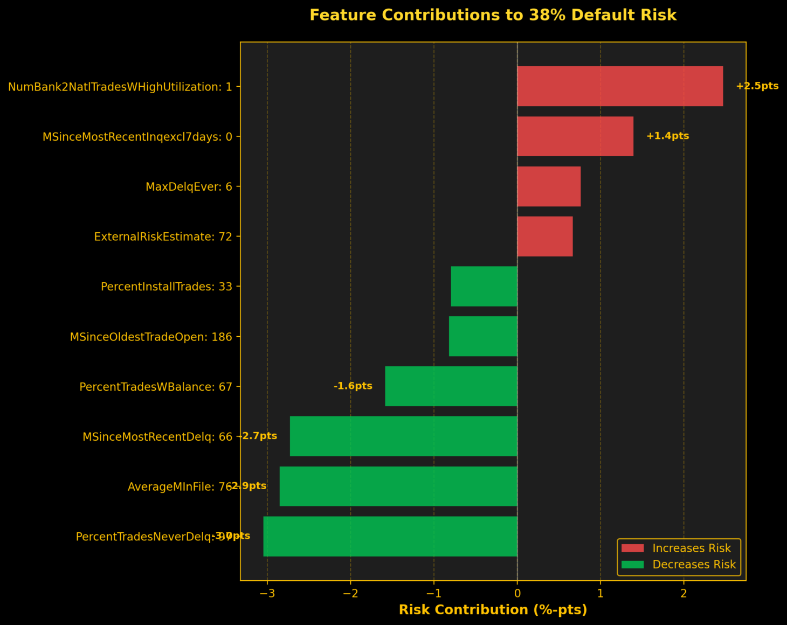
Prediction Explanation Using SHAP
Features and user input

Slide 11
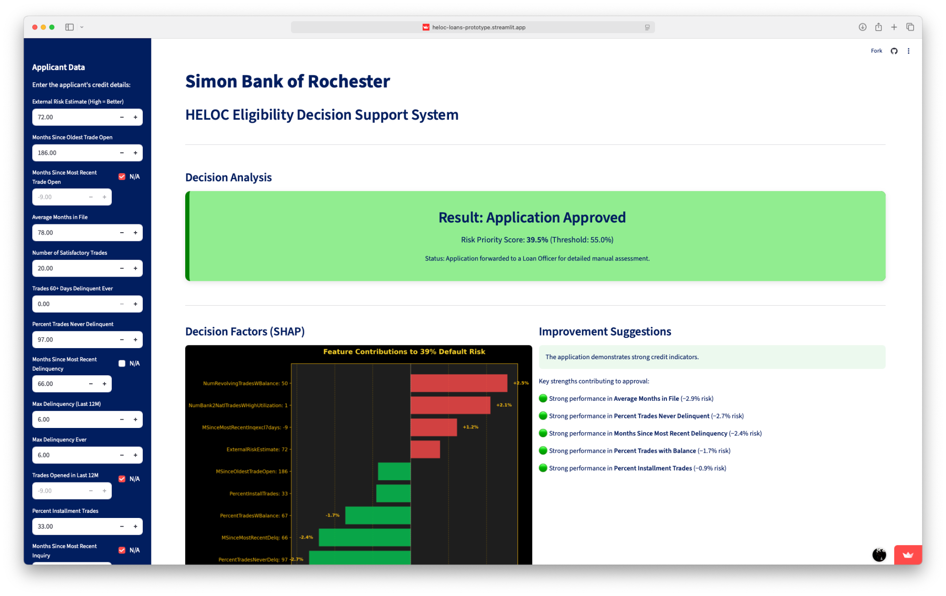
Demo

Slide 12
Future Considerations & Monitoring
1.
2.
Model performance may decline due to economic shifts and changes in borrower behavior
We will monitor approval rate, default rate, and probability drift on a monthly basis
3.
4.
Retrain the model periodically using recent data to prevent concept drift
Maintain human review and threshold control to ensure regulatory and risk compliance

Slide 13
LOAN DECISION SYSTEM
Q & A

Slide 14
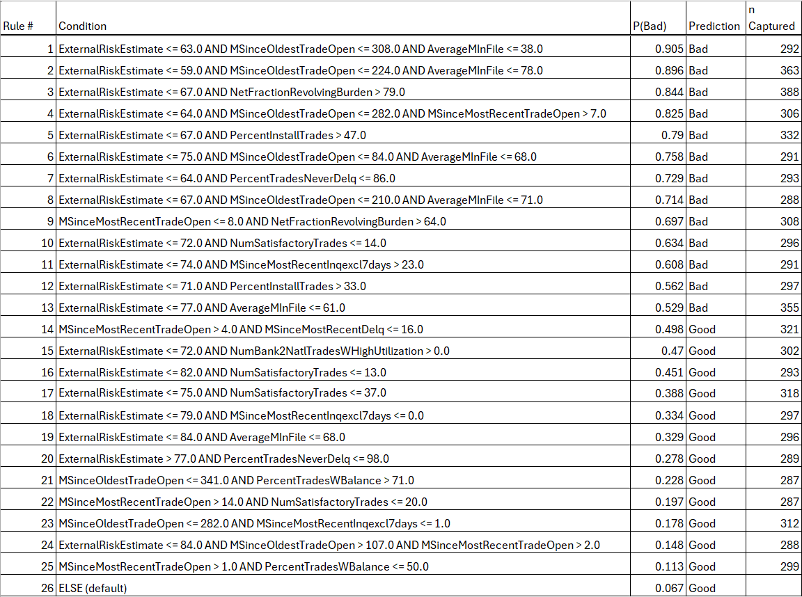
Appendix: Final Falling Rule List Table

Slide 15
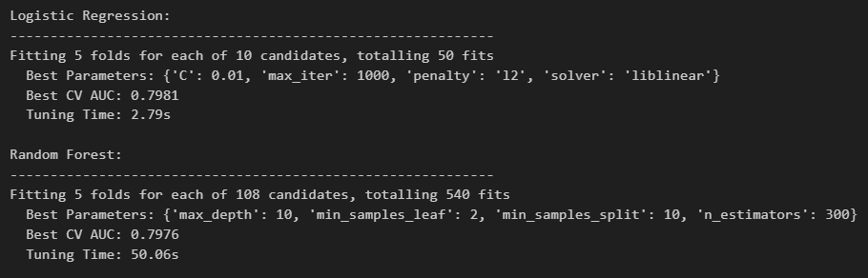
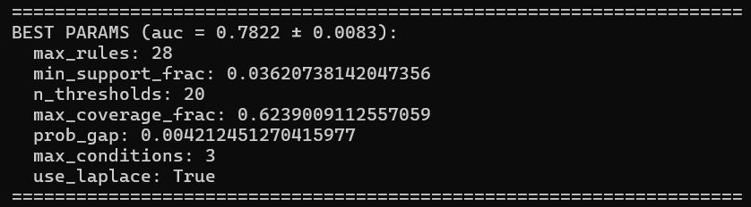
Appendix: Optimal Hyperparameters

Slide 16
