Slide 1
The EHR Package: A Tool to Facilitate Population PK/PD Studies using EHR Data
Ethan Poweleit
July 22nd, 2021

Slide 2
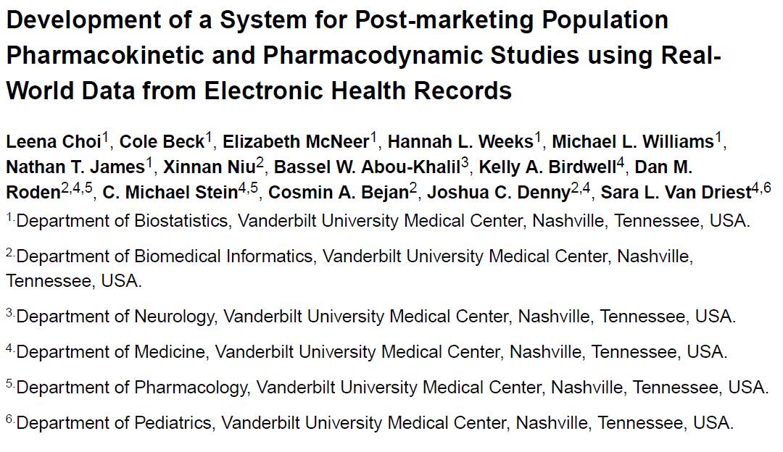
Notes:
Published in CPT in 2021

Slide 3
Outline
Background
Population PK/PD Studies
EHR Data
medExtractR
System Architecture of the EHR Package
Data Extraction
Data Processing
Data Building
Demo (EHR Package)
Discussion

Slide 4
Population PK/PD Studies
Capture patient characteristics affecting PK/PD
Identify intrinsic and extrinsic factors affecting PK/PD
Define dose-exposure-response relationships
Requires longitudinally measured information on dose, drug concentrations, and covariates
Sparse sampling
Analyzed using nonlinear mixed effects modeling (NONMEM)

Slide 5

Workflow for Pop PK/PD Studies
Estimated PK Parameters
Optimize and Refine
Patient Demographics
Model Validation
Data File
NONMEM Control File
Base Model
Covariate Model
Final Model
Estimation Method
Structural Model
Statistical Model
Figure created by Zach Taylor

Slide 6
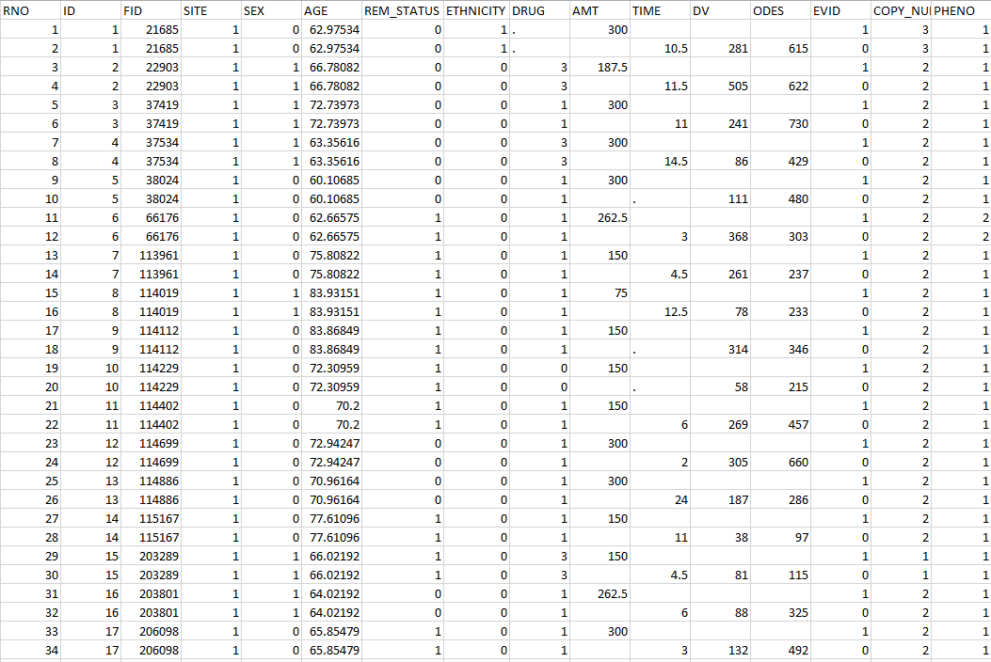
NONMEM Data File
Data stored in “long” format with patients spanning multiple rows in chronological order
Required to have variables on medication information (e.g. AMT, TIME)
Can include optional additional covariates
Methods to optimize this process
Notes:
Time: Time since dose. Dosing events are noted as a Time 0. Each concentration collected thereafter is the time (in hours) since the dose was administered. You can use actual time and dates. NONMEM can read those. I have found that transforming the dates and times into the above format alleviates some errors.
AMT: Amount of the dose administered
DV: Dependent variable. The drug concentration. Typically, in the same units as the dose administered.
Even with methods to optimize this, there is still not a structured, scalable method that can be applied across various studies… especially true when we consider EHR data

Slide 7

Electronic Health Record (EHR) Data

Slide 8


EHR Data
Structured Data:
Demographics
Laboratory
Flowsheet
Medication Administration Records (MAR)
Unstructured Data:
Clinician Notes
Often requires manual review or NLP to extract relevant data

Slide 9

Barriers of Using EHR Data for Pop PK/PD
Data Quality
Manual Curation
Error Prone
Tedious
Time Consuming

Slide 10
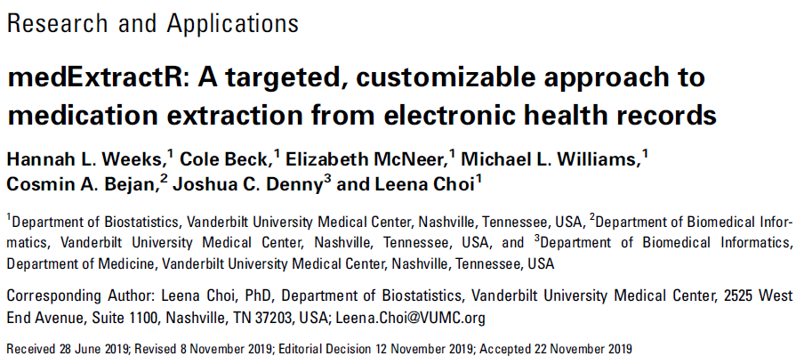

Rule-based natural language processing system to extract medication information from clinical notes

Slide 11
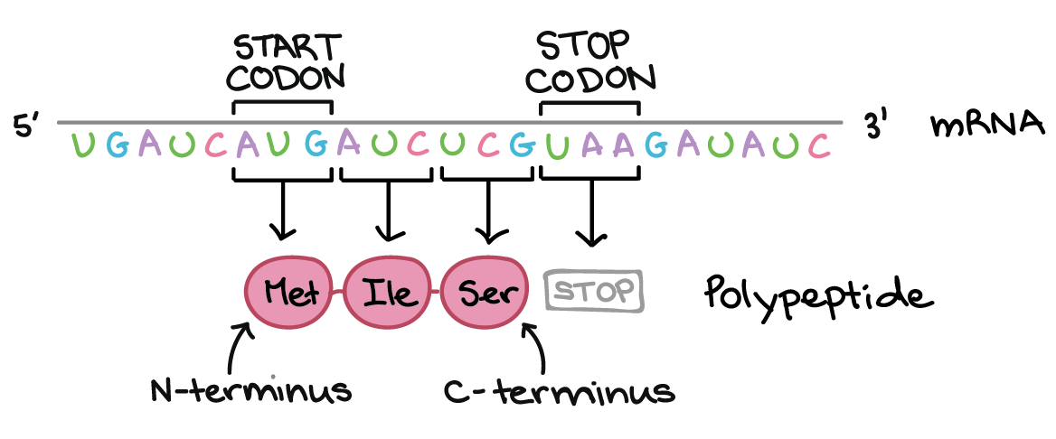
https://www.khanacademy.org/science/ap-biology/gene-expression-and-regulation/translation/a/the-genetic-code-discovery-and-properties

Slide 12
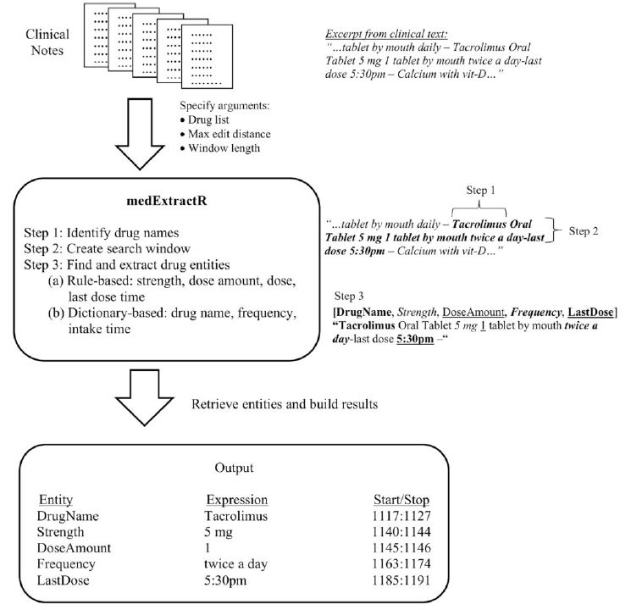
medExtractR
Identify drug names
Create search window
Find and extract drug entities
Figure 1 from Weeks et al (2020)
Notes:
Uses regular expressions and dictionary-defined terms (e.g. RxNorm) to identify drugs of interest
Search window is defined by the user
Max edit distance is also another argument of this function to allow for identification of medications that are misspelled
Search window and max edit distance can be determined via a tuning procedure to identify what parameters correctly obtain the correct entities and corresponding expressions.

Slide 13
medExtractR Development
Developed using tacrolimus and lamotrigine
Tested additionally on allopurinol
Manually annotated notes for each drug of interest
Compared to previously developed medication-extraction systems
Applied to MIMIC-III Clinical Care Database
Tuning Step (pre-processing notes, updating dictionaries, select parameter values)
Customization Step (changing/adding rules to identify entities within the source code)
Adding a text number followed by a digit in parenthesis indicates a dose amount (e.g. five (5))
Notes:
Tacrolimus (immunosuppressive drug commonly given to transplant pts to prevent organ rejection) → simple prescribing patterns involving same dose given twice a day
Lamotrigine (antiepileptic drug) → complex and variable prescribing patterns that can be taken 2 or 3 times a day
Allopurinol (uric acid reducer indicated for treatment of gout and kidney stones) → simple prescribing pattern taken once or twice a day
MIMIC-III Database contains de-identified data on >40,000 patients including clinical notes

Slide 14
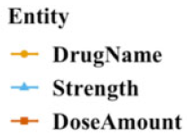
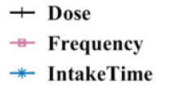
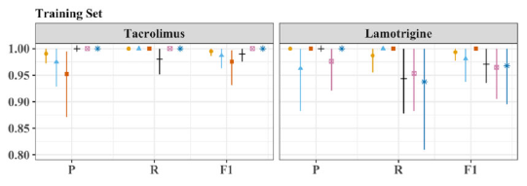
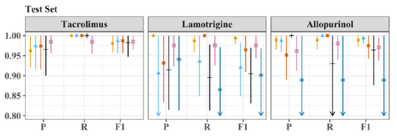
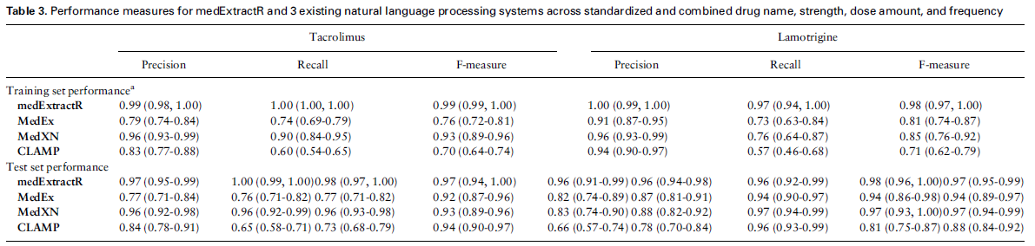
medExtractR Performance
Figure 4 from Weeks et al (2020)
Notes:
Performed well on several different medications which ranged from simple to complex dosing schedules
Outperformed previous NLP systems to extract medication information, possibly due to being general-purpose medication extraction algorithms that may face difficulty extracting specific drug, site, or patient cohort information
MedEx was developed by Josh Denny at Vanderbilt
MedXN was a rule-based system developed at Mayo Clinic
CLAMP can detect treatments, laboratory tests, and drug-related information

Slide 15
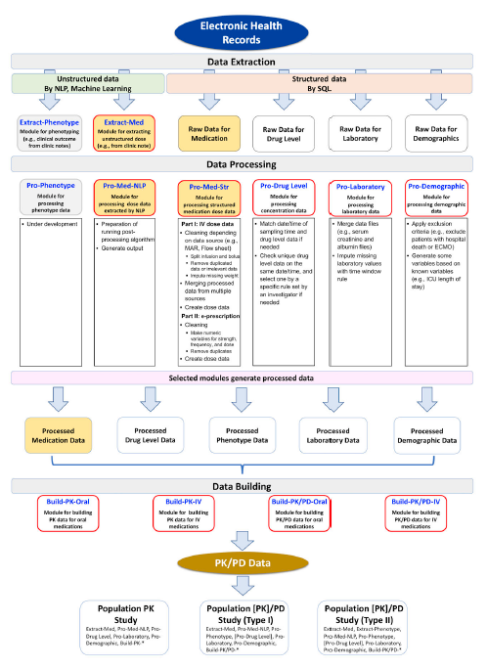
EHR Package System Architecture
Standardized workflow for generating Pop PK/PD studies
Developed in R
Three Steps:
Data Extraction
Data Processing
Data Building
Figure 1 from Choi et al (2021)

Slide 16
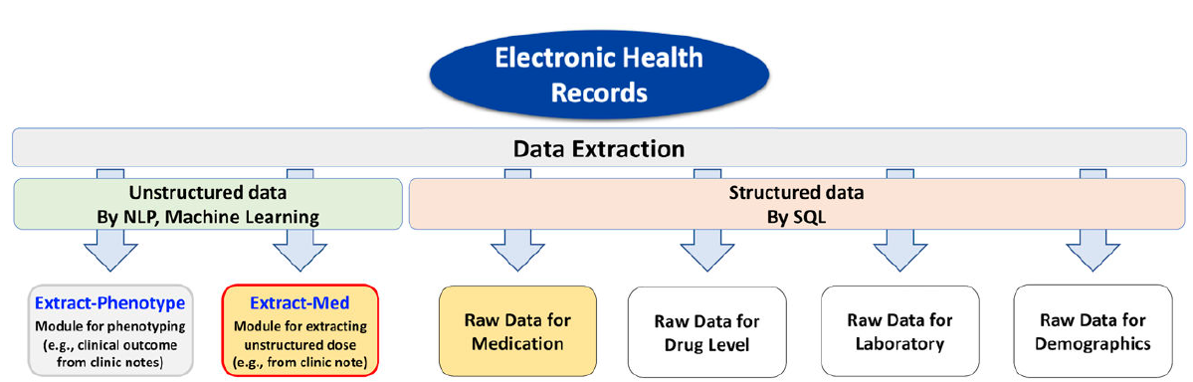
Data Extraction
Still Under Development
medExtractR
(MedEx, CLAMP, MedXN)

Slide 17
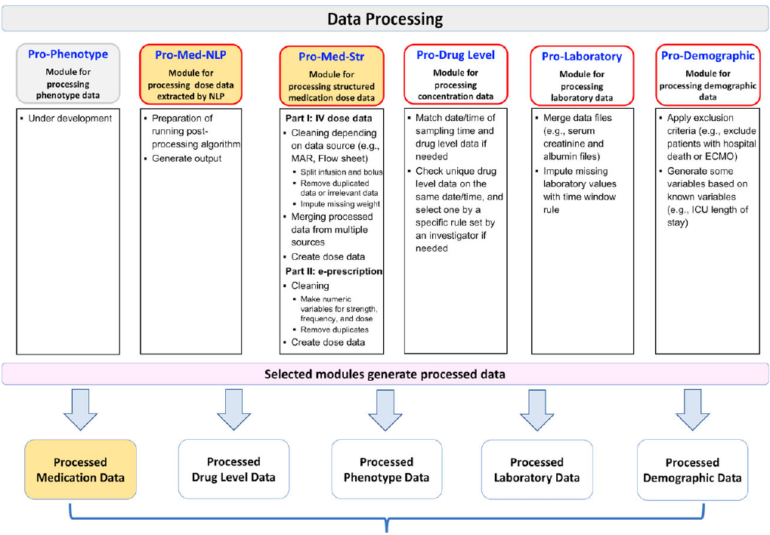
Data Processing

Slide 18
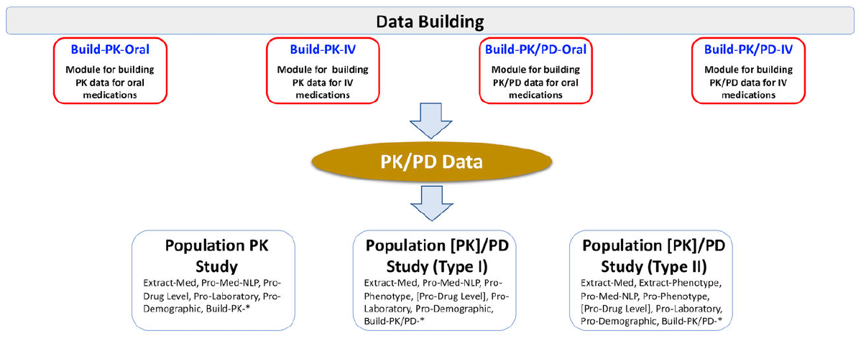
Data Building

Slide 19
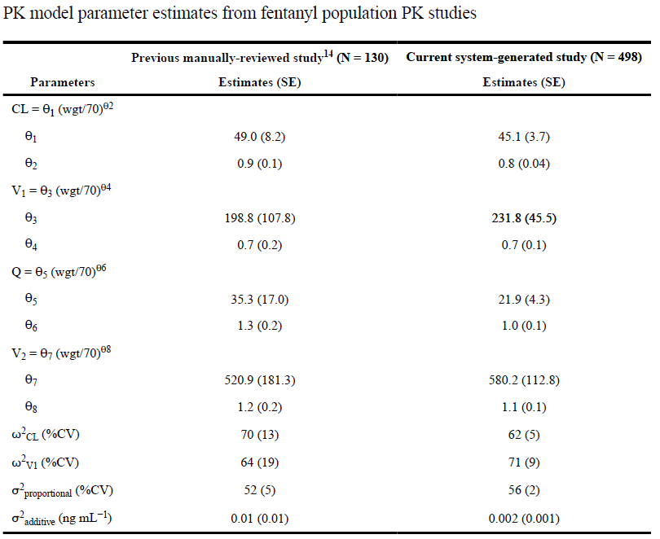
Case Study
Generated fentanyl pop PK dataset with developed system
“Comparable” estimates between studies
Data Preparation: >1 year → 2 weeks
Time Limiting Step: Data Checking
Table 2 from Choi et al (2021)
Van Driest et al. (2016). Pragmatic pharmacology: population pharmacokinetic analysis of fentanyl using remnant samples from children after cardiac surgery. Br J Clin Pharmacol. PMID: 26861166.

Slide 20
EHR Package Demo
Extract-Med (medExtractR) and Pro-Med-NLP Modules
Processing Structured Data
Pro-Demographic
Pro-Med-Str
Pro-Drug Level
Pro-Laboratory
Build-PK-IV and Build-PK-Oral (NONMEM) Modules

Slide 21
Limitations
Unknown how this system will perform for other medications
Haven’t applied to any of our current studies
EHR data availability (e.g. last dose times)
Differences in each institution’s EHR Systems
Vender (e.g., Cerner, Epic)
Location of data

Slide 22
Potential Points for Discussion
Is this useful to you?
Would you implement/replace parts of your workflow with this package?
Are there other processes or modules that the EHR package did not cover?
Are there any limitations of CCHMC’s EHR that may limit the EHR package’s usability?

